Slide 1

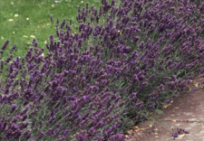
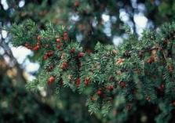
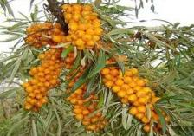

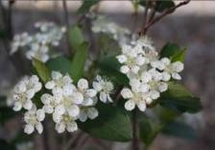
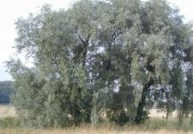
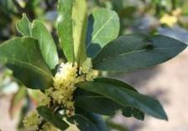
21st Century Hedges
Lavender
Yew
Sea Buckthorn
Black Chokeberry
White Willow
Bay Laurel
Please tap on a picture for more information

Slide 2



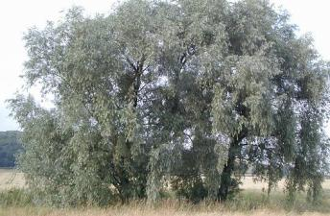
White Willow
Salix alba
Bark from the White Willow (Salix alba) provides raw material used in the commonly known pain relieving drug Aspirin.
The active ingredient is the extract salicylic acid which, mixed with corn starch and water, is used to produce a tablet.
http://www.ryenats.org.uk/trips/wtwill.jpg
Home
Next

Slide 3
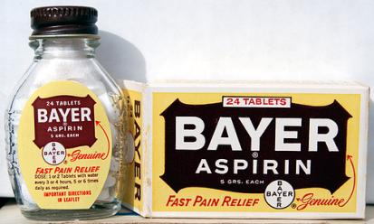
Aspirin
Salix alba
This method was first implemented in 1828, with White Willow being the oldest recorded painkiller used since 500 BC.
In 1828, European chemists extracted the constituent Salicin from white willow bark and converted it to Salicylic acid, the active ingredient in aspirin.
Home
Previous

Slide 4
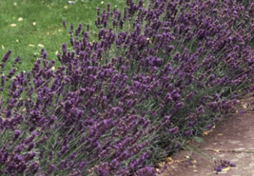
Lavender
Lavandula angustifolia
The main use of Lavender is the production of an essential oil. This can be used in the manufacture of perfume, but also can be used medicinally. The oil can assist healing, act as an antiseptic, and be a calming product.
It was first used during the second century AD as a soother for headaches.
Home
Next

Slide 5
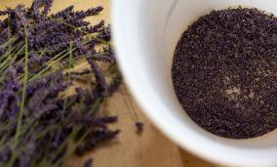
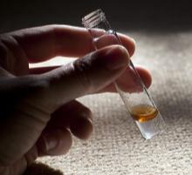
Lavender Oil
Lavandula angustifolia
This process works by subjecting the whole or part of the plant to a steady flow of steam, which penetrates through the plant. As it does this, it collects the oils, from in the plant and turns them into vapour.
When vapour leaves the plant it takes the oil with it. The vapour is then cooled, taking the oil back to its original liquid state.
Home
Previous

Slide 6
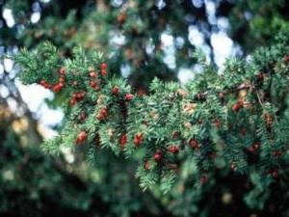
Yew Tree
Taxus baccata
The main product that is derived from Yew (Taxus baccata) is Taxol. Taxol is used as a chemotherapy treatment.
It was discovered in 1989 after a compound known as Paclitaxel was isolated from Taxus baccata.
Home
Next

Slide 7
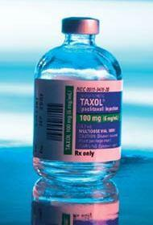
Taxol
Taxol is used to prevent cell division, to inhibit cell growth and to aid killing cancer cells. This is widely used for lung, ovarian, neck and breast cancer as well as brain tumours.
In order to harvest 1kg of the Taxol, 9 tonnes of bark are required. This amounts to between 2,000 to 3,000 trees which is equal to the bark of six 100 year old trees for the treatment of one patient.
Taxus baccata
http://www.research.fsu.edu
Home
Previous

Slide 8
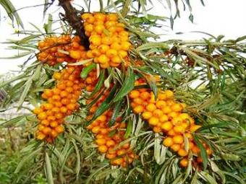
Sea Buckthorn
Hippophae rhamnoides
Sea Buckthorn (Hippophae rhamnoides) is enriched with high levels of Vitamin C. The oil may have potential as an antioxidant affecting inflammatory disorders, cancer and other diseases.
The Sea Buckthorn was introduced to the UK during the 1930s and the berries were used for medicinal purposes around the same time.
Home
Next

Slide 9
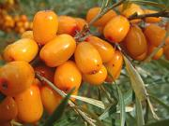
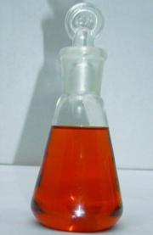
Sea Buckthorn
Hippophae rhamnoides
Oil is produced by removing a branch of berries from the plant, then freezing the branch at -32°C. The berries are then shaken from the plant, crushed into a pulp and refrozen for later use.
The oil can be applied directly to the skin and sometimes used in skin products. It can also be digested as a juice or syrup to boost Vitamin C and E levels
http://farm3.static.flickr.com/2572/4035785481
_a1aa210d07.jpg
Home
Previous

Slide 10
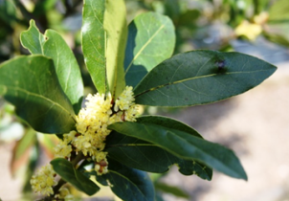
Bay Laurel
Laurus nobilis
Bay Laurel (Laurus nobilis) was first introduced to the UK by the Romans.
The leaves of the Bay Laurel can be used to manufacture a herbal capsule, which helps to settle the stomach and is good for stimulating the appetite.
The leaves are also equally good as antiseptic or an aromatic.
Home
Next

Slide 11
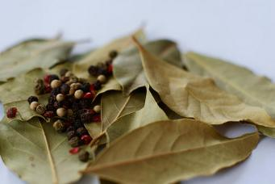
Bay Laurel
Laurus nobilis
In order to make herbal capsules take fresh herb leaves and wash them, dry them thoroughly and leave them out on screens in the sunlight or indoors in non-humid conditions.
When the leaves turn brown and dry they can be ground into a fine powder to be used medicinally.
Home
Previous

Slide 12
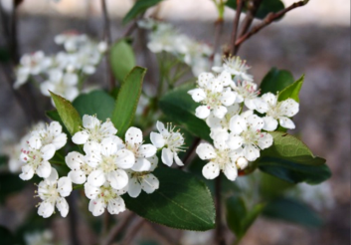
Black Chokeberry
Aronia melanocarpa
Black Chokeberry (Aronia melanocarpa) berries contain a high level of Vitamin C and antioxidants. It was introduced to the UK around 1789.
The berries of the Aronia can be used in a variety of products that include wine, jam, syrup, juice and soft spreads.
Home
Next

Slide 13
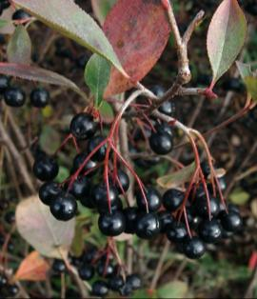
Black Chokeberry
A herbal tea can be made with the use of dried leaves; usually two or three leaves, which are used in the same way as a tea bag.
The tea usually contains other ingredients such as blackcurrant and can be used to relieve the symptoms of hay fever.
Aronia melanocarpa
Home
Previous

