Slide 1

Dissertation Elevator-Pitch Workshop

Slide 2

Purpose of this session:
To help you all:
Clarify and articulate your research question
Communicate your dissertation idea succinctly
Moving forward this will help you
Link your question to a realistic method / process
Receive feedback

Slide 3
What we will do
Review the expectations (focused – do what is expected)
Discuss top tips for elevator pitch (targeted in delivery)

Slide 4
From the assignment brief
Instructions
Prepare and present a speed presentation (up to but no more than 5 minutes) justifying your projects premise and experimental design. Your seminar should include the following:
  An introduction detailing your aim(s)/research question(s) and motivation for choosing your particular study
  Critical evaluation of the relevant literature to justify your chosen study
  A description of the methods you have used or will use to collect data
Key info
The exact time and location of your presentation slot will be set nearer the time.
You will be limited to the allocated 5 minutes, so ensure you plan accordingly. Up to 3 minutes are allocated at the end of your presentation for questions and discussion with the audience.
Ensure you use electronic presentation software (e.g. PowerPoint).
The presentation should be well-structured, succinct but comprehensive.
Communicate the essence of your research appropriately to your audience (primarily your peers). It is expected that you will attend and participate in at least two of the timetabled sessions.

Slide 5
What we will do
Review the expectations (focused – do what is expected)
Discuss top tips for elevator pitch (targeted in delivery)
What you will do
Produce a clear, specific, and measurable research question.
Identify the
  What (What is the topic, what is the issue? ),
  Why (why does it matter - scientifically & why the interest personally)
  How will you answer the question (aim, hypothesis) given in your dissertation .
  Identify the
Next steps
Apply top tips for concise communication (clarity, conciseness, timing, visuals).

Slide 6
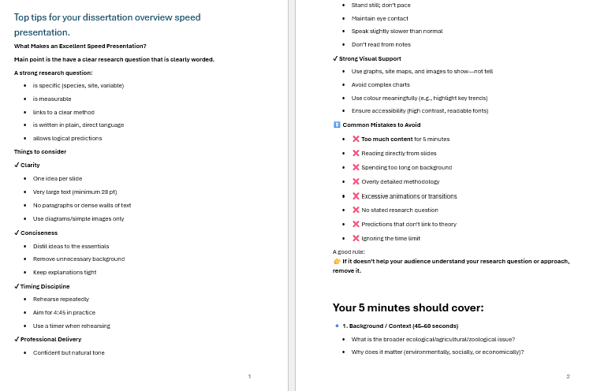

Slide 7
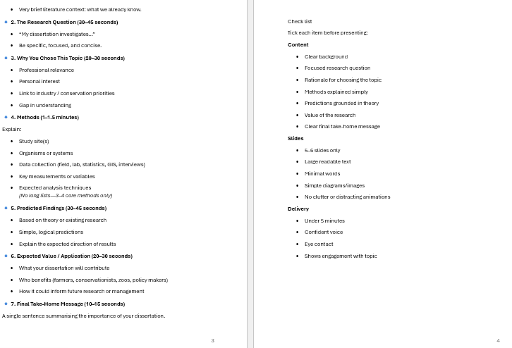

Slide 8
The Secret to Successfully Pitching an Idea | The Way We Work, a TED series - YouTube

