Slide 1
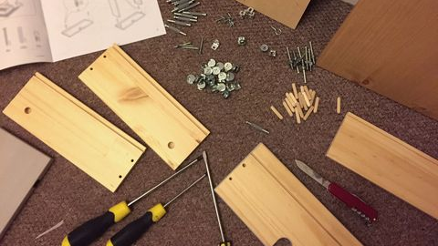

Slide 2
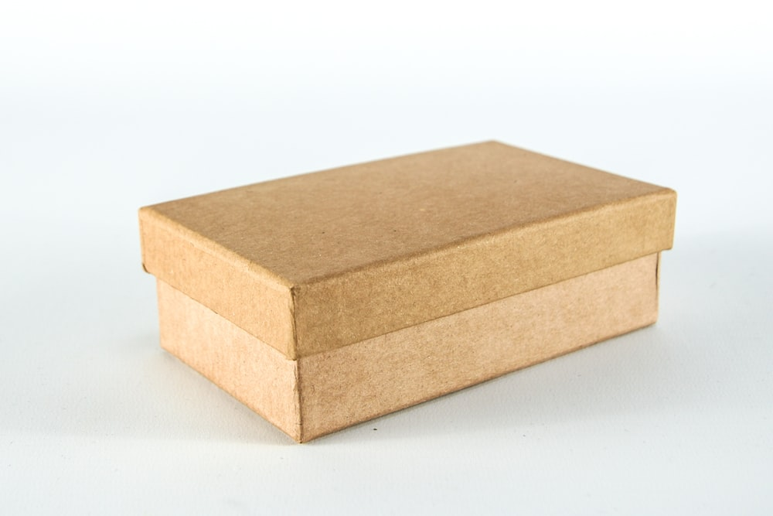

Slide 3


Slide 4


Slide 5
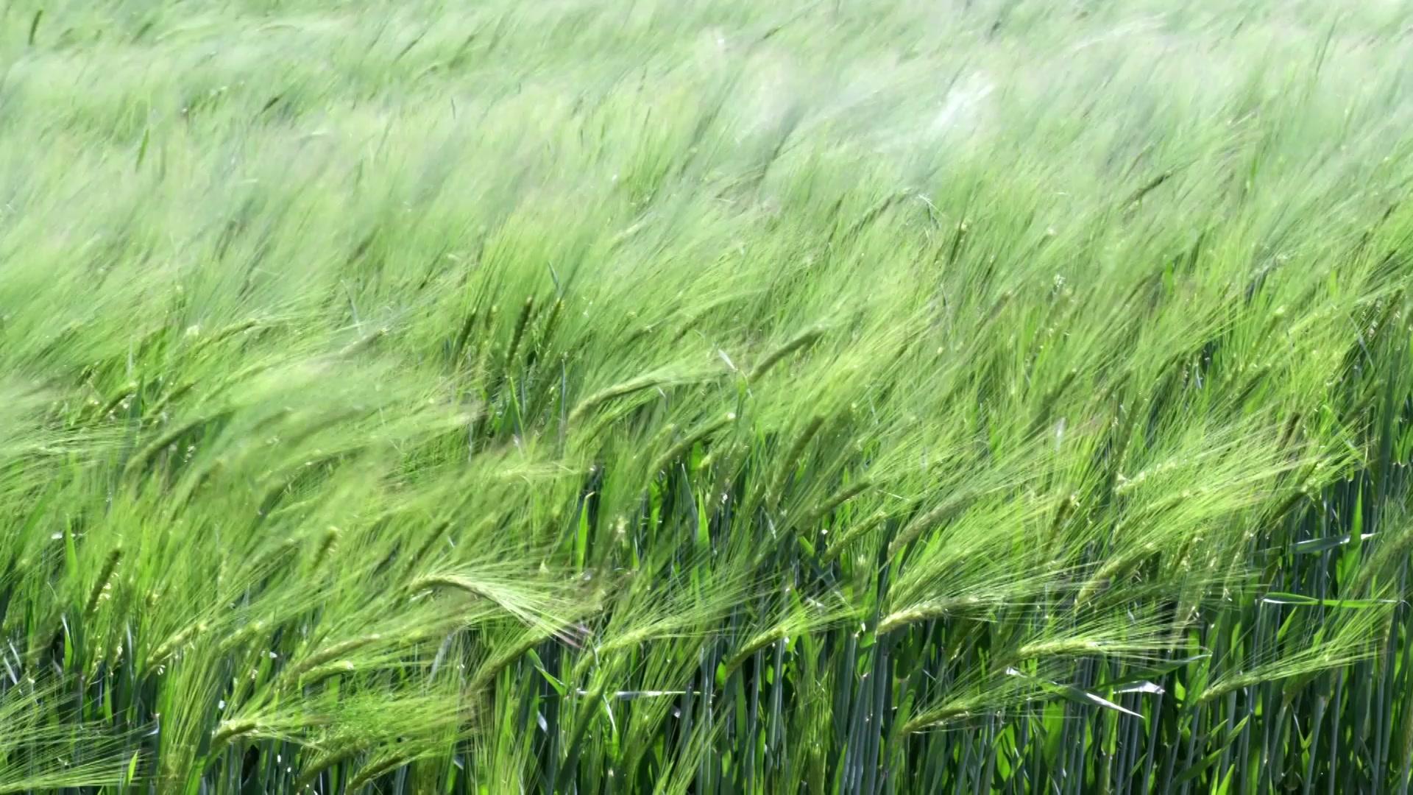
Presenting your method section focused on lab studies

Slide 6

Remember your Handbook. It is on Ledge

Slide 7
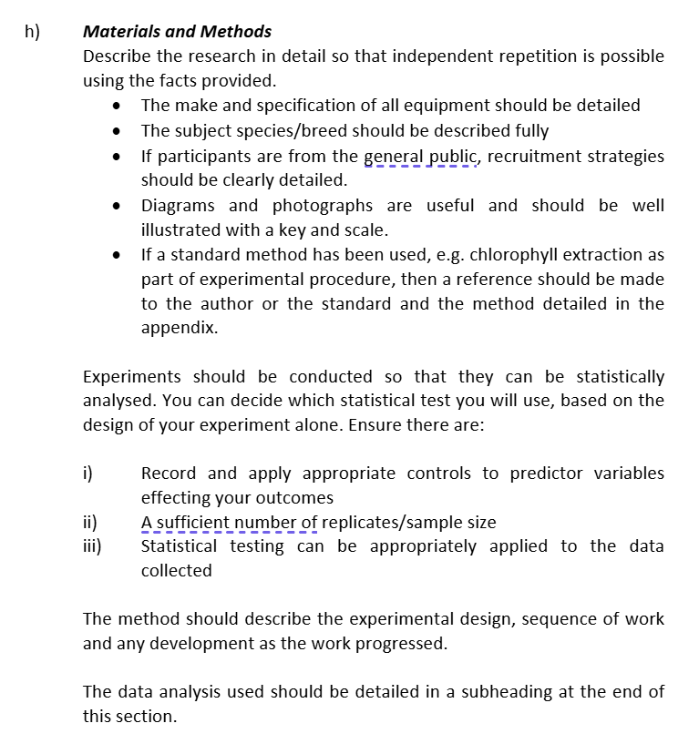

Slide 8
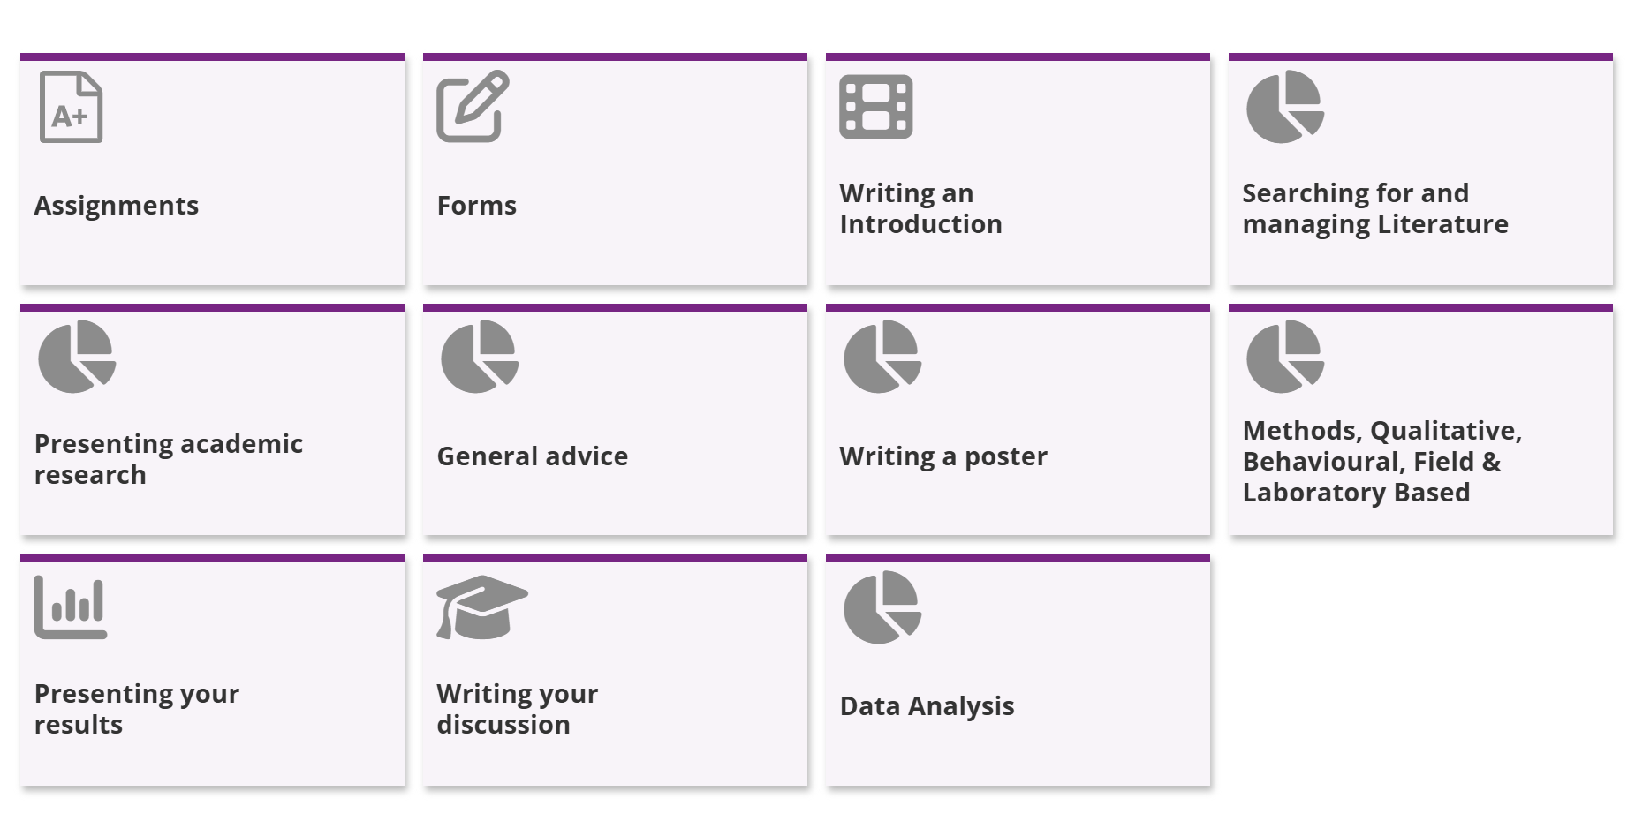

Slide 9

Where to start
Have a clearly defined question to answer, this makes the whole process much better.
Forethought!

Slide 10

Where to start regarding your METHODS
Review journal articles that have a similar methodology to yours
  What specific detail do they present?
  What subheadings/sections do they use?
  What references do they use & when?

Slide 11
Materials and Methods
Describe the research in detail so that independent repetition is possible using the facts provided.
Results
The results must be expressed both factually (brief description) and visually (using graphs and tables). Statistical results should be presented and key findings highlighted (statistically significant or not). Inferential statistical testing must be evidenced for you to meet the learning outcomes for the dissertation.
Discussion
Do not repeat your results in this section. Here you demonstrate the depth of your subject knowledge and critically appraise your results in relation to work done in the same field. This section allows you to demonstrate a critical evaluation of your results.
Methods
Everything you did to get the data (or info) required
  How were the data collected / generated?
  How were the data analysed?
Results
What the data (info) show
Discussion
What the data (info) means

Slide 12
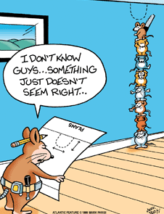
A good method must be…
REPEATABLE!!
DETAILED BUT CONCISELY WRITTEN!!
EASY TO UNDERSTAND

Slide 13
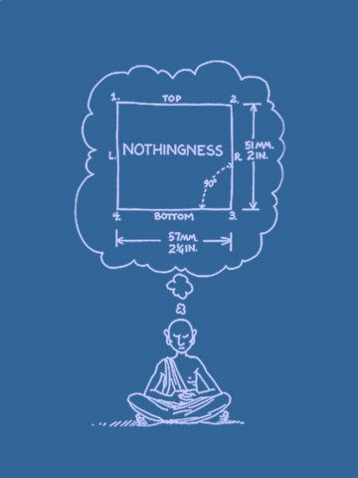
Your method should clearly state the experimental design.
Anyone should be able to read your method and perform the exact same experiment.
This is the hallmark of a proper scientific method
However, this does not mean you include EVERY single detail…

Slide 14
So how can you do this?
You need to state specifically what you did…..
But you don’t need irrelevant detail or detail that has been written before (reference & put in appendix)
Structure it, chronologically and by topic

Slide 15
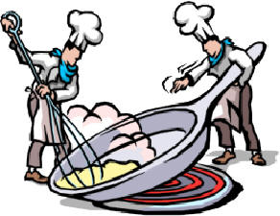
The method is not a recipe!
Try to avoid bullet points and numbered lists.
Write the method in scientific prose, as acceptable for publication in the scientific press.
Look at the format, detail & style of published methods related to your subject.
Don’t use 1st person (I or we) or present / future tense
Use the 3rd person passive past (was/were).
Use metric units!

Slide 16

Materials
Include in your method detail on any specific materials or equipment used.
But, no lists of:
  Pens, Notebooks, Clipboards, Sample bags, Dissection Kit, Pipettes, Crucibles, Test Tubes, Bunsen Burners, Chemicals, etc
  -Not important!
  Unless they are different to standard referenced procedures.

Slide 17
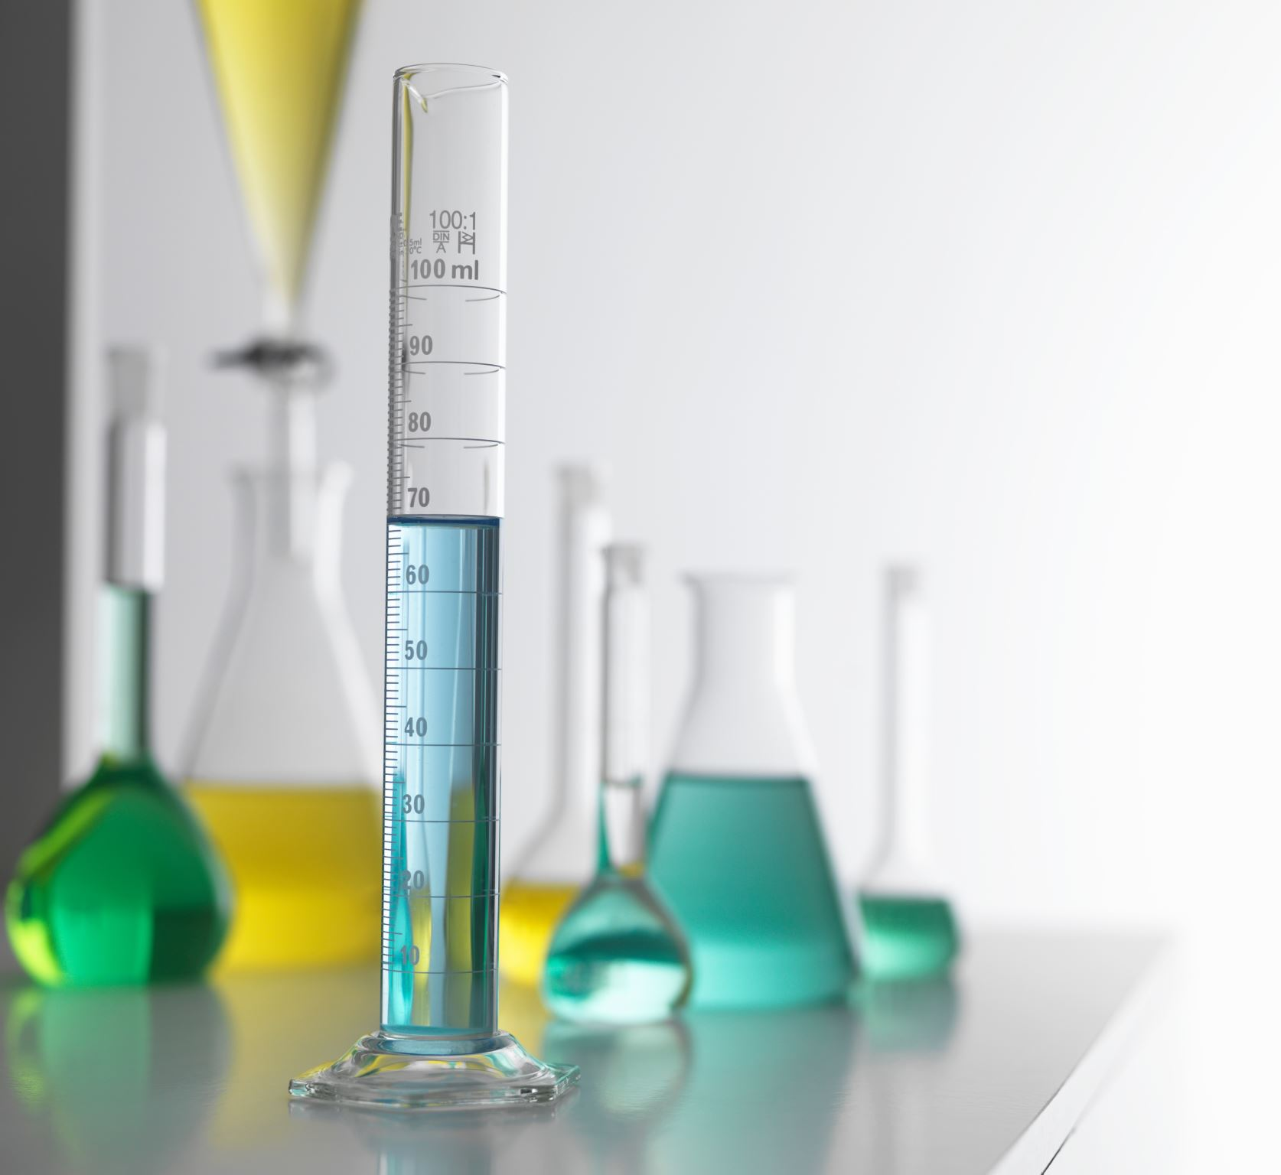
Lab Based Methodology
Most dissertations involving lab work also involve other research eg sample collection, feed trial, behaviour analysis, etc
Must give full description of materials and procedures that are specific to your research and justify their use.
Most lab methods use standard protocols that don’t require full description. State technique, equipment used and reference.

Slide 18
Some Hints for Good Method Writing
Keep precise notes of what you did, why you did it, and what happened → maybe keep a research diary so that there is a record of the methods used.
Carefully structure into logical format using sections and subsections, both chronologically and based on topic.
Write concisely & scientifically; remember who your audience will be.
Start writing each section as soon as possible (no need to have completed all research!)
Could someone else repeat your work?
Get someone else to proof read / give feedback - supervisor / peer / etc

Slide 19
Some Hints for Good Method Writing
Keep precise notes of what you did, why you did it, and what happened → maybe keep a research diary so that there is a record of the methods used.
Carefully structure into logical format using sections and subsections, both chronologically and based on topic.
Write concisely & scientifically; remember who your audience will be.
Start writing each section as soon as possible (no need to have completed all research!)
Could someone else repeat your work?
Get someone else to proof read / give feedback - supervisor / peer / etc
Start writing it now!

Slide 20
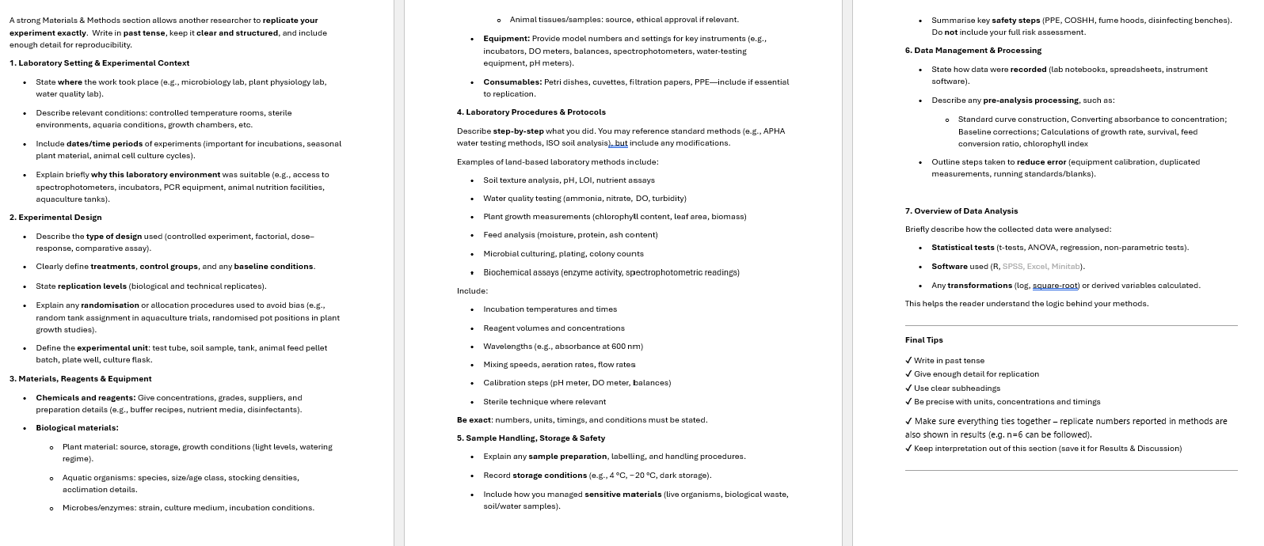

Slide 21
Use the Following Structure for guidance:
Describe precisely the materials used in the study.
Explain how the materials were prepared.
Describe & justify the research protocol.
Explain how measurements were made and what calculations were performed.
State which statistical tests were done to analyse the data.

Slide 22
Use the Following Structure:
Remember:
standard lab protocols need only state technique, specific equipment and be referenced.
(Included in full in appendix)
Describe the materials used in the study.
Explain how the materials were prepared.
Describe the research protocol.
Explain how measurements were made and what calculations were performed.
State which statistical tests were done to analyse the data.

Slide 23
Any questions?

