Slide 1

Recap. and more R practice
Lesson 5
(Equine & Ag)
Ella Bartlett
(ella.bartlett@sparsholt.ac.uk)

Slide 2
Plan for today…
Graphs (quick recap)
Playing with R
Measures of central tendency & measures of variance (recap from last year?)
-Two-way comparisons
-Correlation tests
-Plotting graphs

Slide 3
But first… can you remember from last week how to interpret a correlation?

Slide 4
(R=0.4; P=0.04)
Significant, positive correlation
(R=-0.5; P=0.04)
Significant, negative correlation
(R=0.9; P=0.001)
Significant, (strong) positive correlation
(R=0.2; P=0.07)
Non-significant, positive correlation

Slide 5
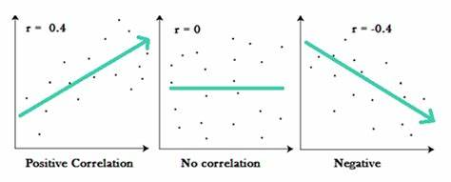
Interpreting a correlation
Positive correlation means when ‘variable 1’ increases, so does ‘variable 2’
Negative correlation means when ‘variable 1’ increases, ‘variable 2’ decreases

Slide 6
Interpreting a correlation
(there is a reason we are covering this)
R-values run on a scale from -1 to 1
If the number is greater than zero = positive correlation
If the number is less than zero = negative correlation
-1
0
1
Strong negative correlation
No correlation
Strong positive correlation

Slide 7

Descriptive stats.

Slide 8
In a study, you might have a large number of animals in your sample.
When we are doing data analysis, we don’t care too much about the effect of our study on each individual animal….
…We look at the sample as a whole.
Not – ‘has the treatment had an effect on each animal in the sample’
We want to know– ‘has the treatment has an effect on the whole group of animals’

Slide 9
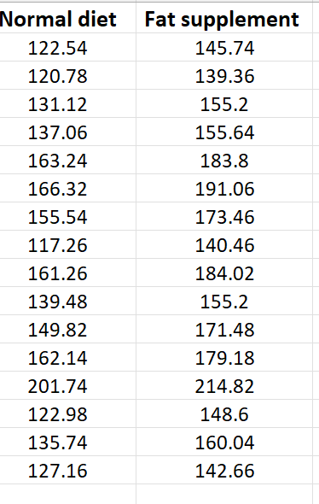
Here we have 32 goats in out sample. If we try to make a graph that shows the data point for each goat it looks crazy!
What do we do to plot this on a graph?

Slide 10
Normal Diet | Mean = 144.64
High-fat Diet | Mean = 165.05
Calculated the mean for each treatment group!
Shows us the middle point of each group.
To calculate mean…

Slide 11
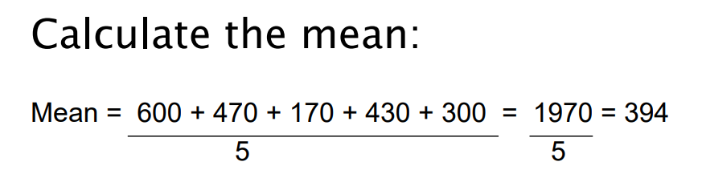
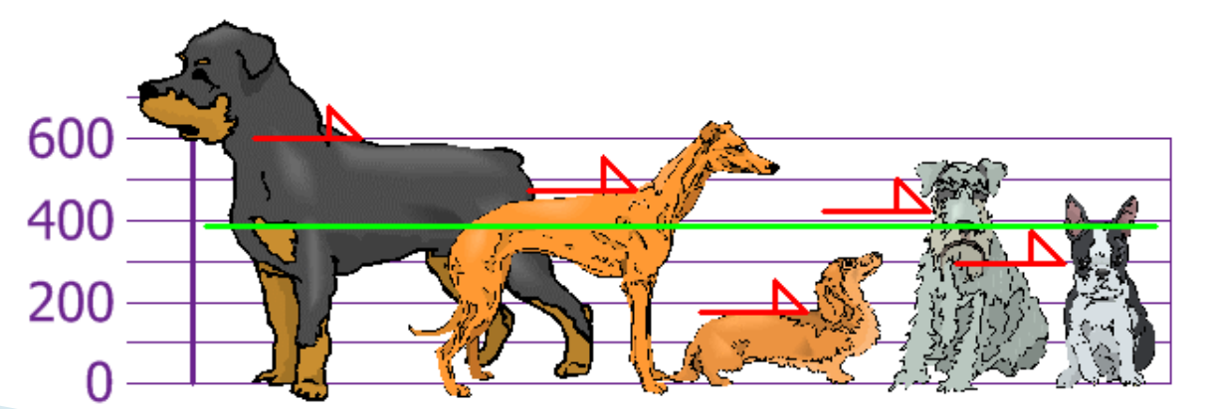
Calculating mean
To calculate the mean height for this group, add up the height of each dog and then divide this by the number of dogs in the group (five).

Slide 12
Considering Variance
There is an issue with just relying on the mean.
Just focusing on the middle of the data set may not be giving us the ‘full picture’.
All of our data points could be very close to the mean – ‘clustered around the mean’
  OR
Our data points could be spread far from the mean = lots of variation in our sample.

Slide 13
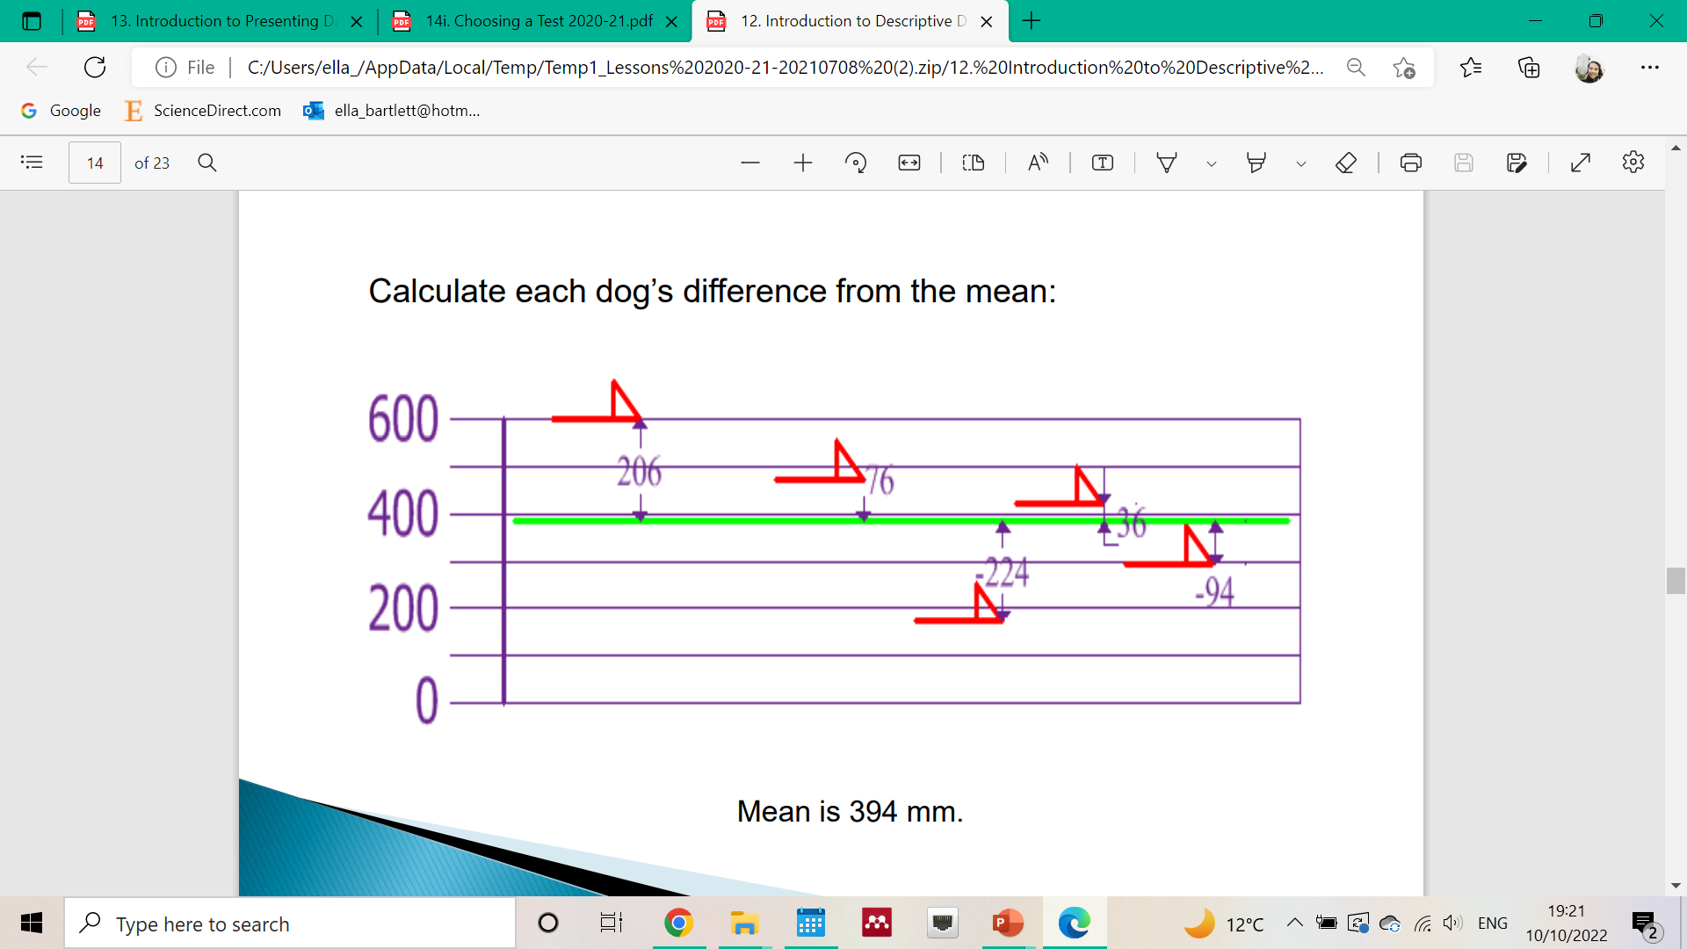
Measures of variance
It is beneficial to also calculate (and display on graphs) this variance.

Slide 14
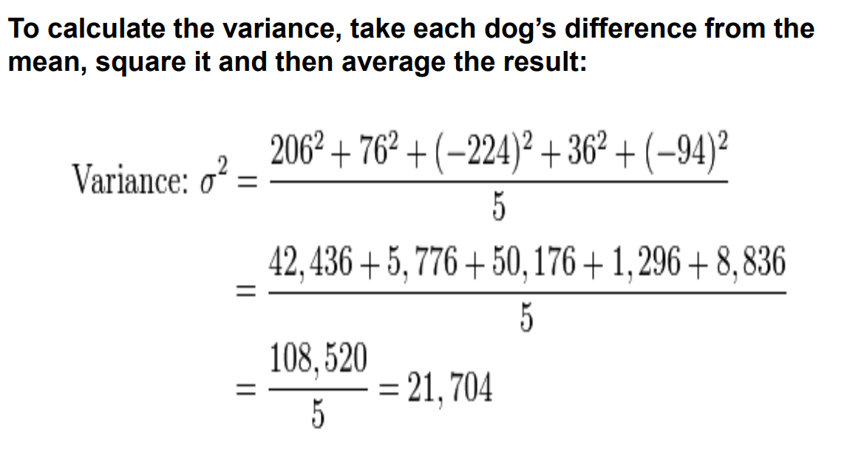
You can calculate variance…

Slide 15
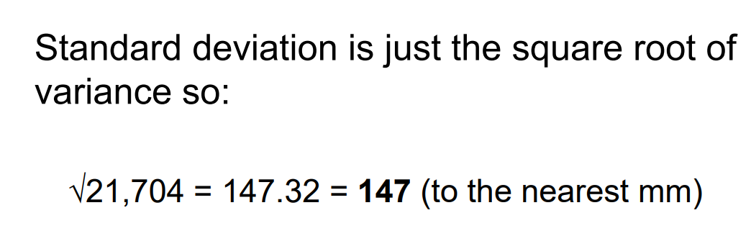
….. and find the square root of this variance to give standard deviation!
Standard deviation is something you give (alongside the mean) when writing up/ presenting scientific work

Slide 16
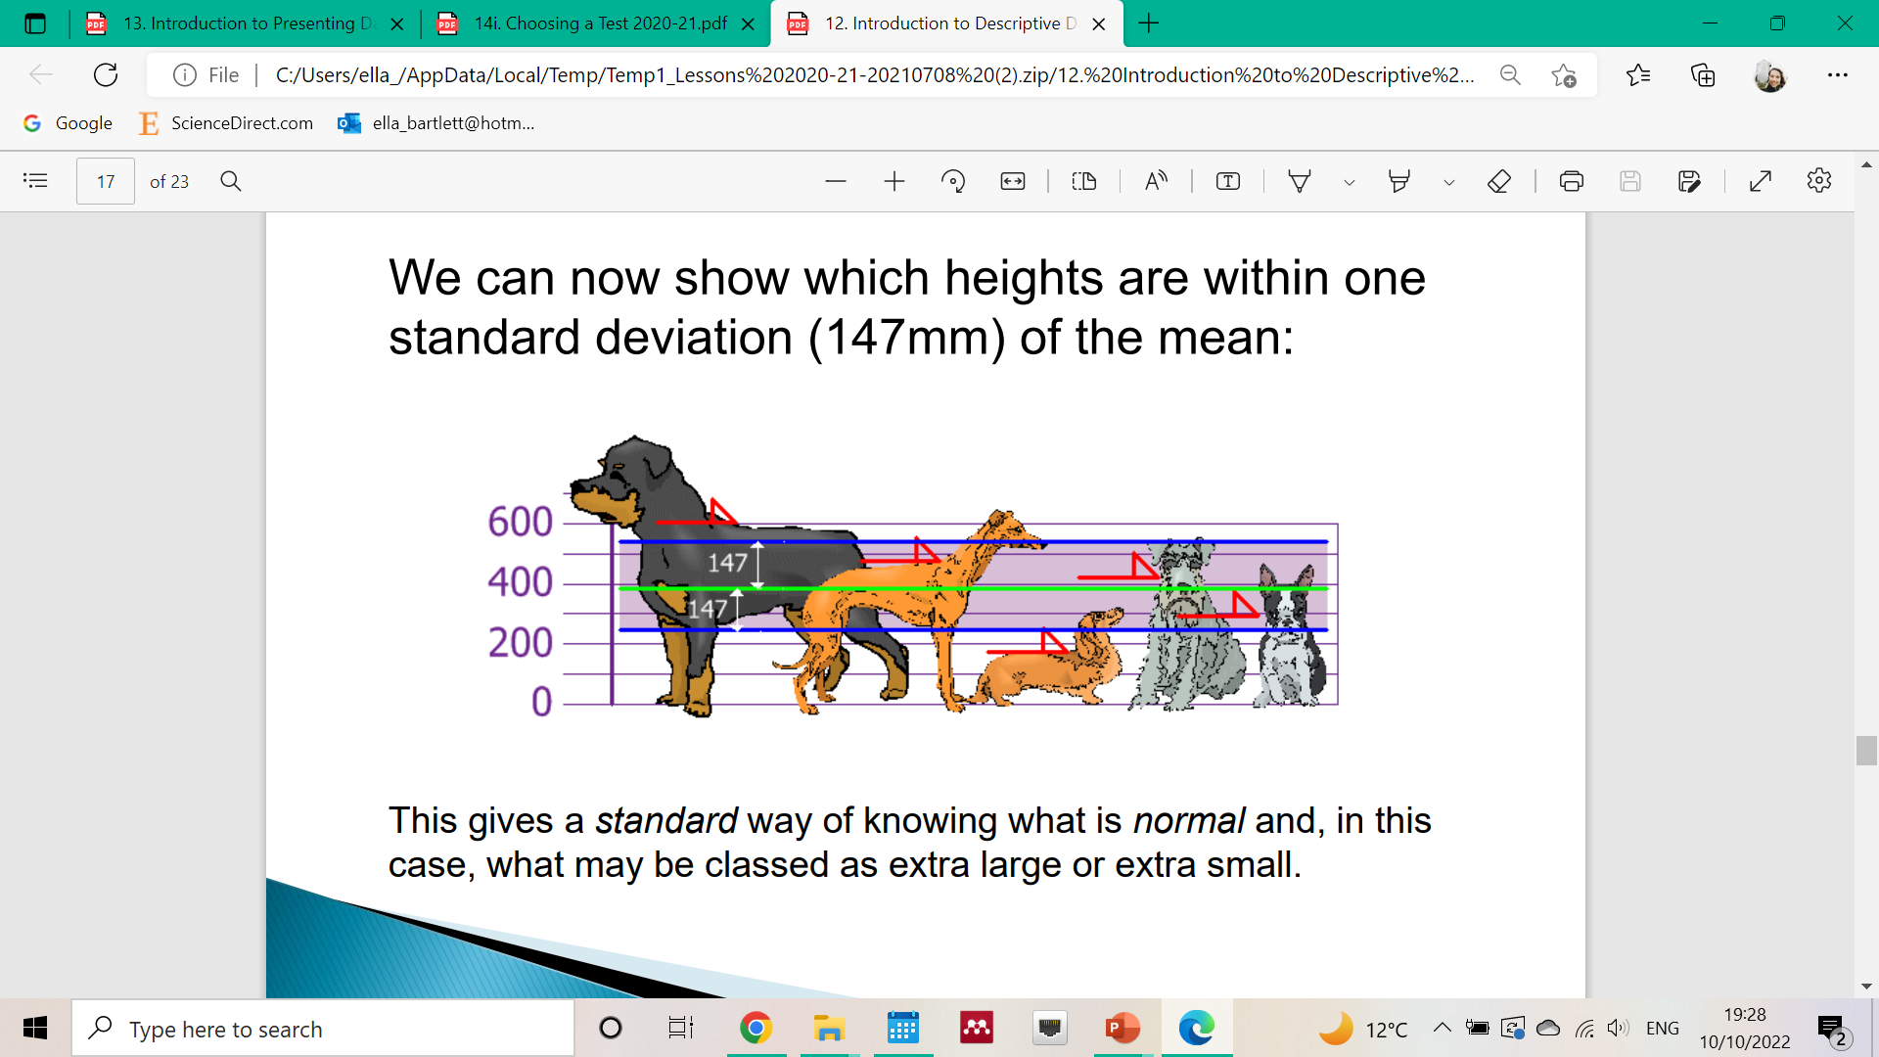

Slide 17
In scientific papers, you often see it written like this…
“The sample comprised five dogs (height = 394 ± 147 mm (mean ± SD))”

Slide 18
So…
When carrying our descriptive statistics, find the middle of your data set (mean) and also give the standard deviation of the sample to show how much your samples varies.
But… if you are working with non-parametric data, using median and range may be more appropriate.
If your data is non-parametric, use the median to show the middle of your data set. Use the range (highest and lowest number) to show the spread of data around the middle point.

Slide 19
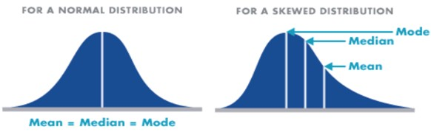

Slide 20
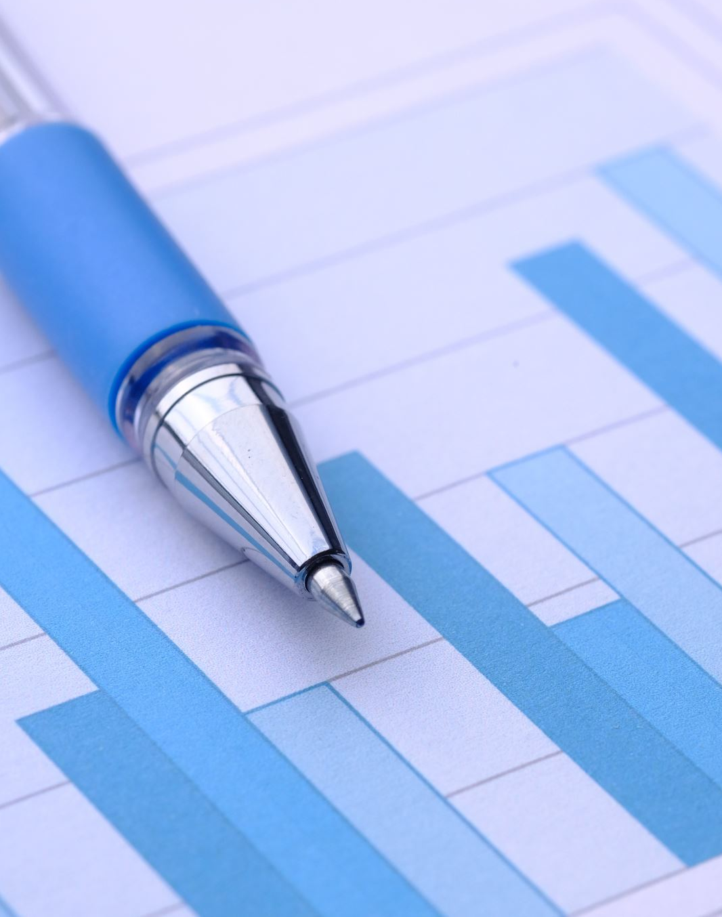
Graphs

Slide 21
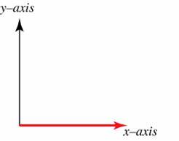
Graph basics
Different data suits different graphs
Most graphs consist of two axes and usually:
  The x-axis (independent variable) is horizontal
  The Y-axis (dependent variable) is vertical
Graphs require:
Description (below the figure)
Labels on its X and Y axes (with units)
a key/ legend (if necessary)

Slide 22
Something to be aware of…
Look carefully at the scale used!
This can be manipulated to make a difference look more impressive than it is.
The graphs below show the same data, just on a different Y-axis scale
Note: neither of these are ideal scales

Slide 23
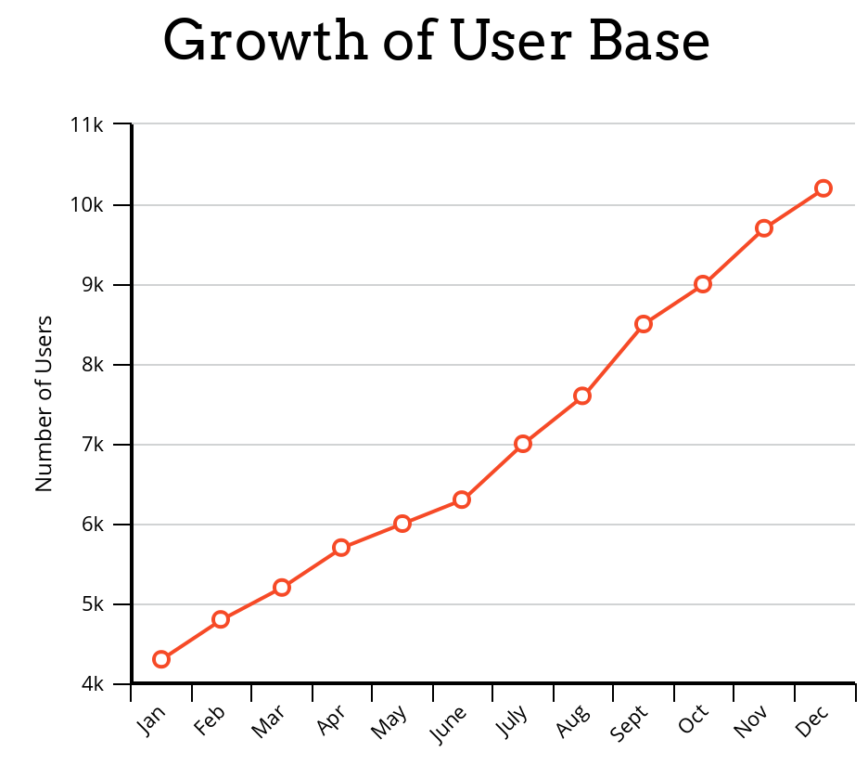
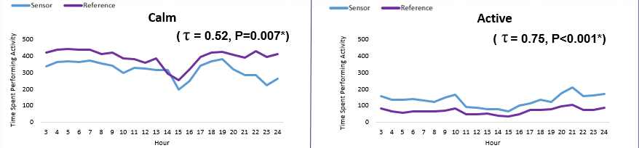
Line graph
Use this kind of graph to show changes over time (time on x-axis as it’s the independent variable)

Slide 24
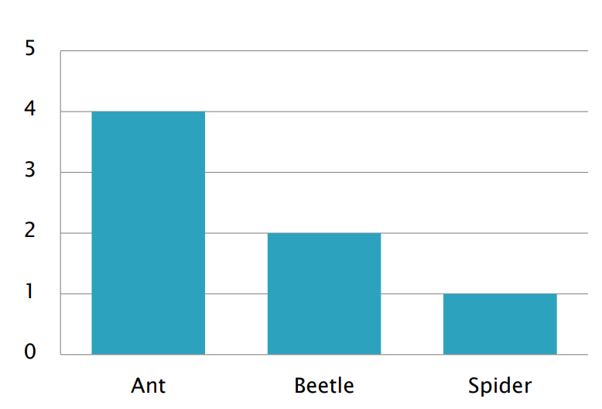
Bar graph (count)
Use for whole number plots
This is a very basic graph, just showing a count of something in two or more separate groups
Axis titles and figure title will tell you that this is count data

Slide 25
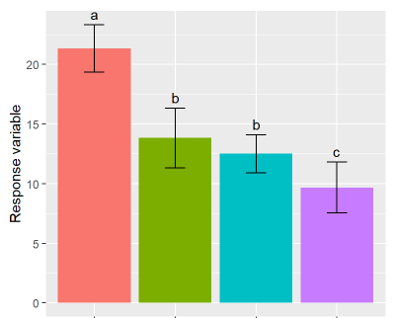
Bar plot (showing mean & standard deviation)
Used to display data when you are looking for a difference between two or more groups.
The top of each bar shows us the mean for each group.
The ‘whiskers’ show standard deviation (more on this next week, but it shows us the spread of the data).
Any idea what the letters tell us?
Diet 1
Diet 2
Diet 3
Diet 4
‘Bars (mean±SD) that do not share a letter represent significantly different values’

Slide 26
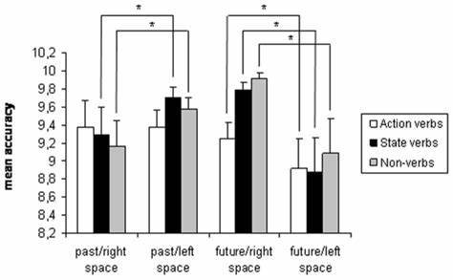
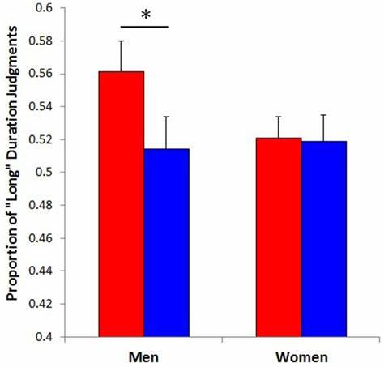
Another way to show significant difference on a graph
The paper will always tell you what the asterisk stands for - don’t just assume (you’ll see why)
(e.g. ‘Asterisks indicate statistically significant differences’)

Slide 27
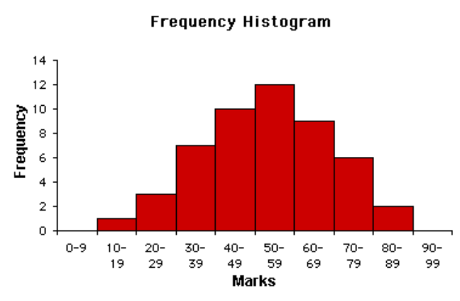
Histogram
Used to look at the spread of continuous data
Used where data is continuous rather than discrete e.g. age range at 0 to 10, 11 to 20, 21 to 30 etc. Therefore, no gaps exist between columns.
Often shows ‘frequency’ e.g. the number of individuals in each age range.
We also use these to check whether our continuous data is normally distributed

Slide 28
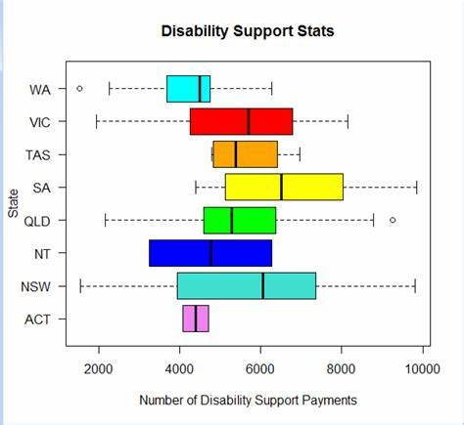
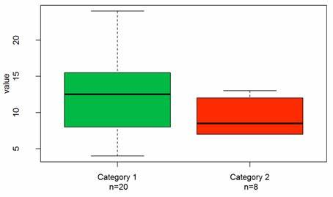
Box plot
The middle line = median
The outer points = range (highest & lowest number in each group)

Slide 29
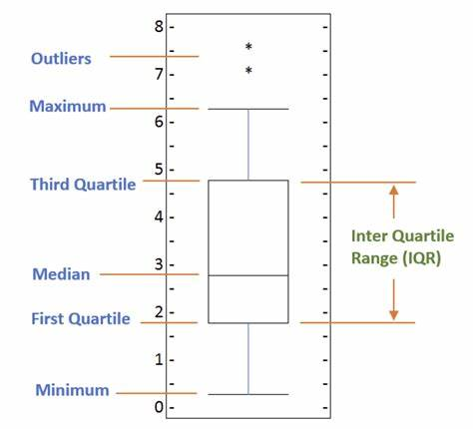
This is why I said ‘don’t assume that asterisks are being used to show significance’ – on boxplots they can be used to display outliers

Slide 30
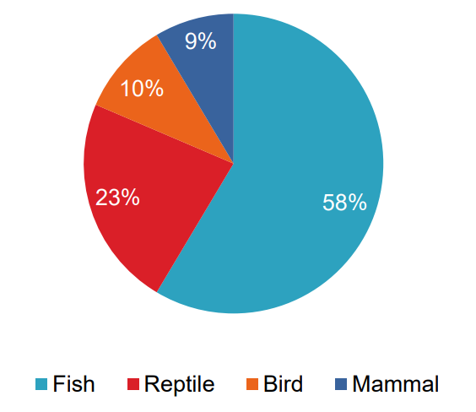
Pie chart
Purpose:
Illustrates the relative contribution different categories make to an overall total

Slide 31
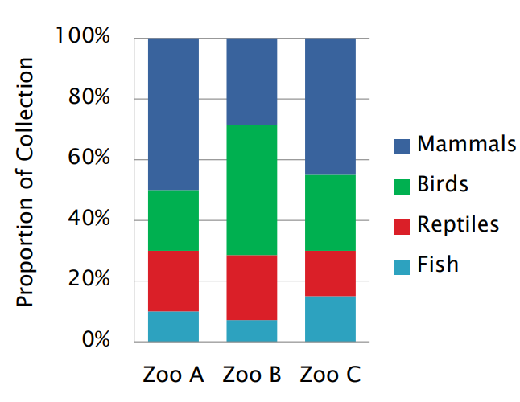
Stacked bar
Used instead of multiple pie charts

Slide 32
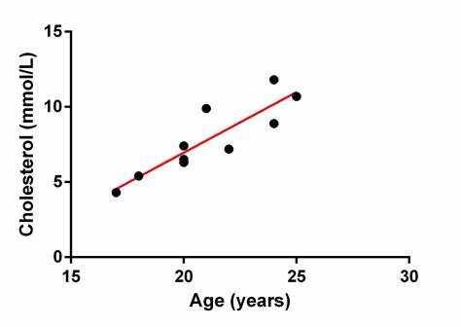
Scatter plot
Purpose:
To represent the relationship/ association between two related variables.
Shows ‘correlation’
To show this, a ‘line of best fit’ is added (in red here)

Slide 33
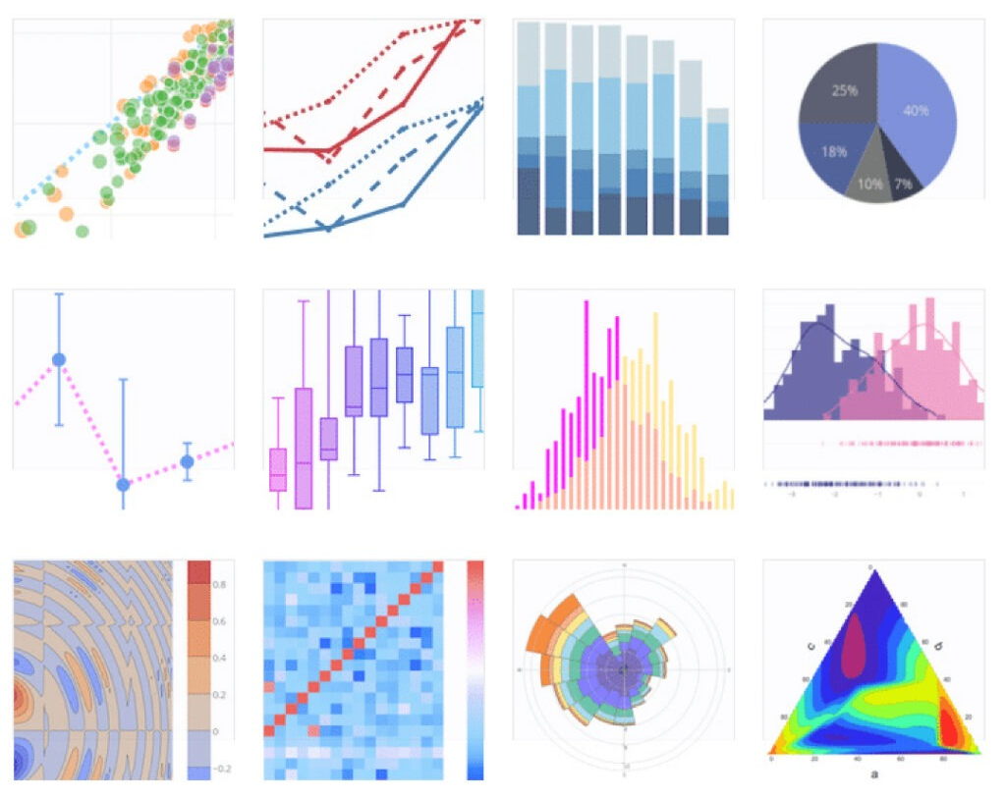
Graphs in R Studio (can be beautiful!)
R CHARTS | A collection of charts and graphs made with the R programming language
The R Graph Gallery – Help and inspiration for R charts
Often require installing packages (like ggplot2)

Slide 34

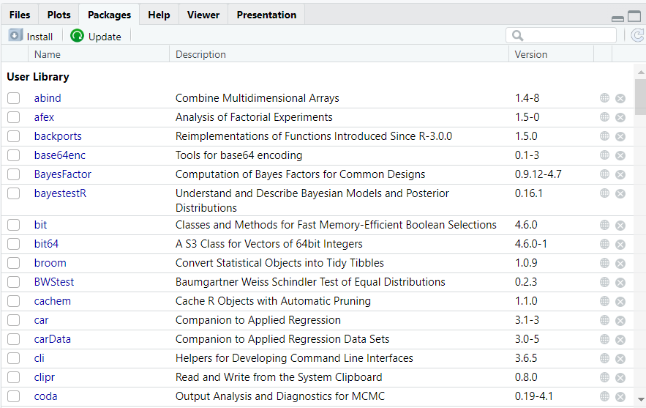
Packages in r
Packages in R are collections of functions, data, and compiled code that enhance the functionality of R.
To use a package, you first need to install it and then load it into your R session.
Once installed, load the package using the library() function to ‘call up’ a package

Slide 35
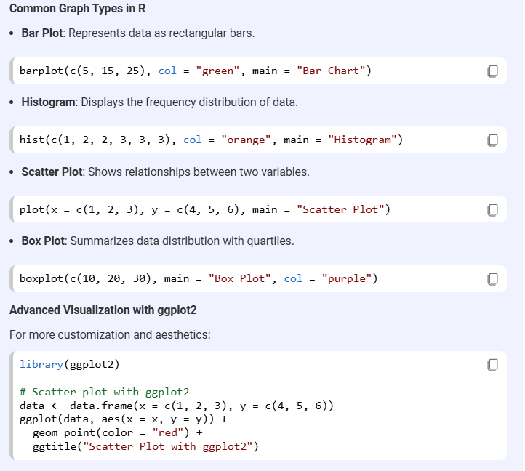

Slide 36
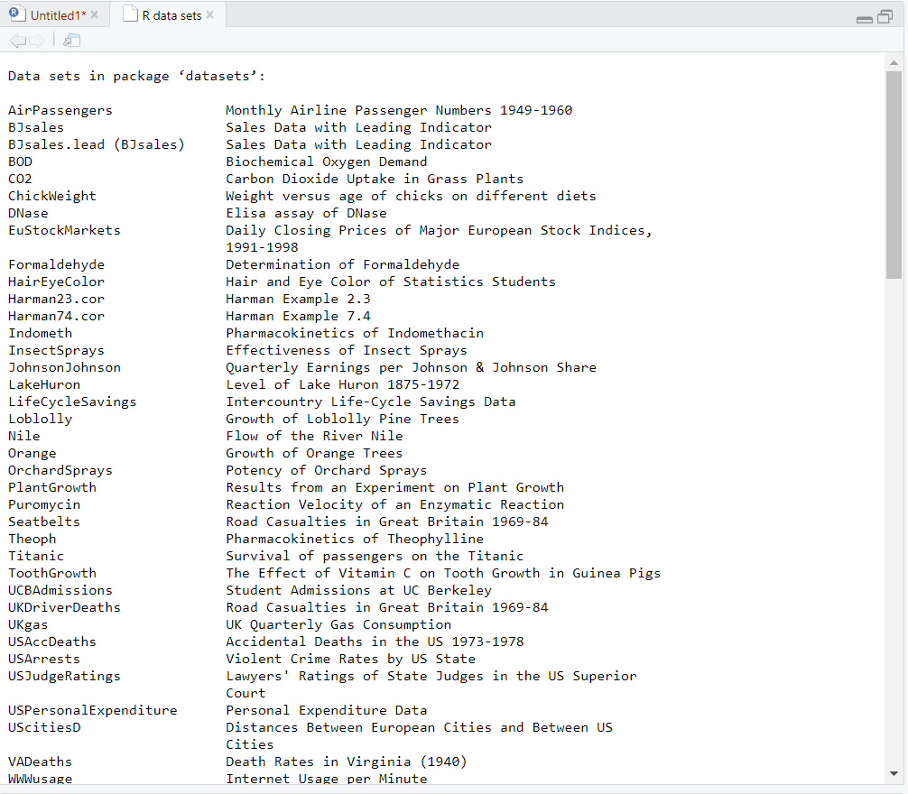
Task for today
Using data that’s already in r
You can run the code ‘data()’ in r studio to see a list of existing data sets

Slide 37
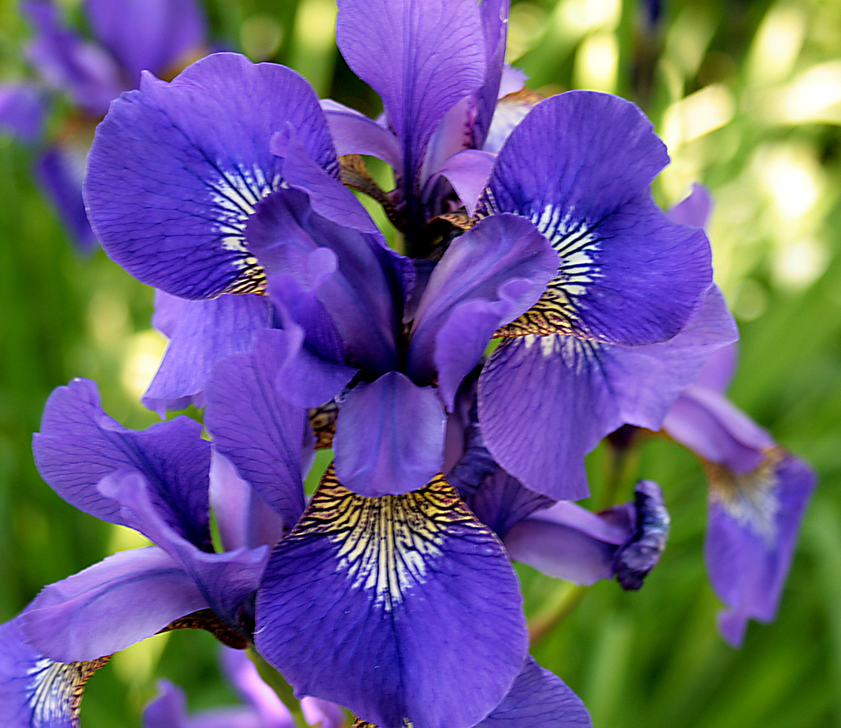

We’re going to use ‘iris’ data set

Slide 38
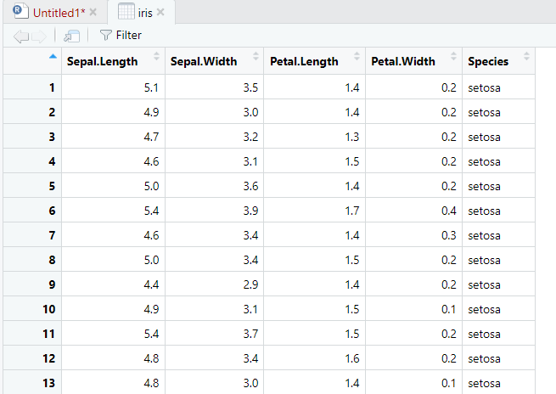
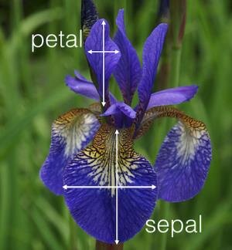
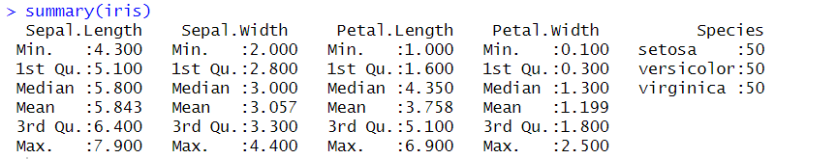

Slide 39
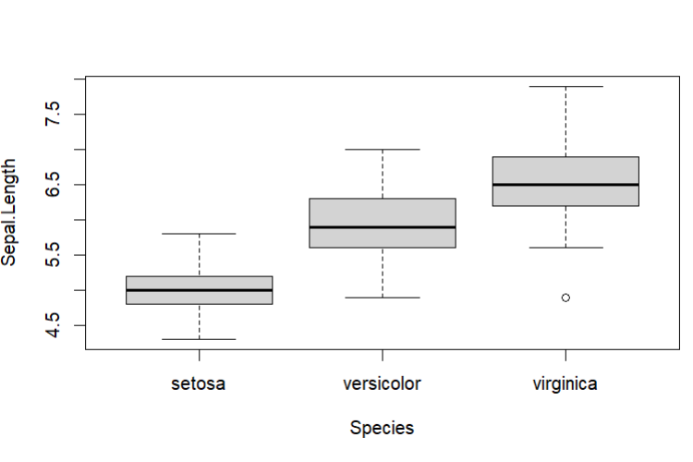
Create a boxplot of sepal.length by species
boxplot(Sepal.Length~Species)

Slide 40
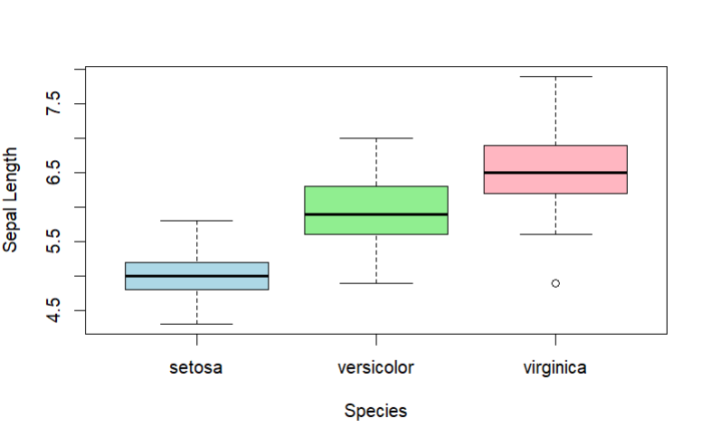
Make it prettier…
boxplot(Sepal.Length ~ Species, xlab = "Species", ylab = "Sepal Length", col = c("lightblue", "lightgreen", "lightpink"))

Slide 41
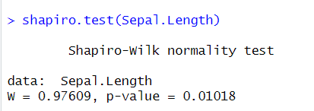
Is there a significant correlation between sepal length and petal length?
cor.test(Sepal.Length, Petal.Length, method = "spearman")

Slide 42
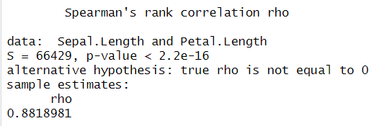
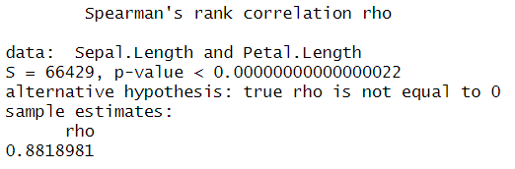
options(scipen = 999)

Slide 43
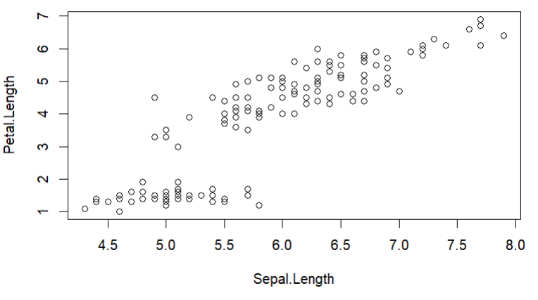
Plot this as a scatter plot
plot(Sepal.Length, Petal.Length)

Slide 44
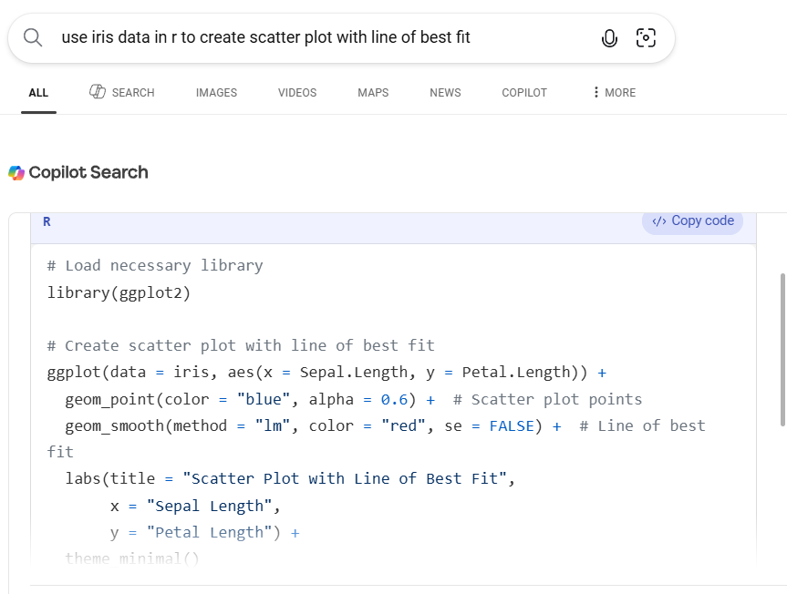
Searching for r code on the internet is NOT cheating ☺

Slide 45
# Load necessary library
library(ggplot2)
# Create scatter plot with line of best fit
ggplot(data = iris, aes(x = Sepal.Length, y = Petal.Length)) +
geom_point(color = "blue", alpha = 0.6) + # Scatter plot points
geom_smooth(method = "lm", color = "red", se = FALSE) + # Line of best fit
labs(title = "Scatter Plot with Line of Best Fit",
x = "Sepal Length",
y = "Petal Length") +
theme_minimal()

Slide 46
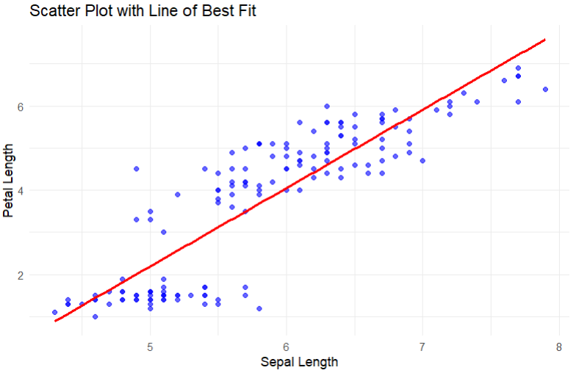

Slide 47
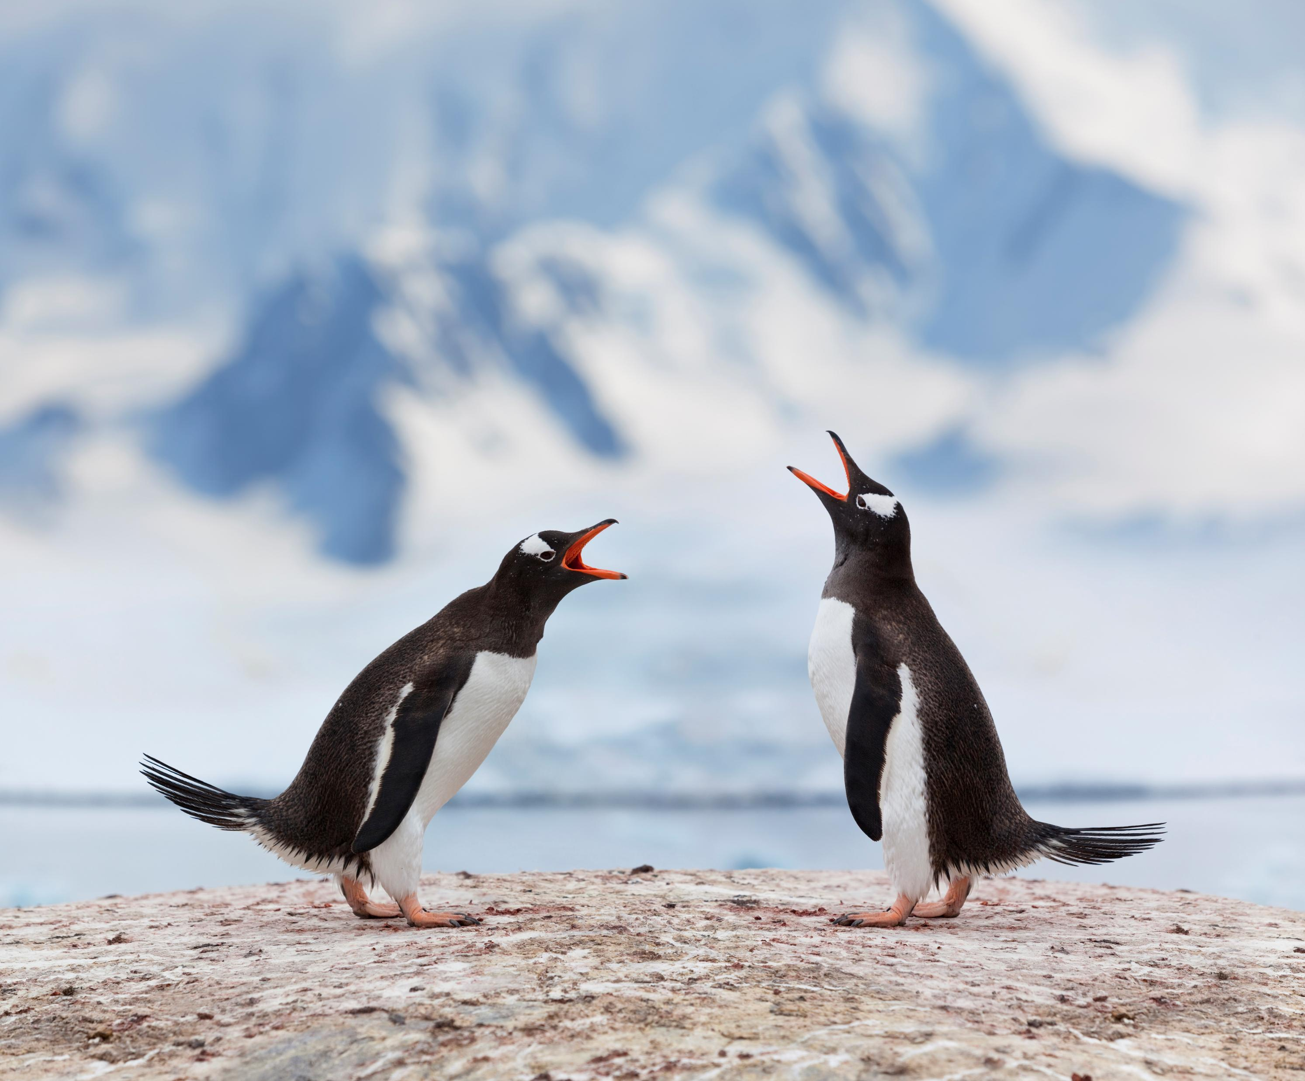
Over to you
Load: penguins data set in R
data("penguins")

Slide 48
Answer the following questions:
Is penguin ‘body mass’ a normally distributed variable?
Is there a significant correlation between ‘body mass’ and ‘bill length’?
Run a Wilcoxon test to determine if there is a significant difference in penguin ‘body mass’ between males and females.
Create a boxplot to compare ‘body mass’ of male and female penguins (use pretty colours and change the label of the Y-axis to show that weight is in grams)

Slide 49
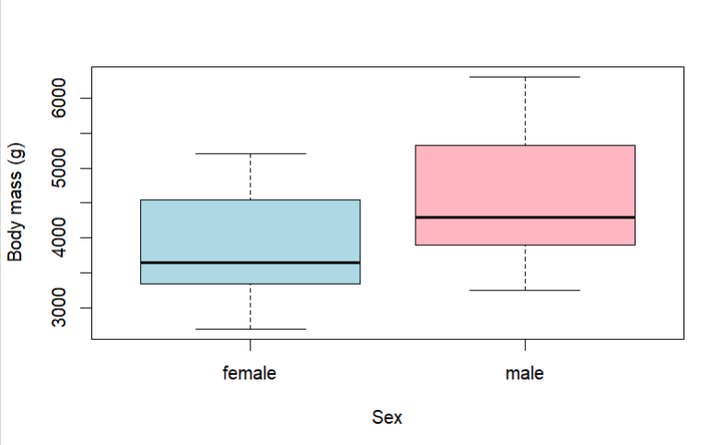
Notes:
boxplot(body_mass~sex, col=c("lightblue", "lightpink"),ylab = "Body mass (g)", xlab="Sex")

Slide 50
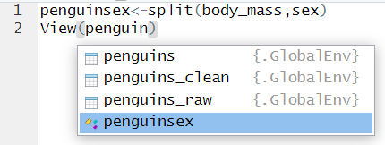
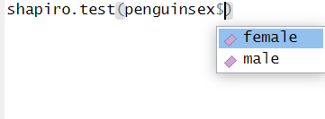
Splitting columns
Name for new list
In r studio (don’t cheat and go back to excel), create new lists that are:
  Body mass of only male penguins
  Body mass of only female penguins
You can now run tests (e.g. Shapiro wilk test) on each group separately.
New list

