Slide 1
AAB Data Analysis
Week 2

Slide 2

Last week

Slide 3
Choosing an appropriate inferential stats. test
“t” test
ANOVA
Friedman
Tests
Chi-squared
GLM
General Linear Modelling
There are lots of different statistical tests available.
Each test is designed to work in a specific situation (depends on type of data, study design, study aim, etc.)
You need to decide which one is most appropriate for a given study….
Pearson’s
correlation
Mann Whitney
Wilcoxon
Kruskal Wallis
Spearman’s
correlation

Slide 4
Testing for…? | Study design | How many groups? | Inferential Test
Difference (independent variable is categorical) We want to see if the ‘independent’ influences the ‘dependent’ variable | Independent groups | Two | T-test or Mann-Whitney
 |  | More than two | ANOVA or Kruskal-Wallis
 | Repeated Measures | Two | Paired T-test or Wilcoxon
 |  | More than two | Repeated measures ANOVA or Friedman’s Test
Correlation (neither variable is categorical, both are numerical) We want to examine the relationship between two variables | - | - | Person's correlation or Spearman's correlation
Yellow = Parametric test
Pink = Non-parametric test

Slide 5
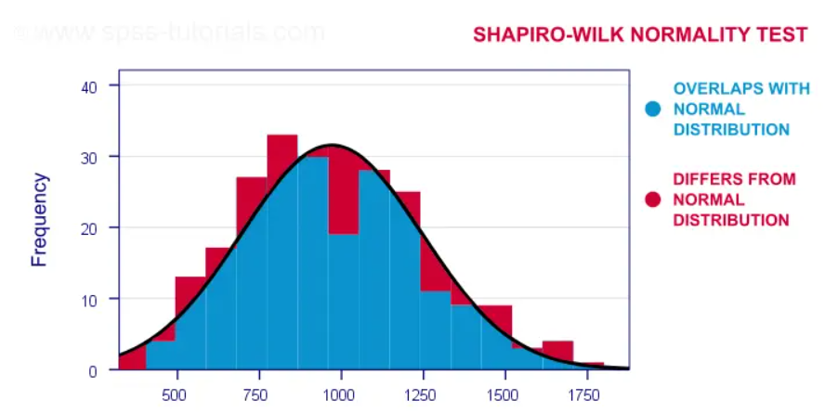

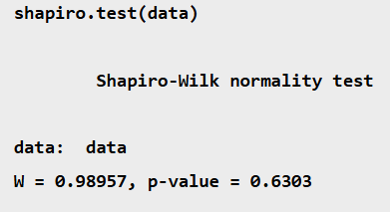
Test normality using a Shapiro-wilk test in R
P<0.05 = Not normal P>0.05 = Normal distribution

Slide 6
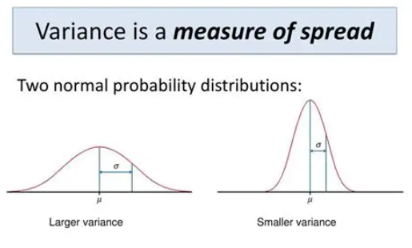
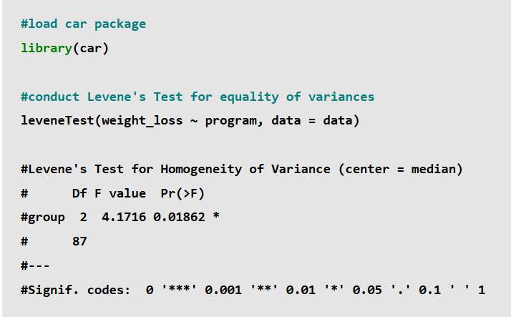
Testing for equal variance
Unnecessary if using a repeated measures study design
P<0.05 = Variance is not equal
P>0.05 = Equal Variance

Slide 7
Parametric or non-parametric?
Load data into R studio
Use Shapiro Wilk test to check distribution of dependent variable data
(split this by independent categories where possible)
P-value greater than 0.05
(normal distribution)
P-value less than 0.05
(distribution not normal)
Use a NON- parametric test
Does this study follow a repeated measures design?
Run Levene’s test to check for equal variance
Yes
(assume equal variance)
No
Use a parametric test
P-value greater than 0.05
(Equal Variance)
P-value less than 0.05
(Variance not equal)

Slide 8

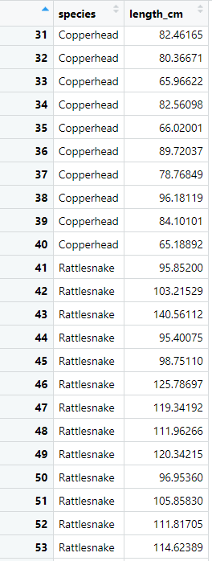
Snake example
Researchers found 80 snakes
Measured the length of each snake (cm)
Recorded the species (all either ‘Copperhead’ or ‘Rattlesnake’.
Research want to find out whether snake length is significantly different between these two species

Slide 9
The Plan ☺
2 Dec.
Week 1: Choosing a test, R Studio Refresh, Two-Way Comparisons
9 Dec.
Week 2: Multiple comparisons and post-hoc tests
16 Dec.
Week 3: Correlation and Regression analysis

Slide 10
So far, we have focused on running two-way comparison tests
Snake species = Copperhead or Rattlesnake
You choose and run the correct stats. test, and you know that if the p-value is significant, there is a significant difference between the two groups

Slide 11
Testing for…? | Study design | How many groups? | Inferential Test
Difference (independent variable is categorical) We want to see if the ‘independent’ influences the ‘dependent’ variable | Independent groups | Two | T-test or Mann-Whitney
 |  | More than two | ANOVA or Kruskal-Wallis
 | Repeated Measures | Two | Paired T-test or Wilcoxon
 |  | More than two | Repeated measures ANOVA or Friedman’s Test
Correlation (neither variable is categorical, both are numerical) We want to examine the relationship between two variables | - | - | Person's correlation or Spearman's correlation
Yellow = Parametric test
Pink = Non-parametric test

Slide 12
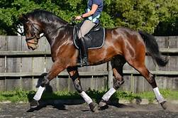
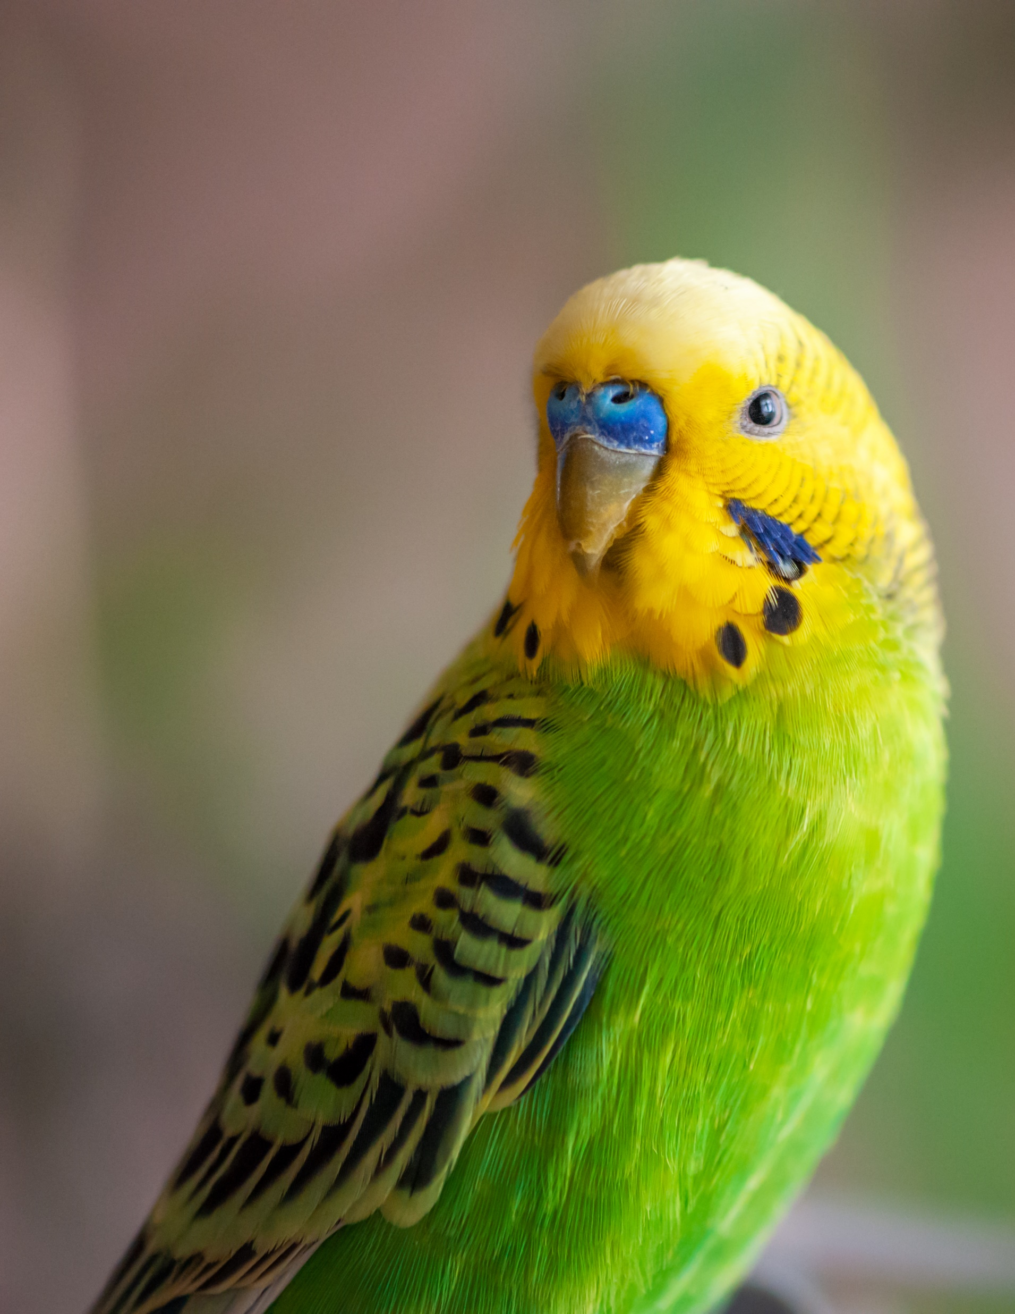
How many ‘groups’ within my predictor variable?
How many categories are you asking the stats. test to compare?
Before joint supplement
PV = Joint supplement
After joint supplement
  High oil (30% of total diet)
  Low oil (10% of total diet)
  No oil (0% of total diet)
PV = % oil in diet

Slide 13

Multiple comparison tests
Diet | Weight (grams)
Flies | 2.03
Flies | 4.11
Flies | 3.33
Flies | 3.23
Flies | 4.58
Flies | 6.98
Flies | 5.05
Flies | 0.56
Crickets | 3.01
Crickets | 5.5
Crickets | 7.79
Crickets | 5.75
Crickets | 4.53
Crickets | 4.21
Crickets | 5.33
Crickets | 6.77
Mealworms | 5.21
Mealworms | 6.32
Mealworms | 8.01
Mealworms | 6.23
Mealworms | 7.77
Mealworms | 8.34
Mealworms | 7.11
Mealworms | 6.03
Null Hypothesis: Diet will significantly alter the amount of weight gained by frogs.
24 frogs in the sample.
Each frog is on one diet (no cross over)
Weight (grams) of each frog after 3 months on the diet treatment was recorded.

Slide 14
Testing for…? | Study design | How many groups? | Inferential Test
Difference (independent variable is categorical) We want to see if the ‘independent’ influences the ‘dependent’ variable | Independent groups | Two | T-test or Mann-Whitney
 |  | More than two | ANOVA or Kruskal-Wallis
 | Repeated Measures | Two | Paired T-test or Wilcoxon
 |  | More than two | Repeated measures ANOVA or Friedman’s Test
Correlation (neither variable is categorical, both are numerical) We want to examine the relationship between two variables | - | - | Person's correlation or Spearman's correlation
Yellow = Parametric test
Pink = Non-parametric test

Slide 15
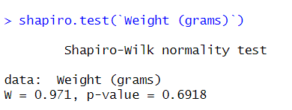
After loading data in R
Is this data normally distributed?
What should I do next?
YES!
Check for equal variance

Slide 16
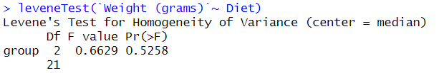
Is there equal variance?
YES!

Slide 17
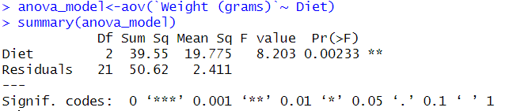
Run a one-way ANOVA
Note that I’ve given the results of my ANOVA a name
What is the outcome?
P-value indicates significant difference

Slide 18
Which of these three treatments are significantly different from each other?
Flies vs crickets = ?
Flies vs mealworms = ?
Crickets vs mealworms = ?

Slide 19
We need to run a post-hoc test to determine where the difference are!

Slide 20
NOTE: we only need to conduct a post hoc test when the p-value for the ANOVA is statistically significant.
If the p-value is not statistically significant, this indicates that the means for all of the groups are not different from each other, so there is no need to conduct a post hoc test to find out which groups are different from each other.

Slide 21
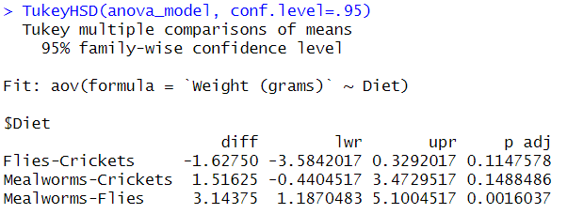
Post hoc test: Tukey test
Sig. difference

Slide 23
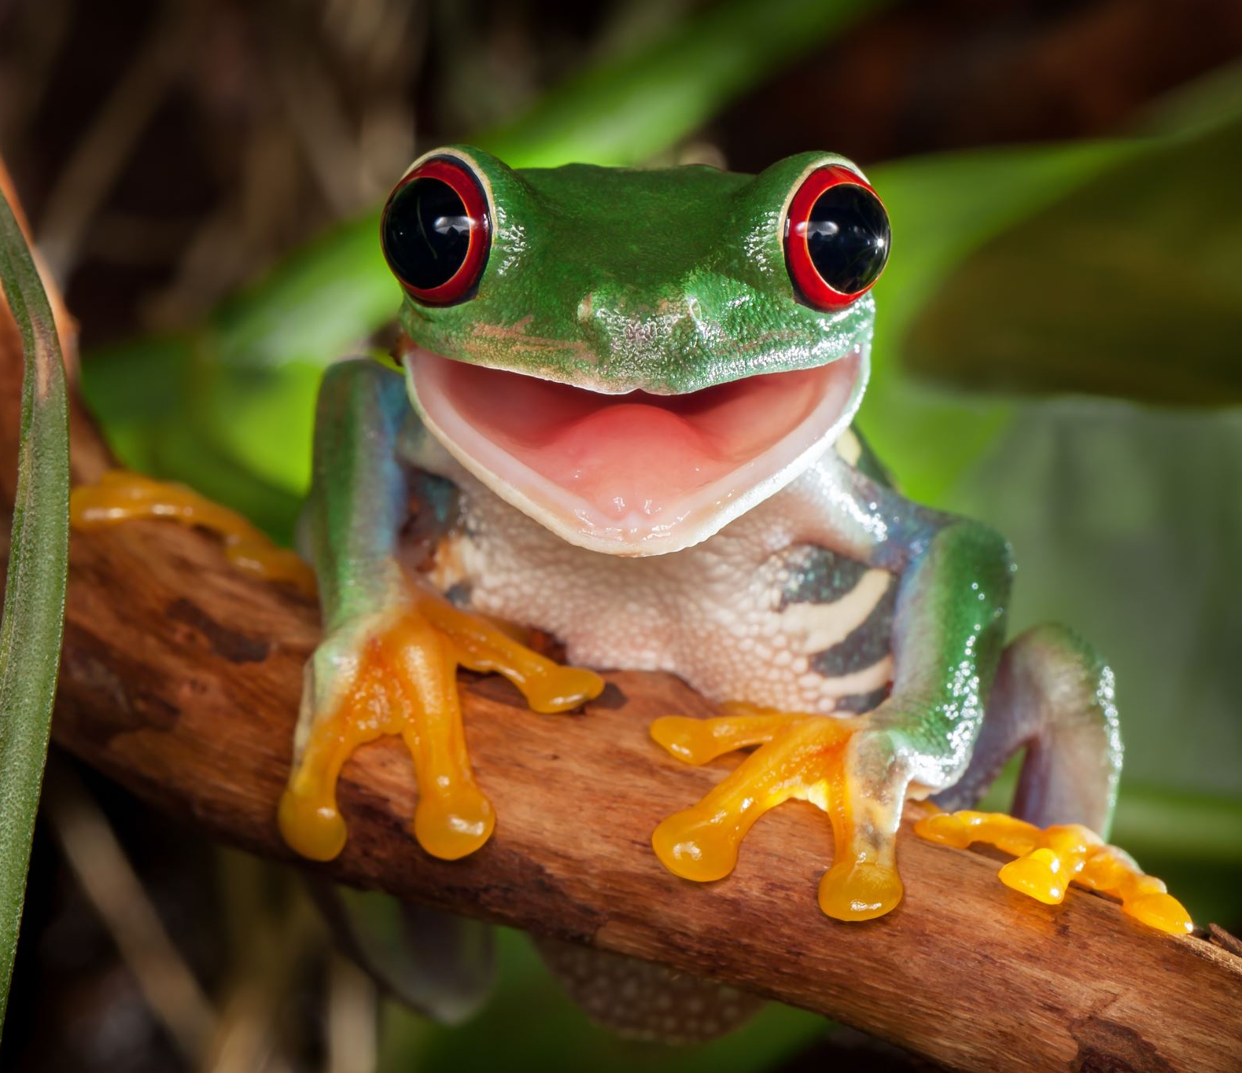
ANOVA test identified a significant difference in frog weight (g) across the different diets (F=8.203, df=2, P=0.00233).
Post-hoc Tukey revealed a significant difference (P=0.0016) in the weight of frogs on the Mealworm (mean weight =6.8775 g) and the Flies (mean weight 3.73375 g) diet

Slide 24
If our parametric assumptions had not been met:
Testing for…? | Study design | How many groups? | Inferential Test
Difference (independent variable is categorical) We want to see if the ‘independent’ influences the ‘dependent’ variable | Independent groups | Two | T-test or Mann-Whitney
 |  | More than two | ANOVA or Kruskal-Wallis
 | Repeated Measures | Two | Paired T-test or Wilcoxon
 |  | More than two | Repeated measures ANOVA or Friedman’s Test
Correlation (neither variable is categorical, both are numerical) We want to examine the relationship between two variables | - | - | Person's correlation or Spearman's correlation
Yellow = Parametric test
Pink = Non-parametric test

Slide 25
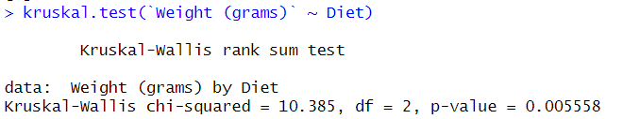
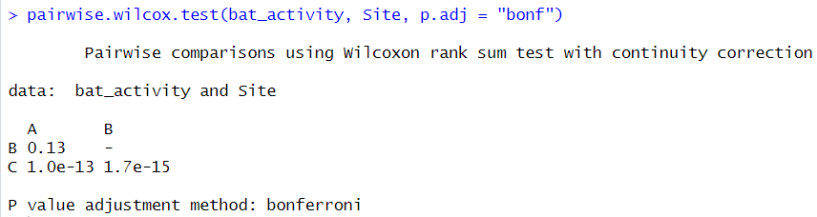
If our parametric assumptions had not been met:
Significant P-value = need to run a post-hoc test
A vs B (P=0.13)
A vs C (P<0.05)*
B vs C (P<0.05)*

Slide 26
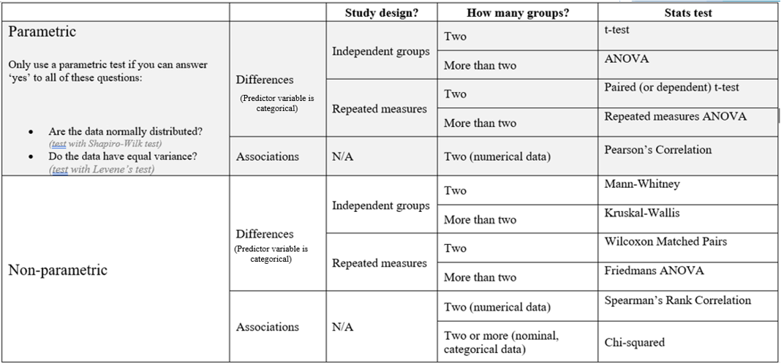
If significant…
Post-hoc Tukey
Post-hoc Tukey
Post-hoc Wilcoxon
Post-hoc Wilcoxon

Slide 27
Let’s work through an example

Slide 28
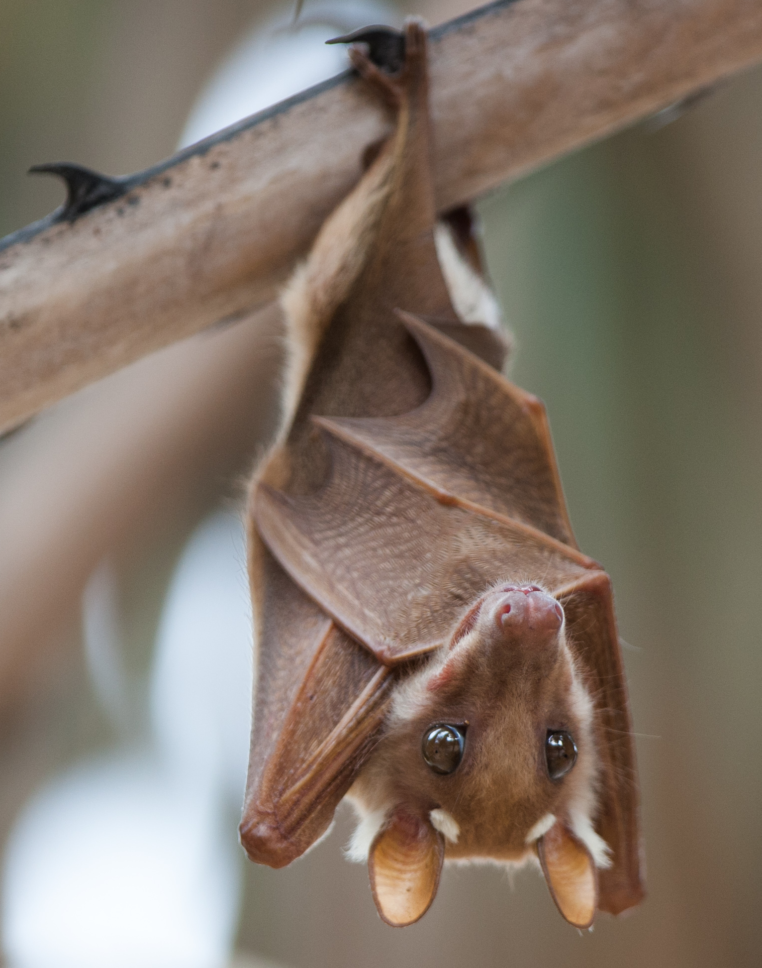
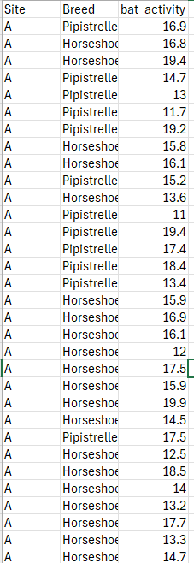
Bat data
Activity of 150 bats was recorded
Also recorded was:
  Species (Horseshoe or Pipistrelle)
  Site where bat was seen (A, B, C)
Null hypothesis 1:
There will be no significant difference in bat activity between bats of different species
Null hypothesis 2:
There will be no significant difference in bat activity between the three sites

Slide 29
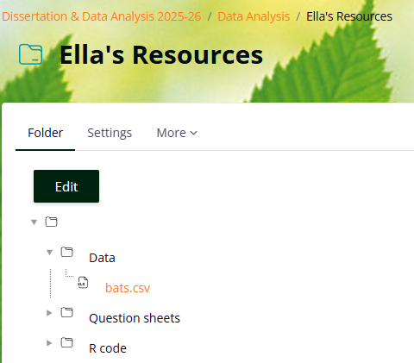

Slide 30
Null hypothesis 1:
There will be no significant difference in bat activity between bats of different species
Null hypothesis 2:
There will be no significant difference in bat activity between the three sites
Testing for…? | Study design | How many groups? | Inferential Test
Difference (independent variable is categorical) We want to see if the ‘independent’ influences the ‘dependent’ variable | Independent groups | Two | T-test or Mann-Whitney
 |  | More than two | ANOVA or Kruskal-Wallis
 | Repeated Measures | Two | Paired T-test or Wilcoxon
 |  | More than two | Repeated measures ANOVA or Friedman’s Test
Correlation (neither variable is categorical, both are numerical) We want to examine the relationship between two variables | - | - | Person's correlation or Spearman's correlation
Yellow = Parametric test
Pink = Non-parametric test

