Slide 1
AAB Data Analysis
Week 1

Slide 2
The Plan ☺
2 Dec.
Week 1: Choosing a test, R Studio Refresh, Two-Way Comparisons
9 Dec.
Week 2: Multiple comparisons and post-hoc tests
16 Dec.
Week 3: Correlation and Regression analysis

Slide 3
The purpose of statistics…

Slide 4
Choose a research area
Conclude study
Review existing literature
Discuss findings
Identify a specific research question/ generate hypothesis
The
Research Process
Analyse data / test hypothesis
(Inferential statistics)
Set project aims and objectives
Design methodology
Visualise data
(Descriptive statistics)
Pilot methodology (if appropriate)
Collect data

Slide 5
Hypotheses
Hypothesis = singular
Hypotheses = plural
These are a ‘statement’/ prediction made at the state of the project
They will be informed by your reading (you aren’t just making a random guess)

Slide 6
You will always write a ‘null hypothesis’ and an ‘alternative hypothesis’
Alternative hypothesis
H₁: The application of fertiliser will significantly increase plant growth rate.
Null hypothesis
H₀: The application of fertiliser will not significantly increase plant growth rate.
To test this hypothesis, what would you need to measure in your study? – Independent Variable? Dependent Variable?

Slide 7
You will always write a ‘null hypothesis’ and an ‘alternative hypothesis’
Alternative hypothesis
H₁: The application of fertiliser will significantly increase plant growth rate.
Null hypothesis
H₀: The application of fertiliser will not significantly increase plant growth rate.
To test this hypothesis, what would you need to measure in your study? – Independent Variable? Dependent Variable?

Slide 8
When you carry out research, you are trying to determine whether or not you can reject the null hypothesis!
How do you figure this out?
Collect relevant data to test your hypotheses

Slide 9
H₀: The application of fertiliser will not significantly increase plant growth rate
It looks like fertiliser has had an effect on our IV… but is this effect ‘significant’?

Slide 10
When you carry out research, you are trying to determine whether or not you can reject the null hypothesis!
How do you figure this out?
Collect relevant data to test your hypotheses
Use P-value to determine whether you should accept of reject null
Run inferential stats tests.

Slide 11
Inferential stats. tests give us P-values
P-value is less than 0.05
Result is significant
P-value is greater than 0.05
Result is NOT significant

Slide 12
P-value
This represents the likelihood that your result has come around by chance (not as a result of what you have changed).
H₀: The application of fertiliser will not significantly increase plant growth rate
Is fertiliser truly having an effect on grass growth – or could any increase in growth simply be due to chance?
5%
95%
0% likelihood that results were just chance. Very reliable. Highly significant finding.
0
1
100% likelihood that results were just chance. Very unreliable. Non-significant finding.
We only want to accept findings that fall in here (so that we are 95% confident that results were not just random chance)

Slide 13
You’ve been presented with some data. You’ve been told to analyse this… Where do you begin?

Slide 14

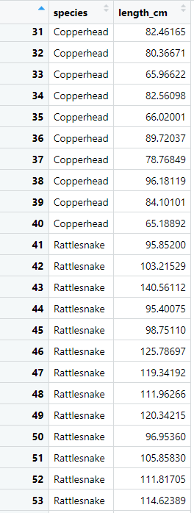
Snake example
Researchers found 80 snakes
Measured the length of each snake (cm)
Recorded the species (all either ‘Copperhead’ or ‘Rattlesnake’).
Research want to find out whether snake length is significantly different between these two species

Slide 15
Null hypothesis
H₀: There will be no significant difference in snake length between Copperheads and Rattle Snakes
Or
H₀: Species will not have a significant effect on snake length
Independent Variable? Dependent Variable?

Slide 16
Null hypothesis
H₀: There will be no significant difference in snake length between Copperheads and Rattle Snakes
Or
H₀: Species will not have a significant effect on snake length
Independent Variable? Dependent Variable?

Slide 17
Null hypothesis
H₀: Species will not have a significant effect on snake length
Collect relevant data to test your hypotheses
Run inferential stats tests.

Slide 18
Choosing an appropriate inferential stats. test
“t” test
ANOVA
Friedman
Tests
Chi-squared
GLM
General Linear Modelling
There are lots of different statistical tests available.
Each test is designed to work in a specific situation (depends on type of data, study design, study aim, etc.)
You need to decide which one is most appropriate for a given study….
Pearson’s
correlation
Mann Whitney
Wilcoxon
Kruskal Wallis
Spearman’s
correlation

Slide 19
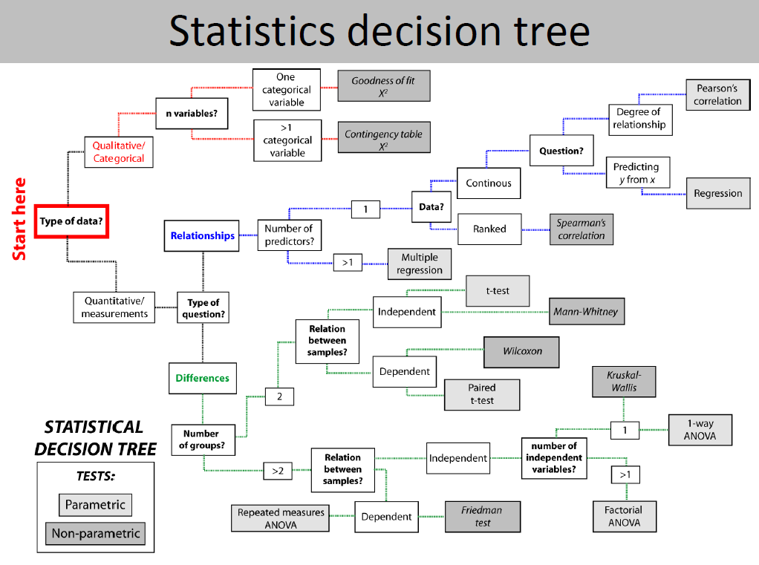

Slide 20
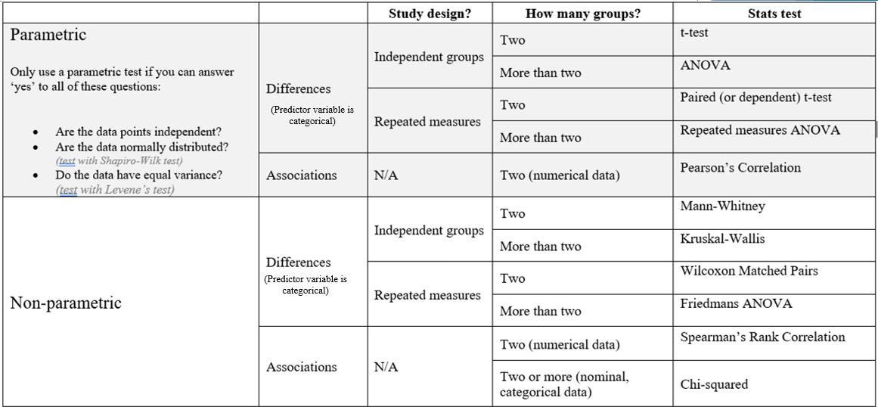

Slide 21
Testing for…? | Study design | How many groups? | Inferential Test
Difference (independent variable is categorical) We want to see if the ‘independent’ influences the ‘dependent’ variable | Independent groups | Two | T-test or Mann-Whitney
 |  | More than two | ANOVA or Kruskal-Wallis
 | Repeated Measures | Two | Paired T-test or Wilcoxon
 |  | More than two | Repeated measures ANOVA or Friedman’s Test
Correlation (neither variable is categorical, both are numerical) We want to examine the relationship between two variables | - | - | Person's correlation or Spearman's correlation
Yellow = Parametric test
Pink = Non-parametric test

Slide 22
Questions you must ask when choosing an inferential test:
Am I testing for a ‘difference’ (i.e. an effect of a categorical variable) or an ‘association’ between variables?
Was a ‘repeated measures’ or an ‘independent groups’ study design followed?
How many ‘groups’ within my predictor variable?
Does the data I’ve collected meet all of the parametric assumptions?

Slide 23
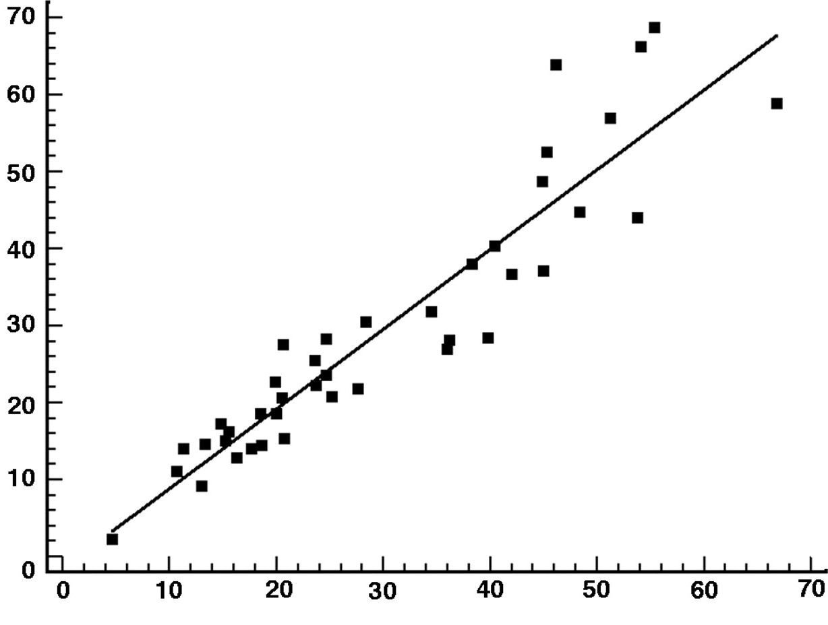
Testing for a difference between categories
Independent variable is categorical
Am I testing for a ‘difference’ (i.e. an effect of a categorical variable) or an ‘association’ between variables?
Two numerical (‘continuous’) variables
Testing for an association between variables

Slide 24

Questions you have to ask when choosing an inferential test
Am I testing for a ‘difference’ (i.e. an effect of a categorical variable) or an ‘association’ between variables?
Was a ‘repeated measures’ or an ‘independent groups’ study design followed?
How many ‘groups’ within my predictor variable?
Does the numerical data I’ve collected meet all of the parametric assumptions?

Slide 25
Questions you have to ask when choosing an inferential test
Was a ‘repeated measures’ or an ‘independent groups’ study design followed?

Slide 26

Study design
Imagine we’re studying the effect of caffeine on activity levels children (not a real study! Not ethical??)
We’ve got a sample of 32 children.
There are two ways we could design this study
32 children
Repeated measures design
Given caffeine drink (n=16)
Given non-caffeine drink (n=16)
32 children
Measure activity level of children
Measure activity level of children
Given caffeine drink (n=16)
Given non-caffeine drink (n=16)
Given non-caffeine drink (n=16)
Given caffeine drink (n=16)
Measure activity level of children
Measure activity level of children
Measure activity level of children
Measure activity level of children
Independent group design

Slide 27
Independent groups
Repeated measures
The sample is split into groups. Each group only experiences one treatment conditions
All participants in the sample experience all treatment conditions

Slide 28
Questions you have to ask when choosing an inferential test
Am I testing for a ‘difference’ (i.e. an effect of a categorical variable) or an ‘association’ between variables?
Was a ‘repeated measures’ or an ‘independent groups’ study design followed?
How many ‘groups’ within my predictor variable?
Does the numerical data I’ve collected meet all of the parametric assumptions?

Slide 29

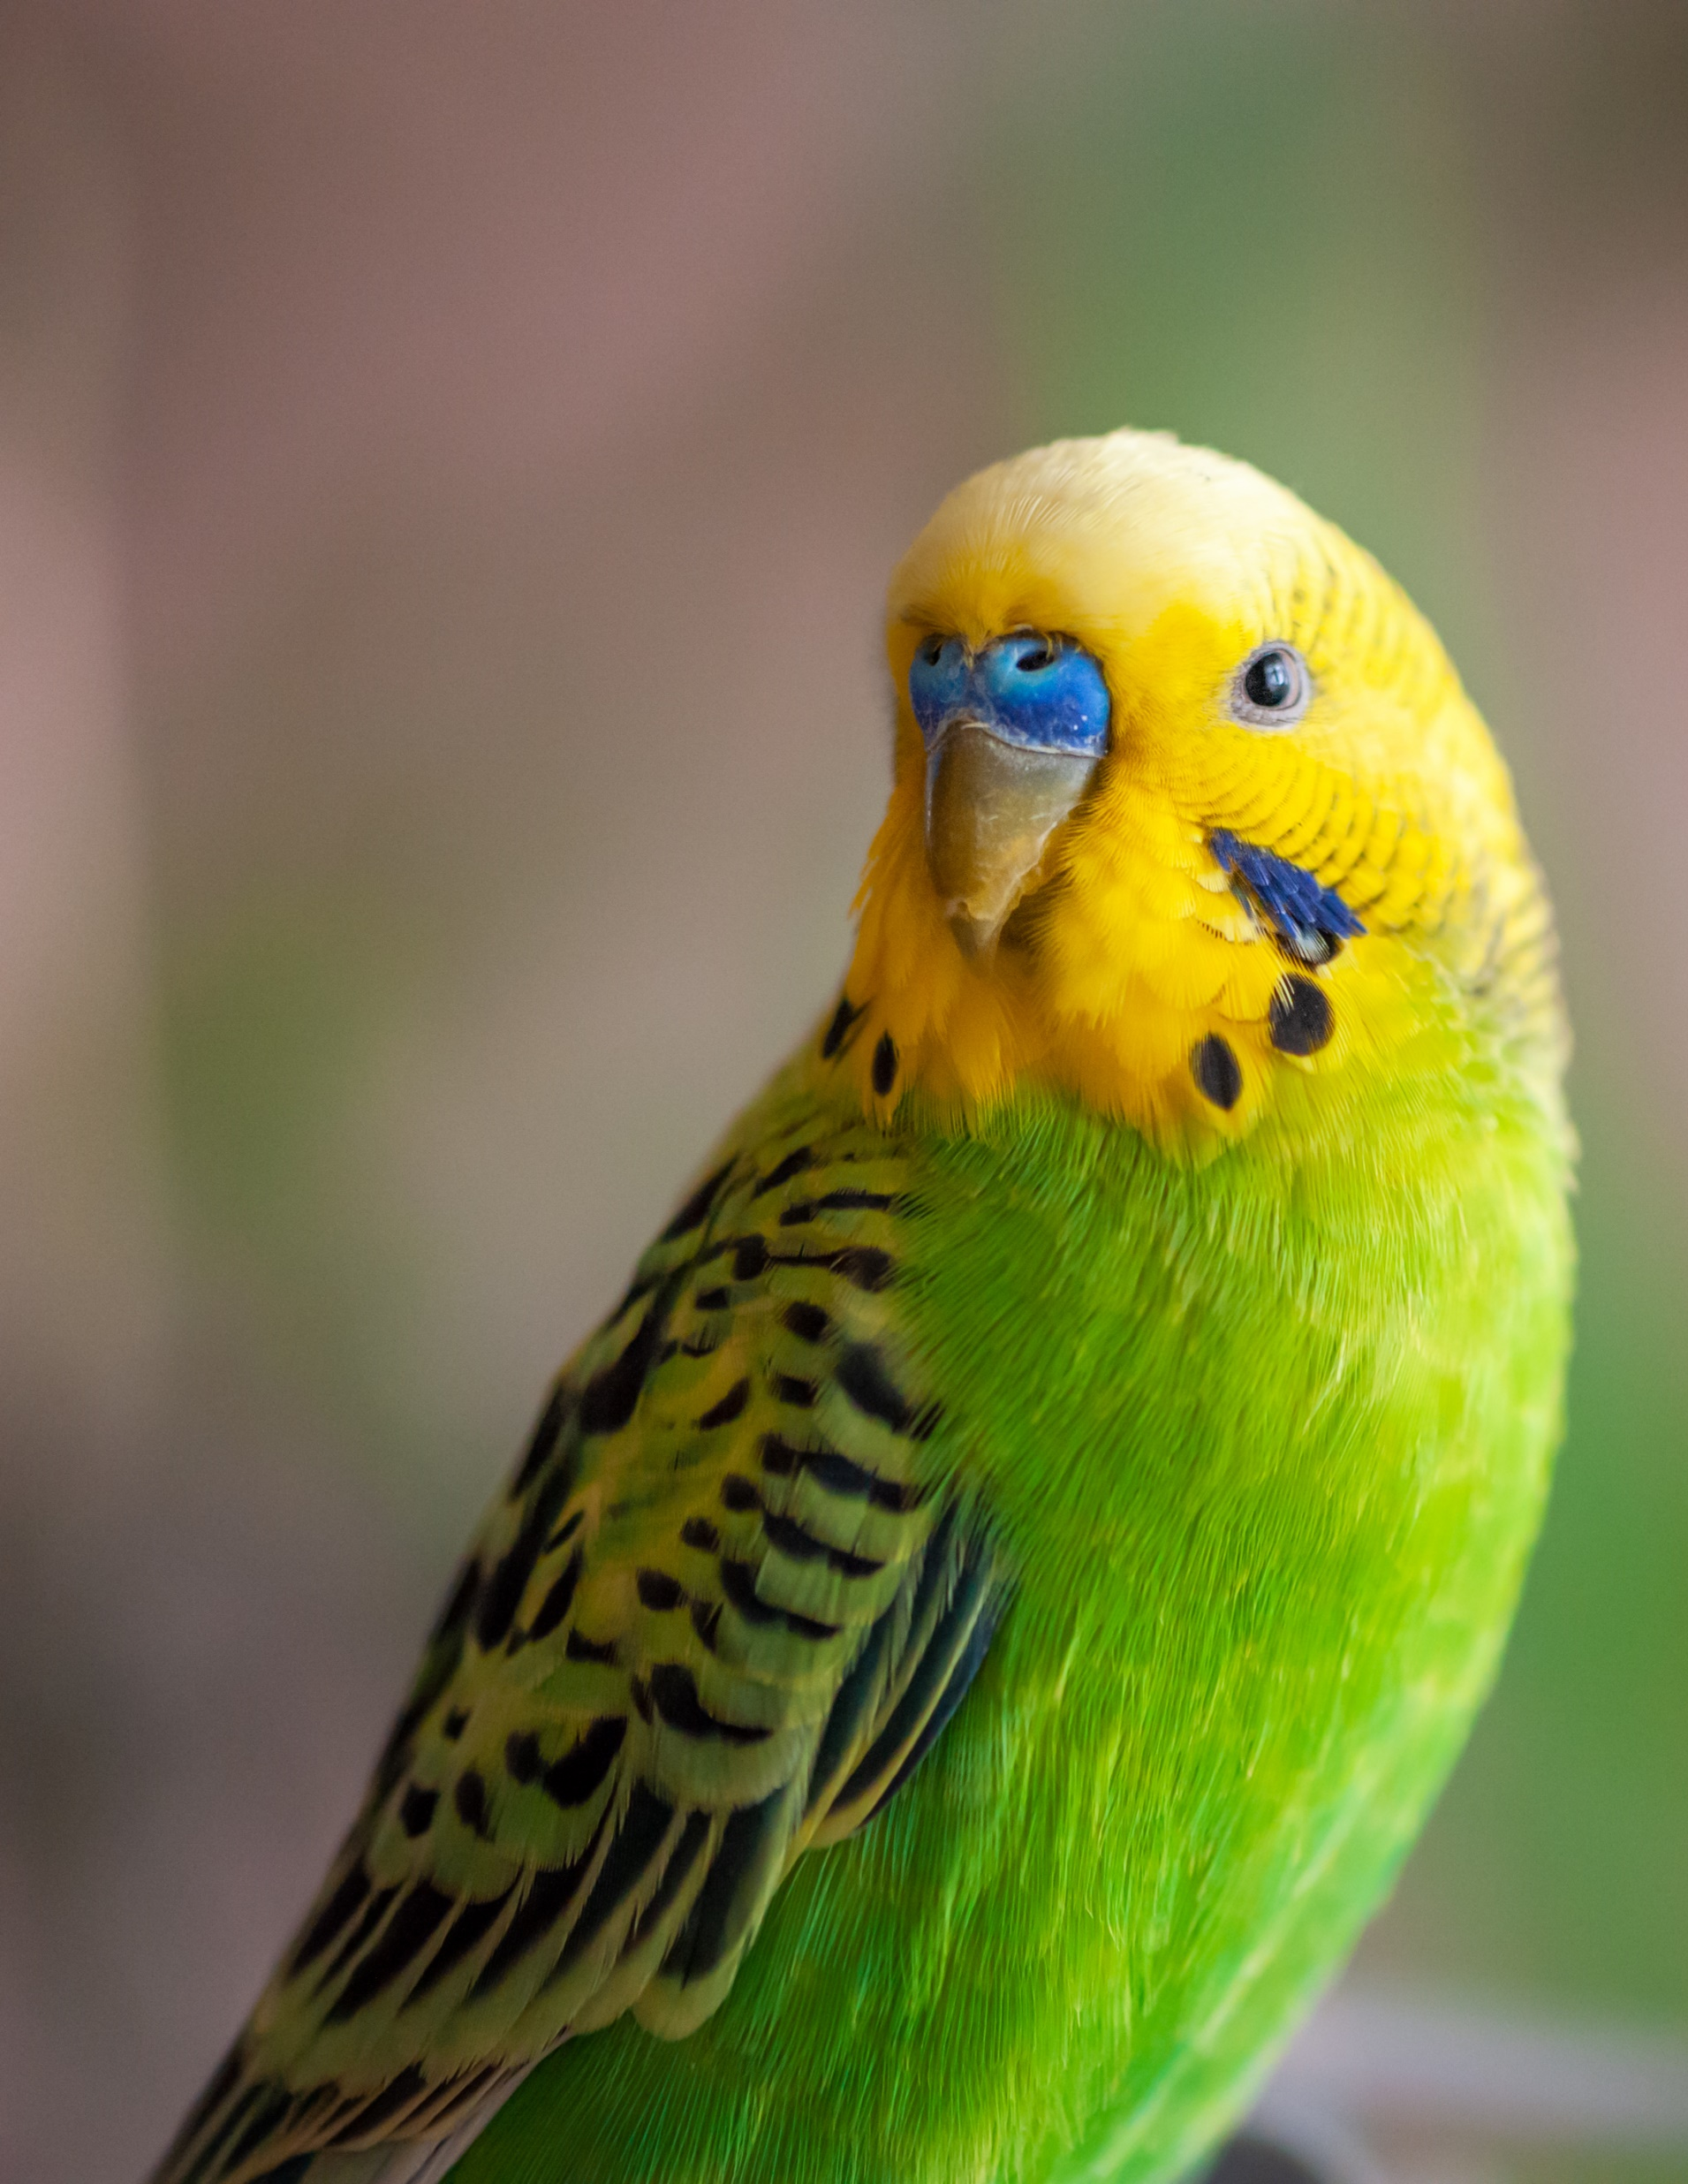
How many ‘groups’ within my predictor variable?
How many categories are you asking the stats. test to compare?
Before joint supplement
PV = Joint supplement
After joint supplement
High oil (30% of total diet)
Low oil (10% of total diet)
No oil (0% of total diet)
PV = % oil in diet

Slide 30
Questions you have to ask when choosing an inferential test
Am I testing for a ‘difference’ (i.e. an effect of a categorical variable) or an ‘association’ between variables?
Was a ‘repeated measures’ or an ‘independent groups’ study design followed?
How many ‘groups’ within my predictor variable?
Does the numerical data I’ve collected meet all of the parametric assumptions?

Slide 31
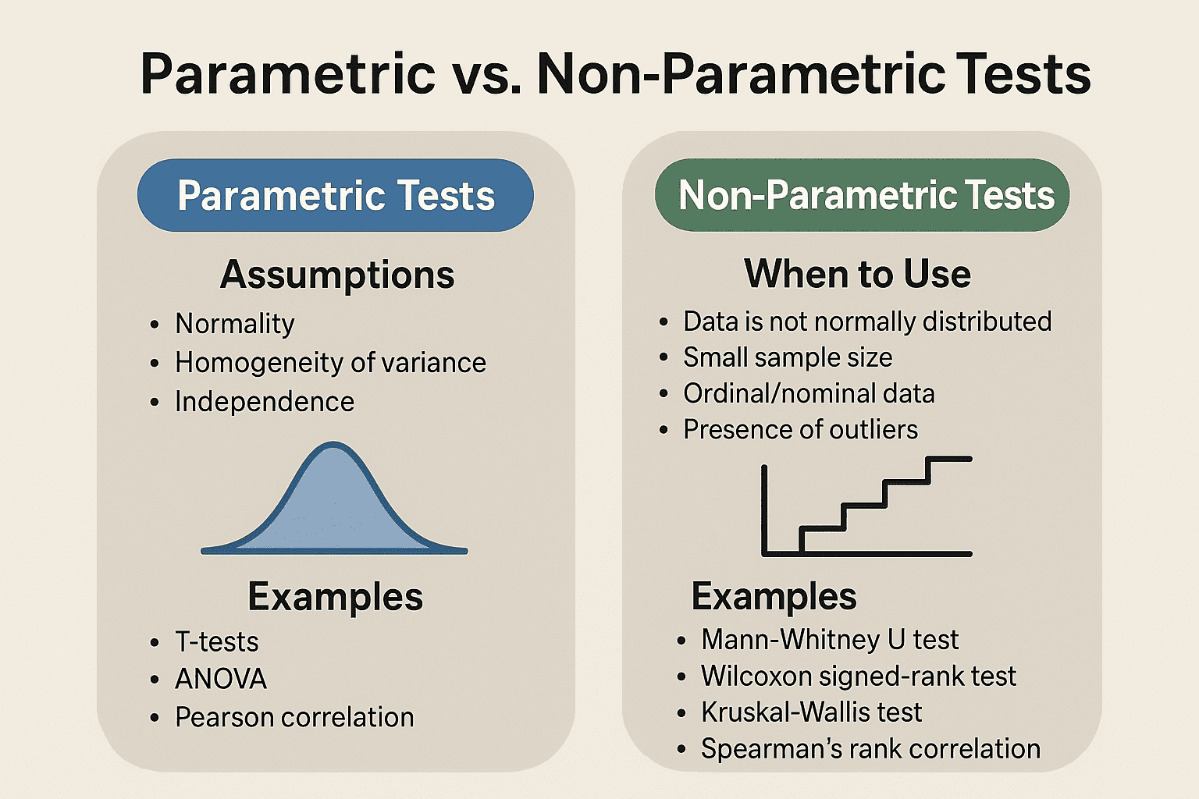
Parametric tests are more statistically powerful, but they make specific assumptions about the data.
Certain assumptions need to be met for the test to work.
Parametric tests use population parameters like the mean and standard deviation in their calculations.
Non-parametric tests can be used when parametric assumptions are not met by the data you are testing.
These use compare medians (rather than means)

Slide 32
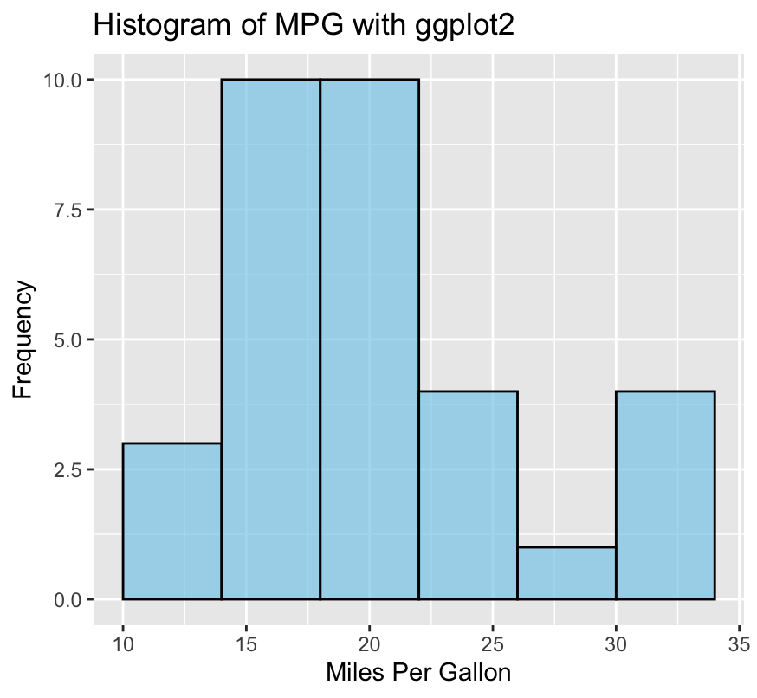
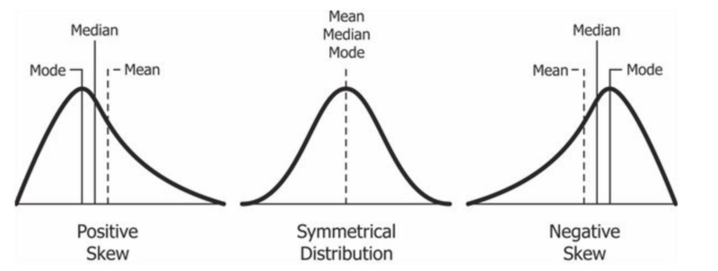

Check distribution by creating a histogram
But this can be subjective
hist(data)

Slide 33
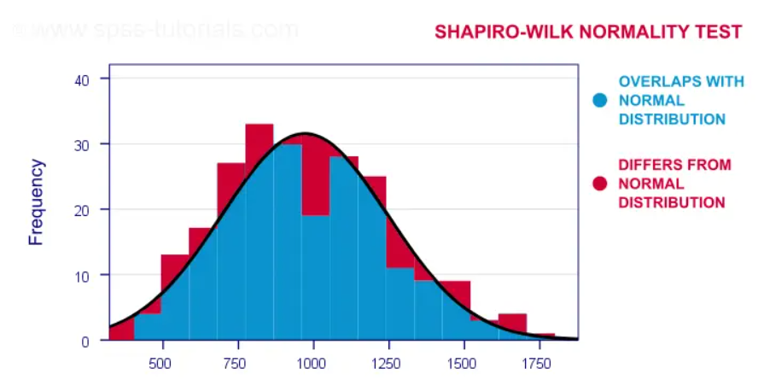
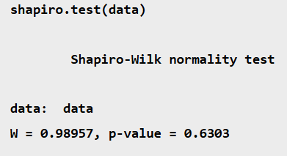
Test normality using a Shapiro-wilk test in R
P<0.05 = Not normal P>0.05 = Normal distribution

Slide 34
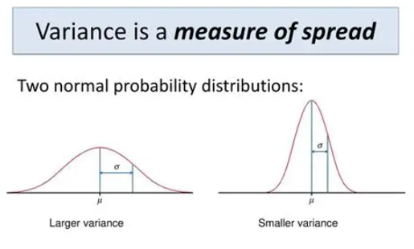
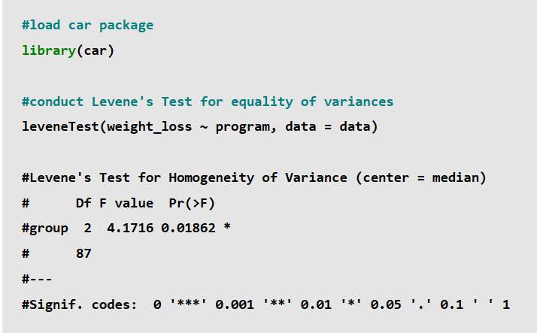
Testing for equal variance
Unnecessary if using a repeated measures study design
P<0.05 = Variance is not equal
P>0.05 = Equal Variance

Slide 35
Questions you have to ask when choosing an inferential test
Am I testing for a ‘difference’ (i.e. an effect of a categorical variable) or an ‘association’ between variables?
Was a ‘repeated measures’ or an ‘independent groups’ study design followed?
How many ‘groups’ within my predictor variable?
Does the numerical data I’ve collected meet all of the parametric assumptions?

Slide 36
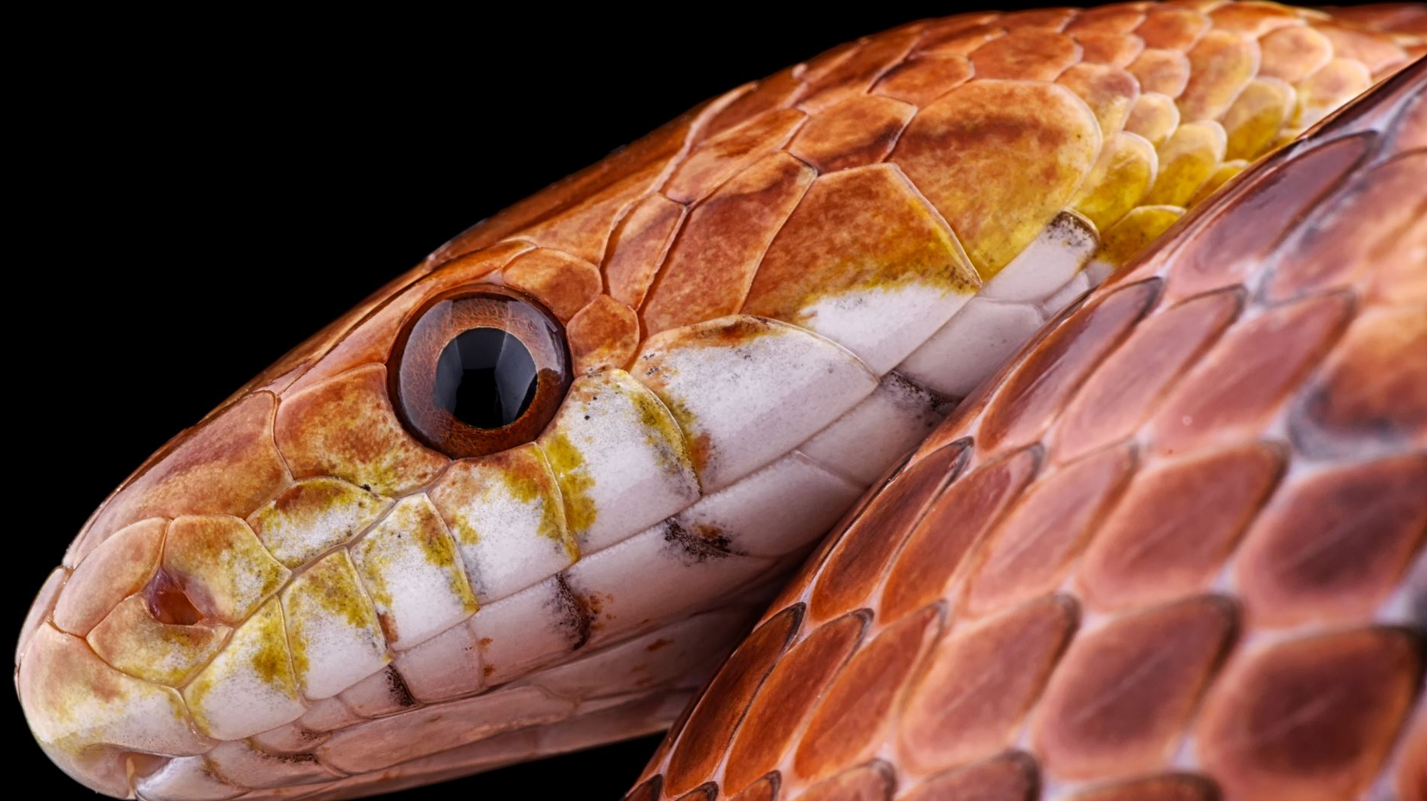
Back to our snake example

Slide 37
Snake example
Researchers found 80 snakes
Measured the length of each snake (cm)
Recorded the species (all either ‘Copperhead’ or ‘Rattlesnake’.
Research want to find out whether snake length is significantly different between these two species

Slide 38
Testing for…? | Study design | How many groups? | Inferential Test
Difference (predictor variable is categorical) We want to see if the ‘predictor’ influences the ‘outcome’ variable | Independent groups | Two | T-test or Mann-Whitney
 |  | More than two | ANOVA or Kruskal-Wallis
 | Repeated Measures | Two | Paired T-test or Wilcoxon
 |  | More than two | Repeated measures ANOVA or Friedman’s Test
Correlation (neither variable is categorical, both are numerical) We want to examine the relationship between two variables | - | - | Person's correlation or Spearman's correlation
Yellow = Parametric test
Pink = Non-parametric test

Slide 39
Parametric or non-parametric?
Load data into R studio
Use Shapiro Wilk test to check distribution of dependent variable data
(split this by independent categories where possible)
P-value greater than 0.05
(normal distribution)
P-value less than 0.05
(distribution not normal)
Use a NON- parametric test
Does this study follow a repeated measures design?
Run Levene’s test to check for equal variance
Yes
(assume equal variance)
No
Use a parametric test
P-value greater than 0.05
(Equal Variance)
P-value less than 0.05
(Variance not equal)

Slide 40

Different tests can be run using different codes in R studio
To simplify this, I’m in the process of creating ‘r code guides’ for each test.
Find these on Ledge:
Inferential statistical tests
T-test | t.test(body_mass_g~sex)
Mann-Whitney | wilcox.test(body_mass~sex)
ANOVA | anova_model <- aov(weight_loss~program) summary(anova_model)
Kruskal-Wallis | kruskal.test(weight_loss~program)
Paired t-test | t.test(Before, After, paired = TRUE)
Wilcoxon | wilcox.test(Before, After, paired = TRUE)
Person’s correlation | cor.test(wing, weight)
Spearman’s correlation | cor.test(wing, weight, method = "spearman")

Slide 42
Tasks
Complete ‘Snake’ worksheet
Complete ‘Deer’ worksheet
I will upload a version of each sheet complete with answers onto Ledge.
Check your own work against these.
Contact me if you have any questions (ella.bartlett@sparsholt.ac.uk )

