Slide 1

Two-way comparisons & correlations
Lesson 4
(Equine & Ag)
Ella Bartlett
(ella.bartlett@sparsholt.ac.uk)

Slide 2
Today
Recap. Steps to choose a test
Discuss two-way comparison tests
Practice uploading data to r Studio, testing parametric assumptions and running two-way tests
Coffee Break
Correlations
Running correlations in r studio

Slide 3
Load relevant data in r Studio
Test to see if data are normally distributed (Shapiro Wilk)
If study follows an independent group design, check for equal variance (Levene’s test)
Select & run appropriate test
Write up results

Slide 4
Let’s work through an example together
Time for you to open up r studio and have a play ☺

Slide 5
Does feeding a magnesium supplement promote weight loss in horses?
8 horses
All weighed at start
Magnesium supplement (n=4)
Limestone flour
(n=4)
Horses receive treatments daily for six months
All weighed at end

Slide 6
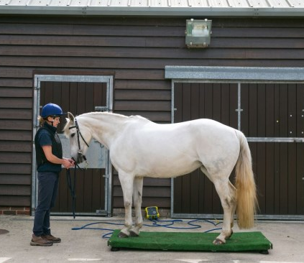
Null hypothesis: supplementing horses' diets with magnesium will not significantly increase weight loss over a six-month period
Download and open ‘horse weight’ data

Slide 7

Task
Identify predictor and outcome variables
Format data in excel
Choose an appropriate stats. test to test the study hypothesis
Run test in r Studio
Determine whether the null hypothesis should be accepted or rejected
Notes:
data<-horse_weight
attach(data)
shapiro.test(weight_loss)
library(car)
leveneTest(weight_loss~supplement)
t.test(weight_loss~supplement)
boxplot(weight_loss~supplement, col="lightblue")
cor.test(age,weight_loss)
plot(age,weight_loss)

Slide 8

Two-way comparison tests

Slide 9
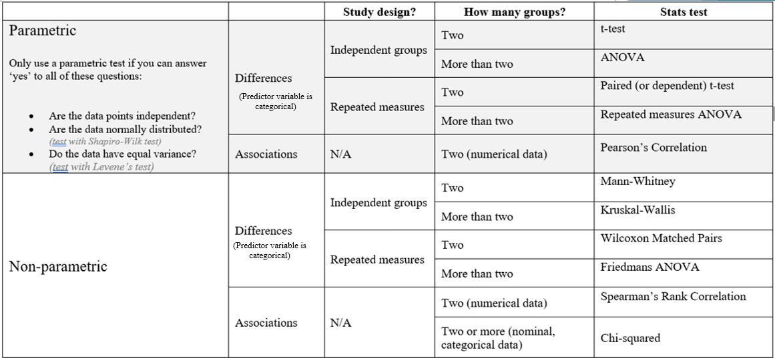
Two-way comparison tests

Slide 10
Two-way comparison tests

Slide 11
Two-way comparison tests
t.test(outcome variable~predictor variable)
t.test(X, Y, paired=TRUE)
wilcox.test(outcome variable~predictor variable)
wilcox.test(X, Y, paired=TRUE)

Slide 12
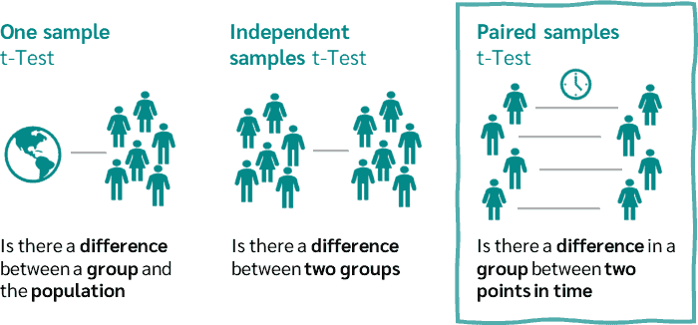
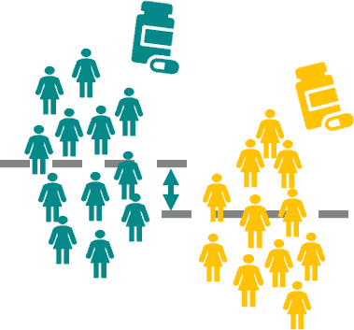
Compared each individual’s score in one condition with that same individuals score in the other condition
Compared the average score of one group with the average score of another group

Slide 13

Example question
Question: Do calming tablets reduce anxiety related behaviour in cats?
Null Hypothesis: Giving cats a calming tablet will not significantly alter the amount of time they spend performing anxiety behaviour.
In this study, 15 cats were given a ‘calming tablet’. The amount of time they spent performing
The amount of time they spent performing anxiety related behaviour (minutes) was measured before and after the tablet was given.

Slide 14
Task
Cat ID | Before treatment | After treatment
1 | 3.33 | 0.27
2 | 3.67 | 0.59
3 | 2.67 | 0.32
4 | 3.33 | 0.19
5 | 3.33 | 1.26
6 | 3.67 | 0.11
7 | 4.67 | 0.3
8 | 2.67 | 0.4
9 | 6 | 1.59
10 | 4.33 | 0.6
11 | 3.33 | 0.65
12 | 0.67 | 0.69
13 | 1.33 | 1.26
14 | 0.33 | 0.23
15 | 2 | 0.38
Download and save (as csv. file) ‘catstress’ data
Choose and run an appropriate test to determine whether or not the null hypothesis should be accepted or rejected
Null Hypothesis: Giving cats a calming tablet will not significantly alter the amount of time they spend performing anxiety behaviour.

Slide 15

Testing for correlation

Slide 16
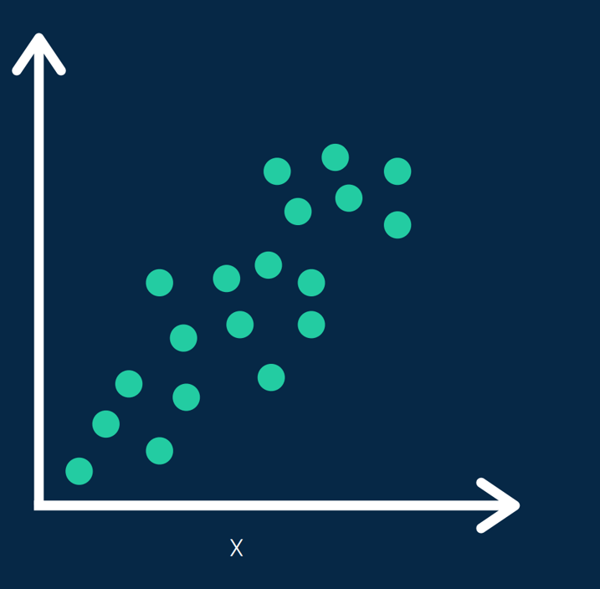
Correlation
A statistical measure that describes the extent to which two or more variables are related to one another.
It indicates how changes in one variable are associated with changes in another variable

Slide 17
Interpreting a correlation
When you run a correlation test in JASP, you will get a P-value and an r-value
P-value : tells you if your result is significant (how much we trust that a correlation between two variables exists)
r-value : tells you how strong the correlation between two variables is.

Slide 18
Interpreting a correlation
r-values run on a scale from -1 to 1
If the number is greater than zero = positive correlation
If the number is less than zero = negative correlation
-1
0
1
Strong negative correlation
No correlation
Strong positive correlation

Slide 19
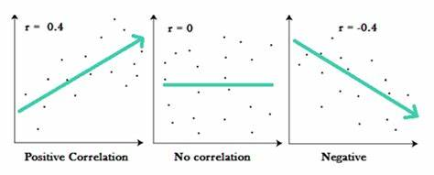
Interpreting a correlation
Positive correlation means when ‘variable 1’ increases, so does ‘variable 2’
Negative correlation means when ‘variable 1’ increases, ‘variable 2’ decreases

Slide 20
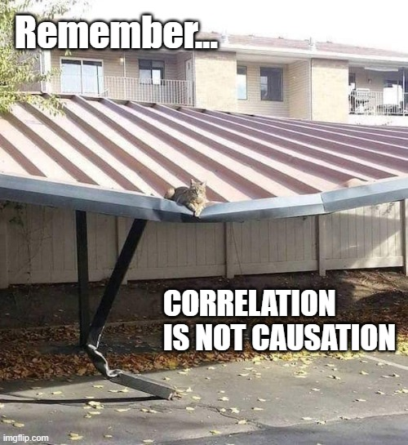
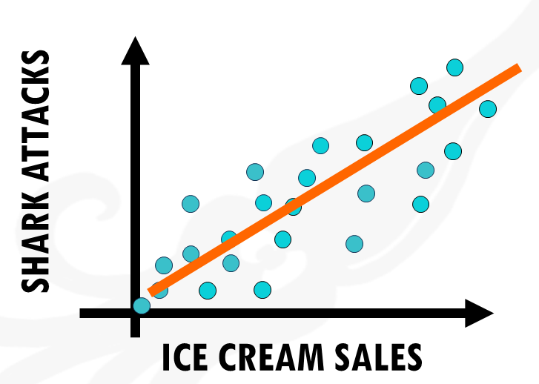

Slide 21
Example question
Question: Does missing lectures affect your final grade?
Null Hypothesis: There will be no significant relationship between ‘number of lectures missed’ and a students ‘Final BSc grade’.

Slide 22
Student | Number of lectures missed | Final BSc grade
1 | 0 | 70
2 | 1 | 68
3 | 2 | 64
4 | 2 | 58
5 | 4 | 58
6 | 0 | 88
7 | 6 | 52
8 | 10 | 40
9 | 5 | 48
10 | 1 | 66
11 | 0 | 80
12 | 2 | 65
13 | 1 | 78
14 | 11 | 38
15 | 9 | 37
16 | 8 | 43
17 | 3 | 62
18 | 2 | 65
19 | 7 | 55
20 | 5 | 50
20 students in the sample.
The number of lectures that they missed during their 3rd year was recorded.
Their finals grade for the year was also noted.
This is how you need to set out your data in excel for a correlation
We want our statistical test to determine whether there is a significant correlation between ‘number of lectures missed’ and ‘Final BSc grade’
i.e. we want to see if one affects the other

Slide 23
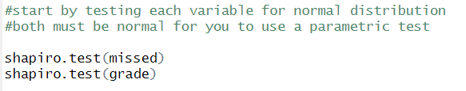
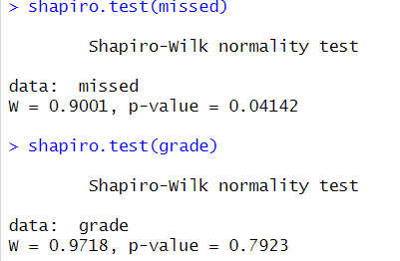

Slide 24

Variable 1
Variable 2
Parametric
cor.test(x, y, method = "pearson")
cor.test(x, y, method = "spearman")
Non-parametric

Slide 25

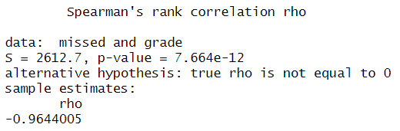
P-value
r-value

Slide 26
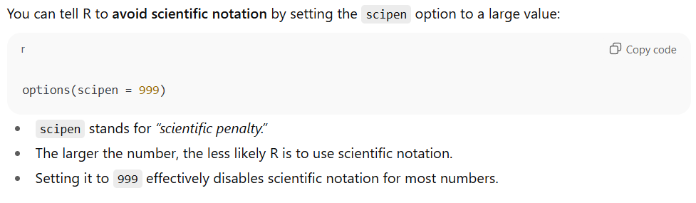
P-value has been written using scientific notation (as it’s very small)
0.000000000007664
Notes:
Scientific notation

Slide 27
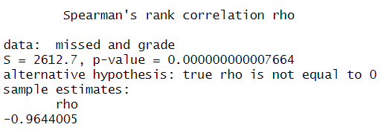
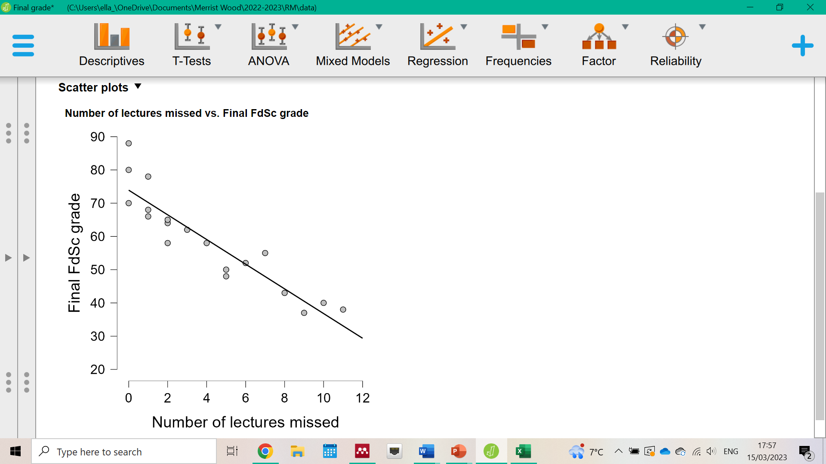
‘The results show that there is a significant negative correlation between ‘number of lectures missed’ and a students ‘final BSc grade’ (r=-0.964, P<0.001)’
This means that when the number of lectures missed increases, student final grade decreases!

Slide 28
Final Task
Back to ‘horse weight’ data
Run an appropriate test in r Studio to determine whether an association (correlation) exists between horse ‘age’ and ‘starting weight’
Notes:
data<-horse_weight
attach(data)
shapiro.test(weight_loss)
library(car)
leveneTest(weight_loss~supplement)
t.test(weight_loss~supplement)
boxplot(weight_loss~supplement, col="lightblue")
cor.test(age,weight_loss)
plot(age,weight_loss)

