Slide 1

Writing up findings

Slide 2
Use the following slides as a guide to help you write up your results (after running appropriate statistical test)
REMEMBER
Parametric tests use the mean as a measure of central tendency
Non-parametric tests use the median

Slide 3
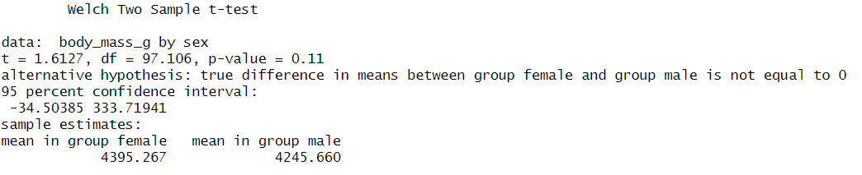
Two sample T test
“There was [no / a] significant difference between the [dependent variable] at [independent variable group 1] (mean = …, SD = …) and [group 2] (mean = …, SD = …) (t= …; df=; P[</=] …).”
e.g. There was no significant difference in the body mass of penguins that were male (mean = 4245.66, SD =450.41) and female (mean = 4395.27, SD = 476.19 grams) (t= 1.6127; df=97.106; P=0.11).

Slide 4
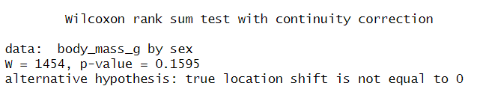
Mann-Whitney
“There was [no / a] significant difference between the [dependent variable] at [independent variable group 1] (median = …) and [group 2] (median = …) (W = …; P[</=] …).”
e.g. There was no significant difference between the body weights (in grams) of penguins that were male (median = 4210) and female (median = 4328) (W =1454; P=0.1595).

Slide 5
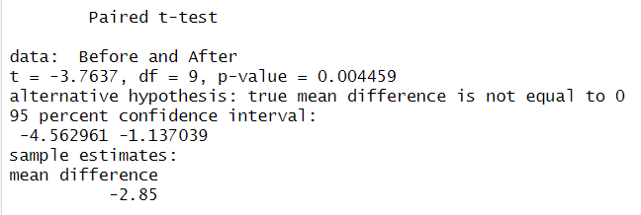
Paired T tests
“There was [no / a] significant difference between the [dependent variable] at [independent variable level 1] (mean = …, sd = …) and [level 2] (mean = …, SD = …) (t(df) = …; P[</=] …).” *Remember to state the direction of the difference when it is significant.
e.g. The mean test score was significantly lower before (mean = 50.53; sd= 4.14) compared to after (mean = 53.38; sd= 4.63) (t= -3.76; sd= 9; P= 0.0045).

Slide 6
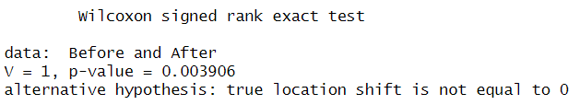
Wilcoxon test
“There was [no difference / a significant median increase/decrease] (median difference = …) in the [Response variable] from [Predictor level 1] to [level 2], W = …; P[</=] ….”
e.g. There was a statistically significant median decrease (median difference = -2.15) in scores from ‘before’ to ‘after’ (W = 1.00; P=0.0039).”

Slide 7
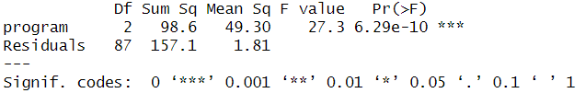
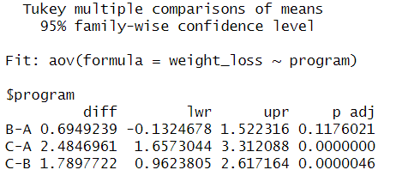
ANOVA
“There was [no / a significant] effect of [independent variable] on [dependent variable] (F=; df=; P[</=] ….”
e.g. There was a statistically significant effect of treatment program on participant weightloss (F= 27.2; df=2; P<0.001).
Post-hoc tests identified that participants on ‘program C’ (mean= xx, SD=xx) lost significantly more weight than those of ‘program A’ (mean=xx, SD= xx) or ‘B’ (mean= xx, SD= xx).

Slide 8

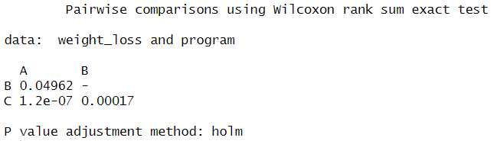
Kruskal wallis
“There was [no / a significant] effect of [independent variable] on [dependent variable] (H=; df= …; P[</=] ….”
e.g. There was a significant effect of program on weightloss (H= 29.681; df=2; P<0.001).
Post-hoc tests identified that participants on ‘program C’ (mean= xx, SD=xx) lost significantly more weight than those of ‘program A’ (mean=xx, SD= xx) or ‘B’ (mean= xx, SD= xx).

Slide 9
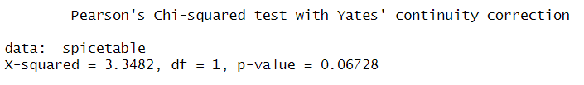
Chi-squared (Test of Independence)
A chi-squared test was run to determine whether there was significant association between participants gender and whether they like or dislike spicy food. The test identified no significant association between these variables (X²= 3.3482, df = 1, P=0.06728).

Slide 10
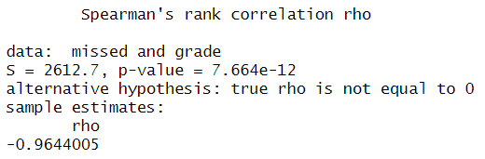
Correlation
‘The results show that there is a significant negative correlation between ‘number of lectures missed’ and a students ‘final BSc grade’ (r=-0.964, P<0.001)’

