Slide 1

End of term revision session
17th Dec. 2025

Slide 2
Yellow = Parametric test Pink = Non-parametric test
Testing for…? | Study design | How many levels in PV? | Inferential Test
Difference (predictor/ independent variable is categorical) We want to see if the ‘predictor’ influences the ‘outcome’ variable | Independent groups | Two | T-test or Mann-Whitney
 |  | More than two | ANOVA or Kruskal-Wallis
 | Repeated Measures | Two | Paired T-test or Wilcoxon
 |  | More than two | Repeated measures ANOVA or Friedman’s Test

Slide 3
Yellow = Parametric test Pink = Non-parametric test
Testing for…? | Study design | How many levels in PV? | Inferential Test
Difference (predictor/ independent variable is categorical) We want to see if the ‘predictor’ influences the ‘outcome’ variable | Independent groups | Two | T-test or Mann-Whitney
 |  | More than two | ANOVA or Kruskal-Wallis
 | Repeated Measures | Two | Paired T-test or Wilcoxon
 |  | More than two | Repeated measures ANOVA or Friedman’s Test
Correlation (neither variable is categorical, two numerical variables) We want to examine the relationship between variables | - | - | Person's correlation or Spearman's correlation

Slide 4
Yellow = Parametric test Pink = Non-parametric test
Testing for…? | Study design | How many levels in PV? | Inferential Test
Difference (predictor/ independent variable is categorical) We want to see if the ‘predictor’ influences the ‘outcome’ variable | Independent groups | Two | T-test or Mann-Whitney
 |  | More than two | ANOVA or Kruskal-Wallis
 | Repeated Measures | Two | Paired T-test or Wilcoxon
 |  | More than two | Repeated measures ANOVA or Friedman’s Test
Correlation (neither variable is categorical, two numerical variables) We want to examine the relationship between variables | - | - | Person's correlation or Spearman's correlation
Chi-squared (Working with only nominal data - words) We want to examine the relationship between variables | - | - | Chi-squared (Test of Independence)

Slide 5
Yellow = Parametric test Pink = Non-parametric test
Testing for…? | Study design | How many levels in PV? | Inferential Test
Difference (predictor variable is categorical) We want to see if the ‘predictor’ influences the ‘outcome’ variable | Independent groups | Two | T-test or Mann-Whitney
 |  | More than two | ANOVA or Kruskal-Wallis
 | Repeated Measures | Two | Paired T-test or Wilcoxon
 |  | More than two | Repeated measures ANOVA or Friedman’s Test
Correlation (neither variable is categorical, two numerical variables) We want to examine the relationship between variables | - | - | Person's correlation or Spearman's correlation
Chi-squared (Working with only nominal data - words) We want to examine the relationship between variables | - | - | Chi-squared analysis
Regression (Working with numerical and/or nominal data variables) We want to see if we can use one (or more) variable/s to predict an outcome variable | - | - | Linear Regression (if using ONE variable to predict another – assuming linear relationship) Multiple Regression (if using MORE THAN ONE variable to predict another)

Slide 6
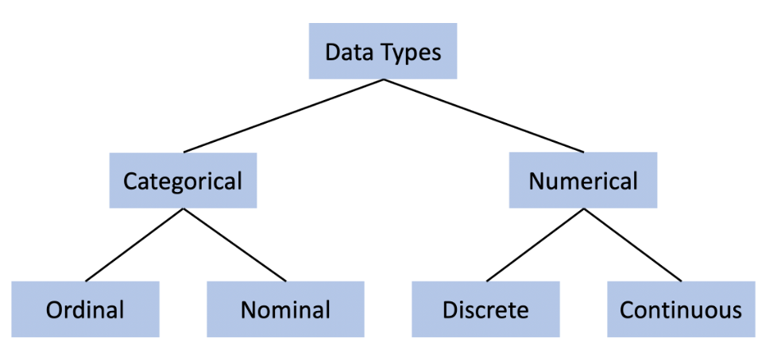
- Words
- Numbers
Words (can be put in order)
Words (no order)
Whole numbers
Numbers that can be further broken down into smaller units

Slide 7

‘What will I need to know for the exam’?

Slide 8
To prepare for exam –
When you are given data, ensure you are able to:
Outline the characteristics of your data
  Data types of variables?
  what is the outcome variable?
  What is the predictor variable(s)?
  If categorical, how many levels are the within the predictor variable?
Present descriptive statistics for numerical variables:
  Calculate Mean, Median, etc.
  Comment on normality
  Comment on variance between groups
Choose and run an appropriate inferential statistical test on your data
Present the results of the test in the appropriate format for a journal article – including written format and graph(s).

Slide 9
What are you allowed to bring into the exam?
USB drive including RStudio files with script to run statistical tests
A flow diagram/schematic on how to choose a stats test

Slide 10
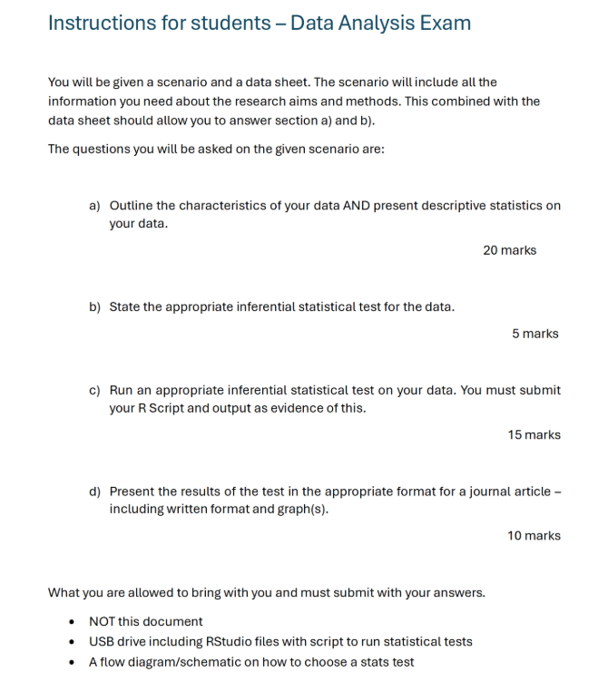

Slide 11
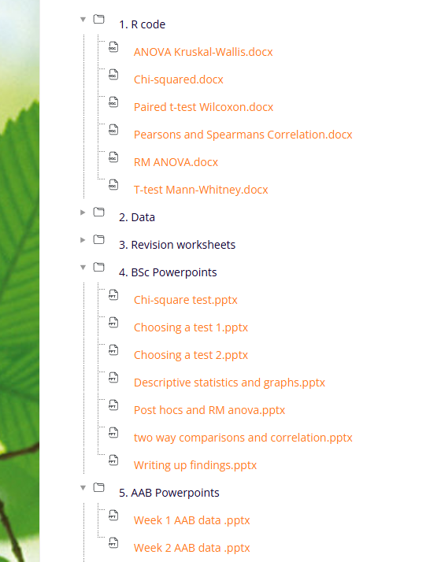

Writing up findings

Slide 12
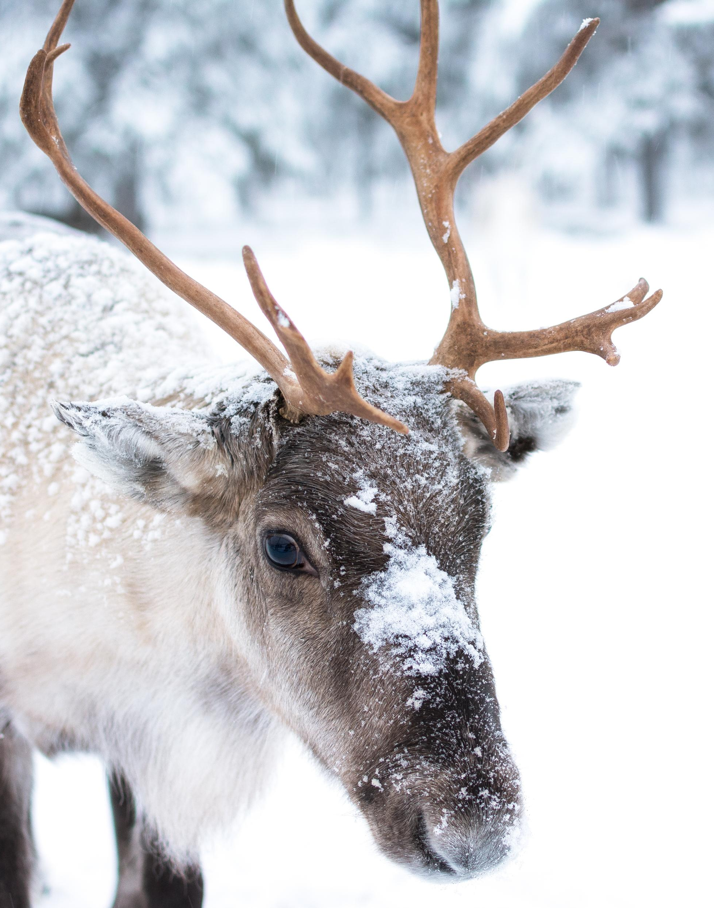
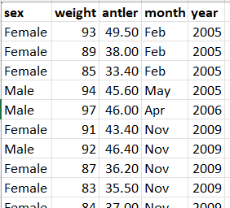
Scenario
As part of a long-term ecological monitoring project, researchers collected morphometric data from reindeer captured at a field site in the North pole over multiple months and years.
Information about each individual was recorded.
The dataset provided to you contains the following variables:
sex – sex of the reindeer (male or female)
antler – antler length measured in centimetres (cm)
weight – body mass measured in kilograms (kg)
month – month in which the reindeer was captured
year – year in which the reindeer was captured

Slide 13
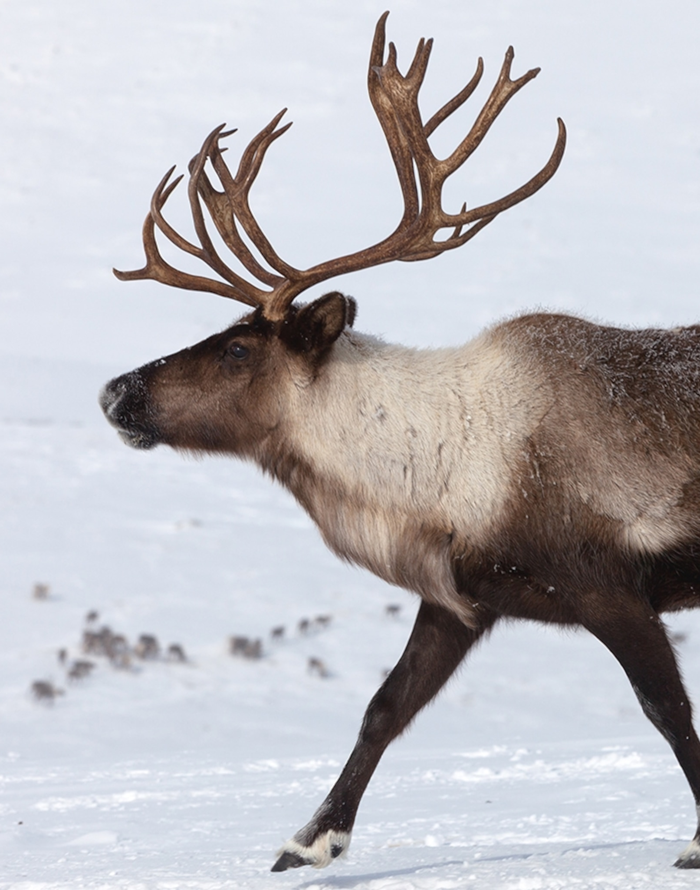
Use the ‘reindeer’ data on ledge to answer the following
For each question, explain your choice of test, write out your results and present them in a graph.
1) Does antler length differ between male and female reindeer?
2) Is there a significant effect of month of capture on antler length of reindeer?
3) Is there a significant relationship between reindeer weight and antler length?

