Slide 4
Last week we covered…

Slide 5
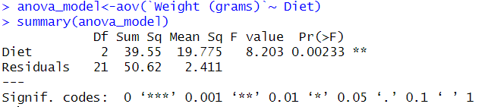
Run a one-way ANOVA

Slide 6
Which of these three treatments are significantly different from each other?
Flies vs crickets = ?
Flies vs mealworms = ?
Crickets vs mealworms = ?

Slide 7
We need to run a post-hoc test to determine where the difference are!
Note – we will cover this more next week, this is just a preview of the next steps ☺

Slide 8
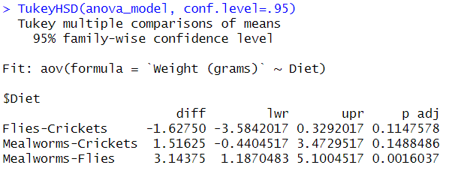
Post hoc test: Tukey test
Sig. difference

Slide 9
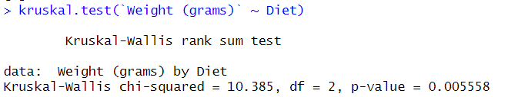

Slide 10
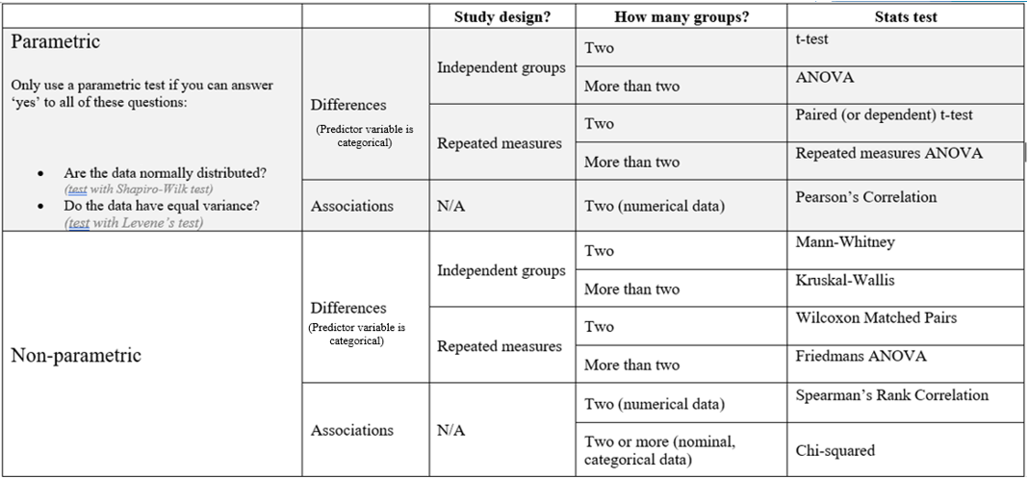

Slide 11
If significant…
Post-hoc Tukey
Post-hoc Tukey
Post-hoc Wilcoxon
Post-hoc Wilcoxon

Slide 12

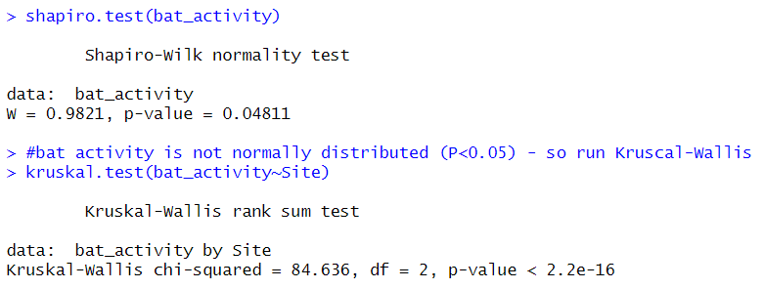
Kruskal-Wallis
Open bat data
Test for a difference in bat activity by site

Slide 13
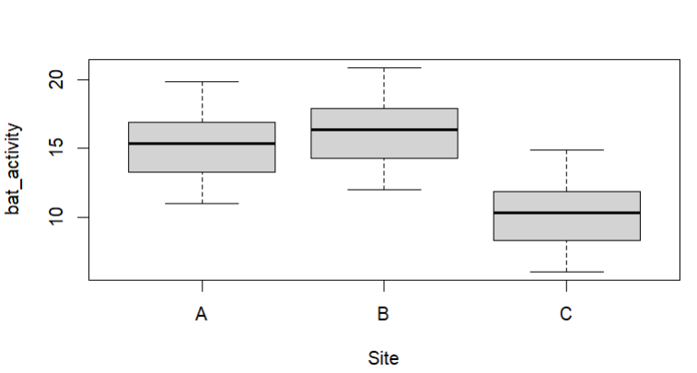
Need to run a Wilcoxon to compare:
A vs B
A vs C
B vs C

Slide 14
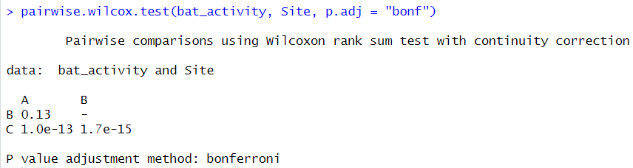
A vs B (P=0.13)
A vs C (P<0.05)*
B vs C (P<0.05)*

Slide 15


Do drugs have an effect on dog stress score during fireworks?

Slide 16
dog | treatment | score
1 | none | 3.33
1 | drugA | 0.27
1 | drugB | 0.918
2 | none | 3.67
2 | drugA | 0.59
2 | drugB | 2.006
3 | none | 2.67
3 | drugA | 0.32
3 | drugB | 1.088
4 | none | 3.33
4 | drugA | 0.19
4 | drugB | 0.646
5 | none | 3.33
5 | drugA | 1.26
5 | drugB | 4.284
6 | none | 3.67
6 | drugA | 0.11
6 | drugB | 0.22
7 | none | 4.67
7 | drugA | 0.3
7 | drugB | 0.6
8 | none | 2.67
8 | drugA | 0.4
8 | drugB | 0.8
9 | none | 6
9 | drugA | 1.59
9 | drugB | 3.18
10 | none | 4.33
10 | drugA | 0.6
10 | drugB | 1.1
11 | none | 3.33
11 | drugA | 0.65
11 | drugB | 1.15
12 | none | 0.67
12 | drugA | 0.69
12 | drugB | 1.19
13 | none | 1.33
13 | drugA | 1.26
13 | drugB | 1.76
14 | none | 0.33
14 | drugA | 0.23
14 | drugB | 0.73
15 | none | 2
15 | drugA | 0.38
15 | drugB | 0.88
dog | none | drugA | drugB
1 | 3.33 | 0.27 | 0.918
2 | 3.67 | 0.59 | 2.006
3 | 2.67 | 0.32 | 1.088
4 | 3.33 | 0.19 | 0.646
5 | 3.33 | 1.26 | 4.284
6 | 3.67 | 0.11 | 0.22
7 | 4.67 | 0.3 | 0.6
8 | 2.67 | 0.4 | 0.8
9 | 6 | 1.59 | 3.18
10 | 4.33 | 0.6 | 1.1
11 | 3.33 | 0.65 | 1.15
12 | 0.67 | 0.69 | 1.19
13 | 1.33 | 1.26 | 1.76
14 | 0.33 | 0.23 | 0.73
15 | 2 | 0.38 | 0.88

Slide 17
For today, let’s assume data are parametric
If significant…
Post-hoc Tukey

Slide 18
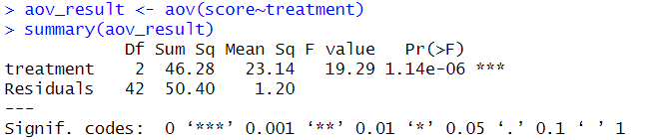
Run repeated measures ANOVA

Slide 19
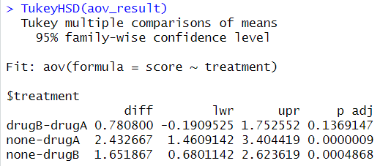
Run post-hoc Tukey

Slide 21
ANOVA with multiple predictor variables

Slide 22
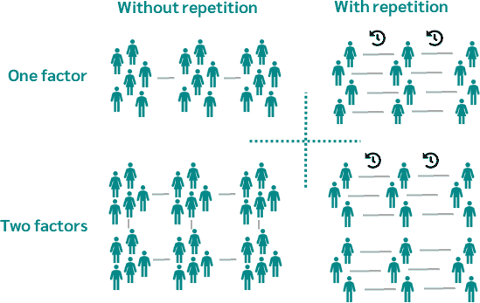
ANOVA
An analysis of variance (ANOVA) tests whether statistically significant differences exist between more than two samples.
Independent groups
Repeated measures
(One study IV)
(Two study IVs)
‘Factor’ = IV (thing that’s being changed)

Slide 23
Treatment | Gender | Blood Pressure
A | Male | 130
A | Female | 125
B | Male | 140
B | Female | 135
A | Male | 128
A | Female | 122
B | Male | 138
B | Female | 130
A | Male | 132
A | Female | 128
B | Male | 144
B | Female | 138
A | Male | 135
A | Female | 125
B | Male | 140
B | Female | 132
A | Male | 128
A | Female | 122
B | Male | 138
B | Female | 130
In this example, we have:
two levels of the "Treatment" factor (A and B)
two levels of the "Gender" factor (Male and Female).
"Blood Pressure" measurements are recorded for each participant based on their treatment and gender.
Using an ANOVA you can answer the questions:
Does ‘Treatment’ have an effect on blood pressure?
Does Gender have an effect on blood pressure?
Is there an interaction effect between treatment and gender on blood pressure?

Slide 24
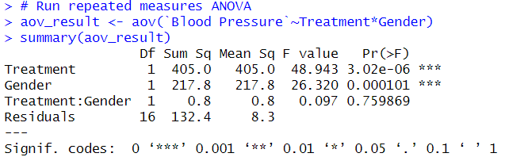
Using an ANOVA you can answer the questions:
Does ‘Treatment’ have an effect on blood pressure?
Does Gender have an effect on blood pressure?
Is there an interaction effect between treatment and gender on blood pressure?
Treatment | Gender | Blood Pressure
A | Male | 130
A | Female | 125
B | Male | 140
B | Female | 135
A | Male | 128
A | Female | 122
B | Male | 138
B | Female | 130
A | Male | 132
A | Female | 128
B | Male | 144
B | Female | 138
A | Male | 135
A | Female | 125
B | Male | 140
B | Female | 132
A | Male | 128
A | Female | 122
B | Male | 138
B | Female | 130

Slide 25
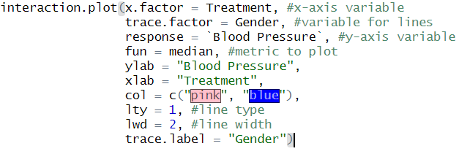
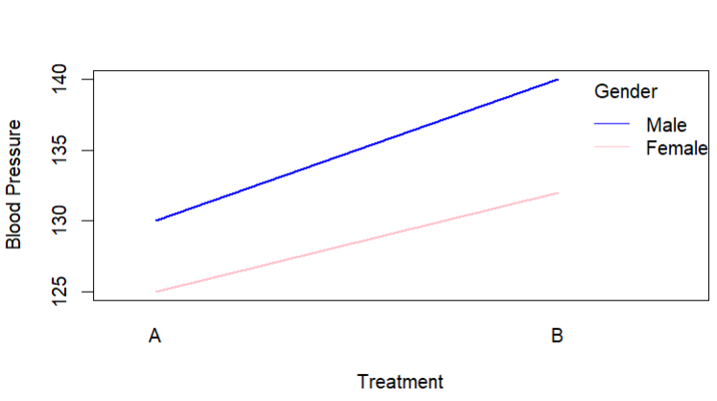
Interaction effect
In general, if the two lines on the interaction plot are parallel then there is no interaction effect. However, if the lines intersect then there is likely an interaction effect.

Slide 26
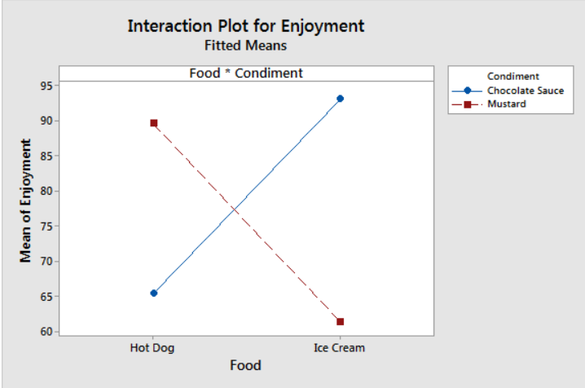
The graph shows that enjoyment levels are higher for chocolate sauce when the food is ice cream. Conversely, satisfaction levels are higher for mustard when the food is a hot dog.

Slide 27
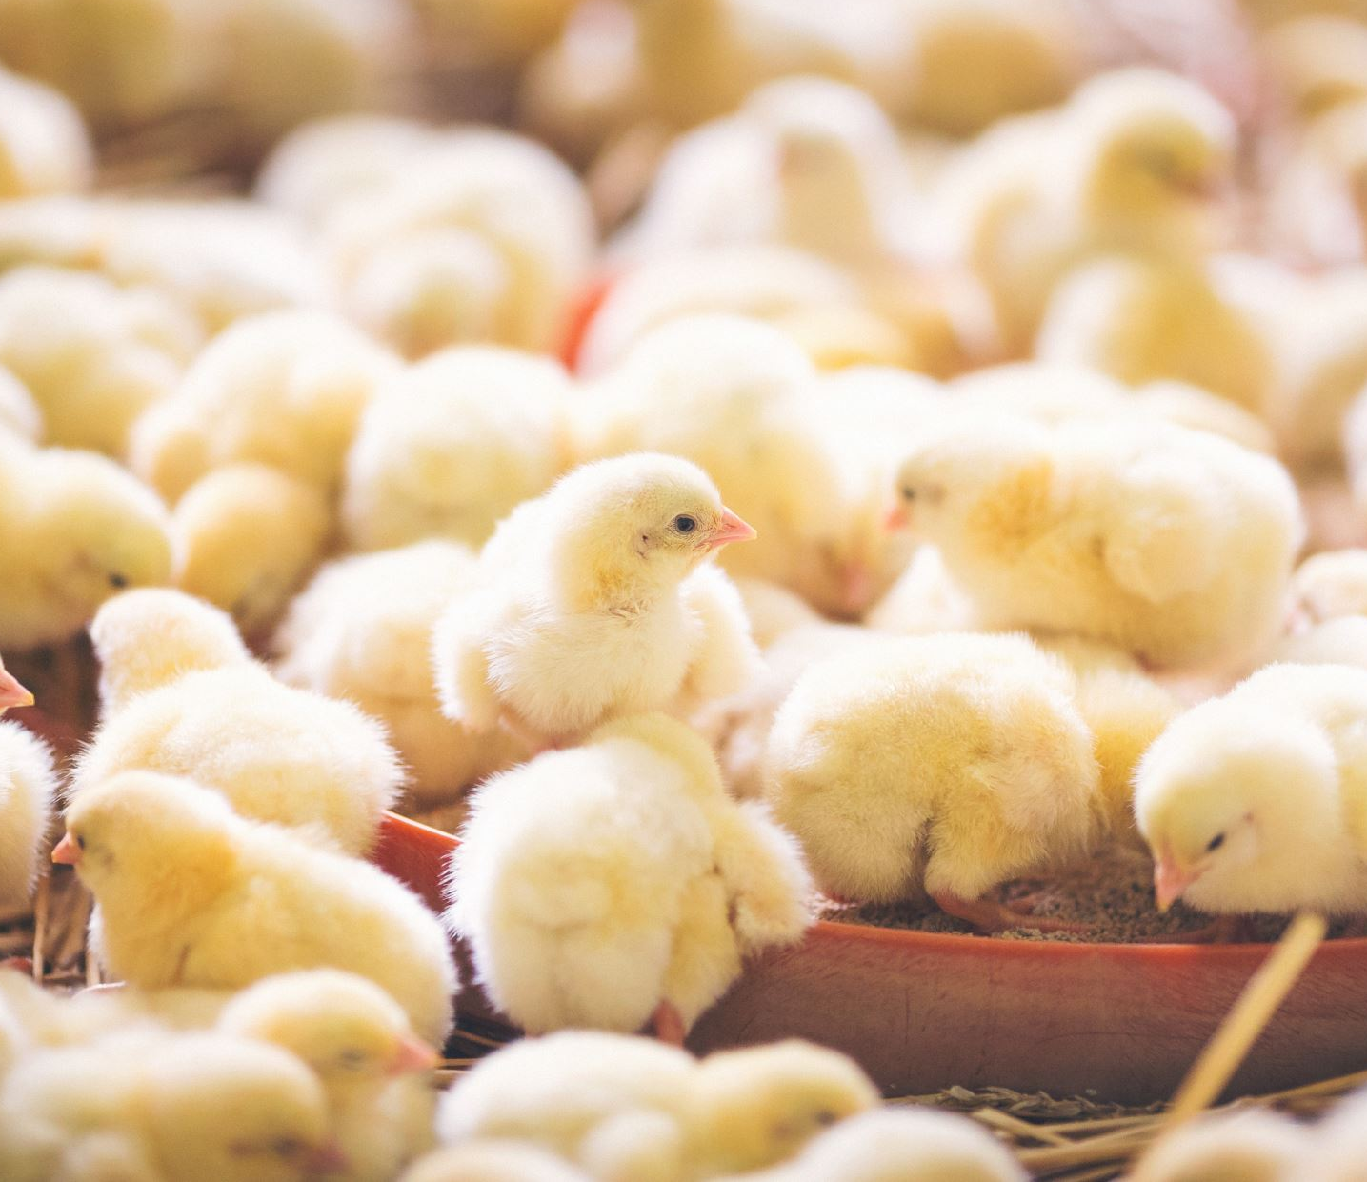
Open Dunsin’s ‘week 8’ R code.
Have a go at following and running this code ☺
Task: as you go, begin creating an electronic r code resource for yourself

