Slide 1

Data Analysis
Lesson 3
(Equine & Ag)
Ella Bartlett
(ella.bartlett@sparsholt.ac.uk)

Slide 2
Last week
Recap. the ‘research process’
Hypothesis testing and P-values
Choosing an appropriate inferential statistical test
Testing parametric assumptions
Today
Practice:
Choosing an appropriate inferential statistical test
Loading data into R Studio
Testing parametric assumptions in R studio
Running two-way comparison tests in R

Slide 3

Last week we…

Slide 4
Choose a research area
Conclude study
Review existing literature
Discuss findings
Identify a specific research question/ generate hypothesis
The
Research Process
Analyse data / test hypothesis
(Inferential statistics)
Set project aims and objectives
Design methodology
Visualise data
(Descriptive statistics)
Pilot methodology (if appropriate)
Collect data

Slide 5
You will always write a ‘null hypothesis’ and an ‘alternative hypothesis’
Alternative hypothesis
H₁: The application of fertiliser will significantly increase plant growth rate.
Null hypothesis
H₀: The application of fertiliser will not significantly increase plant growth rate.
To test this hypothesis, what would you need to measure in your study? - Predictor Variable? Outcome Variable?

Slide 6
H₀: The application of fertiliser will not significantly increase plant growth rate

Slide 7
Inferential stats. tests!
P-value is less than 0.05
Reject the null hypothesis
Result is significant
P-value is greater than 0.05
Result is NOT significant
Accept the null hypothesis

Slide 8
Choosing an appropriate inferential stats. test
“t” test
ANOVA
Friedman
Tests
Chi-squared
GLM
General Linear Modelling
There are lots of different statistical tests available.
Each test is designed to work in a specific situation (depends on type of data, study design, study aim, etc.)
You need to decide which one is most appropriate for a given study….
Pearson’s
correlation
Mann Whitney
Wilcoxon
Kruskal Wallis
Spearman’s
correlation

Slide 9
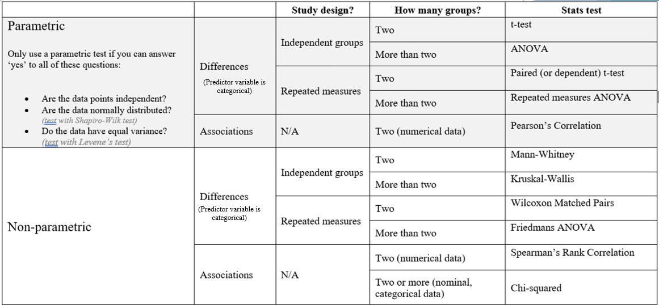

Slide 10
Questions you have to ask when choosing an inferential test
Am I testing for a ‘difference’ (i.e. an effect of a categorical variable) or an ‘association’ between variables?
Was a ‘repeated measures’ or an ‘independent groups’ study design followed?
How many ‘groups’ within my predictor variable?
Does the numerical data I’ve collected meet all of the parametric assumptions?
Independent data points
Normal Distribution
Equal Variance (only need to test independent groups)

Slide 11

First, some questions to warm up your brains

Slide 12
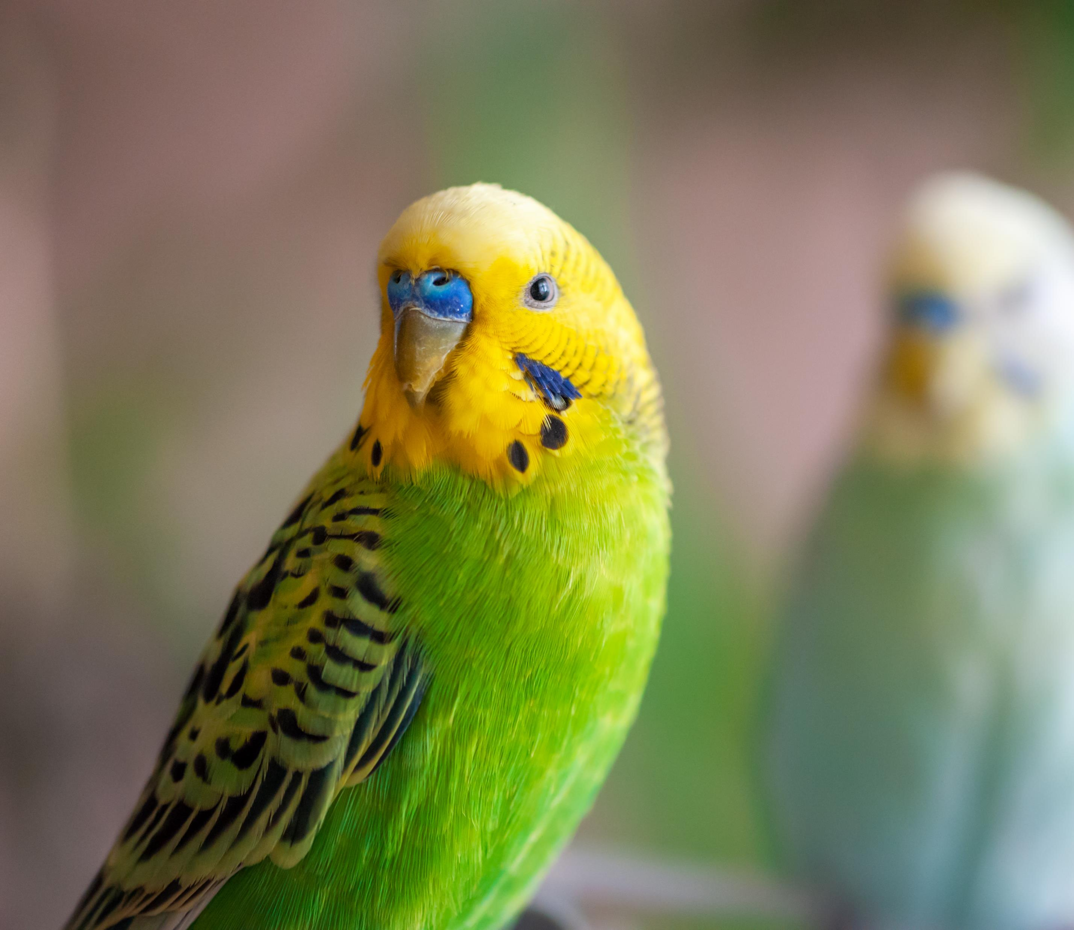
Example 1
Noise levels =
No noise
Low noise level
High noise level
Null hypothesis: There will be no significant difference in bird activity levels when exposed to different noise levels.
Three different noise levels played to birds (n=50) in a random order. The number of ‘high activity’ behaviours they showed was recorded for each treatment.
What’s the study PV?
What's the study OV?
Which stats. Test would you run to test this hypothesis? (assume the data does NOT meet all parametric assumptions)

Slide 14

Example 2
Null hypothesis: There will be no significant association between dog age and number of behaviour issue they show
What’s the study PV?
What's the study OV?
Which stats. Test would you run to test this hypothesis? (assume the data does meet all parametric assumptions)

Slide 16
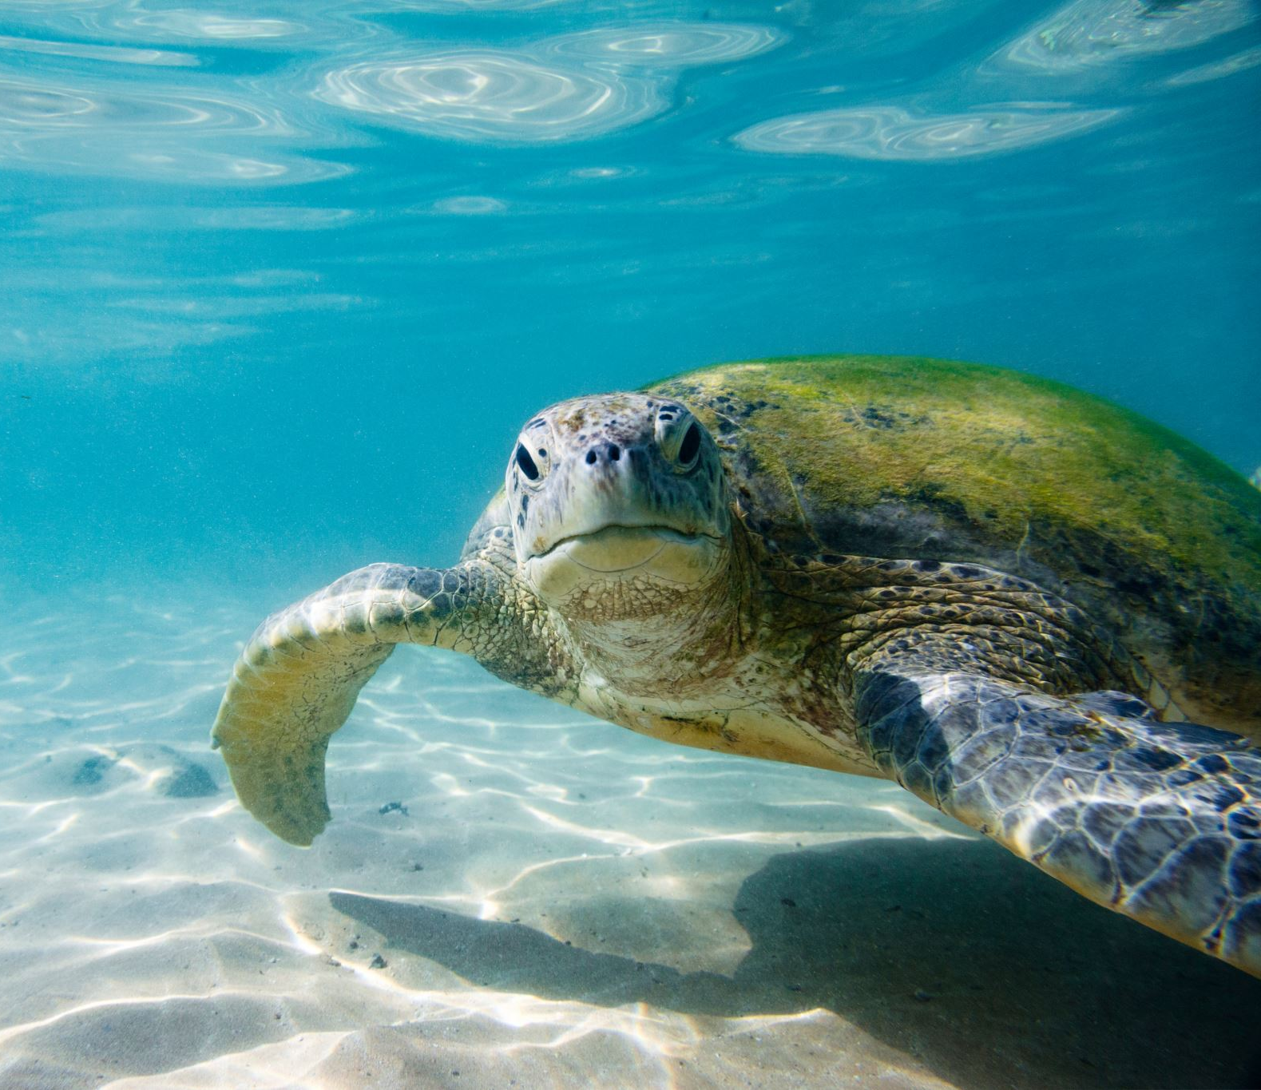
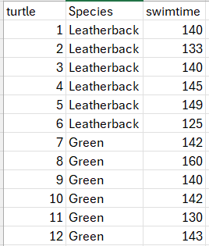
Example 3
Which test will you use to determine whether or not to reject the null hypothesis?
Null hypothesis: There will be no significant difference in the time turtles of different species spend swimming
12 turtles in an aquarium enclosure
A mix of Leatherback (n=6) and Green (n=6) Sea turtles
Outcome variable = time spent swimming per day (mins)

Slide 18

Does the numerical data I’ve collected meet all of the parametric assumptions?
Independent data points?
Equal Variance
Normal Distribution
Yes – one data point for each individual turtle of each species

Slide 19
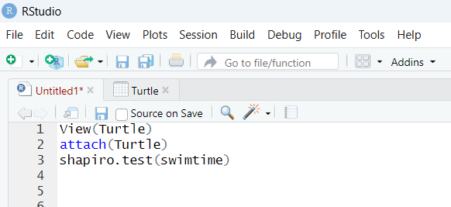
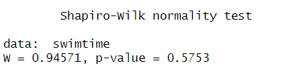
Shapiro-wilk test of distribution
Testing ‘swimtime’ (our outcome variable)
Is it normally distributed?
Yes – so now what?

Slide 20

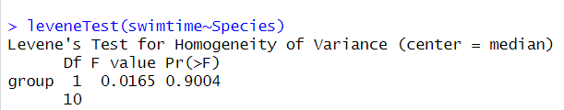
Do we have equal variance between the treatment groups ?
Yes – so now what?

Slide 22
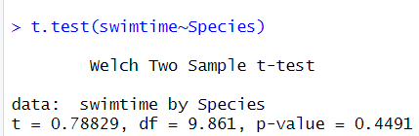
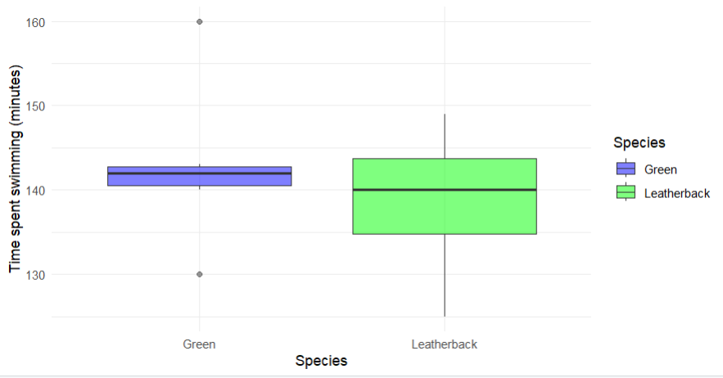
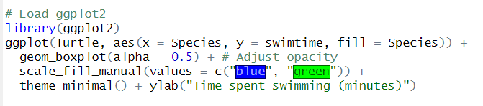
Significant P-value?
Accept or reject null hypothesis?

Slide 23
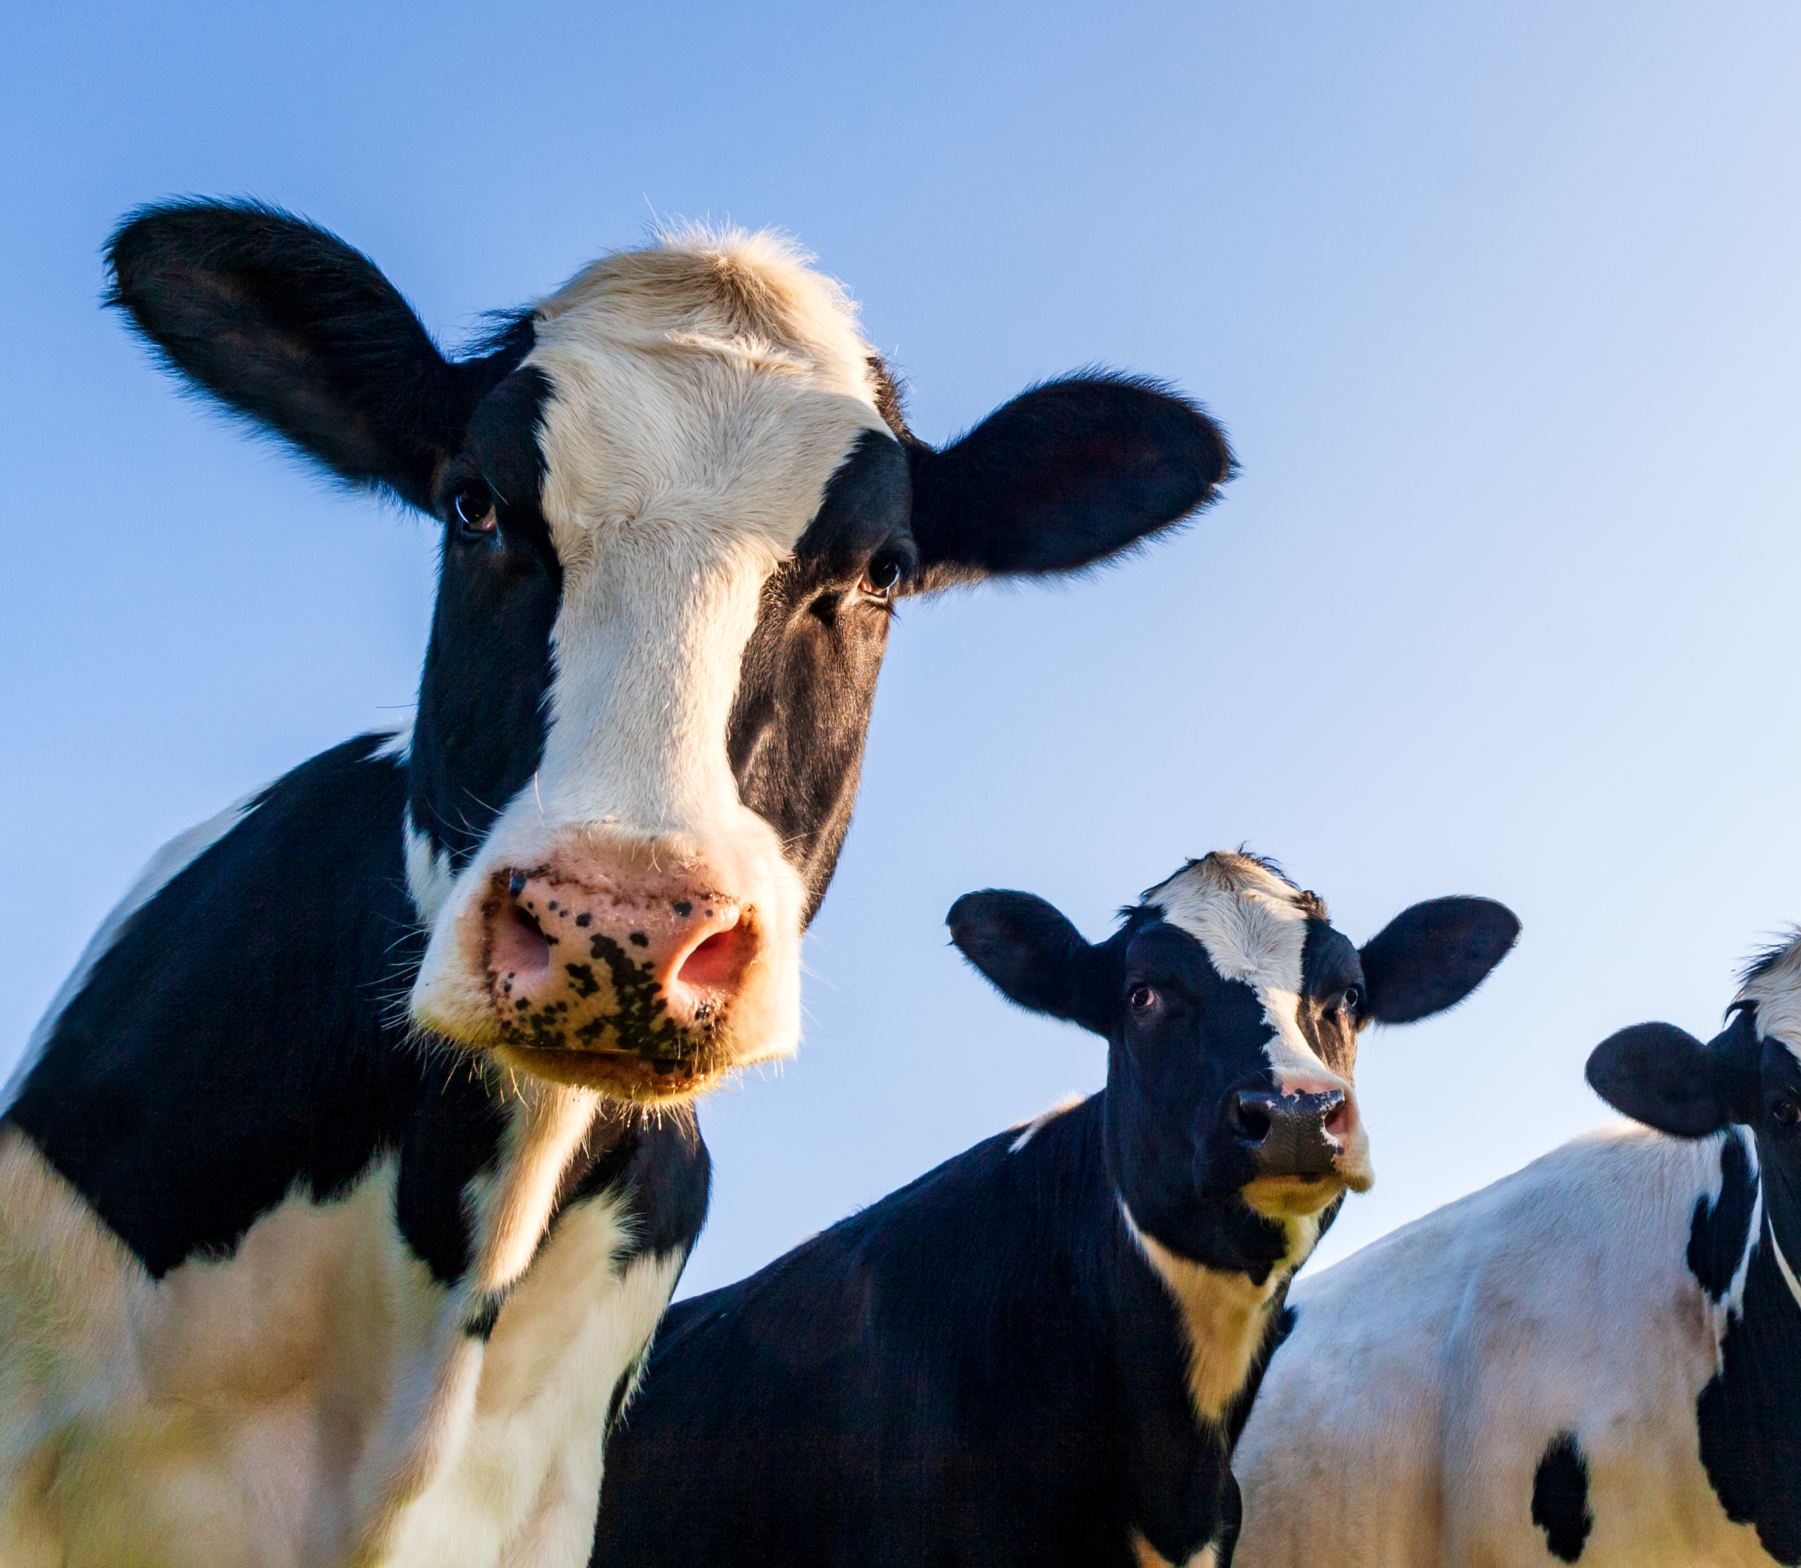
Example 4
Null hypothesis: Providing enrichment will have no significant effect on cow milk production
24 dairy cows
Enrichment (n=12)
No enrichment (control)
(n=12)
Measure vol. milk produced/ day
Measure vol. milk produced/ day
Which test will you use to determine whether or not to reject the null hypothesis?

Slide 24
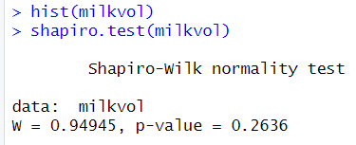
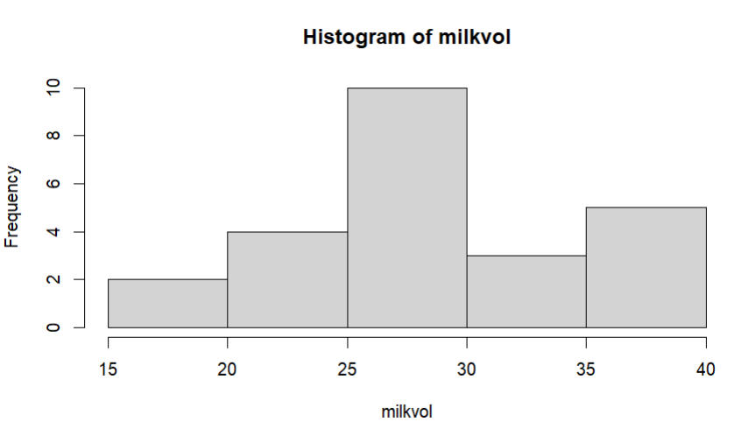
Shapiro-wilk (distribution)

Slide 25
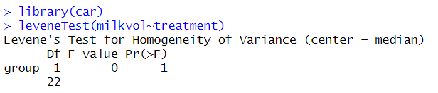
Levene’s test (equal variance)
Note: the P-value is a perfect ‘1’ here (as I made up the data – it would be rare to see this ‘in the wild’)

Slide 26
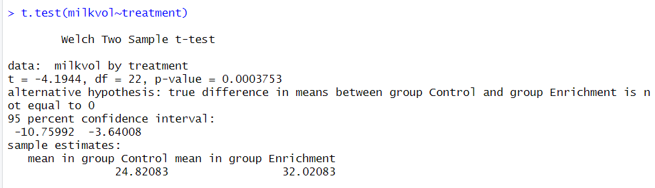

Slide 28
Let’s work through an example together
Time for you to open up r studio and have a play ☺

Slide 29
Does feeding a magnesium supplement promote weight loss in horses?
8 horses
All weighed at start
Magnesium supplement (n=4)
Limestone flour
(n=4)
Horses receive treatments daily for six months
All weighed at end

Slide 30
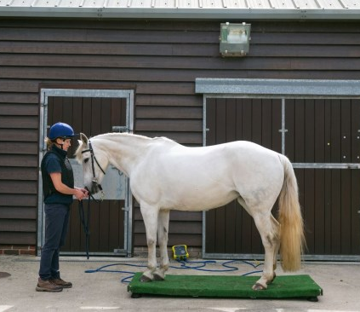
Null hypothesis: supplementing horses' diets with magnesium will not significantly increase weight loss over a six-month period
Download and open ‘horse weight’ data

Slide 31
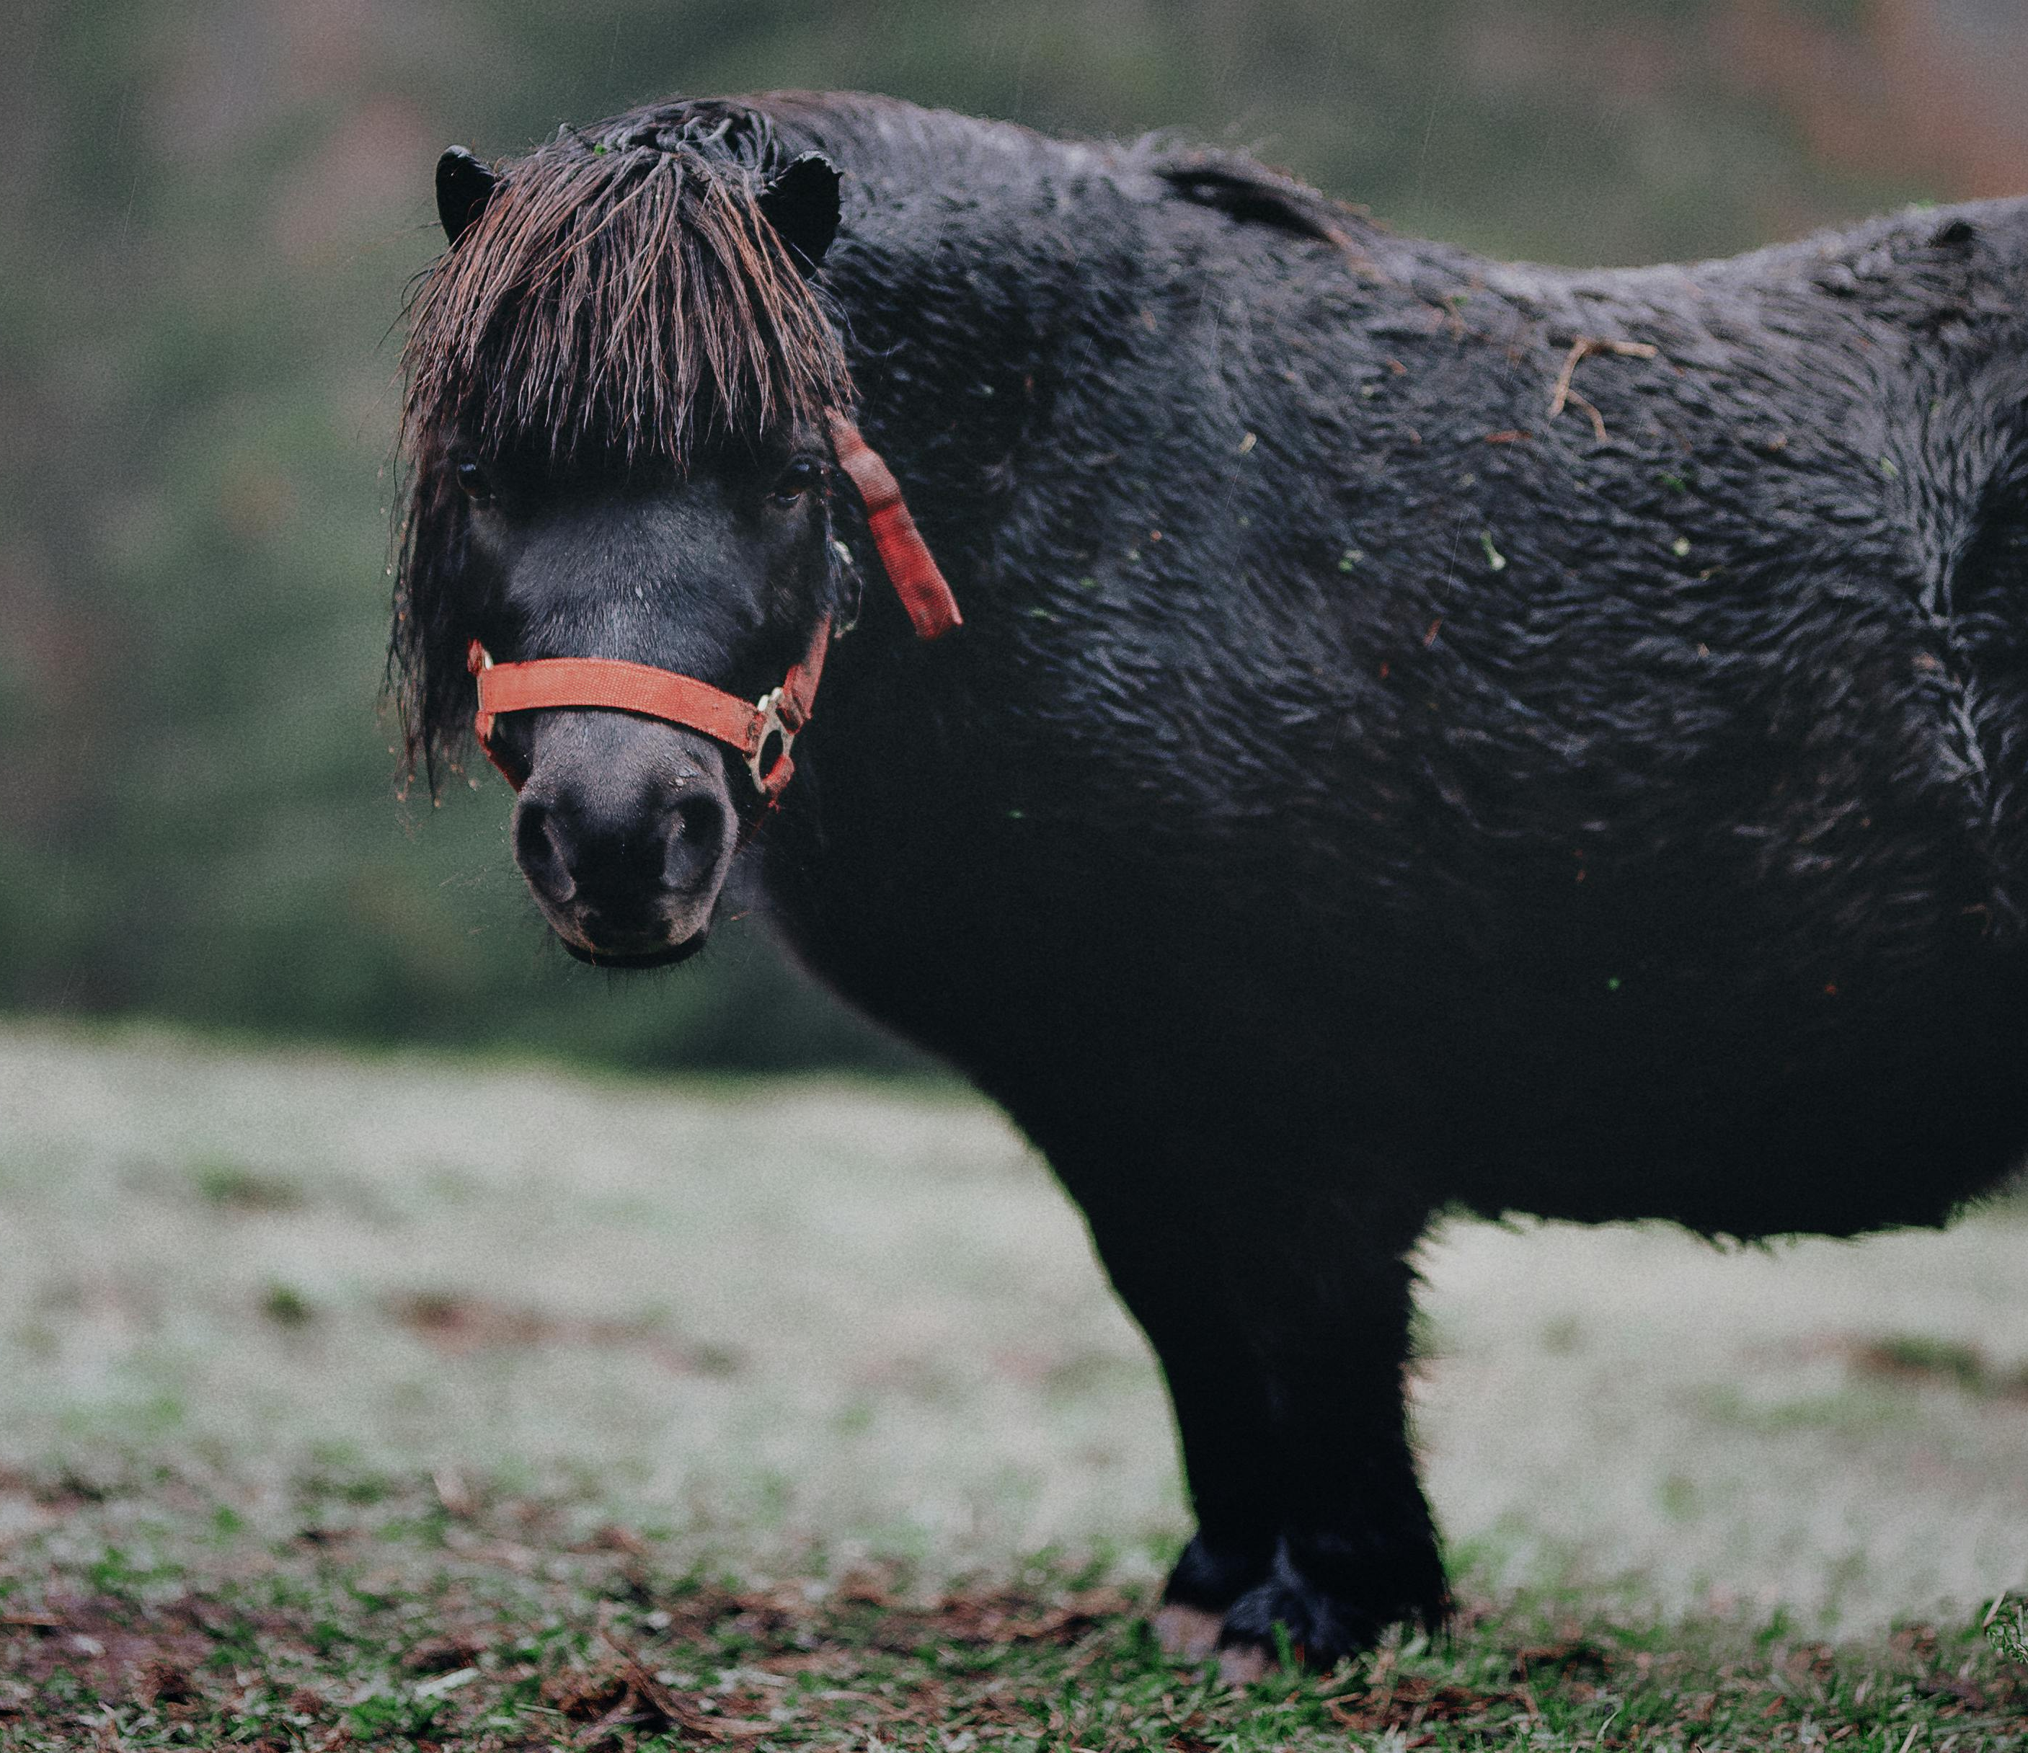
Task
Identify predictor and outcome variables
Format data in excel
Choose an appropriate stats. test to test the study hypothesis
Run test in r Studio
Determine whether the null hypothesis should be accepted or rejected
Notes:
data<-horse_weight
attach(data)
shapiro.test(weight_loss)
library(car)
leveneTest(weight_loss~supplement)
t.test(weight_loss~supplement)
boxplot(weight_loss~supplement, col="lightblue")
cor.test(age,weight_loss)
plot(age,weight_loss)

Slide 32
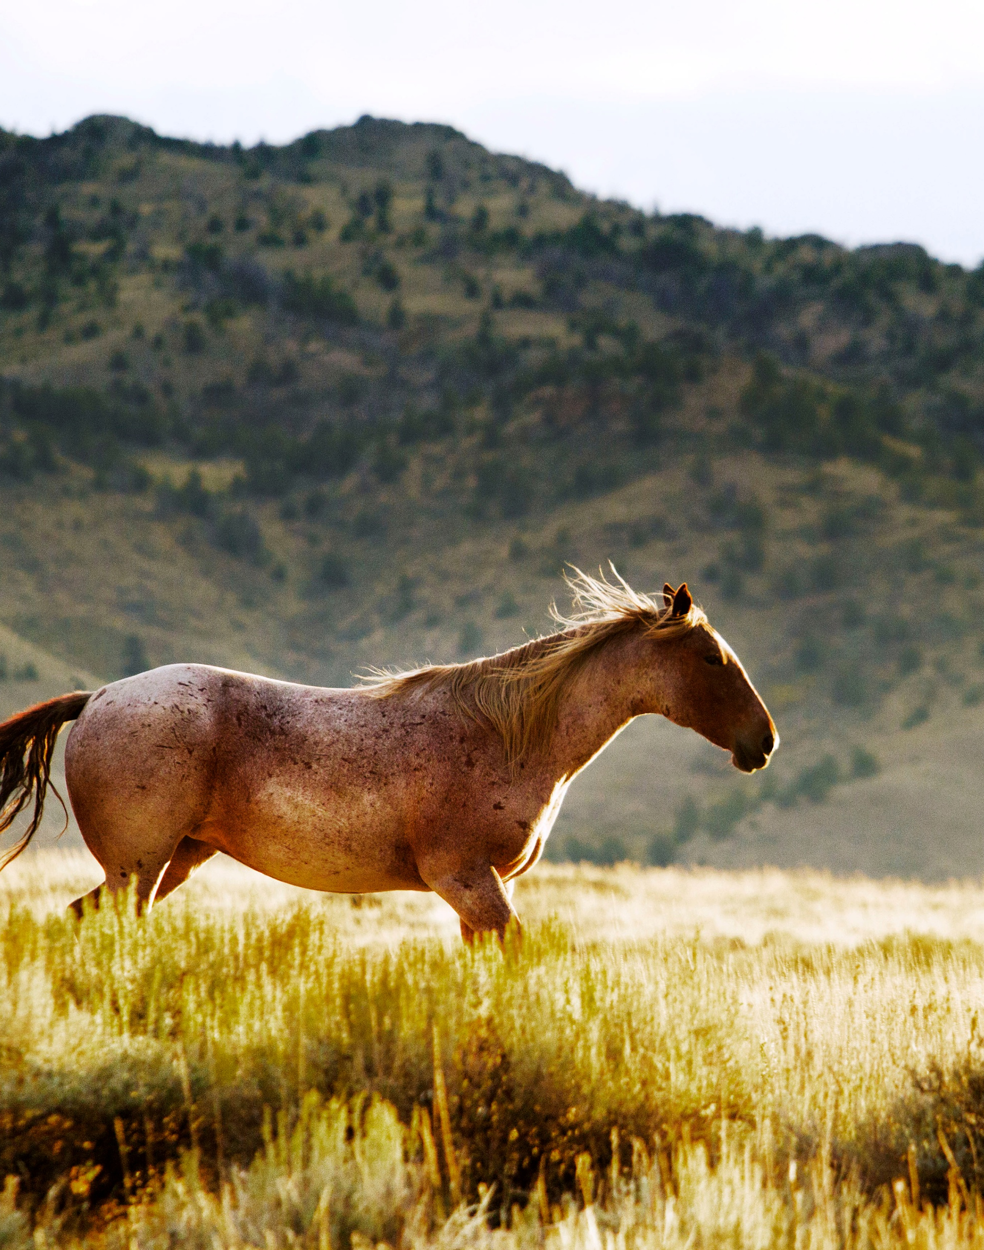
Here’s a new null hypothesis
Null hypothesis: housing conditions (live in field or stable) will not significantly influence horse weight loss
Identify predictor and outcome variables
Determine whether this null hypothesis should be accepted or rejected

