Slide 1

Data Analysis
Lesson 2
(Equine & Ag)

Slide 2

Today
Recap. the ‘research process’
Hypothesis testing and P-values
Choosing an appropriate inferential statistical test
Testing parametric assumptions

Slide 3
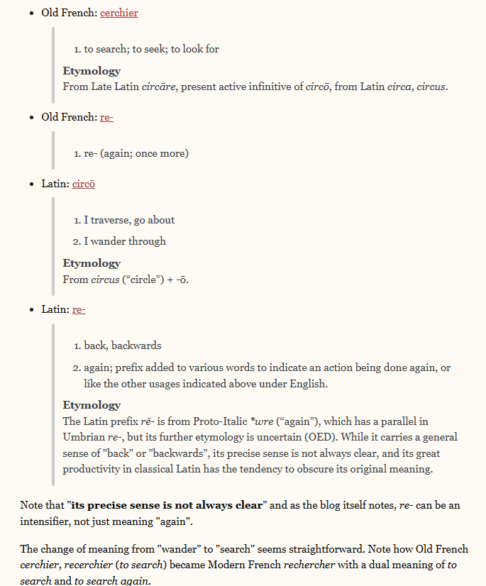

Slide 4
Choose a research area
Conclude study
Review existing literature
Discuss findings
Identify a specific research question/ generate hypothesis
The
Research Process
Analyse data / test hypothesis
(Inferential statistics)
Set project aims and objectives
Design methodology
Visualise data
(Descriptive statistics)
Pilot methodology (if appropriate)
Collect data

Slide 5
Hypotheses
Hypothesis = singular
Hypotheses = plural
These are a ‘statement’/ prediction made at the state of the project
They will be informed by your reading (you aren’t just making a random guess)

Slide 6
You will always write a ‘null hypothesis’ and an ‘alternative hypothesis’
Alternative hypothesis
H₁: The application of fertiliser will significantly increase plant growth rate.
Null hypothesis
H₀: The application of fertiliser will not significantly increase plant growth rate.
To test this hypothesis, what would you need to measure in your study? - Predictor Variable? Outcome Variable?

Slide 7
You will always write a ‘null hypothesis’ and an ‘alternative hypothesis’
Alternative hypothesis
H₁: The application of fertiliser will significantly increase plant growth rate.
Null hypothesis
H₀: The application of fertiliser will not significantly increase plant growth rate.
To test this hypothesis, what would you need to measure in your study? - Predictor Variable? Outcome Variable?

Slide 8
When you carry out research, you are trying to determine whether or not you can reject the null hypothesis!
How do you figure this out?
Collect relevant data to test your hypotheses
To test this hypothesis, what would you need to measure in your study? - Predictor Variable? Outcome Variable?

Slide 9
H₀: The application of fertiliser will not significantly increase plant growth rate
It looks like fertiliser has had an effect on our OV… but is this effect ‘significant’?

Slide 10
When you carry out research, you are trying to determine whether or not you can reject the null hypothesis!
How do you figure this out?
Collect relevant data to test your hypotheses
Use P-value to determine whether you should accept of reject null
Run inferential stats tests.

Slide 11
Inferential stats. tests give us P-values
P-value is less than 0.05
Result is significant
P-value is greater than 0.05
Result is NOT significant

Slide 12
P-value
This represents the likelihood that your result has come around by chance (not as a result of what you have changed).
H₀: The application of fertiliser will not significantly increase plant growth rate
Is fertiliser truly having an effect on grass growth – or could any increase in growth simply be due to chance?
5%
95%
0% likelihood that results were just chance. Very reliable. Highly significant finding.
0
1
100% likelihood that results were just chance. Very unreliable. Non-significant finding.
We only want to accept findings that fall in here (so that we are 95% confident that results were not just random chance)

Slide 13
Inferential stats. tests!
P-value is less than 0.05
Reject the null hypothesis
Result is significant
P-value is greater than 0.05
Result is NOT significant
Accept the null hypothesis

Slide 14
Symbols
P=0.04
‘P’ equals 0.04
Significant
P<0.05
‘P’ is less than 0.05
Significant
P>0.05
‘P’ is greater than 0.05
Non-Significant
P≥0.05
‘P’ is greater than or equal to 0.05
Non-Significant
P≤0.04
‘P’ is less than or equal to 0.04
Significant

Slide 15
Which of these are significant?
P=0.02
a)
P=0.07
b)
P=0.50
c)
P=0.06
d)
P<0.001
e)

Slide 16
Choosing an appropriate inferential stats. test
“t” test
ANOVA
Friedman
Tests
Chi-squared
GLM
General Linear Modelling
There are lots of different statistical tests available.
Each test is designed to work in a specific situation (depends on type of data, study design, study aim, etc.)
You need to decide which one is most appropriate for a given study….
Pearson’s
correlation
Mann Whitney
Wilcoxon
Kruskal Wallis
Spearman’s
correlation

Slide 17
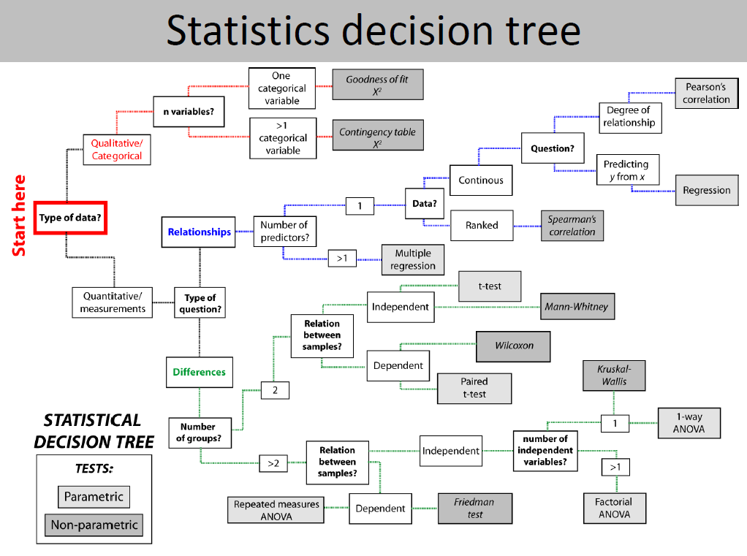

Slide 18
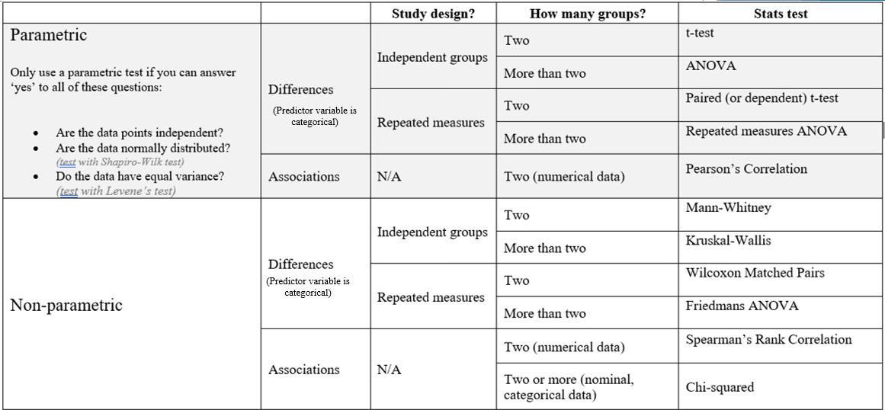

Slide 19
Questions you have to ask when choosing an inferential test
Am I testing for a ‘difference’ (i.e. an effect of a categorical variable) or an ‘association’ between variables?
Was a ‘repeated measures’ or an ‘independent groups’ study design followed?
How many ‘groups’ within my predictor variable?
Does the numerical data I’ve collected meet all of the parametric assumptions?

Slide 20
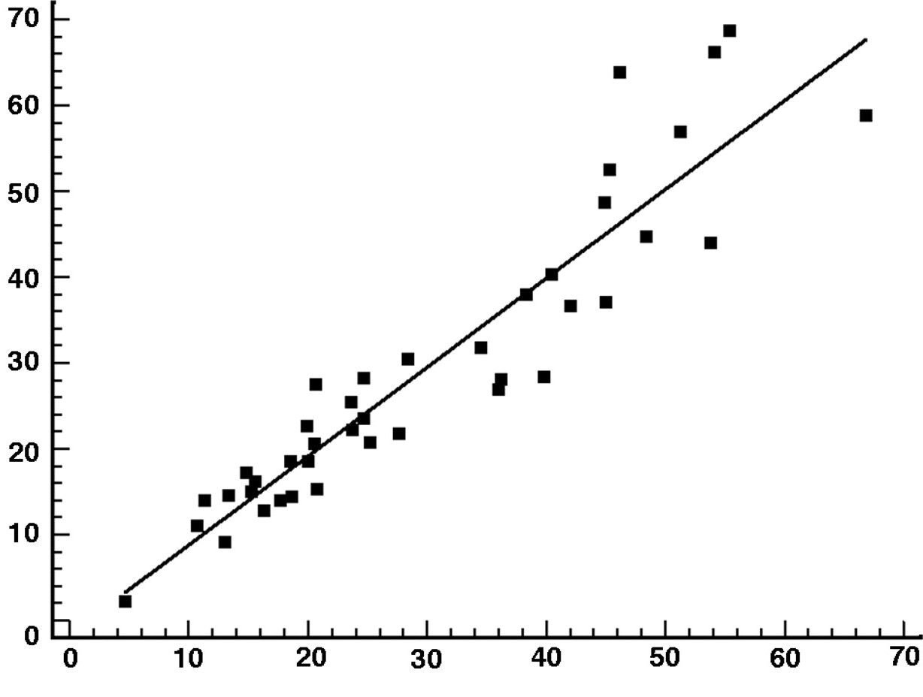
Testing for a difference between categories
Predictor variable is categorical
Am I testing for a ‘difference’ (i.e. an effect of a categorical variable) or an ‘association’ between variables?
Predictor variable(s) = numerical (‘continuous’)
Testing for an association between variables

Slide 21

Questions you have to ask when choosing an inferential test
Am I testing for a ‘difference’ (i.e. an effect of a categorical variable) or an ‘association’ between variables?
Was a ‘repeated measures’ or an ‘independent groups’ study design followed?
How many ‘groups’ within my predictor variable?
Does the numerical data I’ve collected meet all of the parametric assumptions?

Slide 22
Questions you have to ask when choosing an inferential test
Was a ‘repeated measures’ or an ‘independent groups’ study design followed?

Slide 23

Study design
Imagine we’re studying the effect of caffeine on activity levels children (not a real study! Not ethical??)
We’ve got a sample of 32 children.
There are two ways we could design this study
32 children
Repeated measures design
Given caffeine drink (n=16)
Given non-caffein drink (n=16)
32 children
Measure activity level of children
Measure activity level of children
Given caffeine drink (n=16)
Given non-caffein drink (n=16)
Given non-caffein drink (n=16)
Given caffeine drink (n=16)
Measure activity level of children
Measure activity level of children
Measure activity level of children
Measure activity level of children
Independent group design

Slide 24
Independent groups
Repeated measures
The sample is split into groups. Each group only experiences one treatment conditions
All participants in the sample experience all treatment conditions

Slide 25
Independent-groups design
32 children
Sample | Treatment | Outcome….
Participant 1 | Caffeine | 17
Participant 2 | Caffeine | 13
Participant 3 | Caffeine | 16
Participant 4 | Caffeine | 12
Participant 5 | Non-caffeine | 7
Participant 6 | Non-caffeine | 8
Participant 7 | Non-caffeine | 9
Participant 8 | Non-caffeine | 6
Given caffeine drink (n=16)
Given non-caffein drink (n=16)
Measure activity level of children
Measure activity level of children
Independent group design
Participants do NOT receive all treatments. They are split up into sperate groups and only experience one of the treatments each.

Slide 26
Repeated-measures
Repeated measures design
32 children
Participant number | Score with caffeine | Score with no caffeine
1 | 2 | 5
2 | 3 | 6
3 | 4 | 7
4 | 2 | 5
5 | 7 | 9
6 | 5 | 8
7 | 3 | 4
8 | 2 | 6
Given caffeine drink (n=16)
Given non-caffein drink (n=16)
Measure activity level of children
Measure activity level of children
Given non-caffein drink (n=16)
Given caffeine drink (n=16)
Measure activity level of children
Measure activity level of children
All participants receive all the treatment conditions!

Slide 27
Independent groups
Repeated measures
Limitation:
- Result may be influenced by individual variation within the sample.
Strengths:
More practical for some studies (e.g. those that involve changing diet) where using a repeated measures design would be very time consuming.
Limitation:
Impractical for some studies
Potential order effect/ effect of previous treatment
Strengths:
Each participant acts as its own control – remove possibility that individual variation has an effect

Slide 28

Example 1
A study trying to see if giving a joint supplement to horses significantly increases their stride length.
All of the horses (n=30) had their stride length measured at the start of the study. They were then all given the supplement in their daily feeds for 3 months, after which their stride lengths were measured again in the same way.
What is the PV?
What is the OV?
Is this an example of independent groups or repeated measures study design?
Can you think of a limitation of this study that may make us question the results?

Slide 29
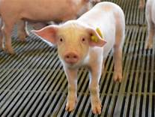
Example 2
Study to see if there is a significant difference in pig activity levels when fed a calming supplement.
Researchers studied pigs (n=50) on a local farm. 50ml of calming supplement solution was administer orally to half of the pigs (n=25), whilst the rest were given 50ml of water in the same manner.
For three hours after administration of the treatments, the number of steps taken by each pig was measured to reflect ‘activity level’.
What is the PV?
What is the OV?
Is this an example of IG or RM study design?
Why were half of the pigs given water?

Slide 30
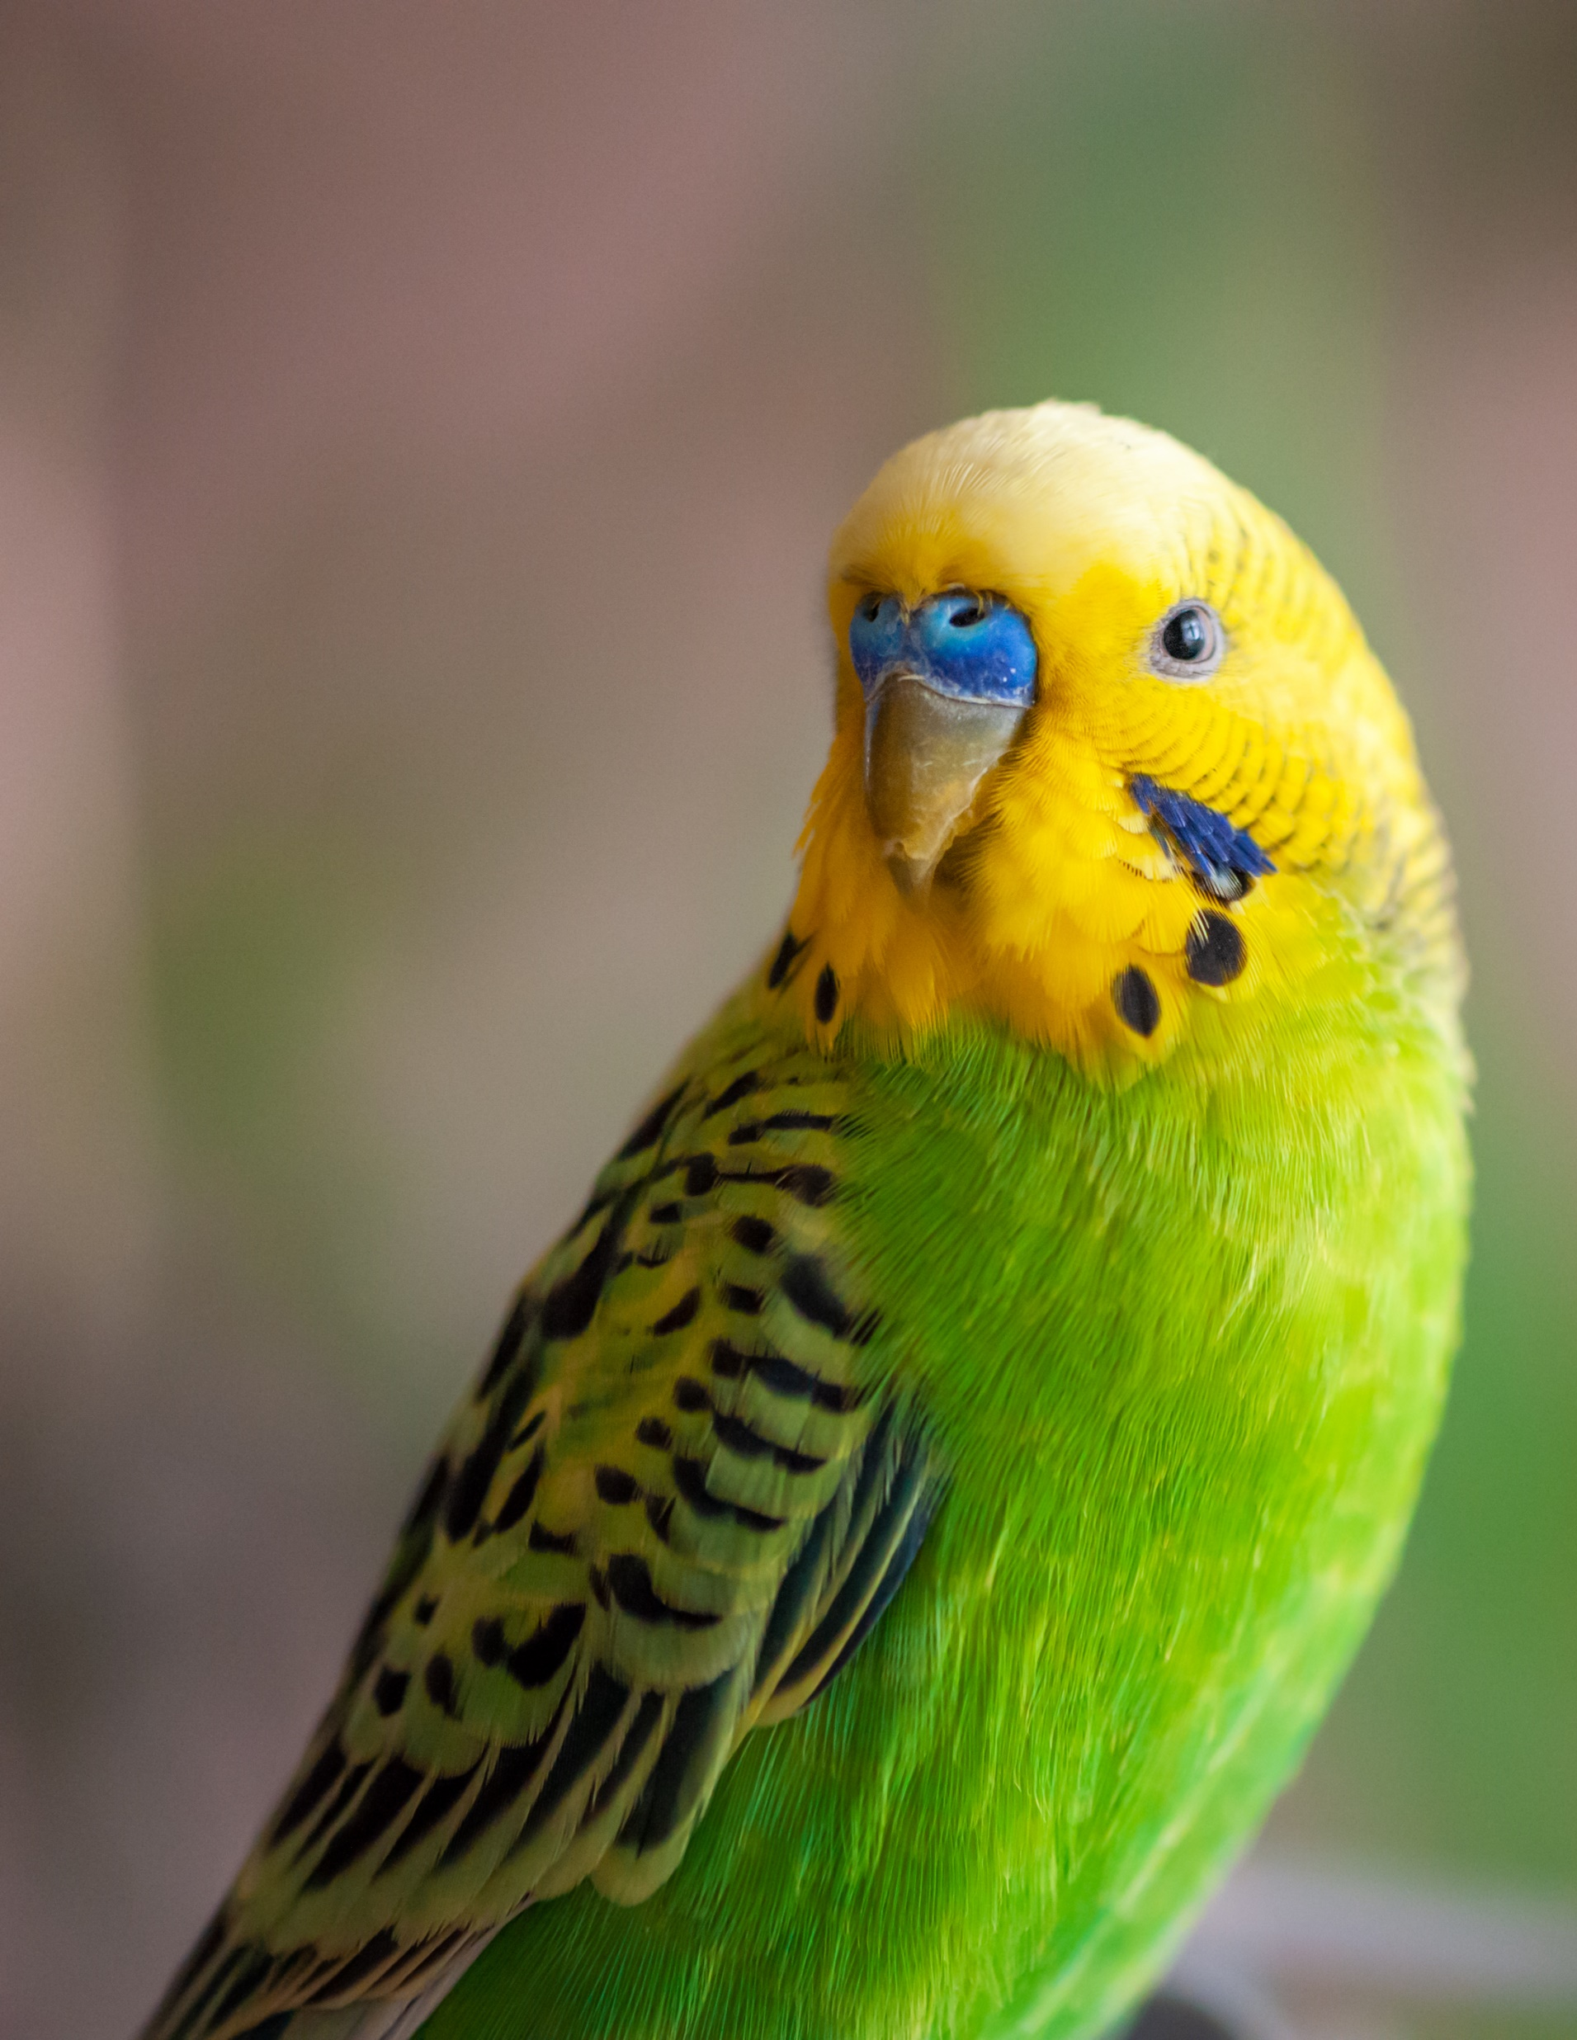
Example 3
Study to see if bird feather condition is significantly influenced by amount of oil in their diet.
Researchers wanted to compare three treatment conditions:
  High oil (30% of total diet)
  Low oil (10% of total diet)
  No oil (0% of total diet)
  30 birds, split into three treatment groups.
  Each group receives each treatment for one month in a randomised order.

Slide 31
Randomised Block Design
Treatment conditions:
  High oil (30% of total diet)
  Low oil (10% of total diet)
  No oil (0% of total diet)
 | Month 1 | Month 2 | Month 3
Group A (n=10 birds) | High oil | Low oil | No oil
Group B (n=10 birds) | No oil | High oil | Low oil
Group C (n=10 birds) | Low oil | No oil | High oil
After each month, their feather condition is scored.
Every animal received every treatment.
Is this an example of repeated measures, or independent group design?

Slide 32
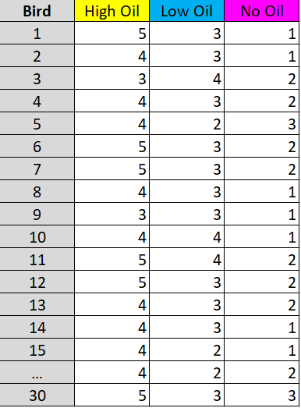
Our data would look like this:
Grey column = Bird ID (30 birds in total)
Yellow column = each birds score for when on the high oil treatment
Blue column = each birds score when on the low oil treatment
Pink column = each birds score when on the no oil treatment

Slide 33
Questions you have to ask when choosing an inferential test
Am I testing for a ‘difference’ (i.e. an effect of a categorical variable) or an ‘association’ between variables?
Was a ‘repeated measures’ or an ‘independent groups’ study design followed?
How many ‘groups’ within my predictor variable?
Does the numerical data I’ve collected meet all of the parametric assumptions?

Slide 34
How many ‘groups’ within my predictor variable?
How many categories are you asking the stats. test to compare?
Before joint supplement
PV = Joint supplement
After joint supplement
  High oil (30% of total diet)
  Low oil (10% of total diet)
  No oil (0% of total diet)
PV = % oil in diet

Slide 35
Questions you have to ask when choosing an inferential test
Am I testing for a ‘difference’ (i.e. an effect of a categorical variable) or an ‘association’ between variables?
Was a ‘repeated measures’ or an ‘independent groups’ study design followed?
How many ‘groups’ within my predictor variable?
Does the numerical data I’ve collected meet all of the parametric assumptions?

Slide 36
Questions you have to ask when choosing an inferential test
Does the numerical data I’ve collected meet all of the parametric assumptions?
Independent data points
Normal Distribution
Normal Distribution

Slide 37
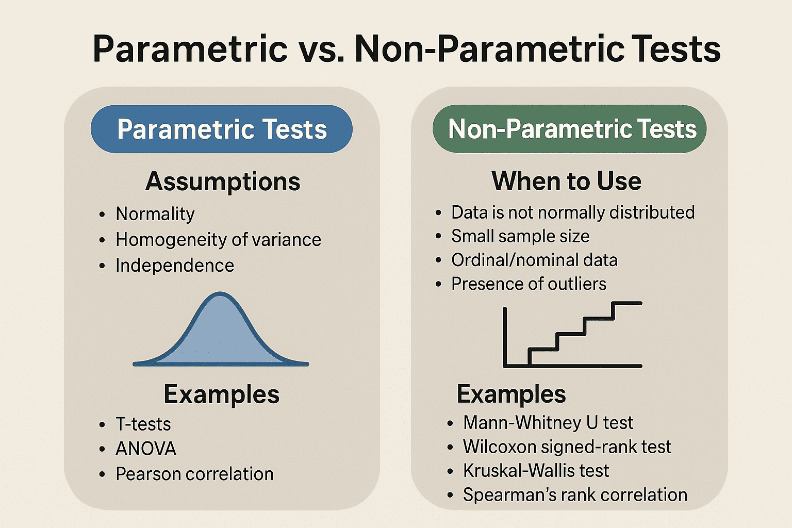
Parametric tests are more statistically powerful, but they make specific assumptions about the data.
These assumptions need to be met for the test to work.
Parametric tests use population parameters like the mean and standard deviation in their calculations.
Non-parametric tests can be used when parametric assumptions are not met by the data you are testing.
These use compare medians (rather than means)

Slide 38
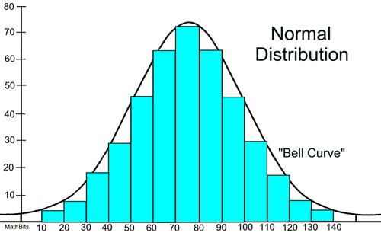
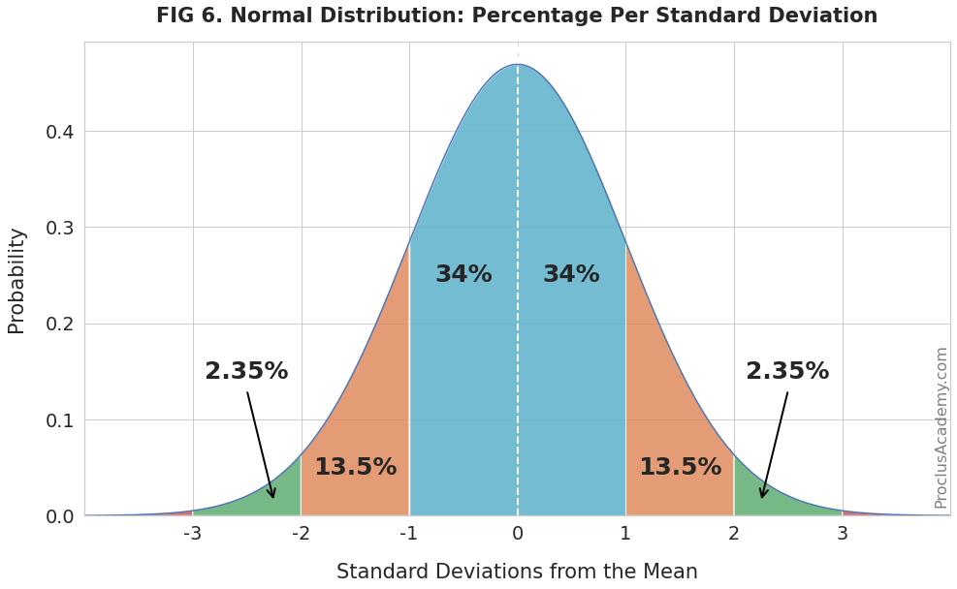
Normal Distribution Characteristics
Symmetry: The normal distribution is symmetric around its mean. This means the left side of the distribution mirrors the right side.
Mean, Median, and Mode: In a normal distribution, the mean, median, and mode are all equal and located at the center of the distribution.
Bell-shaped Curve: The curve is bell-shaped, indicating that most of the observations cluster around the central peak and the probabilities for values further away from the mean taper off equally in both directions.
Standard Deviation: The spread of the distribution is determined by the standard deviation. About 68% of the data falls within one standard deviation of the mean, 95% within two standard deviations, and 99.7% within three standard deviations.

Slide 39
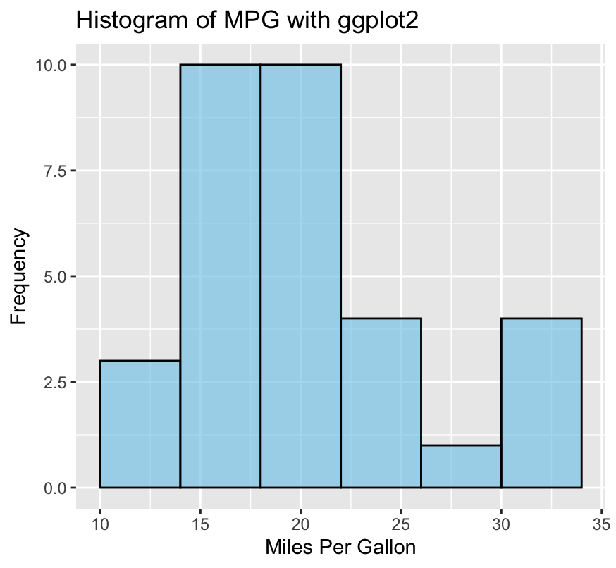
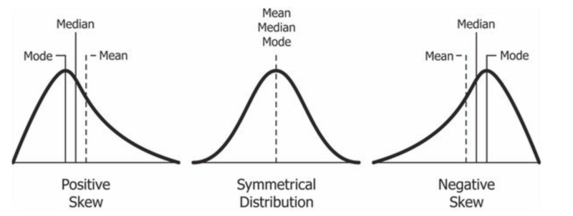

Check distribution by creating a histogram
But this can be subjective
hist(data)

Slide 40
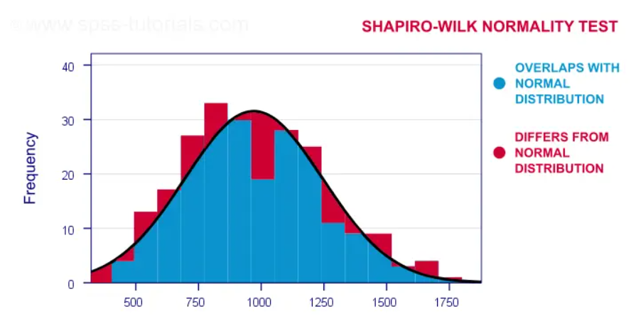
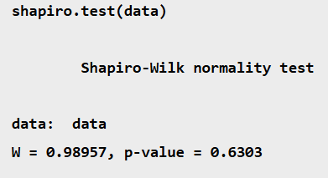
Test normality using a Shapiro-wilk test in R
P<0.05 = Not normal P>0.05 = Normal distribution

Slide 41
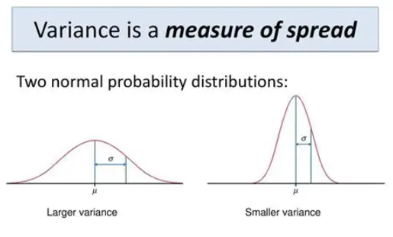
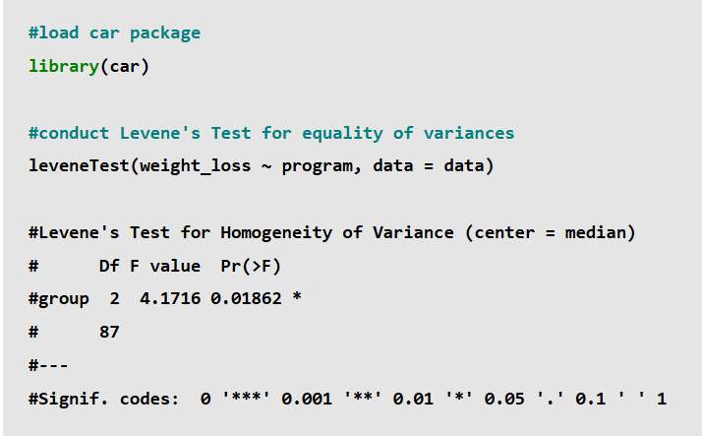
Testing for equal variance
Unnecessary if using a repeated measures study design
P<0.05 = Variance is not equal
P>0.05 = Equal Variance

Slide 42
Assumption of independent data points
The assumption that observations (data points) are independent.
This means that no two observations in a dataset are related to each other or affect each other in any way.
Use careful study design to ensure this assumption is not violated.

Slide 43
Questions you have to ask when choosing an inferential test
Am I testing for a ‘difference’ (i.e. an effect of a categorical variable) or an ‘association’ between variables?
Was a ‘repeated measures’ or an ‘independent groups’ study design followed?
How many ‘groups’ within my predictor variable?
Does the numerical data I’ve collected meet all of the parametric assumptions?

Slide 44


Cat study
Research question: Do ‘natural calming tablets’ significantly reduce the amount of stress-related behaviour performed by cats?
15 cats
The amount of time(sec) they spent displaying stress-related behaviours was measured before they received any treatment, and again after they were given a natural calming tablet.
All parametric assumptions are met by this data
1) Write a null hypothesis for this study
2) Identify the study the Predictor and Outcome Variable?
3)Which stats test would you run to test the hypothesis?

