Slide 1
Chi-square test

Slide 2
Today
Complete worksheet
Chi-square test

Slide 3
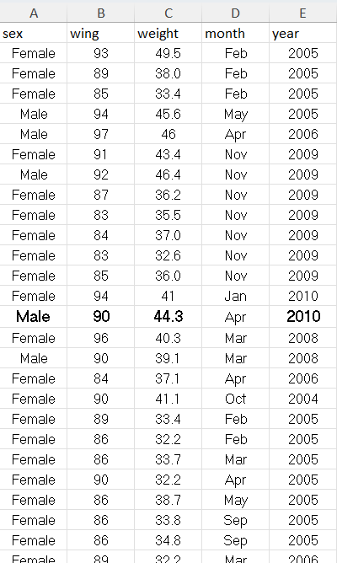
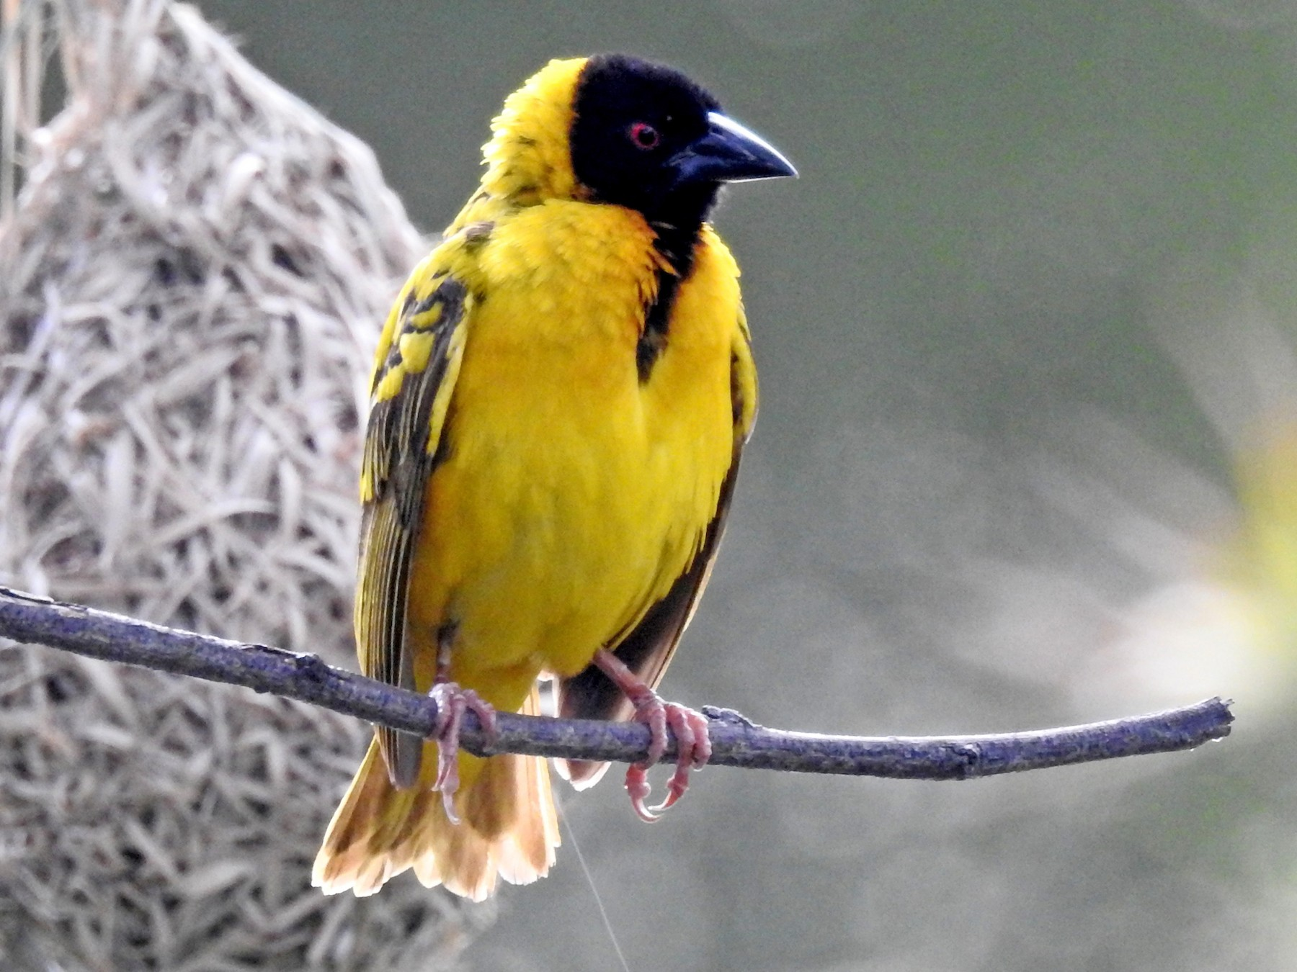
Village weaver
Complete printed worksheet using village weaver data

Slide 4
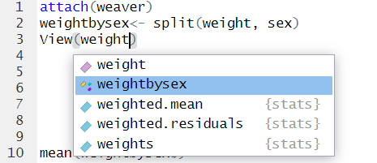
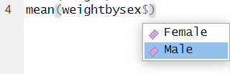
Splitting columns
Name for new list
In r studio (don’t cheat and go back to excel), create new lists that are:
  Weight of only males
  Weight of only femles
You can now run tests on each group separately.
As these new lists are not attached, use $ symbol
Notes:
attach(weaver)
weightbysex<- split(weight, sex)
View(weight)mean(weightbysex$Male)

Slide 5
Village weaver
Complete printed worksheet using village weaver data
Notes:
wilcox.test(weight~sex)
options(scipen = 999)

Slide 6

New type of question

Slide 7
Village weaver
Which test would we use if we wanted to determine whether the proportion of male and female Village Weavers captured differs across months?

Slide 8
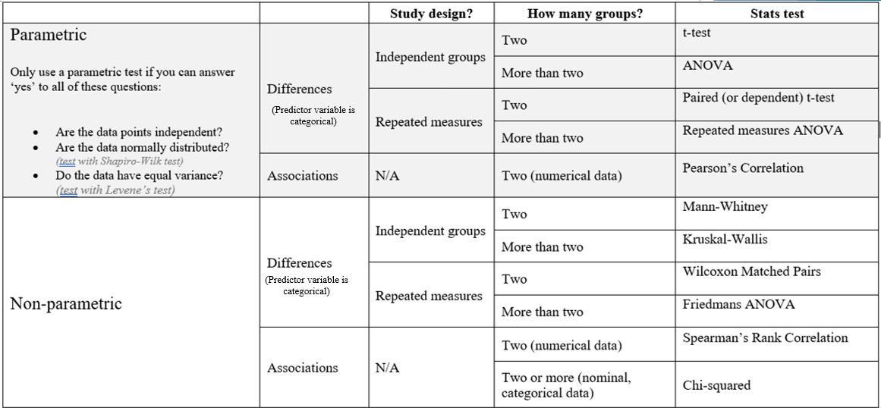

Slide 9
The chi-squared test tests the hypothesis that there is no relationship between two categorical variables.
It compares the observed frequencies from the data with frequencies which would be expected if there was no relationship between the variables

Slide 10

Note:
X²
The name can be written as:
or
This letter (‘χ’) is a Greek letter called ‘Chi’

Slide 11

Example:
Gender | Like spicy food?
Female | Yes
Female | Yes
Female | Yes
Female | Yes
male | Yes
Female | No
Female | No
male | No
Female | No
Female | Yes
Female | Yes
male | No
male | No
male | No
Female | Yes
Female | Yes
Female | No
Female | Yes
Female | Yes
male | No
male | No
male | Yes
male | No
male | No
male | No
male | No
male | Yes
male | Yes
male | Yes
Female | Yes
30 participants (15 male, 15 female) were asked if they like spicy food (yes/no).
We want to know if gender had a significant effect on whether people like/ dislike spicy food.
Null – there will be no significant association between gender and spice preference

Slide 12
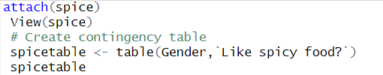

Create a contingency table
Gender | Like spicy food?
Female | Yes
Female | Yes
Female | Yes
Female | Yes
male | Yes
Female | No
Female | No
male | No
Female | No
Female | Yes
Female | Yes
male | No
male | No
male | No
Female | Yes
Female | Yes
Female | No
Female | Yes
Female | Yes
male | No
male | No
male | Yes
male | No
male | No
male | No
male | No
male | Yes
male | Yes
male | Yes
Female | Yes

Slide 13

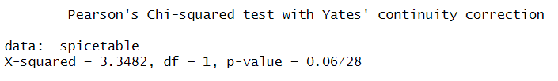
Run chi-square test
Null – there will be no significant association between gender and spice preference
Should we accept or reject the null based on this P-value?

Slide 14
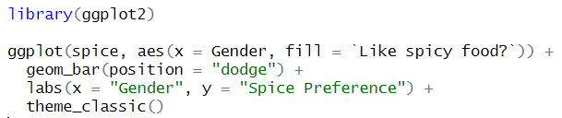
Visualise data (using ggplot2)
Call up package (install it first if needed)

Slide 15
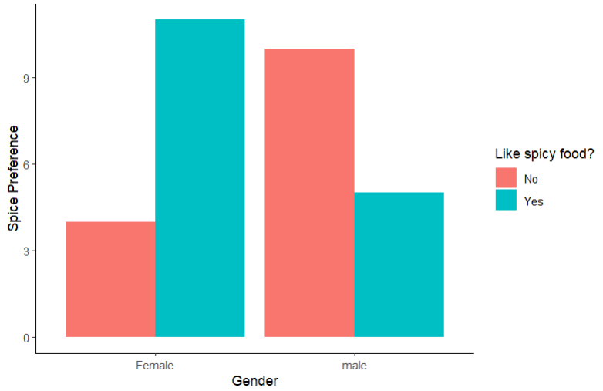

Slide 16
Over to you

Slide 17
Village weaver
Determine whether the proportion of male and female Village Weavers captured differs across months?
i.e. is there an association between sex and month?

Slide 18
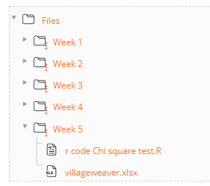
Data (excel) and r code are on Ledge

