Slide 1


Two-Way comparisons
Dr. Oluwadunsin Adekola

Slide 2
Research question: Does bird species richness differ between woodland and open grassland habitats?
Dependent variable(s) =
Independent variable(s) and number of groups =

Slide 3
Research question: Does vegetation cover differ between managed and unmanaged woodland areas?
Dependent variable(s) =
Independent variable(s) and number of groups =

Slide 4
Research question: Does understorey plant diversity vary with canopy cover level (low, medium and high)?
Dependent variable(s) =
Independent variable(s) and number of groups =

Slide 5
Dependent variable(s) =
Independent variable(s) and number of groups =
Research project: Investigation of the effect of habitat type (forest and grassland), season (wet and dry), and place of capture (England, Wales, and Scotland) on the body mass and wing length of Robins.

Slide 6
Choosing a test
The type of test you choose is based on:
  Type of response variable
  Type of predictor variable
    If categorical – how many groups are there? E.g. Habitat type A, B, C (3 groups)
  Distribution of data – normal or not normal?

Slide 7
Normality Testing (for measured dependent variables)
Normality means that the data in each group follow a bell-shaped (normal) distribution — most values are around the average, and fewer are at the extremes.
Think of the heights of adult humans in a population. Most people are close to the average height, and very tall or very short individuals are rarer. This makes a bell-shaped curve — that’s what “normal” looks like in statistics.
Many tests like t-tests and ANOVA assume the data are approximately normal.

Slide 8
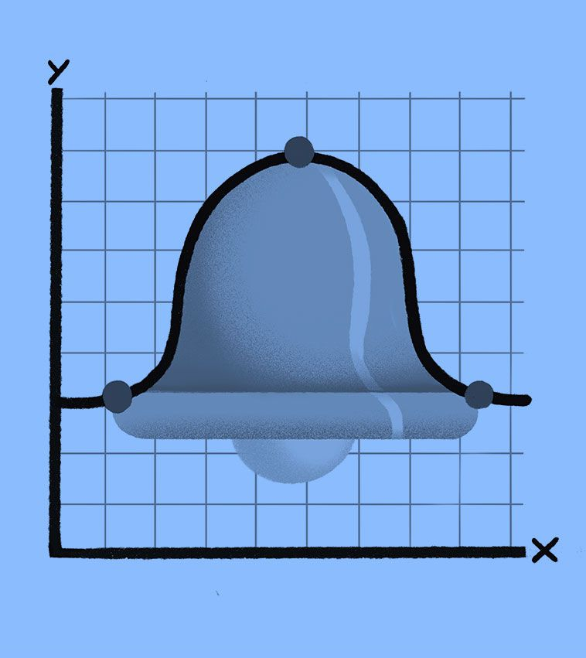
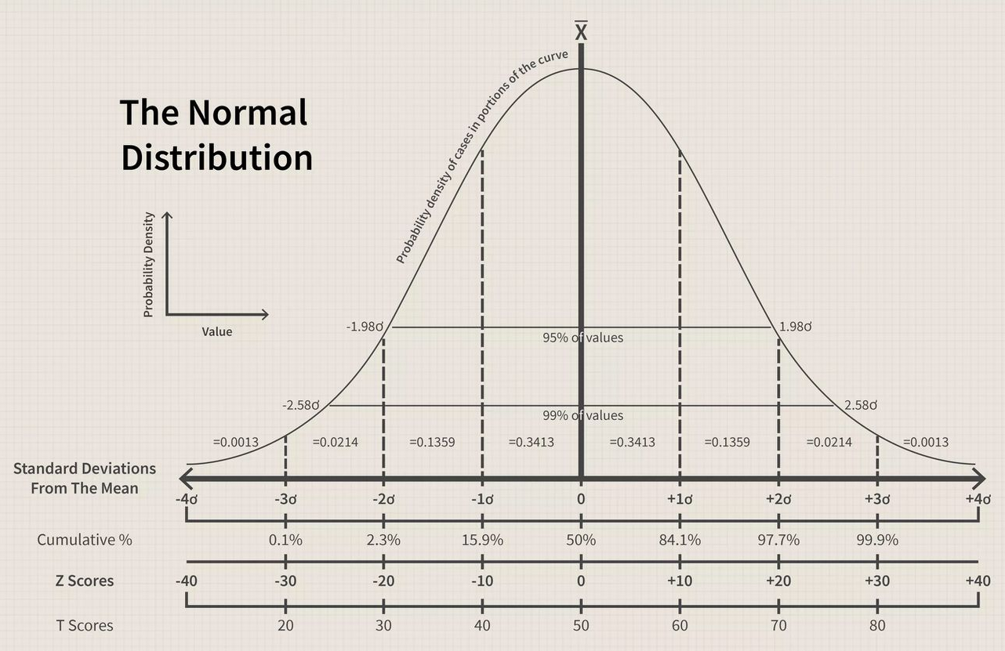

Slide 9
Normality Testing (for measured dependent variables)
Appropriate test: Shapiro-Wilk Test
If the output’s P value ≥ 0.05, it means that the data is normally distributed.
If the output’s P value < 0.05, it means that the data is not normally distributed.
To be employed on a measured dependent variable.

Slide 10
Homogeneity of Variance Testing (for measured dependent variables)
“Homogeneity of variance” just means that the spread (or variability) of the data is roughly the same in each group you are comparing.
Imagine two biscuit factories.
  Factory A makes biscuits that are all about the same size.
  Factory B makes biscuits with wildly different sizes.

Slide 11
If you want to compare the average biscuit size between the two factories, it’s fairer if both factories have a similar level of variation.
If one factory is very consistent and the other is very variable, it can make the comparison less reliable — that’s what the homogeneity of variance test checks.
Most statistical tests (like independent t-tests and ANOVA) rely on the assumption that:
  The variability within each group is about the same.

Slide 12
Can you test for homogeneity of variance for a paired t.test?
  Yes or No? Why?
For a paired t.test, you are not comparing the variances of two independent groups. Instead, you're analysing the difference between paired values.
Unlike an independent t-test or ANOVA, there’s no separate homogeneity of variance assumption to test between groups.

Slide 13
Homogeneity of Variance Testing (for measured dependent variables)
Appropriate test: Levene’s Test
If the output’s P value ≥ 0.05, it means that there is homogeneity of variance in the data and it fulfils the assumptions of normal distribution.
If the output’s P value < 0.05, it means that there is no homogeneity of variance in the data and it does not fulfil the assumptions of normal distribution.
To be employed on a measured dependent variable.

Slide 14
Parametric and Non-Parametric Tests
Does the continuous variable pass the normality and homogeneity of variance tests?
YES
NO
Parametric tests
Non-Parametric tests

Slide 15
Parametric Test
Non-Parametric Test
One category (e.g., habitat type) with two groups (e.g., woodland and grassland) vs one or more a continuous variables (e.g., bird richness).
Appropriate test: Independent student’s T-Test aka Unpaired T-Test.
One category (e.g., habitat type) with two groups (e.g., woodland and grassland) vs one or more a continuous variables (e.g., bird richness).
Appropriate test: Mann-Whitney U Test.

Slide 16
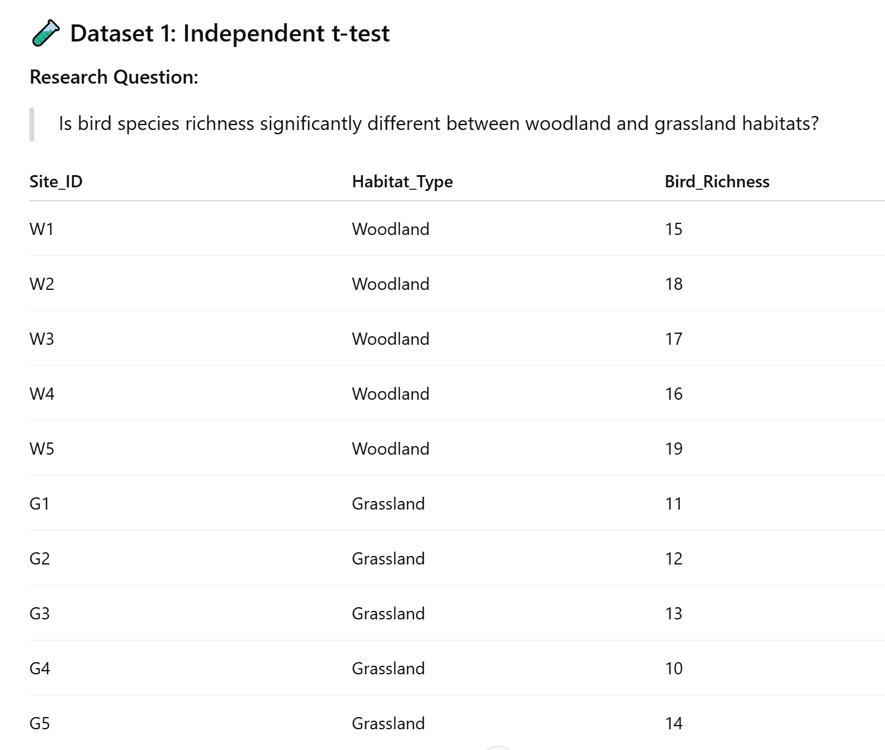
Also called unpaired t-test, this test compares the means of two separate, independent groups.
When to use:
  You have two different groups of subjects or sampling units.
  There’s no relationship between the measurements in one group and those in the other.

Slide 17
Parametric Test
Non-Parametric Test
One category (e.g., rainfall timing) with two groups (e.g., before and after) vs one or more a continuous variables (e.g., invertebrate abundance).
Appropriate test: Dependent student’s T-Test aka Paired T-Test.
One category (e.g., rainfall timing) with two groups (e.g., before and after) vs one or more a continuous variables (e.g., invertebrate abundance).
Appropriate test: Wilcoxon-Signed Rank Test.

Slide 18
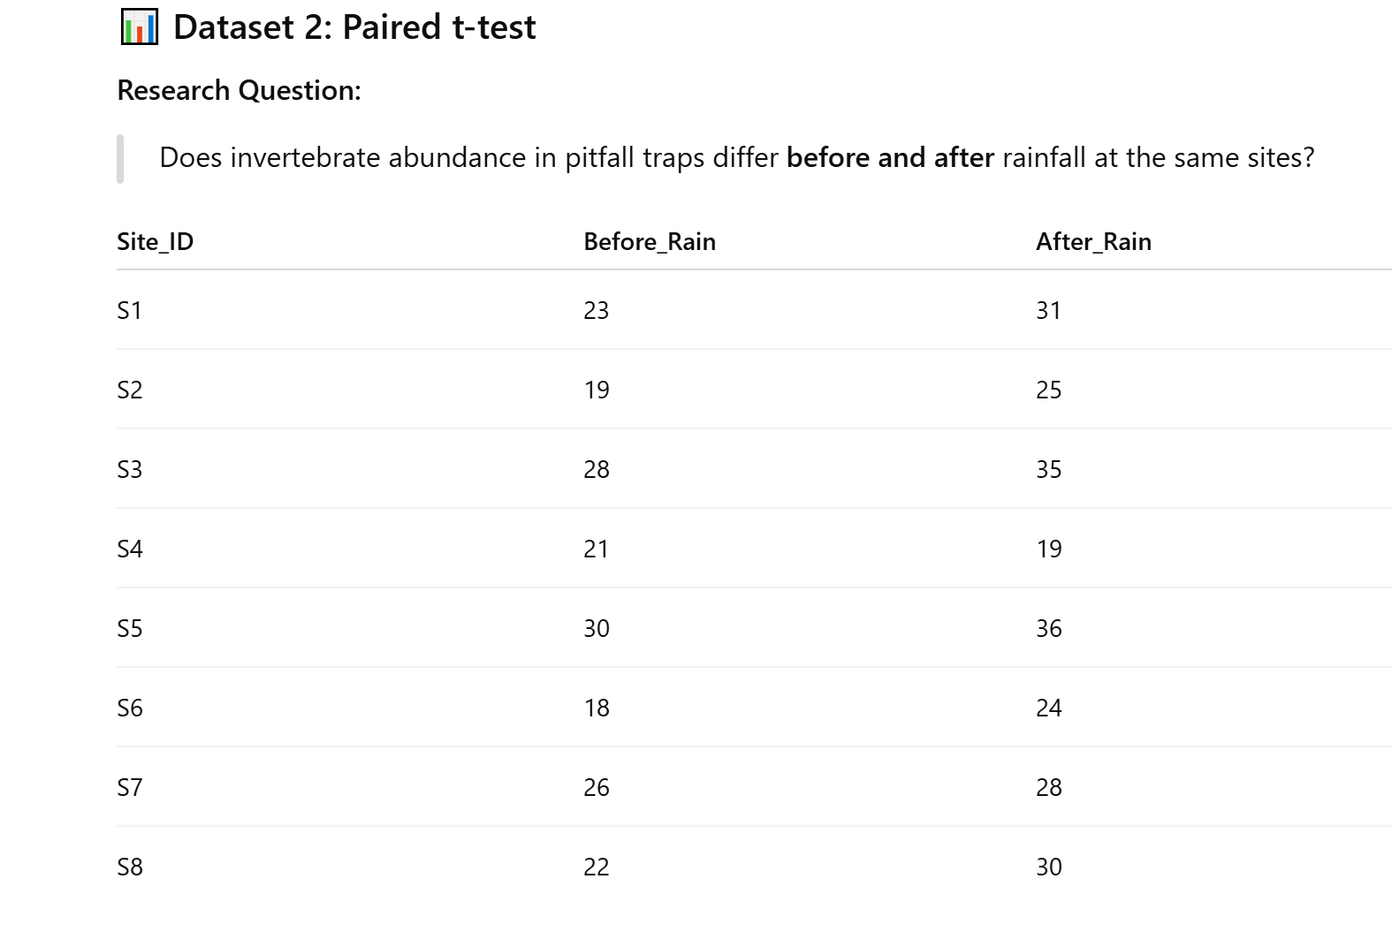
Also called dependent t-test, this compares the means of two related or matched measurements — essentially, you’re looking at the same sampling unit measured twice (before vs after, or under two conditions).
When to use:
  You have the same individuals, sites, or plots measured under two conditions or at two time points.
  There’s a natural pairing between the two sets of data.

Slide 19
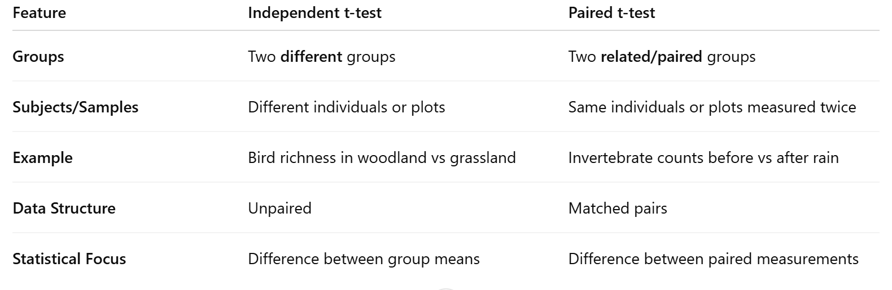

Slide 20
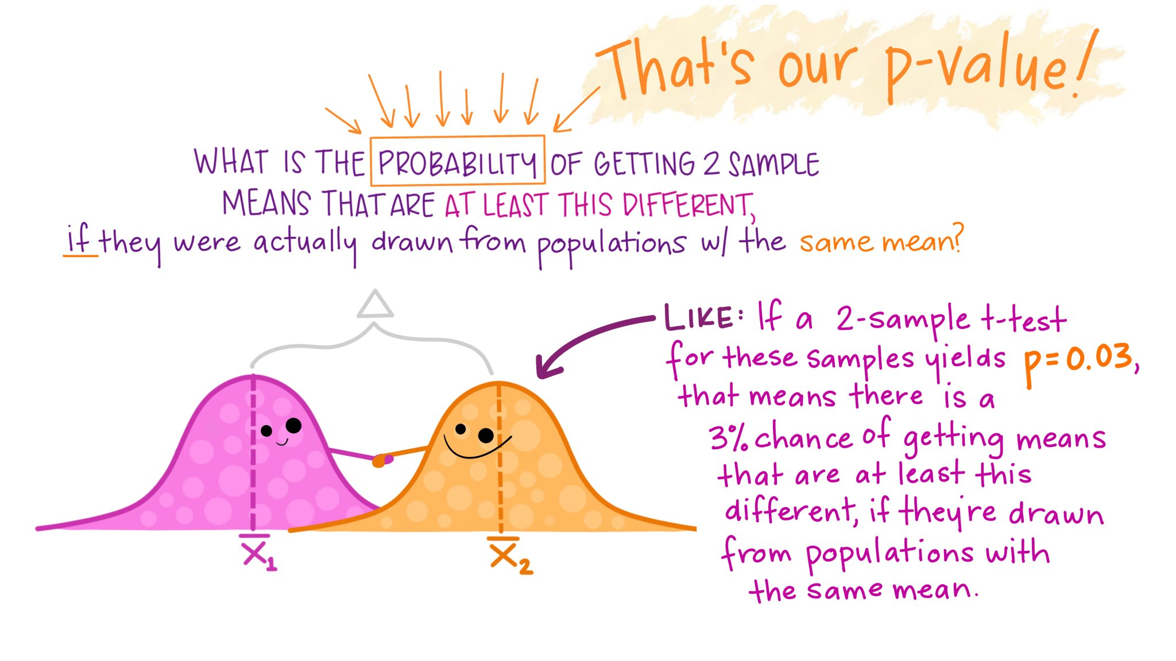

Slide 21
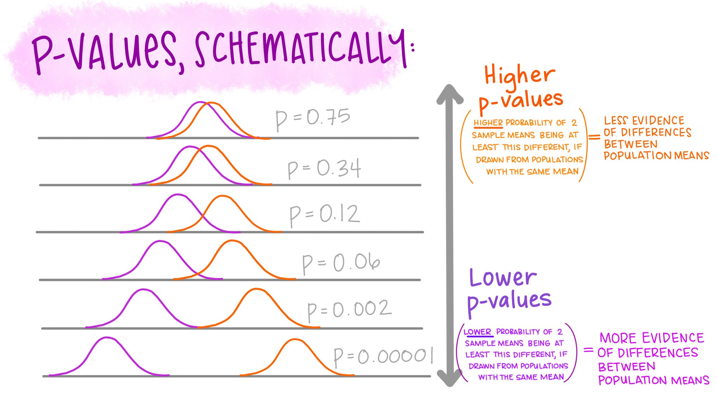

Slide 22
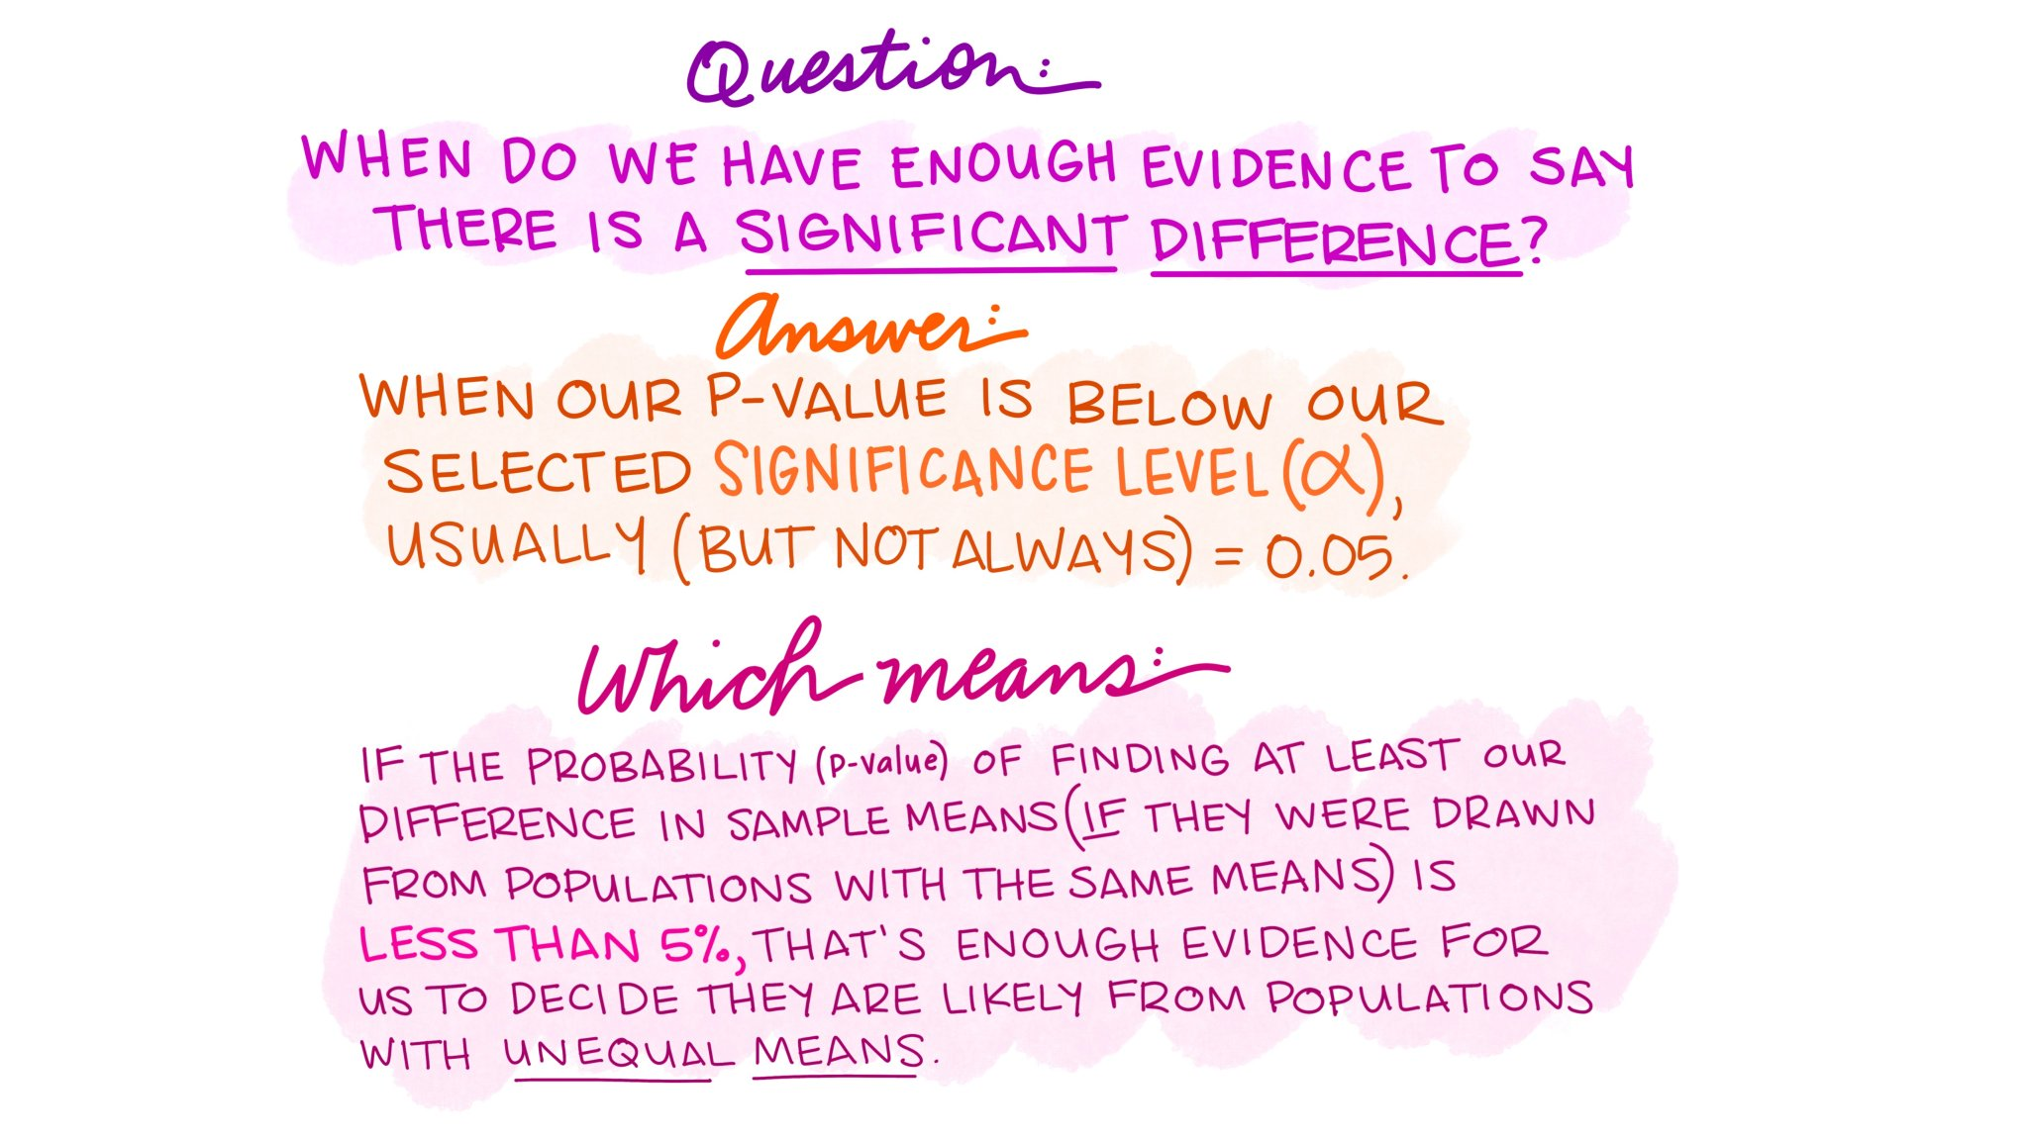

Slide 23
Type(s) of predictor variable(s) | Number of levels | Independent? | Normal distribution? | Test to use
Categorical | 1 | - | Normal | One-sample t test
 | 2 | Independent | Normal | Independent-sample t test
 |  |  | Not normal | Mann-Whitney test
 |  | Not-independent | Normal | Paired sample t test
 |  |  | Not normal | Wilcoxon matched-pairs test
 | ≥2 | Independent | Normal | One-way ANOVA
 |  |  | Not normal | Kruskal-Wallis test
 |  | Not-independent | Normal | Repeated-measures ANOVA
 |  |  | Not normal | Friedman test
Continuous | - | - | - | Linear regression
Categorical &/or Continuous | - | - | - | General linear model
Categorical &/or Continuous | - | - | - | Binary logistic regression
 |  |  |  | Chi-squared test (big samples) or Fisher's Exact test (small samples)

