Slide 1


Importing data into R
Dr. Oluwadunsin Adekola

Slide 2


Village Weaver Ploceus cucullatus
Male
Female

Slide 3
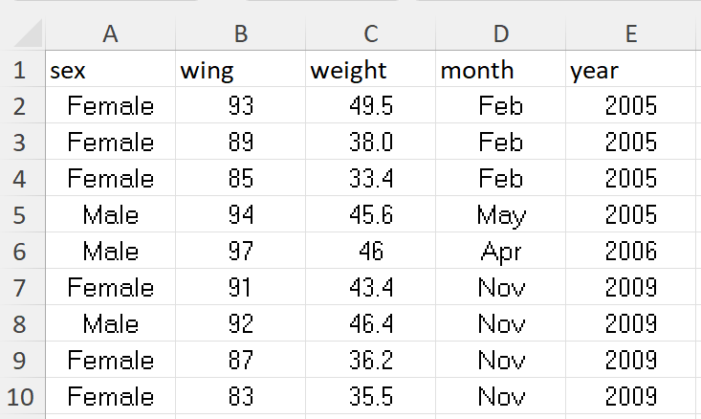

Slide 4
There are different ways of setting working directory.
Create a folder on your computer
Move the excel file into the folder
The easiest format to read data in R is ‘comma-delimited’, with the extension ‘csv’
Remember that the file with you is an excel file. So, you need to convert it to ‘csv’.

Slide 5
To do this:
  Open the excel file ‘Village Weaver’
  Click on ‘File’ → Save as or Save a copy → change from ‘xlsx’ to ‘csv (comma delimited)’ → save
  Confirm that the ‘csv’ file is saved in your working folder
Now open Rstudio
  Click on ‘Session’ → ‘Set Working Directory’ → ‘Choose Directory’
  Then navigate to your created folder and click ‘Open’
  You can confirm that you have done this by checking under ‘Console’ and you will see something like this ‘setwd(“the path to your folder”)’

Slide 6
To import the ‘csv’ file into R, we will use the ‘read.csv’ command.
The R function that reads ‘.csv’ files is called read.csv().
This will read the data, but it would not do anything useful with it.
So, we must give it a variable name.

Slide 7
The full command is:
VariableName <- read.csv('villageweaver.csv')
You can choose any name as your variable name. However, it is best to choose a name that is short but holds some clues of what the object contains. Remember - R is case sensitive!

Slide 8
If you look closely at the top right window, under the ’Environment’ tab, you can see that RStudio now lists the object “vw” and tells us that there are 266 observations of 5 variables.
We want to be sure that our data have been read in correctly. R has a number of functions that help us do so.
Some of them are:
  names(); head(); tail(); dim(); summary(); str()
We will explore all these in RStudio

Slide 9
Computing basic statistics
R includes functions that compute a wide range of numerical and graphical summaries.
In R, the dollar sign ($) is used to extract components of a list or data frame.
For example, if you have a data frame named “vw” with columns “month" and “year", you can access the “year" column using “vw$year”.
It’s a convenient way to subset and access specific parts of data structures in R.

Slide 10
Choosing a test
The type of test you will use is based on:
  Type of outcome variable
  Type of predictor variable
    If categorical – how many levels are there? E.g. Habitat type A, B, C (3 levels)
  Data points – are they independent or not?
  Distribution of data – normal or not normal?

Slide 11
Type(s) of predictor variable(s) | Number of levels | Independent? | Normal distribution? | Test to use
Categorical | 1 | - | Normal | One-sample t test
 | 2 | Independent | Normal | Independent-sample t test
 |  |  | Not normal | Mann-Whitney test
 |  | Not-independent | Normal | Paired sample t test
 |  |  | Not normal | Wilcoxon matched-pairs test
 | ≥2 | Independent | Normal | One-way ANOVA
 |  |  | Not normal | Kruskal-Wallis test
 |  | Not-independent | Normal | Repeated-measures ANOVA
 |  |  | Not normal | Friedman test
Continuous | - | - | - | Linear regression
Categorical &/or Continuous | - | - | - | General linear model
Categorical &/or Continuous | - | - | - | Binary logistic regression
 |  |  |  | Chi-squared test (big samples) or Fisher's Exact test (small samples)

