Slide 1


Introduction to data analysis
Dr. Oluwadunsin Adekola

Slide 2
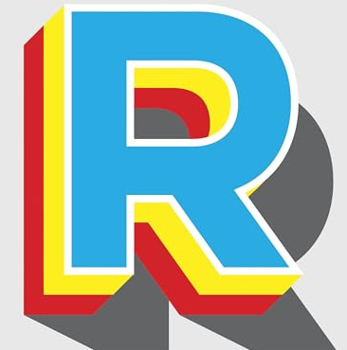
The plan for today
  Introduction to research design and analysis
  Download and Install R and Rstudio
  Getting familiar with R

Slide 3
Learning outcome
LO4:
Analyse data using inferential statistics and explain the resulting output.

Slide 4
Give you the tools to:
  Choose
  Implement
  Understand
  Report
  Interpret
    your research analysis

Slide 5

Statistics is the tool that allows us to estimate whether what we observed is likely to have arisen by chance or not
If it hasn’t arisen by chance, what is the cause?

Slide 6

Remember…
We statistically analyse samples to infer things about populations
We compare means / medians
Look for correlations
Compare frequency counts

Slide 7
Makes sure you are asking a sensible question
Makes sure that your techniques work-
Can you view all the animals at the same time?
Can you get people to take part?
Does the equipment work in the way you expected?
Does that way you have collected the data help you answer your question?
is it coded correctly ?
what is your reliability?
can you use your data appropriately for the statistics you need to run?

Slide 8

Qualitative research
Qualitative research can be used to make observations and determine a question
  Participant observation
  Unstructured or intensive interviewing
  Questionnaires
  Case studies
  Focus groups

Slide 9
Types of variables
Variable Type
Continuous
Discrete
Derived
Ranked (Ordinal)
Categorical (Nominal)

Slide 10
Types of variables
Variable Type | Definition
Continuous | Can take any value within a range; measured, not counted.
Discrete | Whole-number counts; cannot be meaningfully split into fractions.
Derived | Calculated or obtained from other variables.
Ranked (Ordinal) | Shows order or position, but not the exact difference between ranks.
Categorical (Nominal) | Distinct groups or labels with no inherent order.

Slide 11
Types of variables
Variable Type | Definition | Example
Continuous | Can take any value within a range; measured, not counted. | Height of a person (168.2 cm, 168.25 cm)
Discrete | Whole-number counts; cannot be meaningfully split into fractions. | Number of bird species seen (5, not 5.3)
Derived | Calculated or obtained from other variables. | Body Mass Index (BMI = weight ÷ height²)
Ranked (Ordinal) | Shows order or position, but not the exact difference between ranks. | Class position (1st, 2nd, 3rd)
Categorical (Nominal) | Distinct groups or labels with no inherent order. | Habitat type (forest, grassland, wetland)

Slide 12
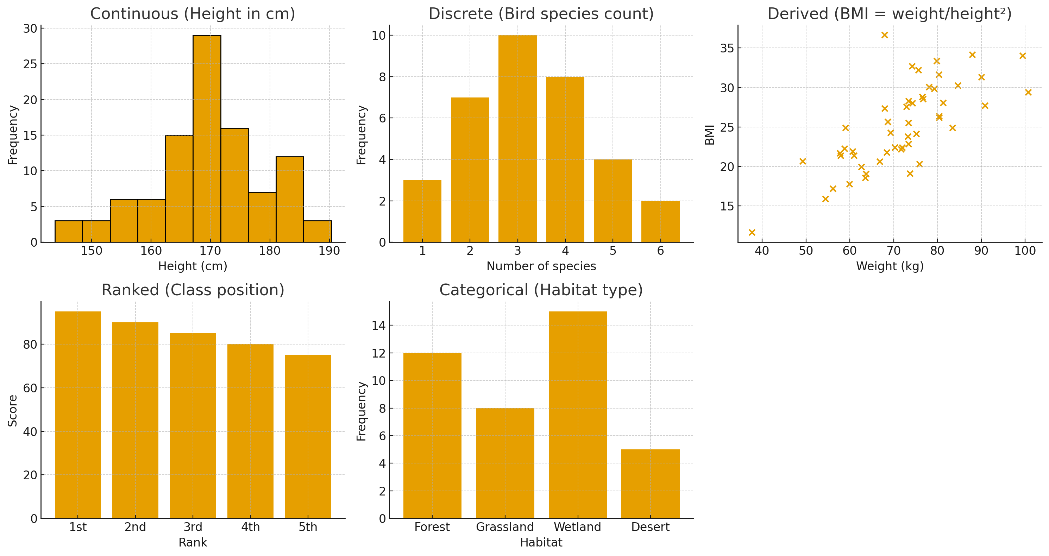

Slide 13
Variables:
  Variables that we change or are changing
    Independent variables or predictors
  Variables that we set out to measure
    Dependent variables or responses
  Variables that are not part of the design- so we either control or measure
    Extraneous variables or covariates

Slide 14

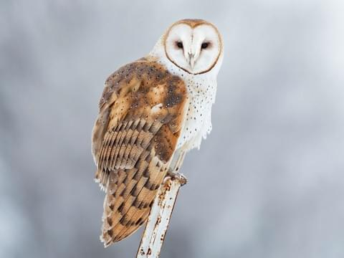
What is the response variable?
What is the predictor variable?
Is there a difference between the body mass of male and female foxes?
Is the density of owls related to the density of rodents?

Slide 15
What is the response variable?
What is the predictor variable?
Is there a difference between the body mass of male and female foxes?
  Response = body mass
  Predictor = gender
Is the density of owls related to the density of rodents?
  Response = density of owls
  Predictor = density of rodents

Slide 16
Are they categorical or continuous?
Is there a difference between the body mass of male and female foxes?
  Response = body mass
  Predictor = gender
Is the density of owls related to the density of rodents?
  Response = density of owls
  Predictor = density of rodents

Slide 17
Are they categorical or continuous?
Is there a difference between the body mass of male and female foxes?
  Response = body mass – continuous
  Predictor = gender - categorical
Is the density of owls related to the density of rodents?
  Response = density of owls - continuous
  Predictor = density of rodents - continuous

Slide 18
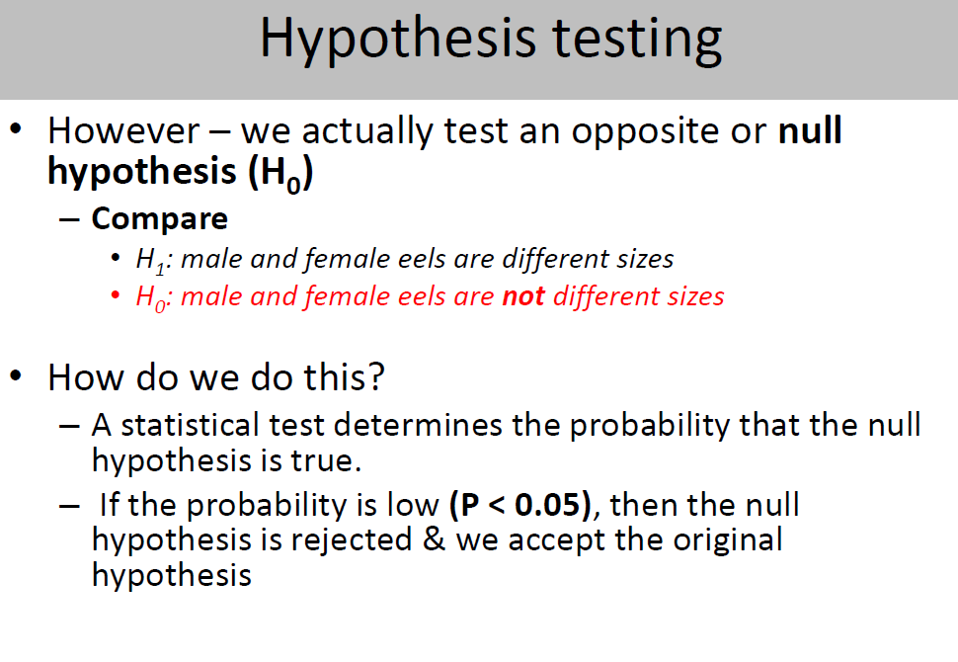

Slide 19
Experimental design
Repeated measures
Same animals in all conditions (pre, during, post enrichment)
Independent groups
Different animals in all conditions (pre, during, post enrichment)
Repeated Measures:
Example: Measuring the foraging behaviour of the same group of birds before enrichment (no extra food), during enrichment (extra food provided), and after enrichment (food removed). Each bird acts as its own control because it experiences all conditions.
Independent Groups:
Example: Comparing three separate groups of lizards: one group observed before enrichment, a second group during enrichment, and a third group after enrichment. Each group only experiences one condition, so comparisons are made between groups, not within the same individuals.

Slide 20
What are the benefits of a repeated measures design?
Less animals needed
More realistic – you would apply enrichment like this in industry
No need to worry about individual differences or participant variables

Slide 21
What are the benefits of an independent groups design?
No order effect
No extra experience

Slide 22
An Introduction to R
R is a powerful tool for statistics, graphics and statistical programming
It is a free and open-source programming language
R packages – which must be installed (one time) and loaded (each session)
Note: R is case-sensitive

Slide 23
Downloading and installing R and RStudio
It is possible to do everything just using the plain R editor and user interface. However, RStudio provides some extras (e.g. writing reports and documents) and is very popular.
Note that the statistical software is still R, RStudio just makes it easier to read and write the code and easier to interact with R.
Note that R should be installed first.

Slide 24
Downloading and installing R and RStudio
It is available for Windows, Mac and Linux
For Windows:
  Go to https://cran.r-project.org/
  Click on ‘Download R for Windows’
  Click on ‘base’
  Click on ’Download R .... for Windows’. This will download an .exe file.

Slide 25
Downloading and installing R and RStudio
Double-click on the downloaded .exe file. This will install R on your computer. Installation is straightforward, you can accept all the defaults.
  After the installation, R can be started like any other application for Windows, that is by double–clicking on the corresponding icon.
  RStudio can be found at https://www.rstudio.com/

Slide 26
For those using Mac
Install R and RStudio for Mac | RStudio | TC Technology Knowledge Base

Slide 27
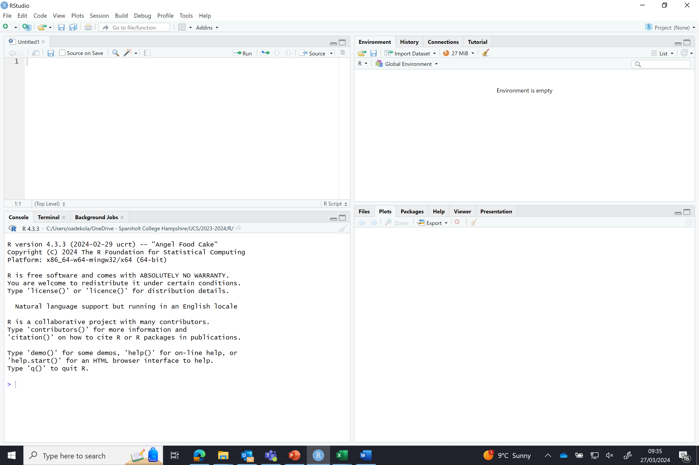
The workspace tab shows all the active objects. The history tab shows a list of commands used so far
R script editor – for text/codes
The file tab shows all the files and folders in your default workspace. The plots tab will show all your graphs. The packages tab will list a series of packages needed to run certain processes. For additional info, see the help tab
The console – for output/results

Slide 28
Using R as a calculator
When you open Rstudio, Go to ‘File → New File and click on ‘R script’.
Don’t forget to save your R script. The ‘save’ option is under ‘File’.
An R script is a collection of commands or codes.

Slide 29
Using R as a calculator
Another important aspect of scripts: annotation (comments).
Annotation contains information for you (not for R), to remind you what a particular R script does. Any information you don’t want R to read and process should be preceded by a #. When R sees a #, it ignores the rest of the line and does not attempt to do anything with it.

Slide 30
Using R as a calculator
For each line of code or command, you will need to run it.
To do this, you need to either highlight the code or place the cursor flashing after it, then click on the ‘Run’ (see next slide) button just above the top right corner of the script window.
Now look at the console window again. RStudio has sent the highlighted lines of code to the R console, which returned with the output/result.

Slide 32
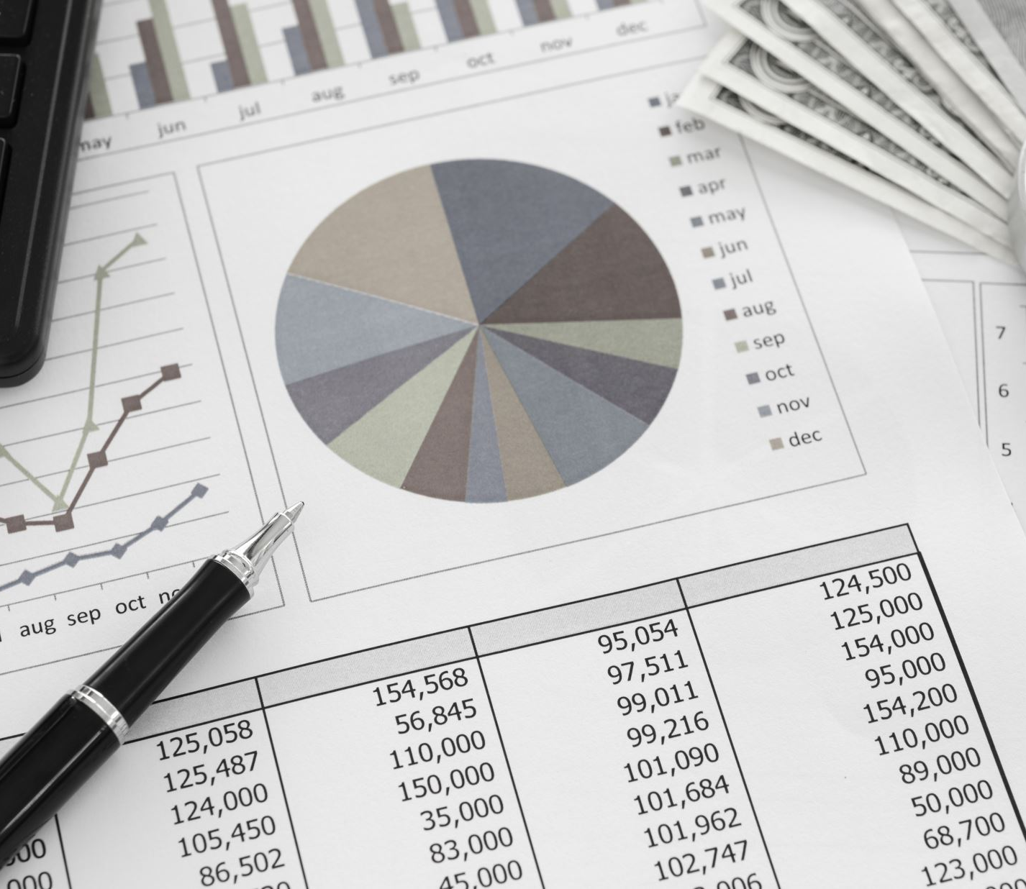
After today’s session:
You should be confident in the following areas;
  Using R as a basic calculator
  Assigning a variable
Keep the R scripts from today saved!!!

