Slide 1

Regressions

Slide 2
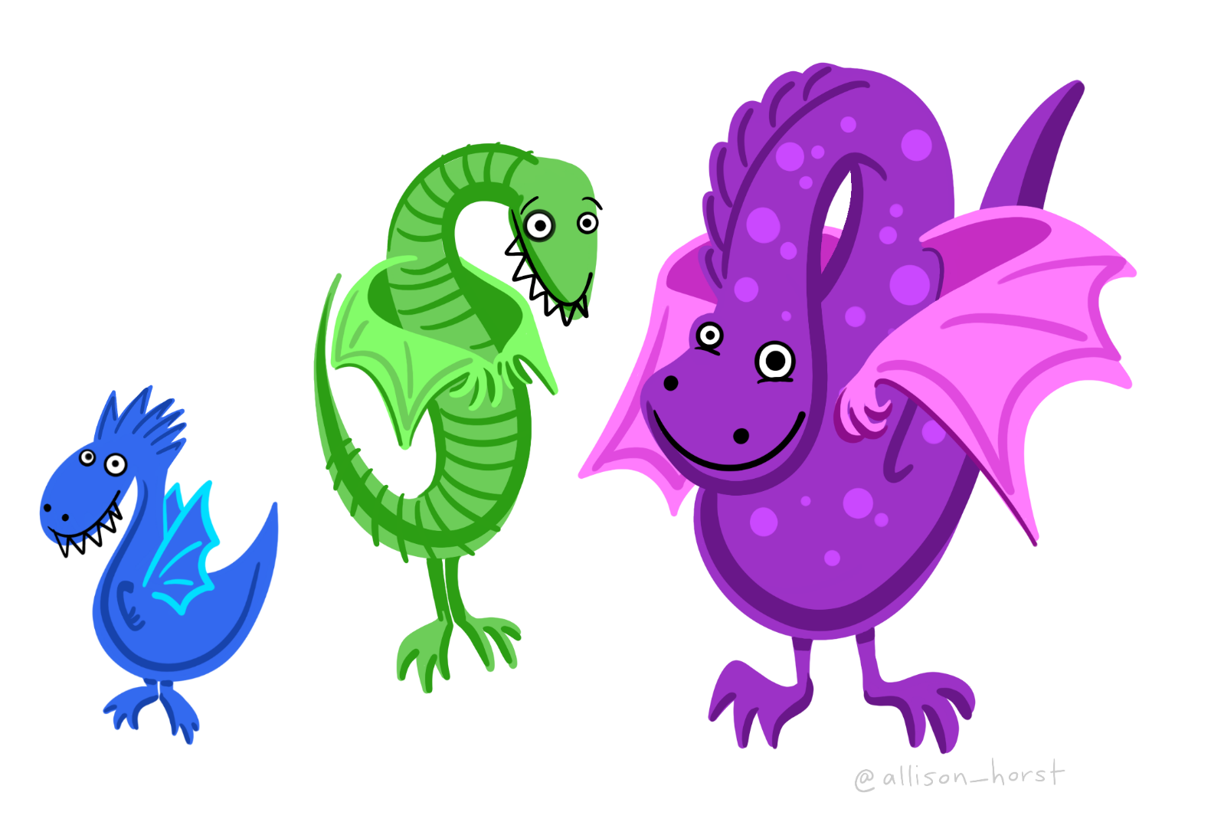
Does weight correlate with height

Slide 3
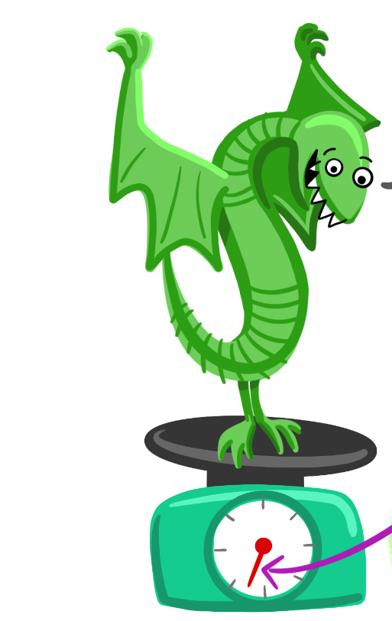
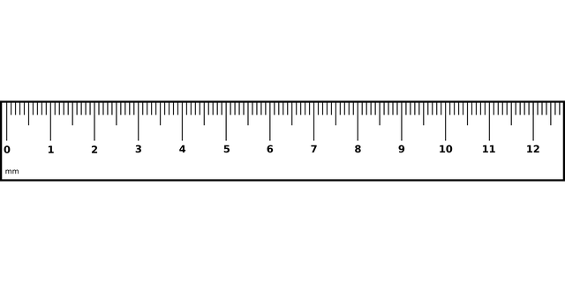
So we weigh and measure a sample of dragons

Slide 4
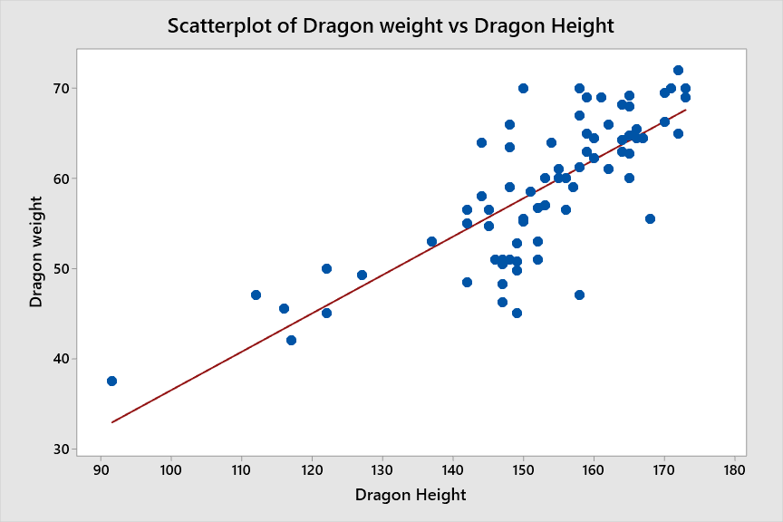


Slide 5
Correlation test
With the equation
Dragon weight= r(dragon height)
A correlation test will tell us r (the slope of the line)
We can also work out p (the probability that there is a significant association.

Slide 6
If we know how tall a dragon is, we could also predict how heavy it would be.
A regression test will give us the equation
Dragon weight= a + b(dragon height)
Where a is the intercept
And b is the slope

Slide 7
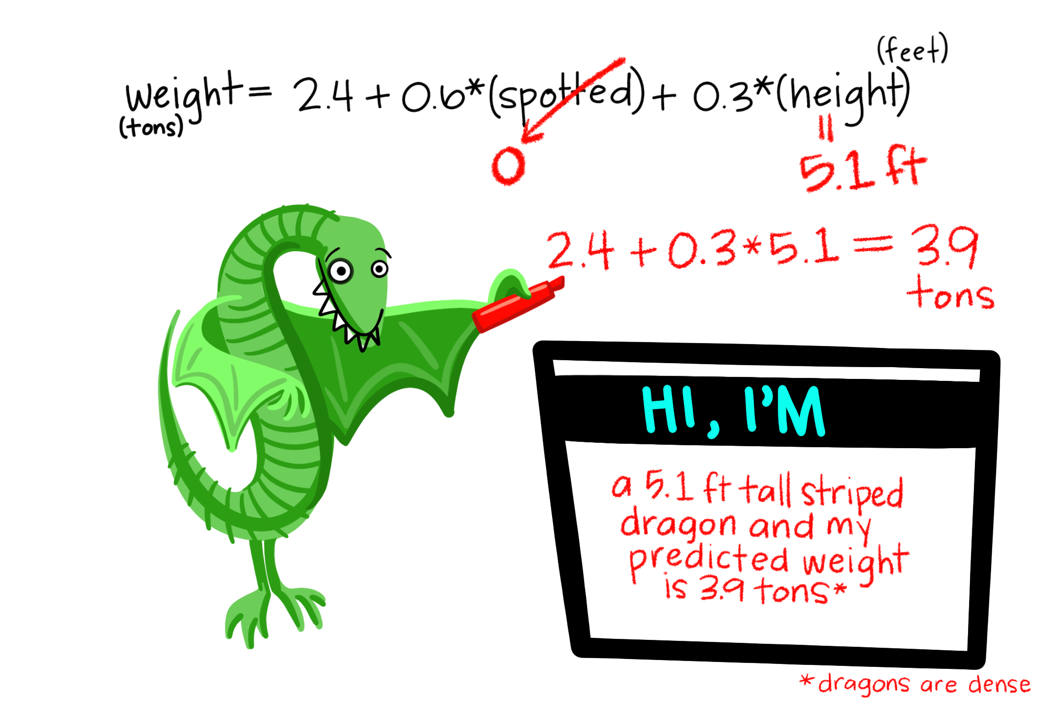


Slide 8
Assumptions
Response data should be continuous
Predictor variables should not be correlated
Data should be recorded in the order it was collected
The model should fit the data well.

Slide 9

Have a go

Slide 10
Main results
Explanation of the variation in response.
Analysis of Variance
Source DF Adj SS Adj MS F-Value P-Value
Regression 1 103.6 103.64 4.65 0.042
Outdoor temperature (oC) 1 103.6 103.64 4.65 0.042
Error 22 490.1 22.28
Lack-of-Fit 13 167.2 12.86 0.36 0.954
Pure Error 9 322.9 35.88
Total 23 593.8
Sig. relationship
F_{1,23}= 4.65, p=0.042
The test does not detect any lack of fit.

Slide 11
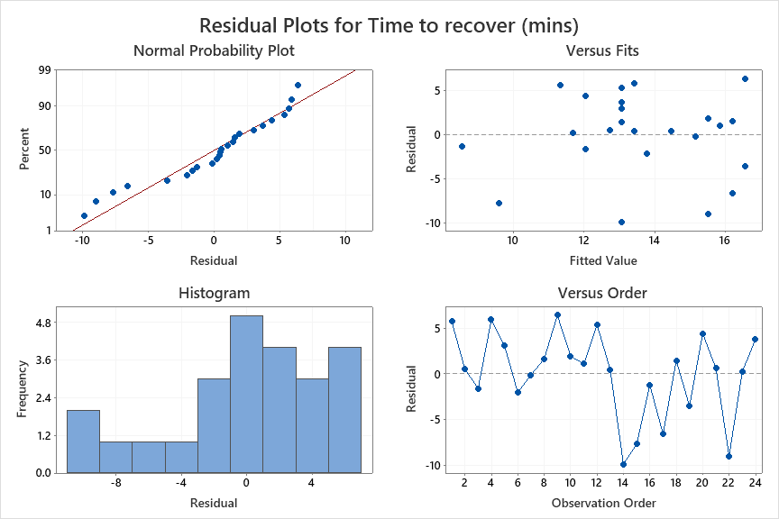

Slide 12
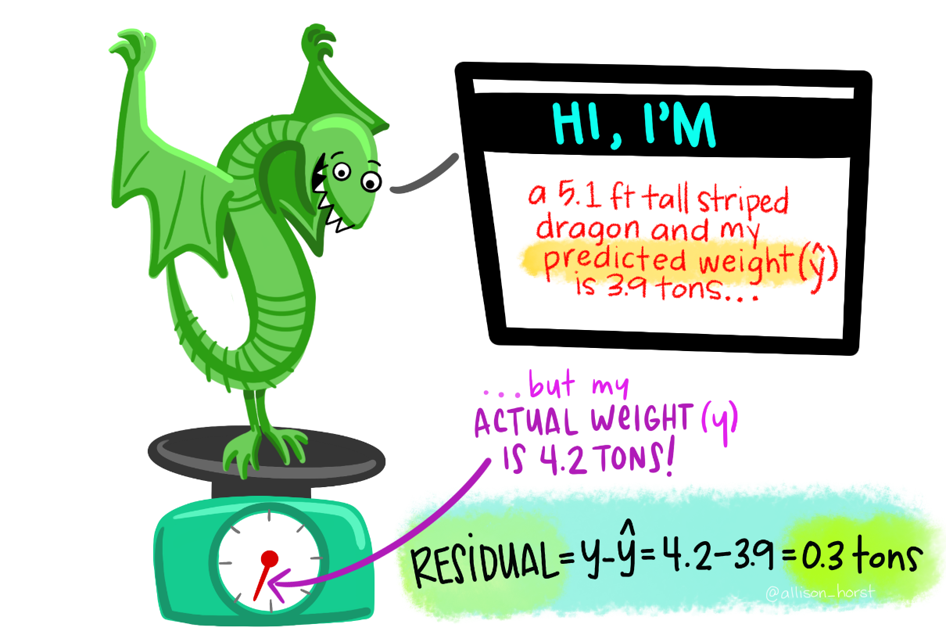
What are residuals?
Residuals are the equivalent of the results of the ANOVA for each data point.
They are calculated by
the actual result – the predicted result
y- ŷ

Slide 13
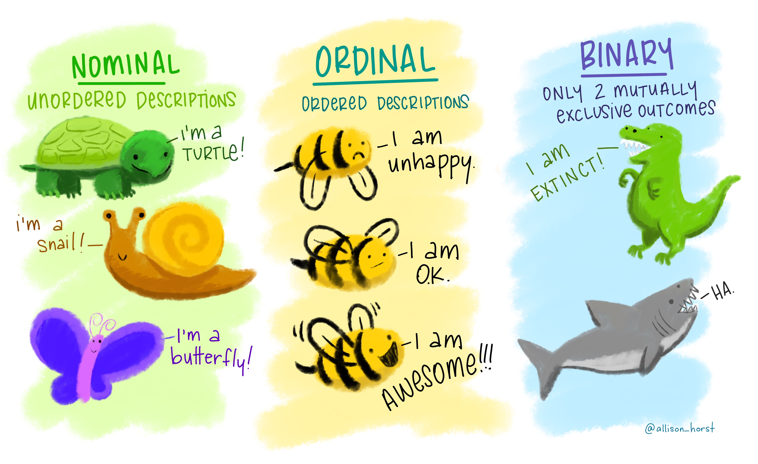
Other types of regressions
You can model non linear regressions
You can model the probability of a binary event happening
  Binary logistical regression
You can model the affect of variable on a categorical response
  Ordinal or categorical
You can model count data with a Poisson regression

