Slide 1


Data Analysis
Normality and t tests

Slide 2
Descriptive analysis
Patterns in data
Measures of central tendancy
Measures of dispersion

Slide 3
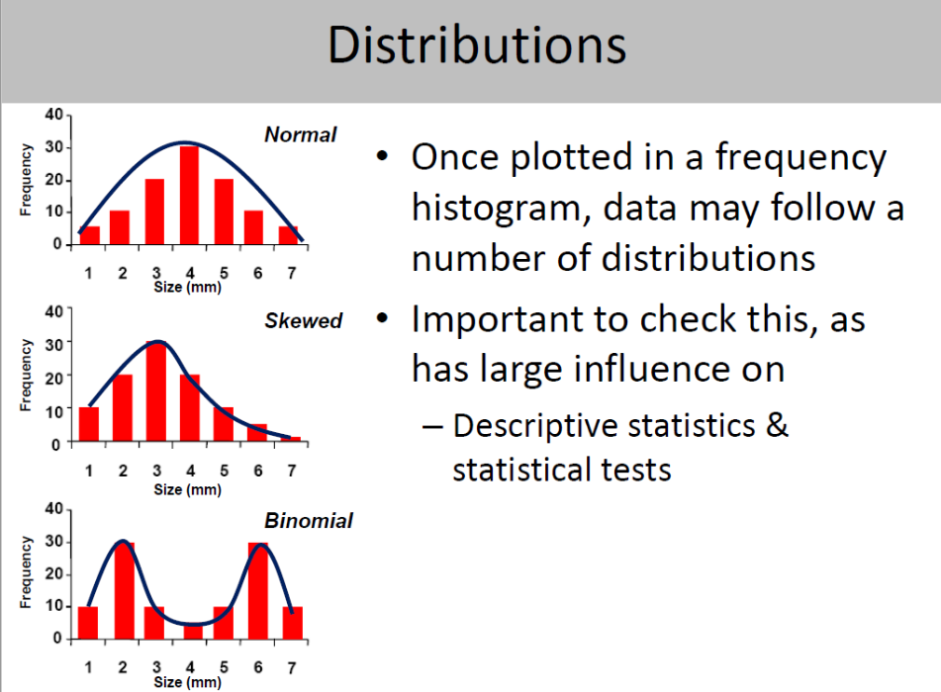




Slide 4
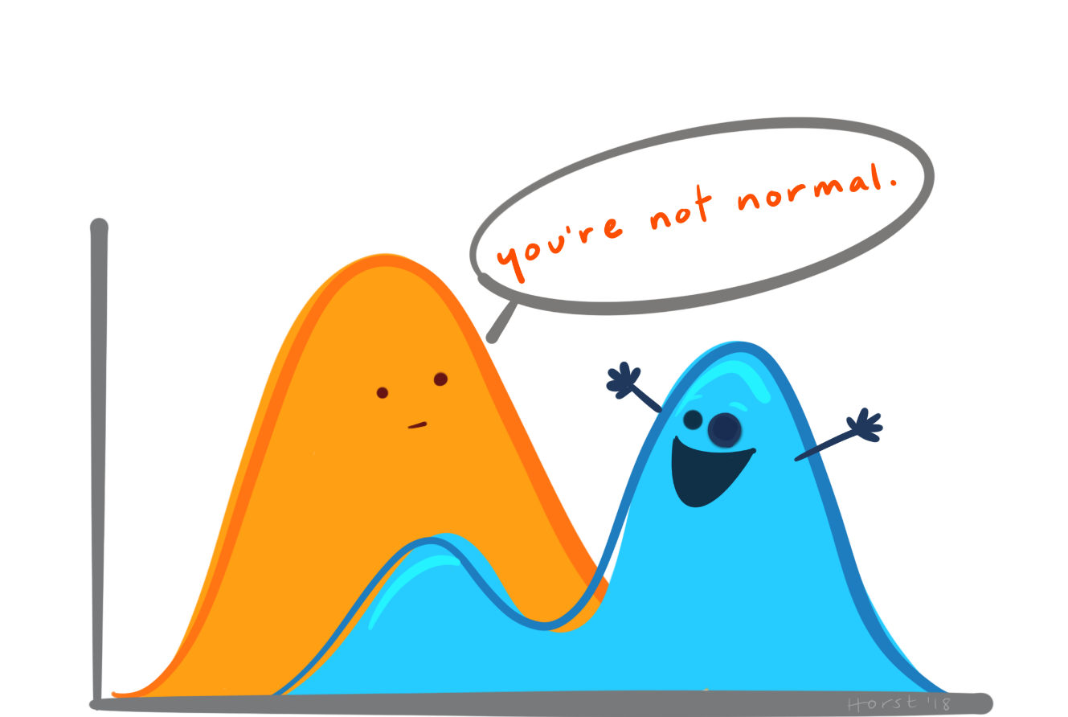
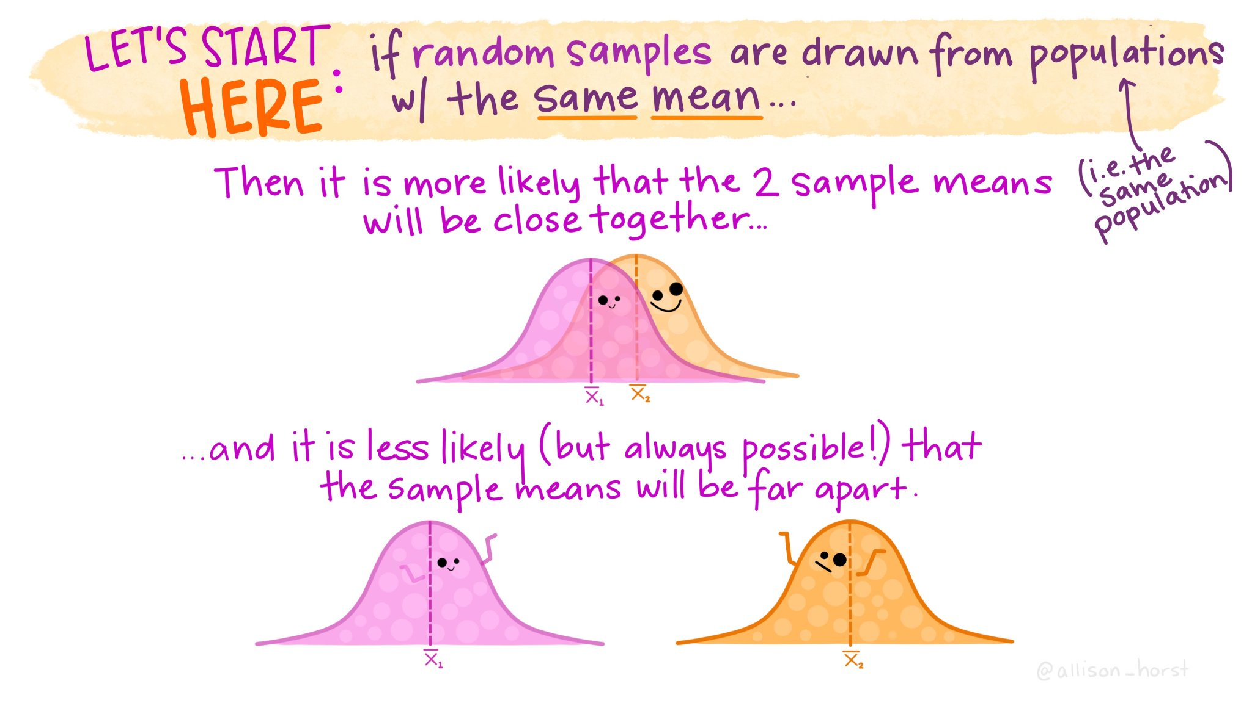
Descriptive statistics
Median
ẋ
Measurement scale Best measure
Nominal Mode
Ordinal Median
Continuous Normal- mean
Skewed - median

Slide 5
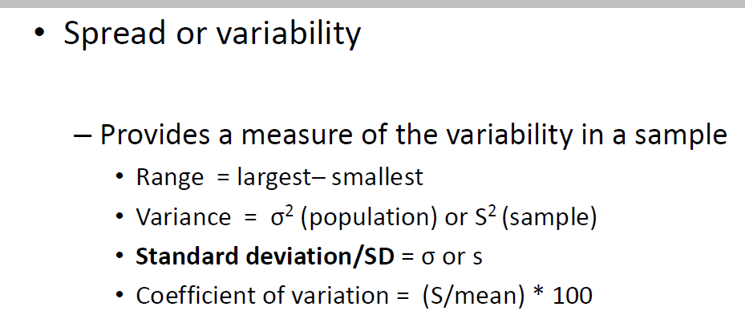
Notes:
Range- good for skew
Sd – generally used
CV good when comparing different means, not so good when mean close to 0

Slide 6
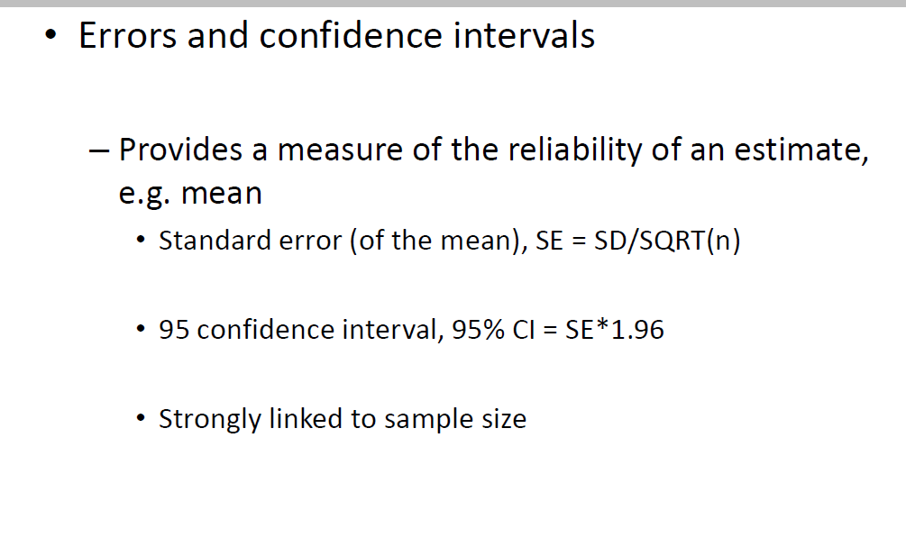
Notes:
If we are simply interested in measuring how spread out values are in a dataset, we can use the standard deviation.
However, if we’re interested in quantifying the uncertainty around an estimate of the mean, we can use the standard error of the mean.

Slide 7
Assumption tests
Test for normality
Here we are asking is there a difference between my set of data and a normal distribution.
If P<0.05 then there is likely to be a difference so data not normal
If P>0.05 then there is no evidence to assume a difference so data is normal

Slide 8
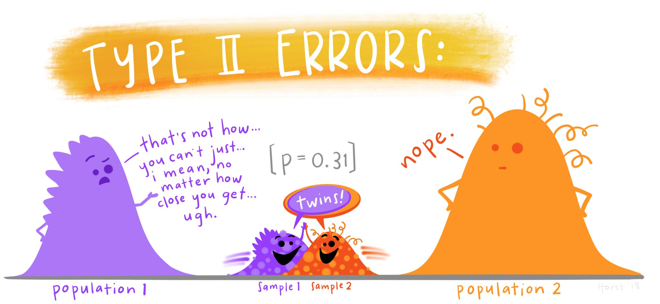
When comparing independent groups
We also need to test for equal variances

Slide 9
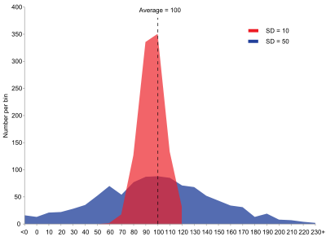
Variance

Slide 10
Equal variances
Here we are asking are the variances equal
P<0.05 likely to be different= unequal variances
P>0.05 not enough evidence to suggest a difference= equal variances

Slide 11
The 2 Sample (Independent) t-test
A parametric test applied to identify differences between two groups of animals/people.
It is a measure of the difference between the mean of each group in relation to the estimated difference between the means of the two populations from which the sample is recruited (the estimate of standard error).

Slide 13
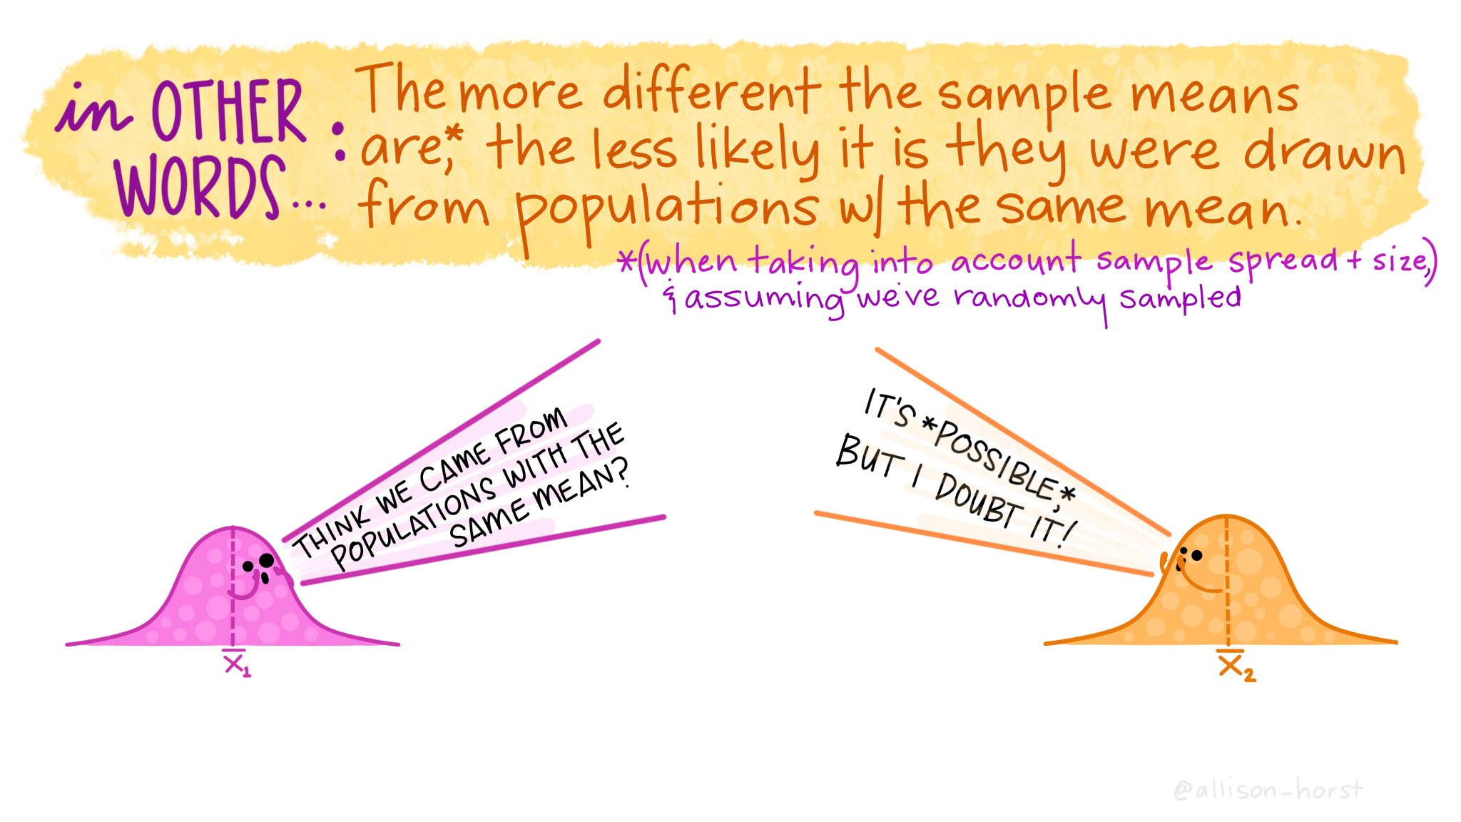

Slide 14
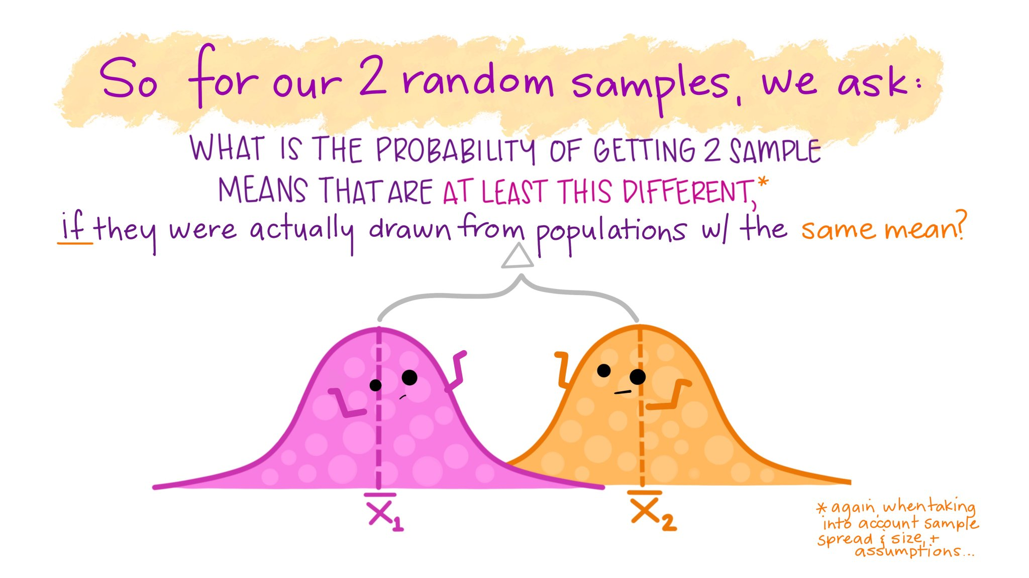

Slide 15
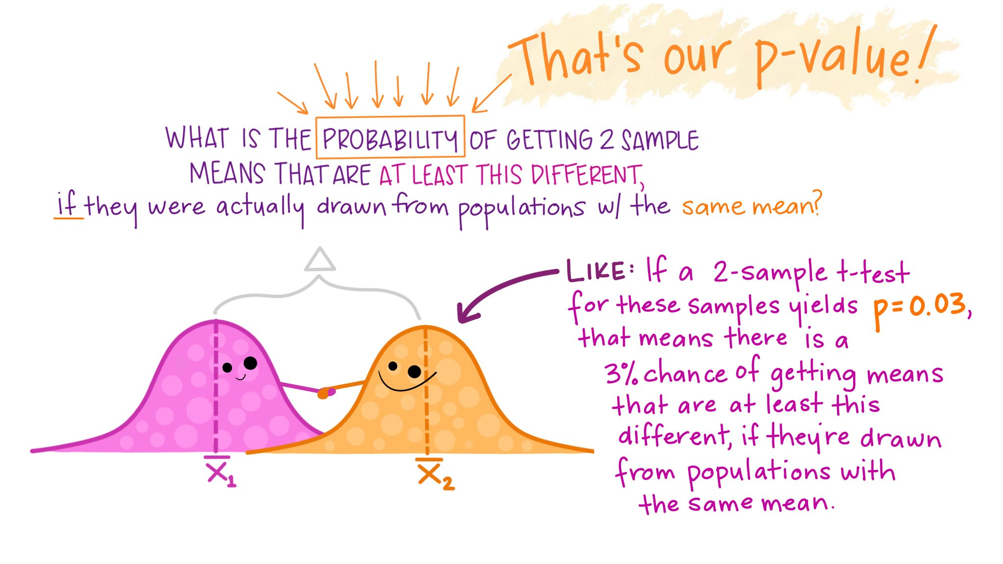

Slide 16
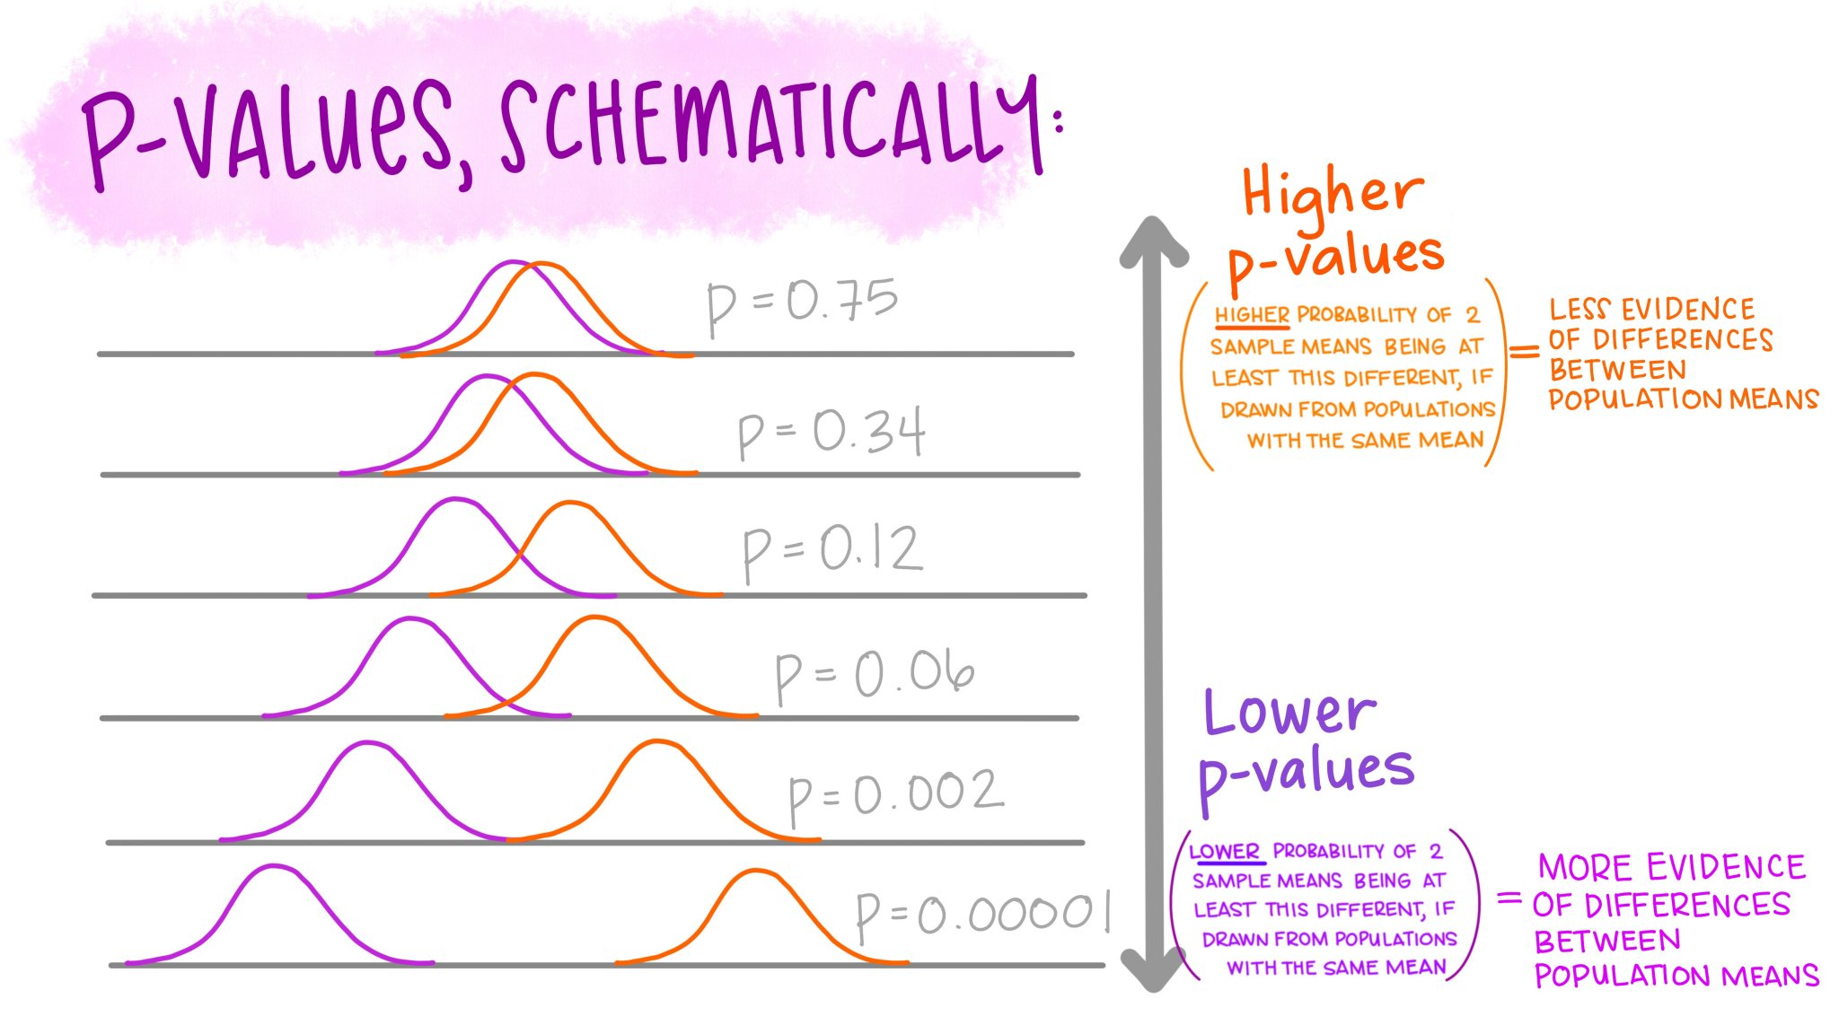

Slide 17
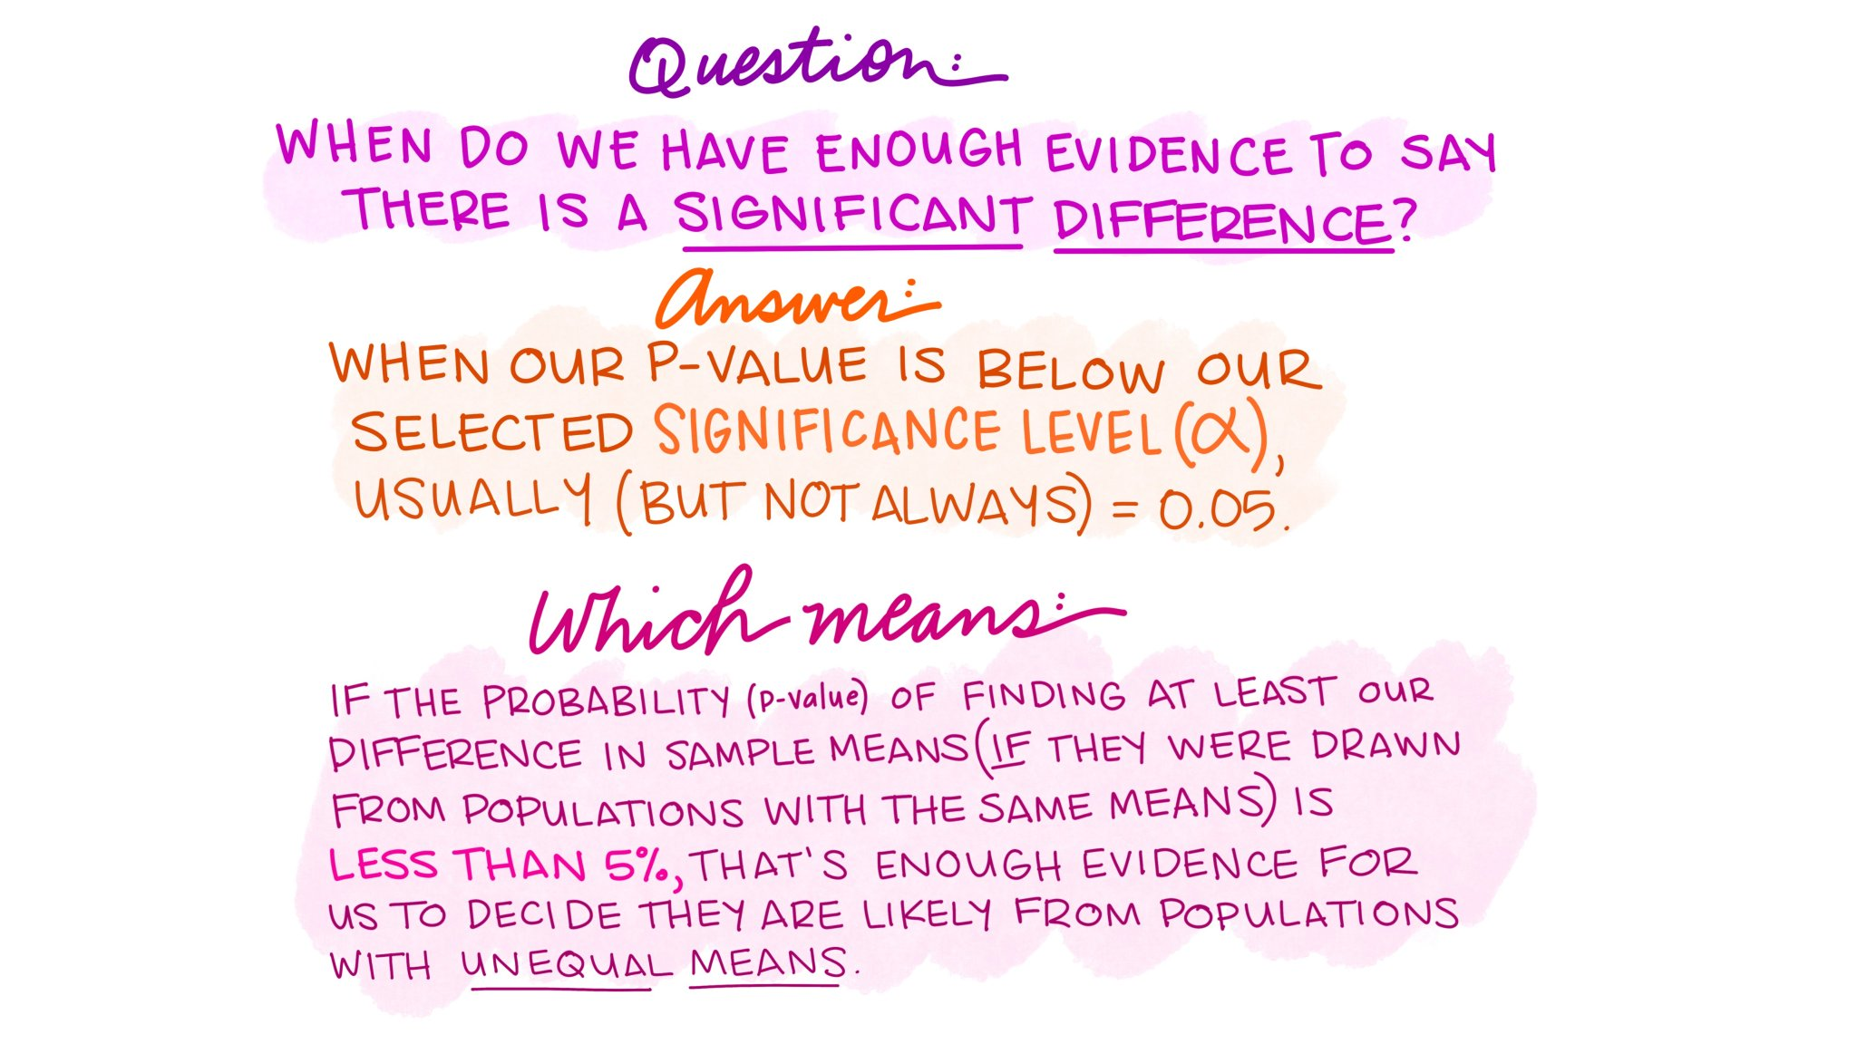

Slide 18
Assumption of a t-test
The data is normally distributed and has equal variance
Data is numerical
e.g height
Each data point between and within groups is independent
You have used an INDEPENDENT GROUPS design
You want to compare the MEANs of TWO groups

Slide 19
Each data point between and within groups is independent – each animal is in only one group and has only one data point
Pre enrichment
Individual | Day | Behaviour (time spent in min)
1 | 1 | 23
1 | 2 | 43
1 | 3 | 12
2 | 1 | 32
2 | 2 | 16
2 | 3 | 9
etc
Incorrect
Individual | Mean behaviour (time spent in min)
1 | 26
2 | 15.7
etc
Correct

Slide 20

T-test calculation
.
Group | Sample size | Sample mean | Sample standard deviation
1 | n₁ | x¯₁ | s₁
2 | n₂ | x¯₂ | s₂

Slide 21
Mann-Whitney u Test
A nonparametric test applied to identify differences between two groups of animals/people.
The nonparametric equivalent to an Independent t-test.
Like all nonparametric tests the data is ranked. The Mann-Whitney considers the sum of ranks in relation to the mean rank given sample size, in relation to the standard error.

Slide 22
Assumption of a Mann-Whitney test
The data is NOT normally distributed but must have equal variance
Data is ordinal or numerical
Each data point between and within groups is independent
You have used an INDEPENDENT GROUPS design
You want to compare the MEDIAN and SUM of RANKS of TWO groups

Slide 23
The Paired t-test
A parametric test applied to identify differences between two conditions when the same animals have participated in both conditions.
It is a measure of the average difference between scores in the two conditions in comparison to the variation (standard deviation) of the difference between scores in the two conditions, given sample size.

Slide 24
Assumption of a PAIRED t-test
Paired differences are normal
Data is numerical
e.g height
Each data point within groups is independent
You want to compare the MEANs of TWO conditions
You have used an REPEATED MEASURES design

Slide 25


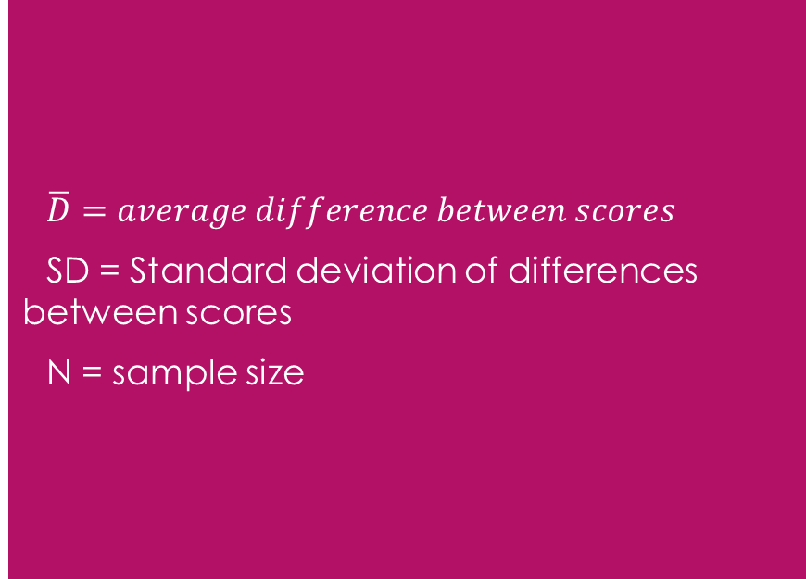
Paired t – test calculation
t = $\frac{\overline{D}}{SD/{\sqrt{N}}}$
$\overline{D}=average difference between scores$
SD = Standard deviation of differences between scores
N = sample size

Slide 26
Wilcoxon signed-rank Test
A nonparametric test applied to identify differences between the same participants in two conditions.
The nonparametric equivalent to a paired t-test.
Like all nonparametric tests the data is ranked. The Wilcoxon is based on the negative and positive rank of the differences between condition 1 and 2, given standard error and sample size(Like the paired t-test).

Slide 27
Assumption of a wilcoxon test
The data is NOT normally distributed
Data is ordinal or numerical
Each data point within conditions is independent
You have used a
REPEATED MEASURES design
You want to compare the MEDIAN and SUM of RANKS of TWO conditions

