Slide 1


Slide 2

Data Analysis
Session 1: Intro to Data Analysis

Slide 3
Learning outcomes for Data analysis
Collect, present, evaluate and undertake inferential analysis of data as part of a selected research plan.
Demonstrate competent use of relevant analytical tools and techniques, theoretical and/or conceptual frameworks and critically review literature sources.
Critically evaluate and clearly communicate arguments and ideas in a variety of ways.
Analyse data using inferential statistics and explain the resulting output.
Present and defend research/project findings in a manner suitable for an academic conference.

Slide 4
Sessions
Introduction to Data Analysis
R basics revision – dummy data
R basics revision – reorganising data
T–test revision - one-sample, independent sample & non-parametric alternatives
T-test revision – paired-sample & non-parametric alternative
Chi squared + extension
One-way ANOVA & non-parametric alternative
Repeated–measures ANOVA & post hocs
Friedman test & post hocs
Correlations, linear regression
General linear model & multiple comparisons

Slide 5

Cumulative sessions
The sessions will become progressively more complex
You need to:
  Attend every session
  Complete the practical tasks
  Revise and remember what was covered in the previous week
Keep all your notes, PowerPoint slides and practical exercises in one place so you can develop a reference folder for all things statistical
Read around the subject and practice what you have been taught

Slide 6

Today
What on
Overview of statistical analysis
Types of data/variables
Types of statistical tests
Statistical terminology
P-values
Choosing a statistical test
is statistical analysis?

Slide 7

Why is statistical analysis important?
Statistics is the tool that allows us to estimate whether what we observed is likely to have arisen by chance or not
If it hasn’t arisen by chance, what is the cause?
Notes:
But if what we observe is not likely to have arisen by chance alone, then this is interesting
Something that we have manipulated in an experiment or observed in a study seems to have had an effect

Slide 8


You can all analyse data!
You do not need to understand the underlying theory to apply and interpret statistics correctly
You just need to follow some basic rules
  Keep all your notes etc together!
In these sessions, focus on understanding the general concepts

Slide 9

You can all analyse data!
You need to know:
  What tests to use when and why
  What assumptions those tests make and how to test them
  How to enter data into a computer and run the test
  What a P value means
  How to write about the results using the correct language

Slide 10
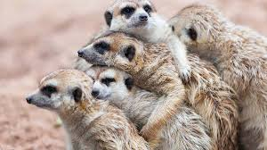
Remember…
We statistically analyse samples to infer things about populations
We compare means / medians
Look for correlations
Compare frequency counts

Slide 11

Firstly…
Outcome variable = Dependent variable
Predictor variable = Independent variable
DRY PIX

Slide 12

Types of variables – Outcome variable
What you are interested in…
Continuous
  Fish populations or diversities
  Animal species richness

Slide 13
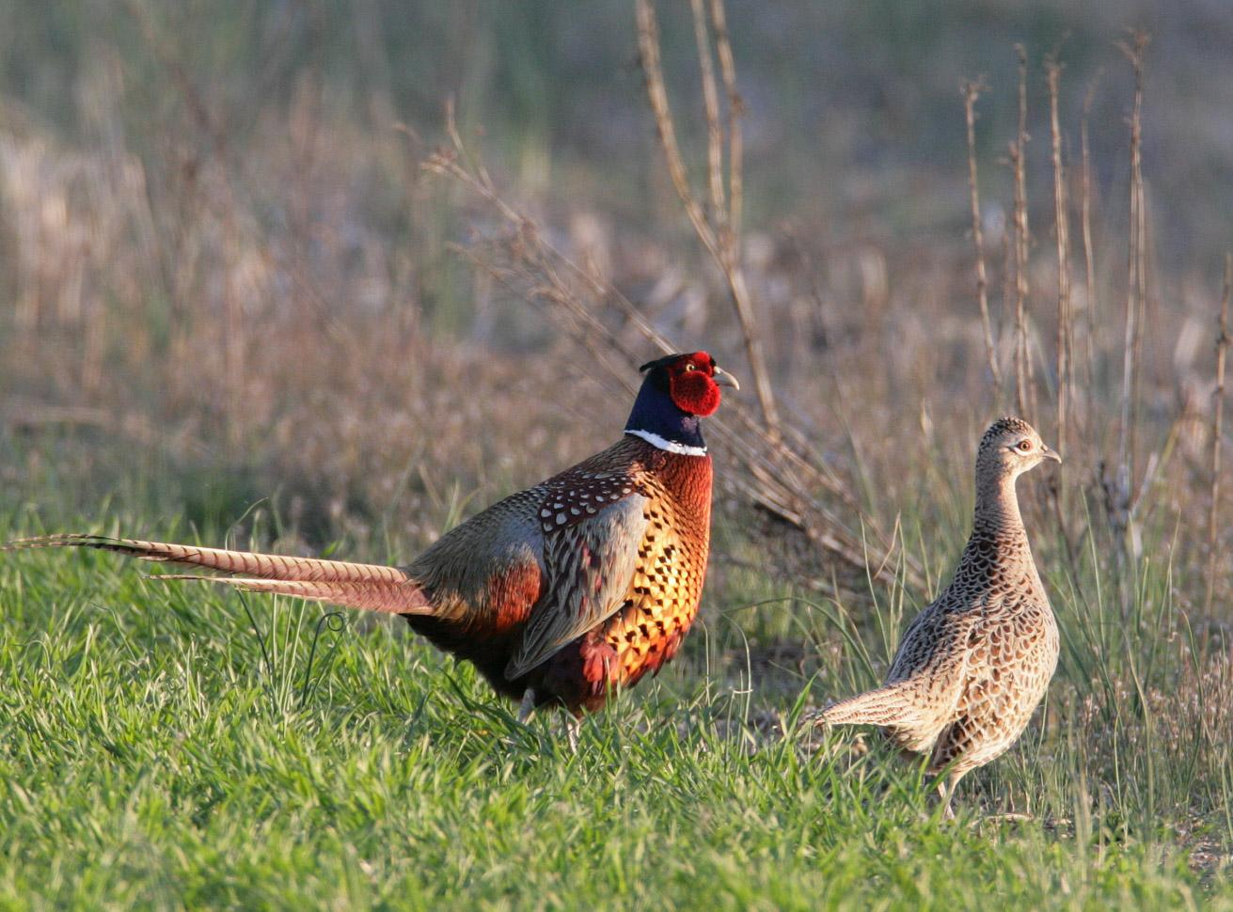

Types of variables – outcome variable
Binary
  Died / survived
  Male / Female

Slide 14
Types of variables – outcome variable
Ordinal
  Small / medium / large
  <5cm, 5-10cm, >10cm

Slide 15


Types of variables – predictor variable
What effects what you are interested in
Continuous
  Habitat heterogeneity
  Time

Slide 16
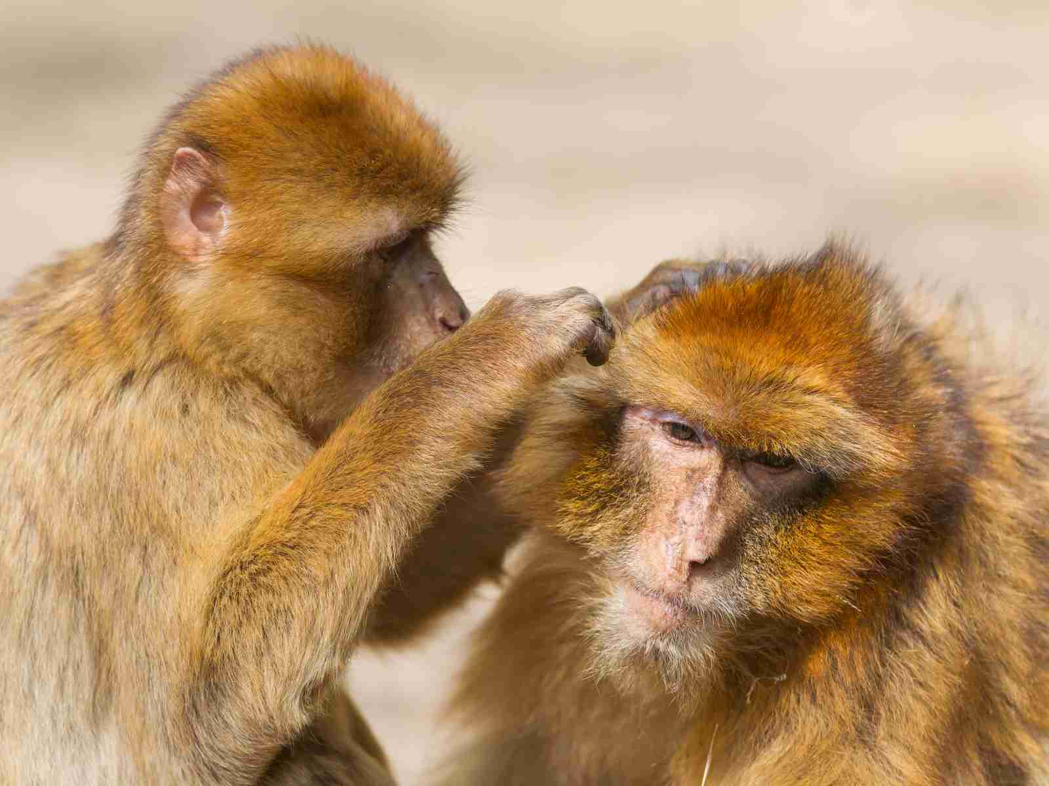

Types of variables – predictor variable
Categorical
  Habitat type A, B, C
  Animal Behaviour

Slide 17


What is the outcome variable?
What is the predictor variable?
Is there a difference between the body mass of male and female Tigers?
Is the density of fish related to the density of insects?

Slide 18
What is the outcome variable?
What is the predictor variable?
Is there a difference between the body mass of male and female tigers?
  Outcome = body mass
  Predictor = gender
Is the density of fish related to the density of insects?
  Outcome = density of fish
  Predictor = density of insects

Slide 19
Are they categorical or continuous?
Is there a difference between the body mass of male and female tigers?
  Outcome = body mass
  Predictor = gender
Is the density of fish related to the density of insects?
  Outcome = density of fish
  Predictor = density of insects

Slide 20
Are they categorical or continuous?
Is there a difference between the body mass of male and female foxes?
  Outcome = body mass – continuous
  Predictor = gender - categorical
Is the density of owls related to the density of rodents?
  Outcome = density of fish - continuous
  Predictor = density of insects - continuous

Slide 21
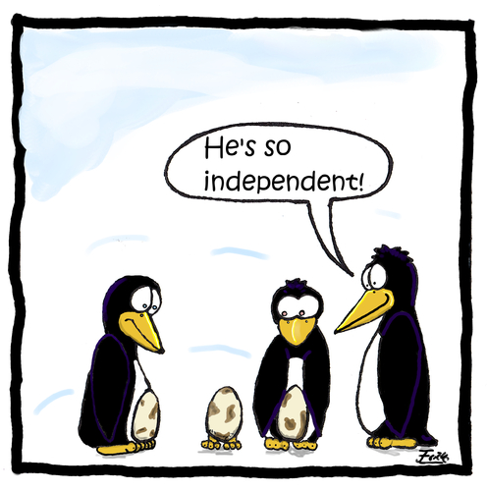
Is your data independent?
Does any data point in the data set influence any other data point?
YOU decide this when designing your experiment
E.g. Does plant diversity affect fish abundances in river margins?

Slide 22

Does plant diversity effect fish abundances at river margins?
Sample fish abundances in river margins
Ensure that:
  All collected with the same method e.g. line
  Each sample from each river margin collected at similar times
  Randomly sampled
  Recorded plant diversity at the same time
  The fish assemblage dispersal in one river margin does not overlap with that of another sampled river margin!

Slide 23

River margin sites
River margin 2
River margin 1
Sampling points

Slide 24
Independent
Fish dispersal range
River margin 2
River margin 1
Sampling points

Slide 25

Not-independent
Fish dispersal range
River margin 2
River margin 1
Sampling points

Slide 26
Did you notice anything else that may influence the samples taken from the margins?

Slide 27
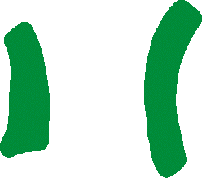
Replication & pseudo-replication
Ideally:
  Multiple River margin sites
  Return to river margin samples to take additional samples over several rounds
If the fish dispersal ranges overlap then any samples taken would be pseudo-replication

Slide 28
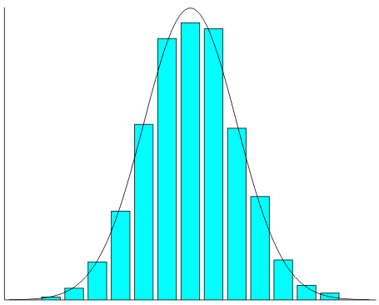
Types of tests - Parametric
Assumes data are normally distributed
Data like height of every man/woman in the UK
Most people
Frequency
Mean
Few really short people
Few really tall people
Height

Slide 29
Types of tests – Non-parametric
Assumes data are not normally distributed
E.g. Plant diversity measured in quadrats
Frequency
Mean
Plant diversity

Slide 30
Choosing a test
The type of test you will use is based on:
  Type of outcome variable
  Type of predictor variable
    If categorical – how many levels are there? E.g. Behaviour A, B, C (3 levels)
  Data points – are they independent or not?
  Distribution of data – normal or not normal?

Slide 31
Type(s) of predictor variable(s) | Number of levels | Independent? | Normal distribution? | Test to use
Categorical | 1 | - | Normal | One-sample t test
 | 2 | Independent | Normal | Independent-sample t test
 |  |  | Not normal | Mann-Whitney test
 |  | Not-independent | Normal | Paired sample t test
 |  |  | Not normal | Wilcoxon matched-pairs test
 | ≥2 | Independent | Normal | One-way ANOVA
 |  |  | Not normal | Kruskal-Wallis test
 |  | Not-independent | Normal | Repeated-measures ANOVA
 |  |  | Not normal | Friedman test
Continuous | - | - | - | Linear regression
Categorical &/or Continuous | - | - | - | General linear model
Categorical &/or Continuous | - | - | - | Binary logistic regression
 |  |  |  | Chi-squared test (big samples) or Fisher's Exact test (small samples)

Slide 32
P-values
Did the pattern in the data arise by chance or not?
Is the difference between the means significant or not?
  P<0.05 =
Is the association between two variables significant or not?
  P<0.05 =

Slide 33
P-values
Did the pattern in the data arise by chance or not?
Is the difference between the means significant or not?
  P<0.05 = significant difference
Is the association between two variables significant or not?
  P<0.05 =

Slide 34
P-values
Did the pattern in the data arise by chance or not?
Is the difference between the means significant or not?
  P<0.05 = significant difference
Is the association between two variables significant or not?
  P<0.05 = significant association

Slide 35
Dictionary of terms - variables
Not very usefully, books & software packages use different terms to mean the same things
CATEGORICAL: also known as nominal
  Sometimes referred to as FACTORS
CONTINUOUS: also known as scalar or ratio
  Sometimes referred to as COVARIATES
ORDINAL
  Often treated as categorical / factors

Slide 36
Dictionary of terms - data
Not-independent data also known as:
  Paired
  Matched
  Repeated
  Repeated-measures

Slide 37
Your assignments!
Data report 90%
Observation task 10%

Slide 38

Next week…
Using R again
Revisiting R practice data sets

