Slide 1
Correlation stats test

Slide 2
Today working towards……….
Outlining when a correlation test is suitable.
Identifying how to complete a correlation test.
Outlining how to write the results of a correlation test.
Demonstrate completing a correlation test and write up the results.

Slide 3
What is our significant P value??
What does this mean?

Slide 4
When to do a test of correlation…
When you are testing for an association.
For example the larger the girth size the heavier the horse.
Or as age of the mare increases fertility decreases.

Slide 5
Steps to complete a test of correlation
Line your data up and sort the data points.
So high values in one should roughly equate with high or low values in the other data set.
Eye ball the data see if you can see a pattern to your data set.

Slide 6
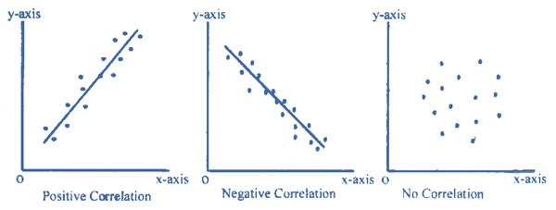
Steps to complete correlation
Use a scatterplot
Make sure you get the correct figures on the X and Y axis.
Then add a trend line (regression line)

Slide 7
Steps to complete a correlation
Calculate a coefficient of correlation
This will tell you the strength of the correlation
Anything above or below 0 is some correlation.
The nearer to plus or minus 1 the stronger the correlation.

Slide 8
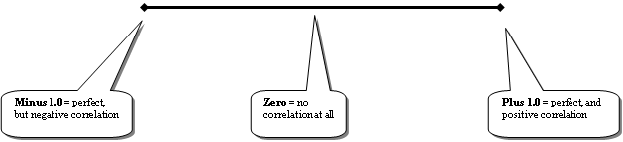

Slide 9
Steps to complete a correlation
Now we need to test to see if the association is significant
To do this we either do a spearmans or a pearsons correlation test on mini tab.

Slide 10
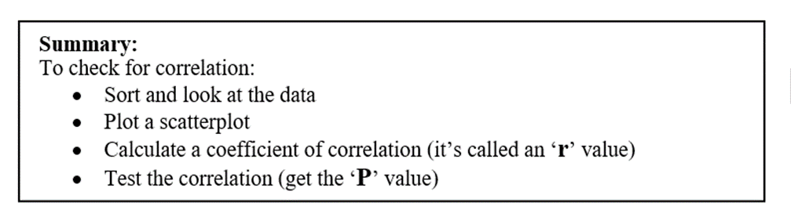
Now you guys have a go with a different data set.
Remember to test your data for normality first

