Slide 1
ANOVA and penguins

Slide 2
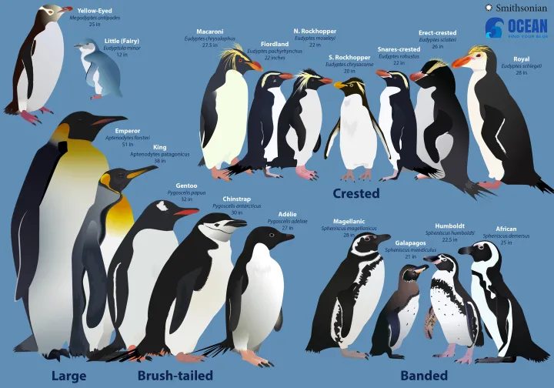

Slide 3
We are interested to see if there is a difference in flipper length between the three species.
So we measure a sample of each species.

Slide 4
ANOVA
As we have a categorical factor (species) and a continuous response (Flipper length)
And we want to determine if the population means of three groups differ.
We could use a one way ANOVA to compare the results

Slide 5
Assumptions
The design is an independent design- each group is a different species (not repeated measures).
The data points are independent (not affected by others in the group).
The response data is continuous
You only have one categorical fixed factor (independent variable)
The sample data should be from a normally distributed population (or large sample size (15-20)

Slide 6
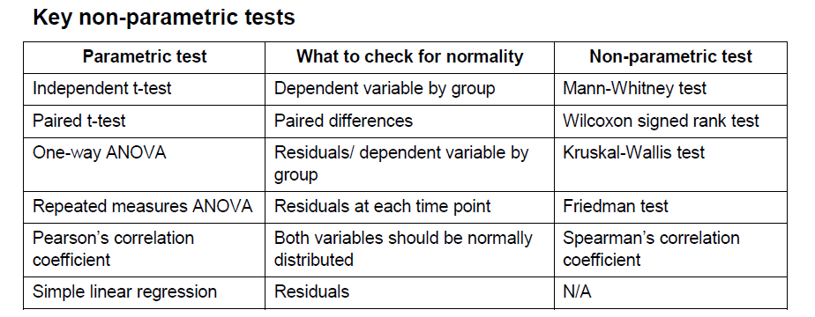
Checking for normality

Slide 7
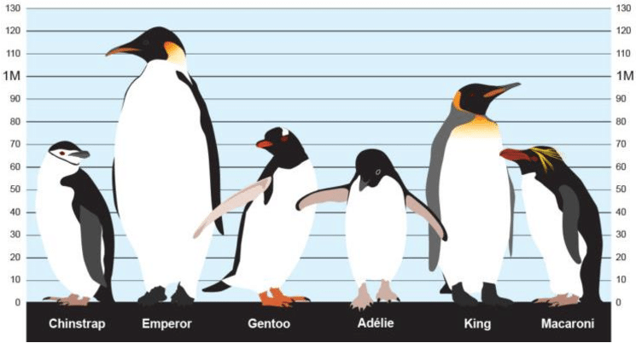
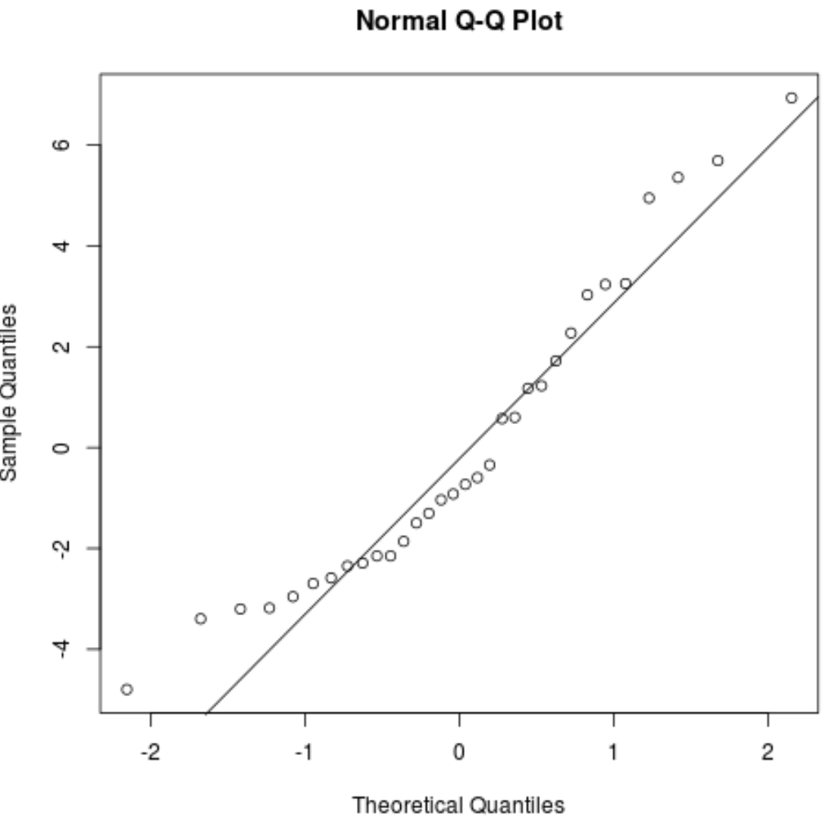

Slide 8
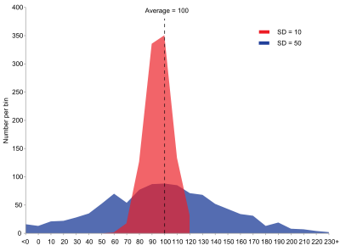
Test for equal variance
You will also need to ensure the variances are equal.
If this is not the case there is a slight variation that can be made.

Slide 9
Equal variance
Test this with test for equal variance- use multiple comparisons unless < 20 sample observations each.
The distribution for one or more of the populations is extremely skewed or has heavy tails. If so use Levene’s
Notes:
Because the susceptibility of different procedures to unequal variances varies greatly, so does the need to do a test for equal variances. For example, ANOVA inferences are only slightly affected by inequality of variance if the model contains only fixed factors and has equal or almost equal sample sizes. Alternatively, ANOVA models with random effects and/or unequal sample sizes could be substantially affected.

Slide 10
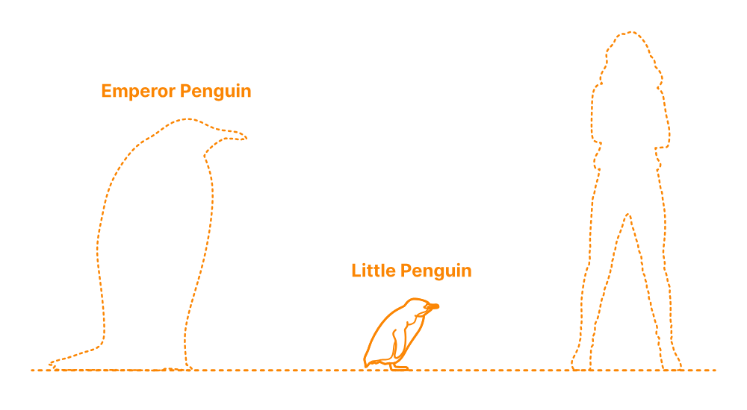
So there is a significant difference…..
Now what?
There is a difference in the group but the ANOVA doesn’t tell us where that difference lies.
To find out we need a comparisons test otherwise known as a
  post hoc test

Slide 11
The post hoc choices
Tukey- compares all pairs of groups whilst controlling for confidence levels
Fisher- compares all pairs of groups, while controlling for individual error rate.
Dunnett- compares treatment groups to a control
HSU MCB- compares each group to the largest or smallest mean
Games- Howell- compares all pairs of groups while controlling for confidence levels (when variances are not equal).

Slide 12
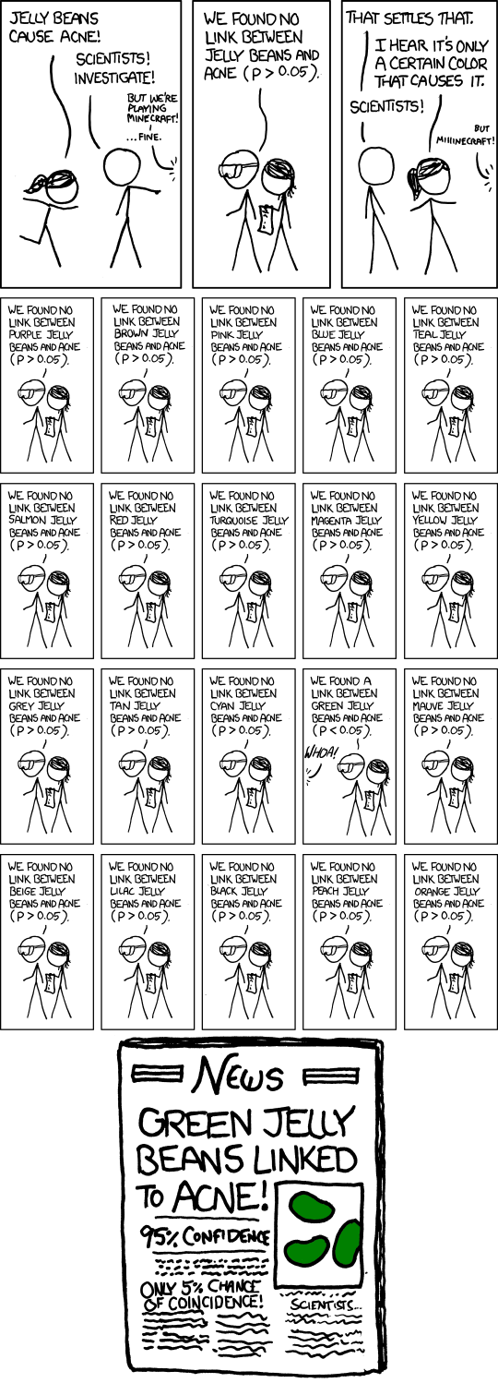

Slide 13
P hacking

Slide 14
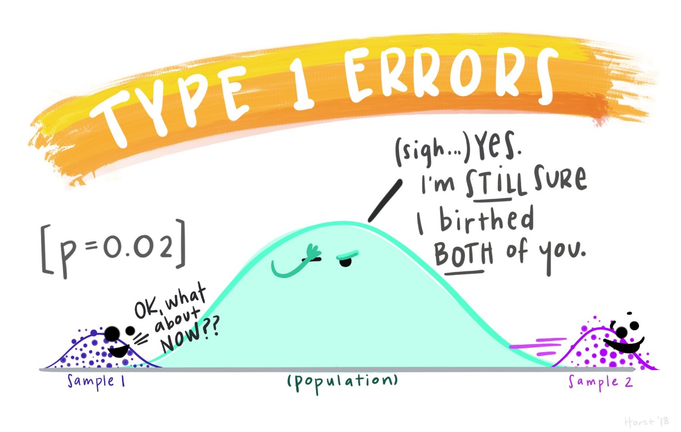
If the assumptions are not followed:

Slide 15
