Slide 1
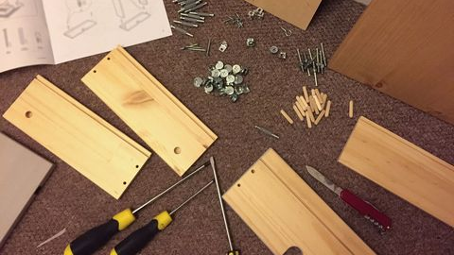

Slide 2
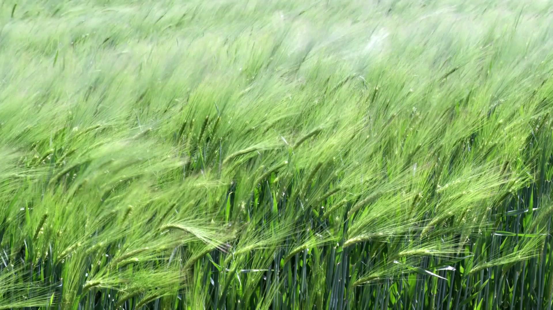
Presenting your method section focused on field studies

Slide 3

Remember your Handbook. It is on Ledge

Slide 4
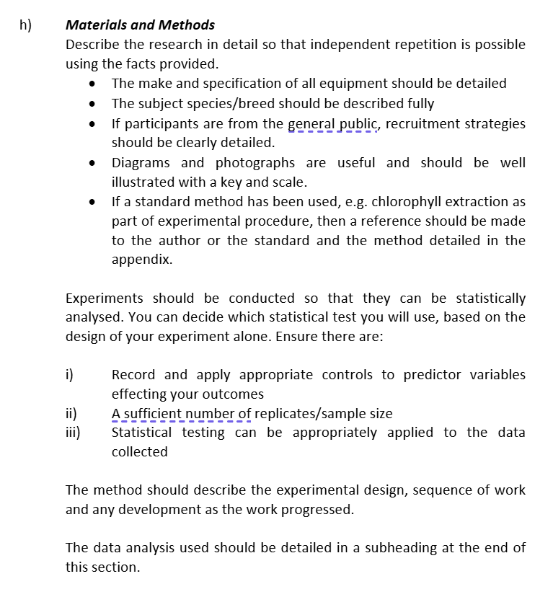

Slide 5

Where to start
Have a clearly defined question to answer, this makes the whole process much better.
Forethought!

Slide 6

Where to start regarding your METHODS
Review journal articles that have a similar methodology to yours
  What specific detail do they present?
  What subheadings/sections do they use?
  What references do they use & when?

Slide 7
Materials and Methods
Describe the research in detail so that independent repetition is possible using the facts provided.
Results
The results must be expressed both factually (brief description) and visually (using graphs and tables). Statistical results should be presented and key findings highlighted (statistically significant or not). Inferential statistical testing must be evidenced for you to meet the learning outcomes for the dissertation.
Discussion
Do not repeat your results in this section. Here you demonstrate the depth of your subject knowledge and critically appraise your results in relation to work done in the same field. This section allows you to demonstrate a critical evaluation of your results.
Methods
Everything you did to get the data (or info) required
Results
What the data (info) show
Discussion
What the data (info) means

Slide 8
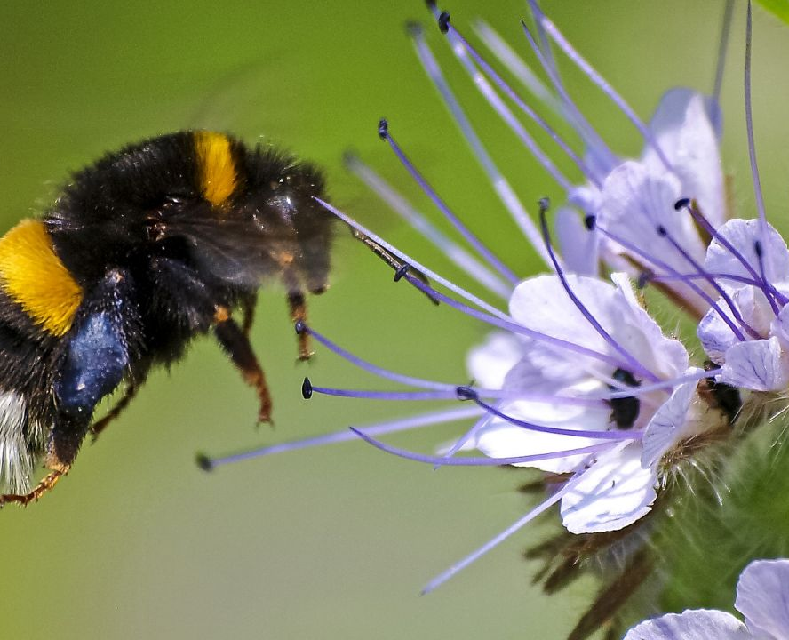
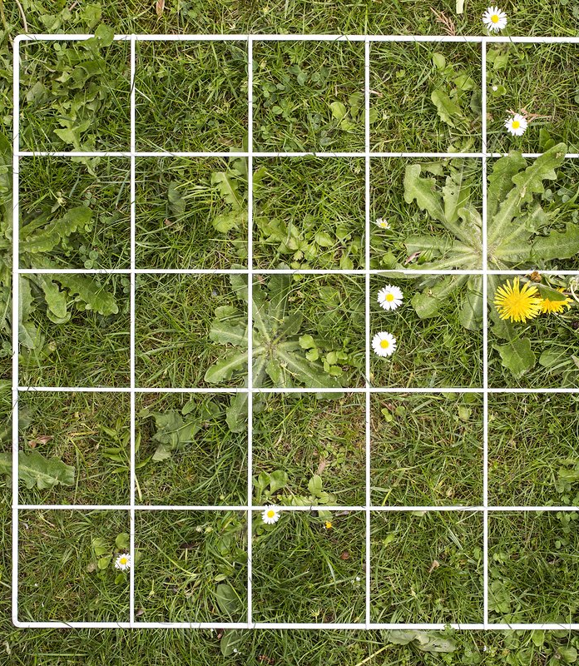
General (minimal) subheadings in order (field studies)
Study area and experimental design
Methods on your specific surveys (Vegetative surveys, Invertebrate surveys)
  Make sure you split them into separate sections for clarity
Statistical analyses

Slide 9
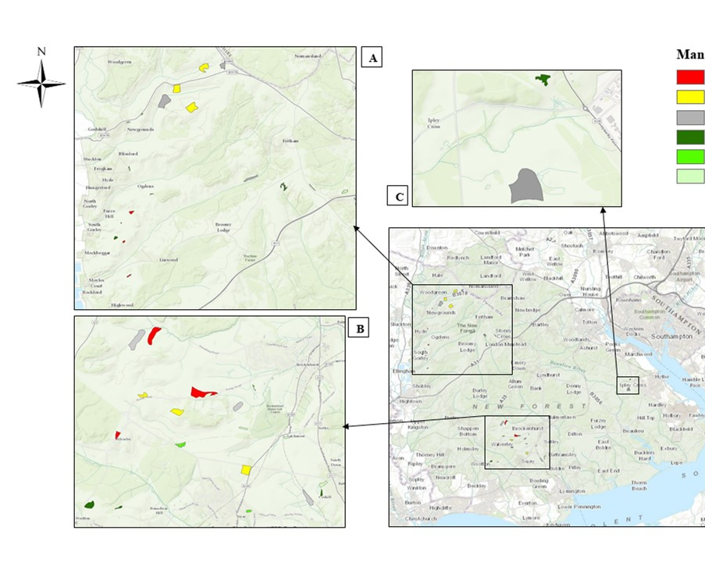
1. Study area and experimental design
Describe study area, number of sites etc.
Include:
  Location
  Town & country
  Co-ordinates
Always, always, always include maps and refer to them
State dates within which the study was undertaken and tiny bit of reasoning why...
Describe your experiment:
  How is it set up? Randomised design? Block-randomised?
  Was there any preparation work before the study began?
  Diagrams are excellent here.

Slide 10
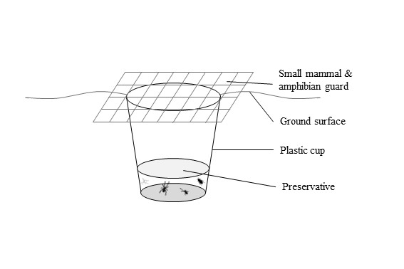
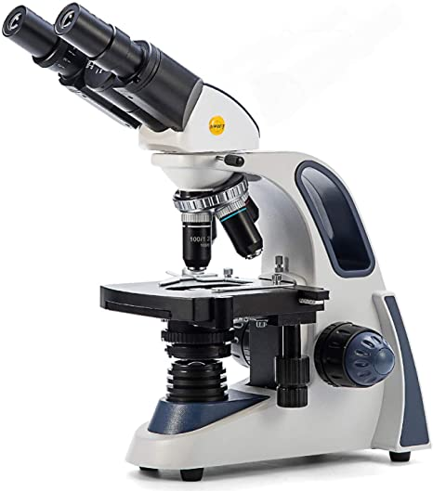
2. Methods on specific surveys
Include separate sections for each of the things you surveyed.
  E.g. if you have done vegetative surveys and invertebrate surveys
Give dates and timings of your surveys (if these differ between the surveys)
Describe in detail, but concisely, how you have undertaken your surveys
Include only key equipment in this description (not clipboards, pens etc!)
Include any relevant diagrams of your experimental setup
If you used a standardised method, reference it clearly

Slide 11

3. Statistical analyses
Include details of which software package you used and the test(s) you have run
  Any assumptions that have been made (e.g. normal distribution)
  Any data transformations undertaken
If you calculated something (e.g. Shannon diversity index) include the relevant equation

Slide 12
Top tip

Slide 13

Structure

Slide 14

Follow structure guide for methods (hand out shown next) and on ledge
Report results in the same order as related activities were presented in your methods.
Guide the reader – make it easy on the reader ‘logical clear structure’
Make sure results represent outcome of details given in methods.
E.g. if three treatments represented five times (n=5 per treatment) then remind of this in the legend of the related results fig.
Make sure all ties together. If marker gets lost, and must ‘read-between-the-lines to follow what you did then you cannot get top marks.

Slide 15
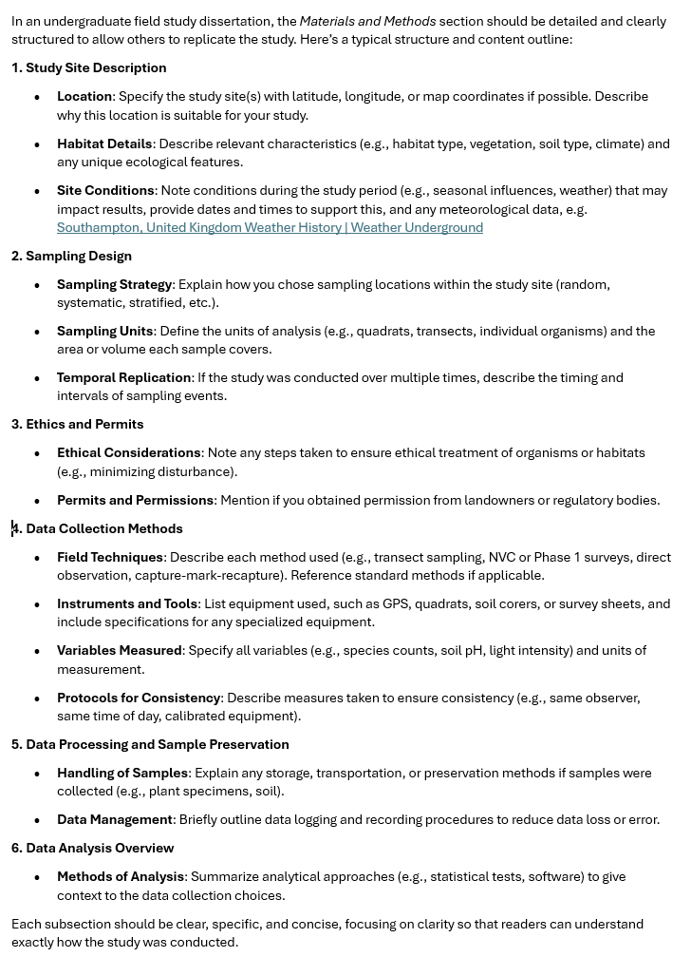
Summary handout
Southampton, United Kingdom Weather History | Weather Underground
https://www.wunderground.com/

Slide 16
Now let's look at real examples...
Sillars-Powell, Tallis & Fowler 2020
Dash et al., 2010
Tallis et al., 2011

Slide 18


Slide 19
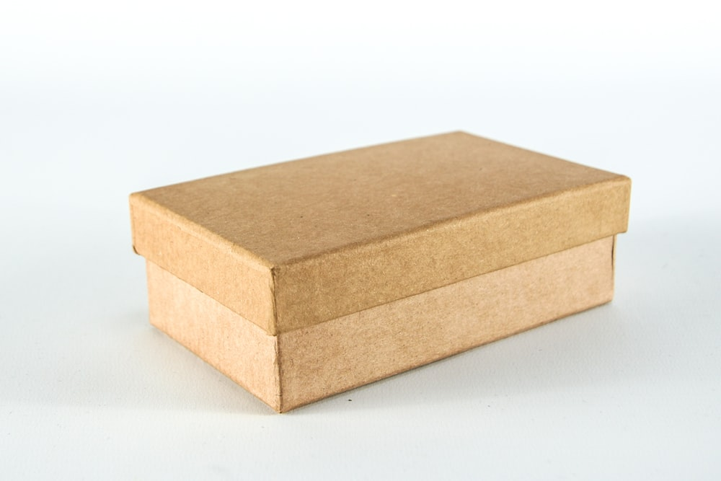

Slide 20


Slide 21
Any questions?

