Slide 1
Emerging infectious diseases

Slide 2
Aims and objectives
Aims: to understand the factors influencing EIDs and how they can be controlled
Objectives:
Outline the epidemiology of zoonotic diseases affecting wildlife and humans
Discuss the spread and persistence of key pathogens
Critically evaluate the factors influencing the spread of EIDs
Evaluate the future areas of study required to limit the spread

Slide 3
Definition of EIDs
Centers for Disease Control and Prevention (CDC, 2014):
‘Infectious diseases whose incidence in humans has increased in the past two decades, or threatens to increase in the near future’
Tompkins et al (2015):
‘Disease causing agents that rapidly increase in geographical range, host range or prevalence’

Slide 4
Examples of well known EIDs
How are they transmitted?
Dr Robert Nasi

Slide 5
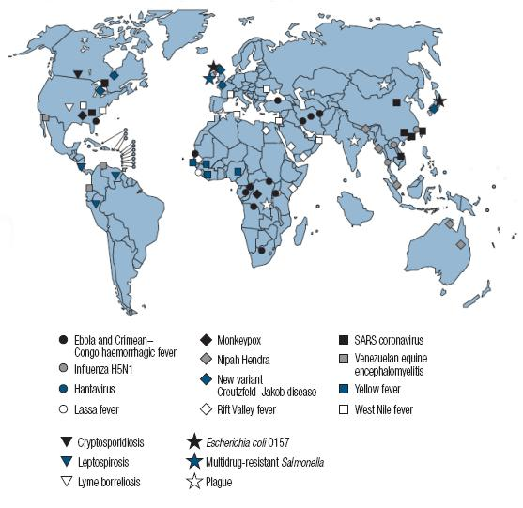
Selected emerging and re-emerging diseases (1996-2004); WHO, 2007

Slide 6
So what pathogens are we talking about?
Anything that was under control but now appears to be reoccurring more frequently.
Anything that can spread quickly and infect a range of novel hosts.
Anything that has been discovered as a brand new disease and whose control and treatment is uncertain or unknown.
Anything that has become more prevalent in recent years, perhaps due to changes in population trends.

Slide 7
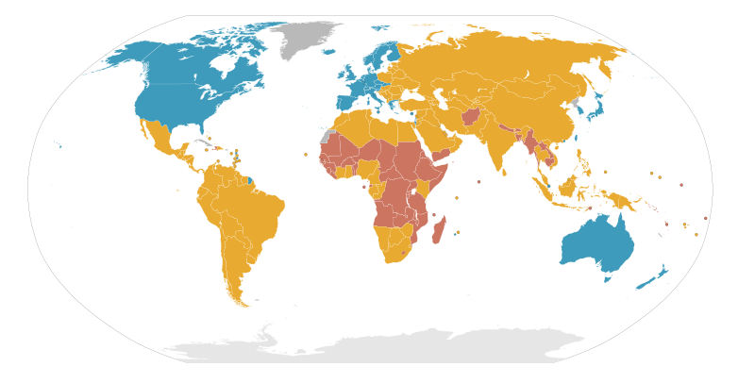
Where do they tend to be occurring or ‘emerging’ from?

Slide 8
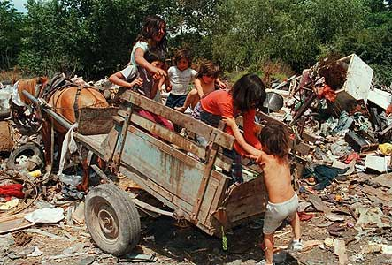
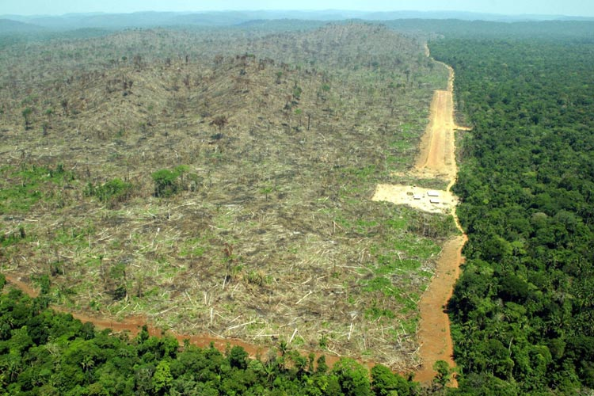
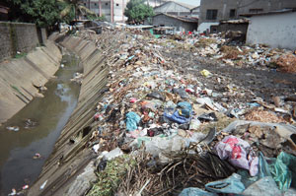
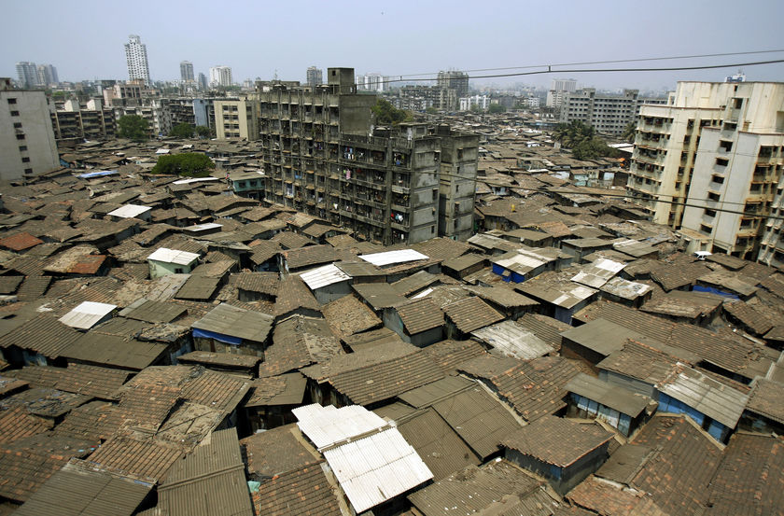
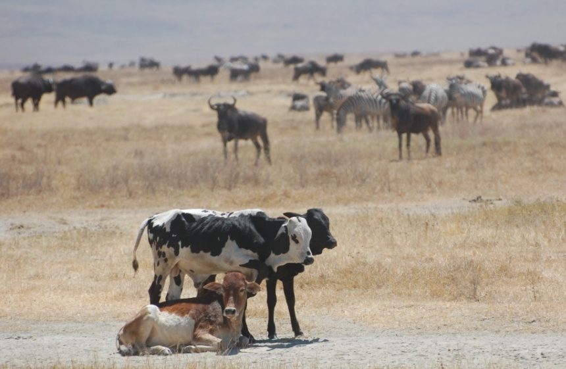
How to produce an EID?

Slide 9
Why you should care.
“Of the 1415 known human pathogens, 61% are zoonotic. Of pathogens causing emerging infectious diseases, 75% are zoonotic, with wildlife being an increasingly important source.”

Slide 10
Five steps to a zoonotic infection
1) Interspecific exposure.
4) Replication of infective (transmission) stages.
2) Overcoming host barriers.
5) Transmission and persistence within the population.
3) Establishment within the host.

Slide 11
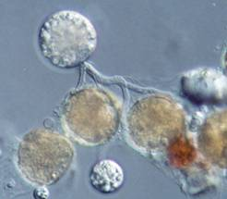
Can the body fight back?

Slide 13
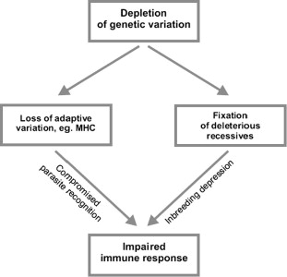
From Radwan et al. (2010)

Slide 14
Wolfe, Dunavan and Diamond (2007)
Five stages of transfer from animals to humans
Early warning system needed
Where should the focus be on?

Slide 15
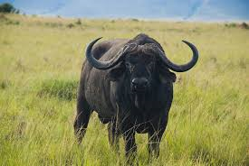
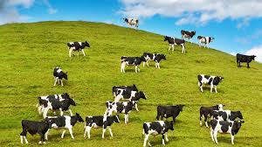
Bosch et al (2015)
Economic and health costs, ‘globally degrading our natural capital’
Need to control environmental reservoirs of infection
In situ vs Ex situ- which is most successful? Why?

Slide 16
Tompkins et al (2015)
Insufficient evidence to support status of current EIDs
Numerous drivers of EIDs
Evidence of absence or absence of evidence?

Slide 17
Topics to consider for the future
Host and pathogen co-evolution
Importance of new vectors
Environmental changes and disease spread
Susceptibility of new hosts
Host natural history and behavioural ecology
Consider the following:
Examples of how these factors influence EIDS
How can these topics be further studied to prevent the spread of EIDs.
How they can be used to prevent the spread or monitor EIDs.
Relevant examples?
Recently on the news…

Slide 18
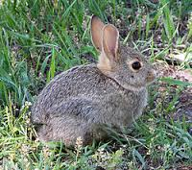
Host and pathogen co-evolution
Woolhouse et al (2002)
Natural co-evolution= reciprocal adaptive genetic change in one or more species
Difficult to demonstrate in humans/vertebrates but commonly seen between inverts, plants and bacteria
Genetic changes in susceptibility and pathogenicity
Dynamic process

Slide 19
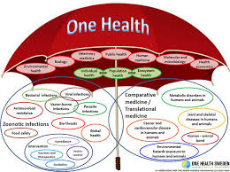
Importance of (new) vectors
Savic et al (2014)
Previously mainly of concern in tropical/subtropical areas
Now a threat in developed countries as well
Occur when numerous factors occur together
Require reliable surveillance e.g. One Health

Slide 20
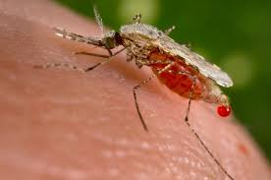
Environmental changes and disease spread
Which diseases show an increase in range caused by climate change?
Rohr et al (2011)
Generally accepted that climate change=increase in human/wildlife diseases
Significant knowledge gaps in this area of study and can be influenced by disease control efforts

Slide 21
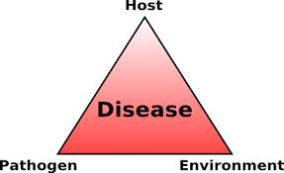
Susceptibility of new hosts
Longdon et al (2011)
Host shifts e.g. parasite originates in a different host species
Factors determining whether pathogen can infect novel host is poorly understood
Needs initial exposure to a pathogen
Can this be avoided in wild populations?

Slide 22
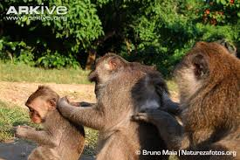
Host natural history and behavioural ecology
Han et al (2015)
Social behaviour and movement behaviour can impact disease dynamics
Need appropriate pathogen traits as well as behaviour to influence behaviour patterns

Slide 23
Summary
EIDs constantly develop and adapt
Need to consider One Health approach
International surveillance essential
Further study needed for better understanding

Slide 24
References
Please see Ledge for pdfs of all research discussed here.

