Slide 1
Non-infectious diseases
Wild Animal Veterinary Science

Slide 2
Learning outcomes
LO1
Detail, describe and discuss key features of pathogenesis of infectious and non-infectious disease in captive wild animals and wildlife
What comes to mind when we think about non-infectious diseases?

Slide 3
Today’s lesson will cover
Poisons
Endocrine disorders
Reproductive disorders
Nutritional disorders
Neoplasia
Wounds and fractures
Notes:
Neoplasia definition abnormal growth of cells or tissues in the body

Slide 4
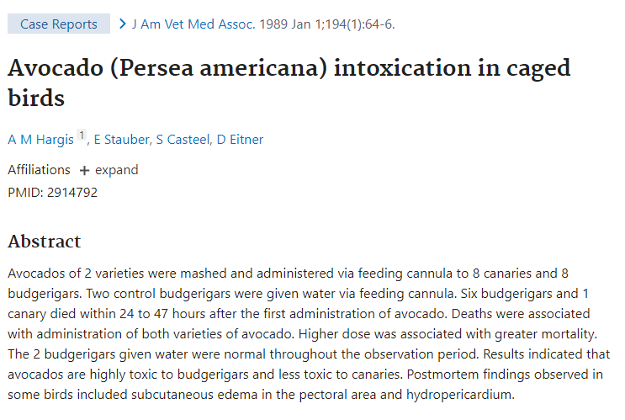
What common poisons are you aware of in wild animals/captive wild animals?
Radhakrishnan, S. (2018): considers incidence of wildlife poisoning (accidental or intentional) to be under reported in Asia
Mateo-Tomas, P. et al (2020) suggests the impact of poisonings on biodiversity relies on indirect evidence
Green, R.E. et al (2004)
Pain, D.J. et al (2019)
Notes:
Wildlife poisoning is an important conservation threat for endangered species.
Primary exposure to poisons occurs when wildlife is intentionally poisoned for hunting or due to human-wildlife conflict.

Slide 5
Common signs of poisons
Neurological signs
Gastrointestinal signs
Respiratory/CV signs
Urinary signs
First aid and treatments?

Slide 6
Endocrine and reproductive conditions
Ganswindt, A. et al (2012)
Hormones key to understanding basic body functions e.g. reproduction, metabolism and health
Hormone analysis used to monitor reproductive function
Use blood, saliva, urine, hair and faeces
Choice depends on techniques used
International Society for Wildlife Endocrinology (ISWE) est. 2010
Advances in relation to reproduction
Advances in relation to adrenal function
Innovative approaches and method development
Standardisation and information sharing
Assay reagent resources
Further reading: McCormick, S.D and Romero, M (2015), Conservation Endocinology. Bioscience. 67: 429-442
On Ledge

Slide 7
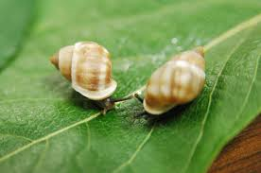
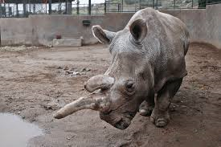
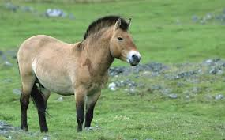
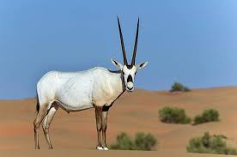
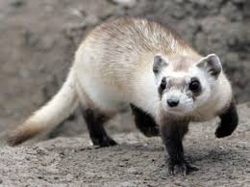
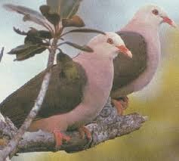
Reproductive disorders
Why is this an important concern?
Artificial reproductive technologies may be required
What do we mean by this?
Some species may struggle to reproduce
Some species have successfully increased numbers following conservation breeding schemes

Slide 8
Nutritional disorders
What diseases are we talking about?
Notes:
Nutritional disorders vary between species and feeding strategies
Can be caused by an imbalance in various nutrients, including protein, vitamins and minerals or by defects or other diseases that prevent proper utilisation of nutrients. For example, snakes fed whole prey are more likely to show generalised starvation in contrast to iguanas and other herbivorous reptiles, which are more likely to suffer from calcium deficiency from imbalanced diets (Donoghue, 2006)

Slide 9
Nutritional disorders
What diseases are we talking about?
For a species of your choice, research the most common nutritional disorders seen, including:
What the causes (pathogenesis) are
The common signs and symptoms
The treatment or prevention of the disease
Notes:
Nutritional secondary hyperparathyroidism (NSHP) is a form of metabolic bone disease and the most common nutritional disorder seen in captive reptiles.
When dietary calcium and/or vitamin D3, insufficient dietary intake or of a lack of adequate exposure to UVB radiation, occasionally, when diets are high in phosphorus (reversed calcium/phosphorus; Ca:P ratio), NSHP can occur in captive reptiles. Snakes are not affected by NSHP.

Slide 10
Neoplasias
Neoplasia, by definition, the abnormal growth of cells or tissues in the body.
No vertebrates are exempt
Examples include:
Squamous cell carcinomas in Solomon Island Leaf Frogs
Odontomeloblastoma in red deer
Intestinal adenocarcinoma in Northern Leopart Frog
Mast cell tumours in cheetah
Peritoneal mesothelioma in American Black bear
Ovarian adenocarcinoma in white rhino

Slide 11
Clinical signs
Abnormal swellings
Bleeding/discharge from mouth, nose, other openings
Dyspnoea
Anorexia
Vomiting/diarrhoea
Weight changes
Malignant vs benign
Diagnosis
Metastases
To treat or not to treat?
Chu et al (2012) reviewed cases in 150 zoo animals and found the most common tumours in mammals were mammary tumours (12%), uterine tumours (10.2%), lymphosarcoma (9.3%), hepatocellular carcinoma (8.3%), and cutaneous squamous cell carcinoma (6.5%).

Slide 12
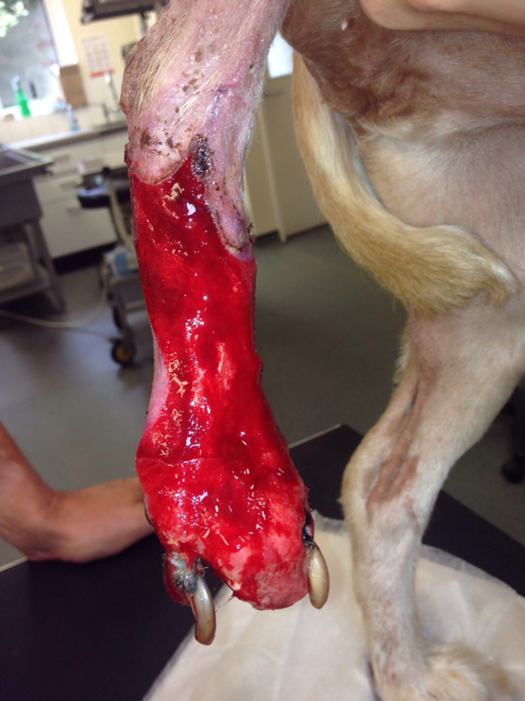
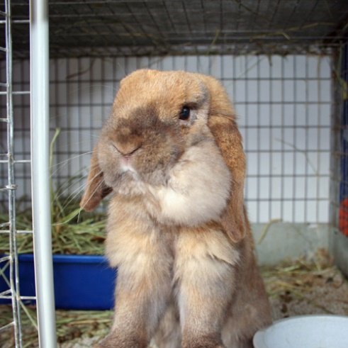
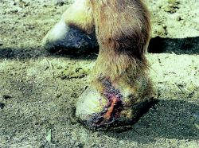
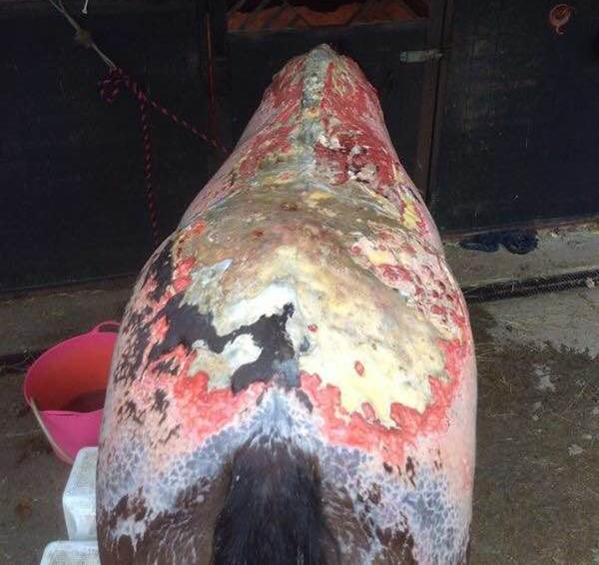
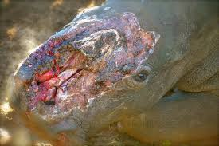
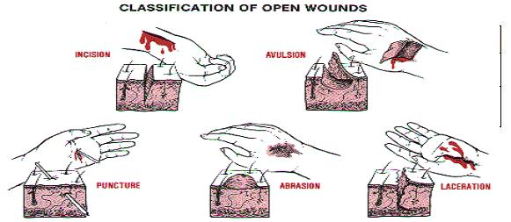
Wounds
Oxford dictionary definition ‘an injury to living tissue caused by a cut, blow or other impact, typically one in which the skin is damaged’
What are the common types or causes of wounds?
Classified by open and closed
Or by level of contamination

Slide 13
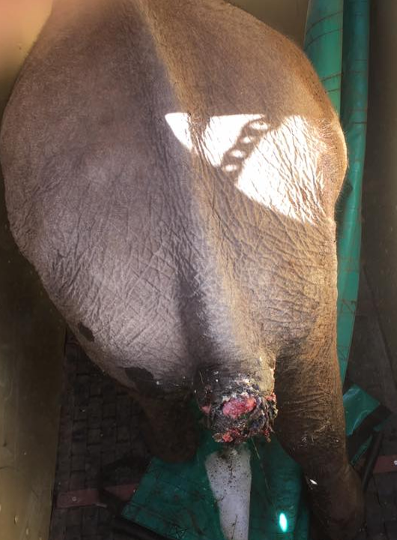
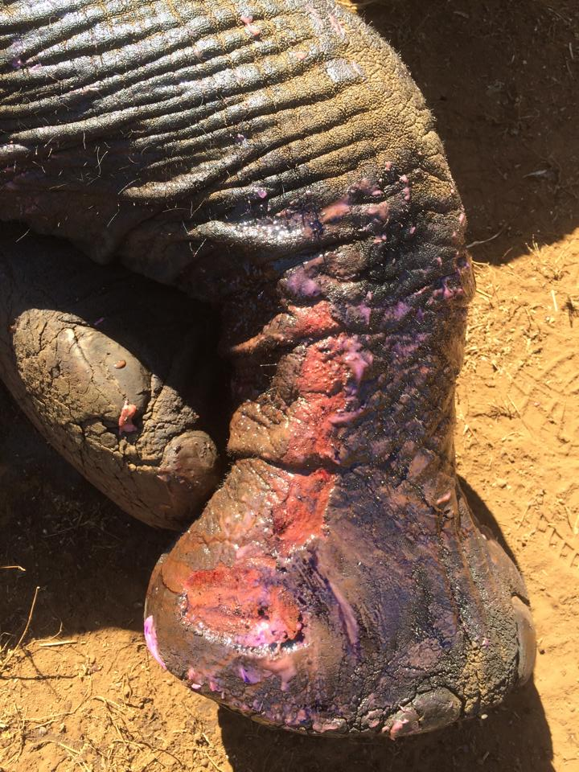

Slide 14
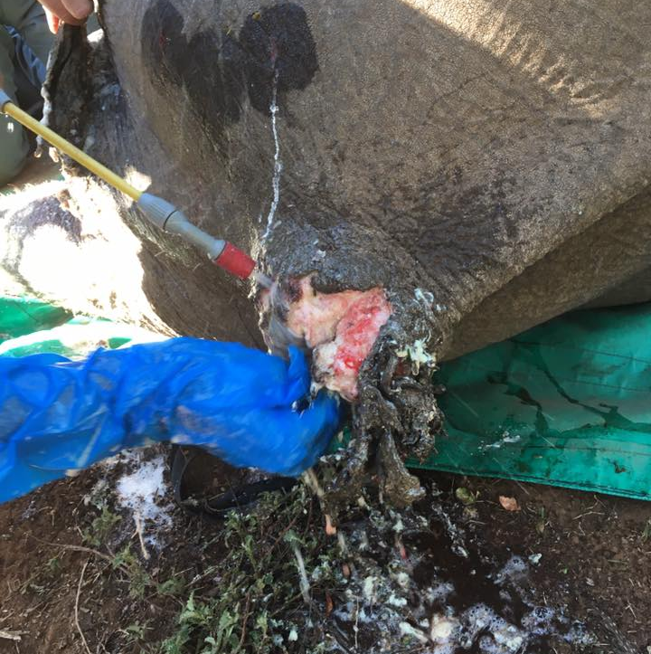
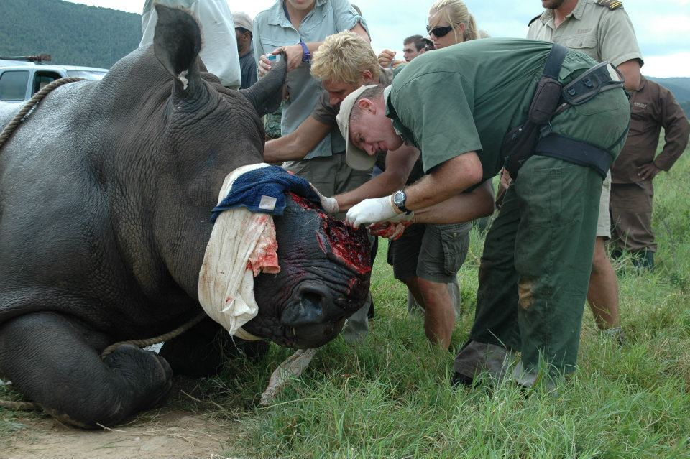
Wound care
Immediate 1st aid
Prevent shock or condition worsening
Reduce pain and discomfort
Lavage
Debridement
Closure?

Slide 15
Notes:
https://www.youtube.com/watch?v=RpuHXqb8gb4
Hope’s story

Slide 16
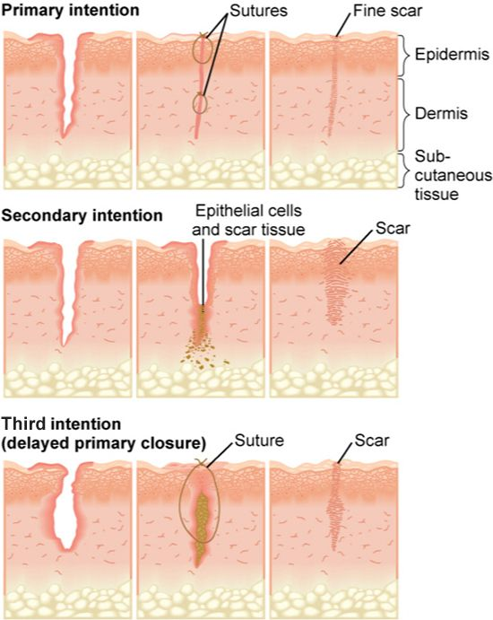
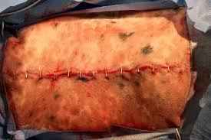
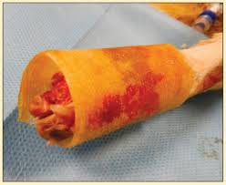
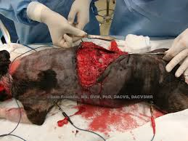
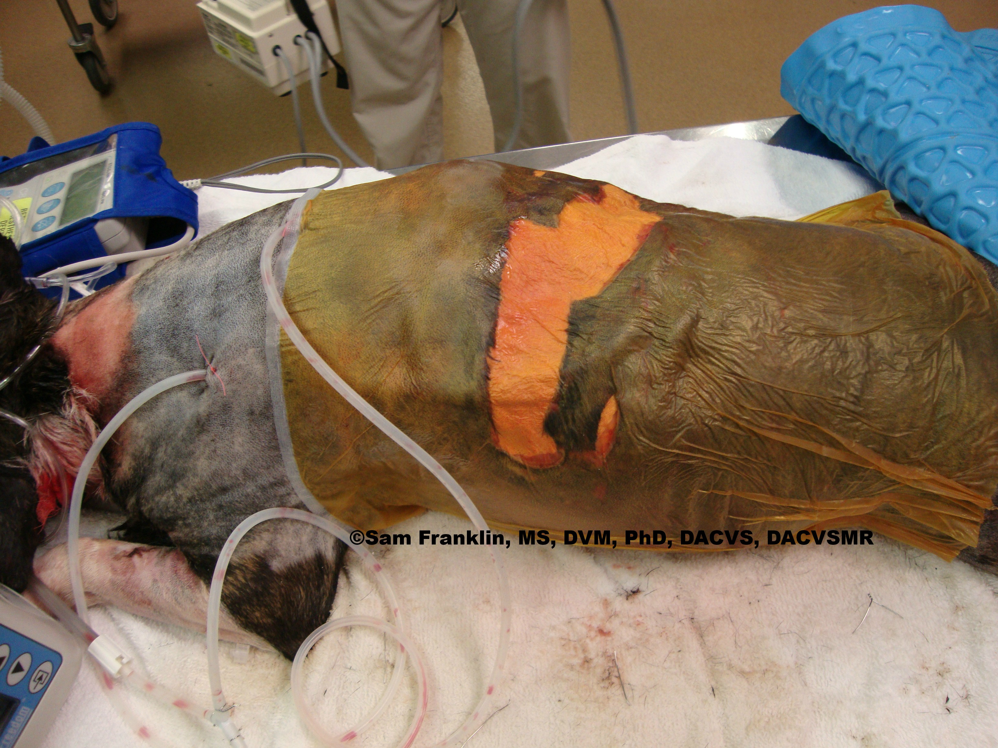
Closure options
Primary closure (first intention)
Delayed primary closure
Secondary closure
Second intention

Slide 17
Notes:
Ted talk

Slide 18
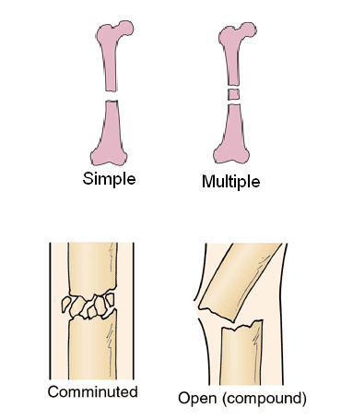
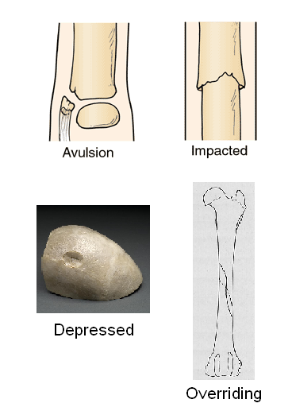
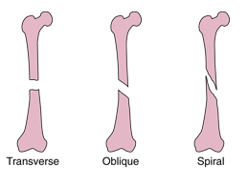
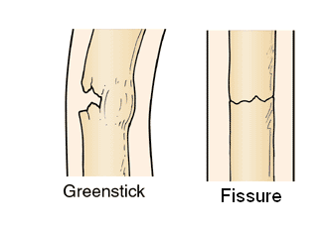
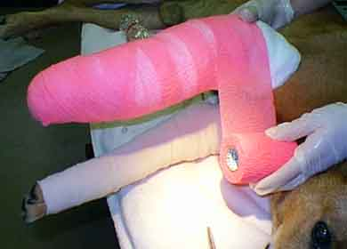
Fractures
By definition‘a forcible break in the continuity of a bone’
Swelling, pain, loss of function, crepitus, abnormal movement.
1st aid?

Slide 19
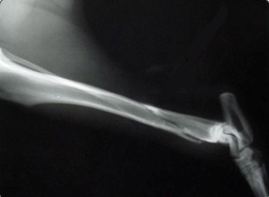
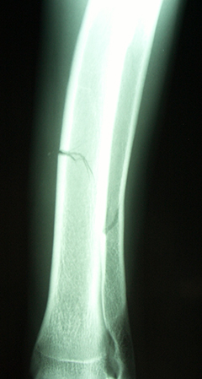
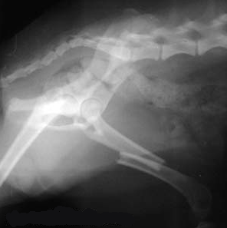
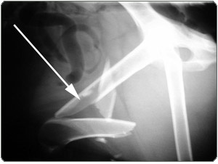
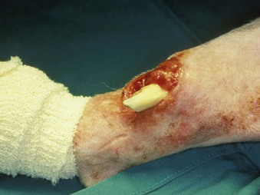
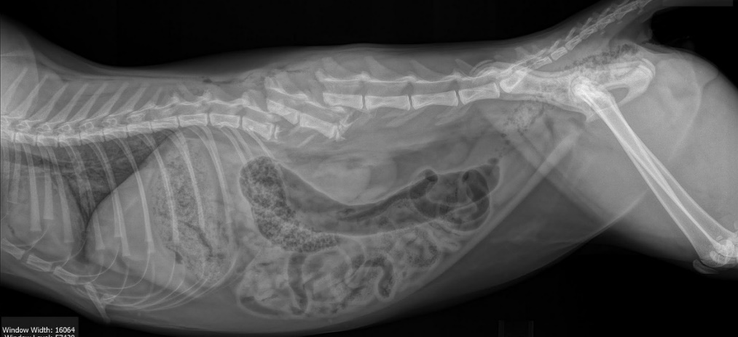

Slide 20
Summary
Varied range of non-infectious diseases in captive and wild animals
Lack of knowledge and understanding of basic anatomy and physiology
To treat or not to treat?
Difficulties in treatment when compared to companion animals

Slide 21
References
Chu, P-Y., Zhuo, Y-X., Wang, F-I., Jeng, C-R., Pang, V.F., Chang, P-H., Chin, S-C., Liu, C-H. (2012) Spontaneous neoplasms in zoo mammals, birds, and reptiles in Taiwan- a 10-year survey. Animal Biology. 62: 95-110
Ganswindt, A., Brown, J.L., Freeman, E.W., Kouba, A.J., Penfold, L.M., Santymire, R.M., Vick, M.M., Wielebnowski, N., Willis, E.L., Milnes, M.R. (2012) Internatinal Society for Wildlife Endocrinology: the future of endocrine measures for reproductive science, animal welfare and conservation biology. Biol. Lett. 8: 695-697
Green, R.E., Newton, I., Schultz, S., Cunningham, A.A., Gilbert, M., Pain, D., Prakash, V. (2004) Diclofenac poisoning as a case of vulture population declines across the Indian subcontinent. Journal of Applied Ecology. 41: 793-800
Mateo-Tomas, P., Olea, P.P., Minguez, E., Mateo, R., Vinuela, J (2020) Direct Evidence of poison-driven widespread population decline in a wild vertebrate. PNAS. 117(28): 16418-16423
McCormick, S.D and Romero, M (2015), Conservation Endocinology. Bioscience. 67: 429-442
Pain, D.J., Mateo, R., Green, R.E. (2019) Effects of lead from ammunition on birds and other wildlife: a review and update. Ambio. 48: 935-953
Radhakrishnana, S. (2018) A note on wildlife poisoning cases from Kerala, South India

