Slide 1
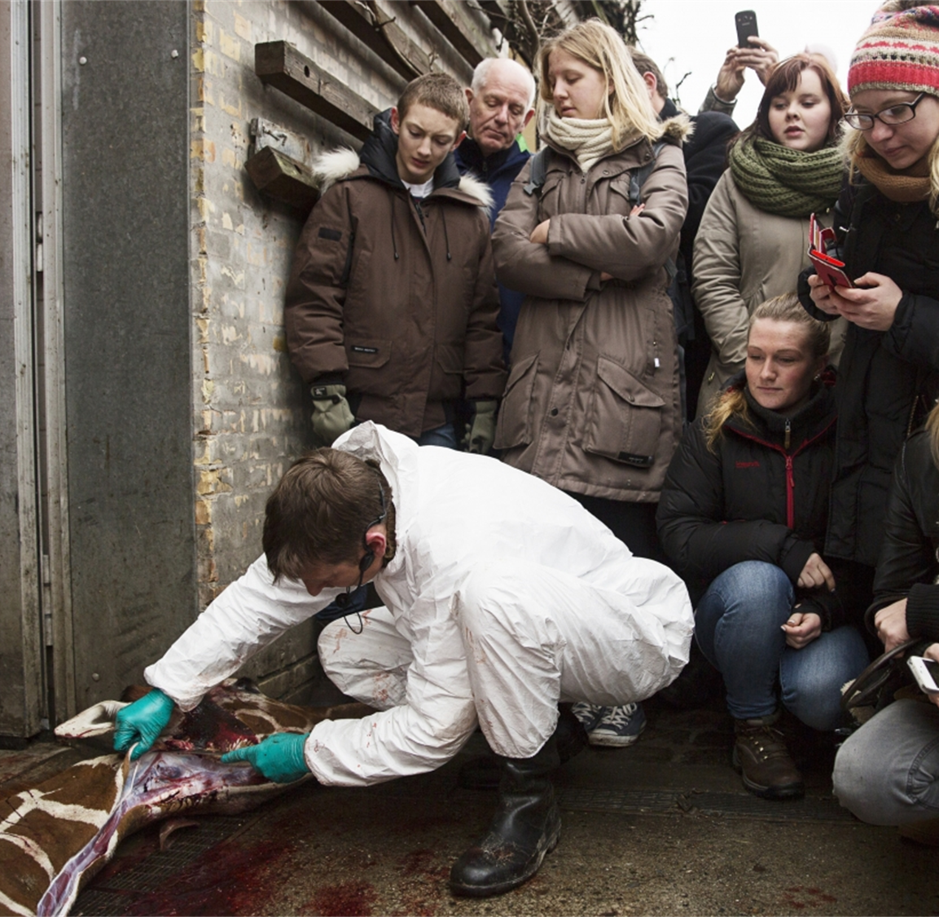
Preparation for your post mortem

Slide 2
What we are going to cover today…
Evaluate the importance of post-mortems within industry
Discuss the correct protocol for post-mortems
Evaluate the implications and limitations of post mortems within industry

Slide 3
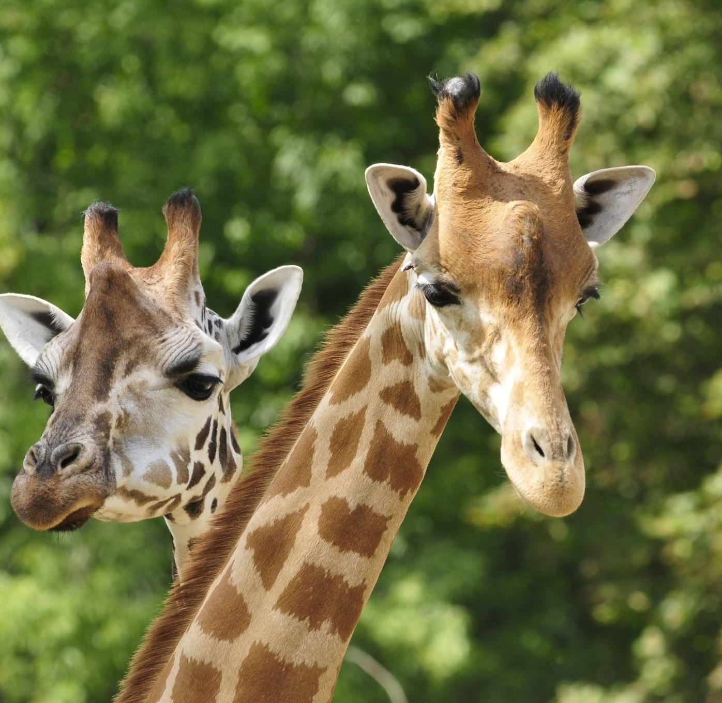
What are the key reasons we complete postmortem in animals?
Notes:
A post-mortem can be a useful – sometimes vital - tool to diagnose the cause of a health problem!

Slide 4
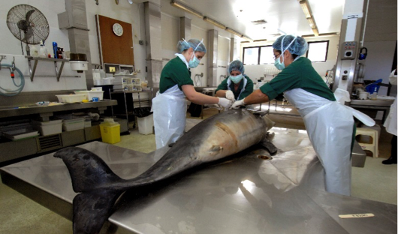
Why do we do a postmortem?
Human health – zoonosis
A post-mortem can be costly yet valuable in the long run!,
Especially where herd and flock animals are concerned; determining what one animal died of, may identify a disease issue which is sub-clinically affecting the whole flock or herd.
Some diseases cannot be diagnosed purely on clinical signs.
Disease surveillance
Animal welfare
Parasites
Husbandry purposes
Notifiable diseases
Notes:
Cosmetic necropsy is carried out to preserve specimens for a museum o Care required with incisions and examination

Slide 5
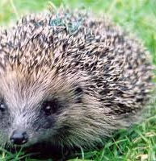
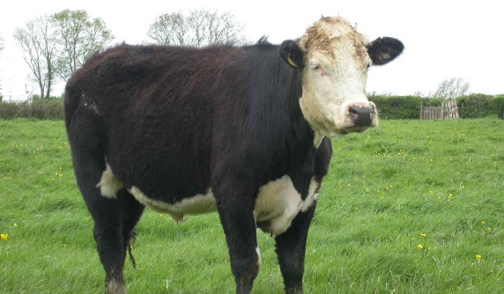
Previous case studies from industry
Unexpected notifiable disease confirmed in Somerset - APHA Science Blog
Streptococcus pyogenes Infection in a Free-Living European Hedgehog (Erinaceus europaeus)
(Franklinos et al., 2015).
Cornwall fin whale: Work to move carcass at Newquay Fistral beach - BBC News
Notes:
New diseases in a species - Recent PM on 2 hedgehogs showed hepatitis
Legal reasons - Horse meat scare – 5 horses were PM and discovered Bute – legal implications regarding horse passport, not for human consumption – Tesco
Considered a turning point for DNA analysis in food authenticity. The discovery of horse meat as a fraudulent addition to beef meat preparations across Europe, such as burgers and lasagne, brought to the attention of consumers, law enforcers, and regulators the need for reliable, rapid, and effective tools for detection of such cases of adulteration.
Cattle: BSE was confirmed in September 2021 in a six-year-old cow that was unresponsive to veterinary treatment and therefore euthanised. As with all fallen stock over 48 months of age, the brain had to be tested for BSE which was sadly subsequently confirmed as classical BSE.
Hedgehogs: Disease surveillance by GWH project. Franklinos et al., 2015 This is the first known report of S. pyogenes in a hedgehog
A recent study detected L. monocytogenes infection in five of 266 hedgehogs examined post mortem in Great Britain over a four-year period, which corresponds to 2% of the animals examined, indicating the infection to be relatively uncommon.
Whale wash up in Cornwall: Cornwall fin whale: Work to move carcass at Newquay Fistral beach - BBC News

Slide 6
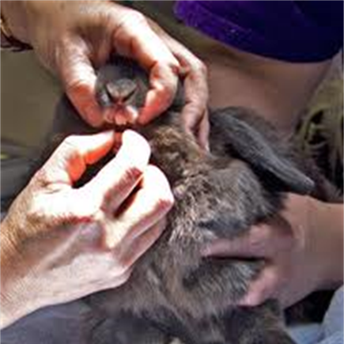
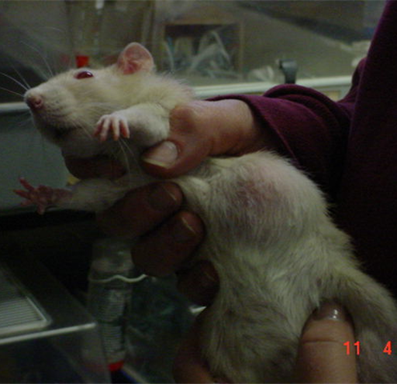
Where would you start with a post-mortem?

Slide 7
How would you prepare for a PME?
Notes:
Make sure you have obtained signed consent
A detailed clinical background
all the necessary equipment before you start.
It’s important to carry out risk management at every location you undertake a PME
You should consider how to approach the PME – think about the equipment and techniques you’ll use.
Health and safety considerations; PPE, scapels, formalin- A 40% solution of formaldehyde in water is known as formalin. Formalin is irritating, corrosive and toxic and absorbed from all surfaces of the body.
formaldehyde
Allow enough time, and ideally have someone assist you with note taking and photography.
Take a logical and systematic approach!

Slide 8
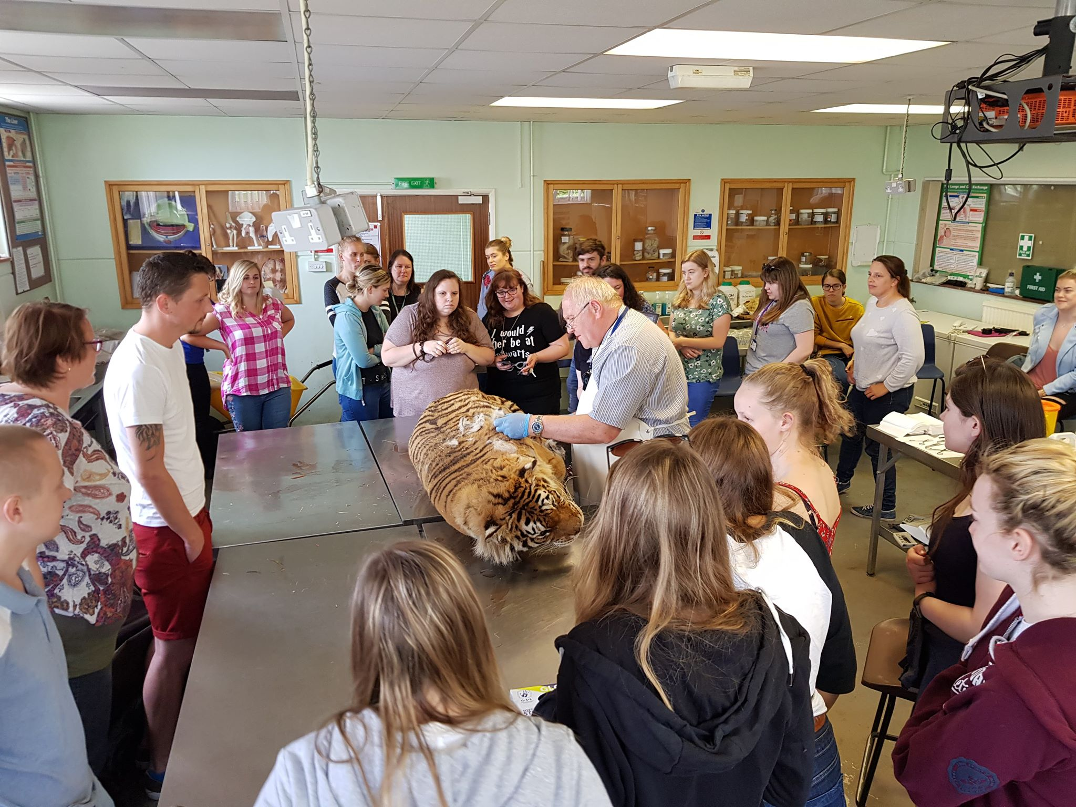
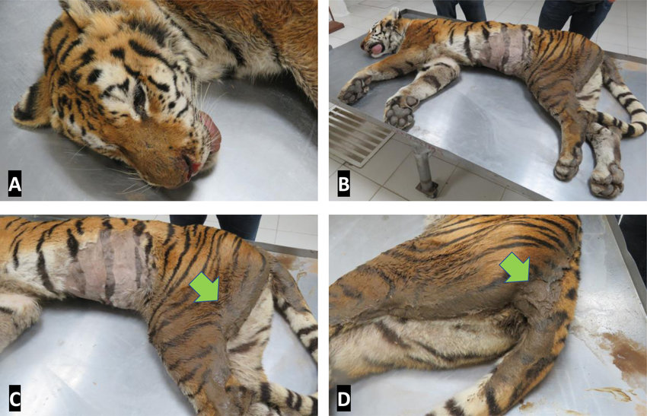
1. External examination
Notes:
Always read the history of the animal to determine any background illnesses and whether there may be any potentially dangerous pathogens (= zoonoses) involved.
What do you spot in the photograph on the right?
Check superficially for wounds, blood in the mouth, eyes sunken, previous surgery, external genitals, condition (fat, thin), skin (alopecia, smell, numerous fleas, thickened or thinned etc).

Slide 9
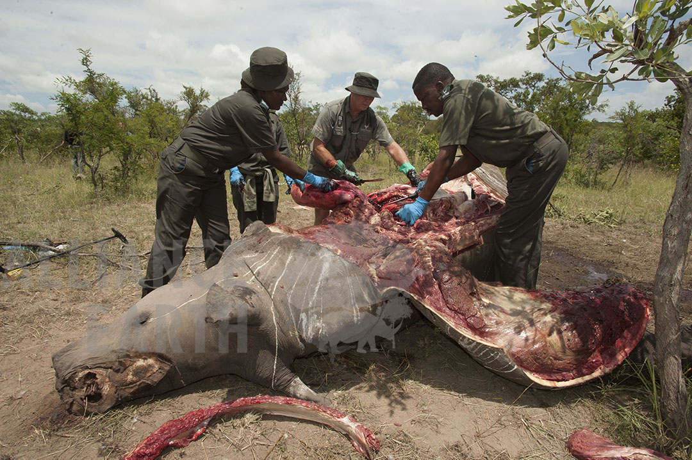
2. Opening body cavities

Slide 10
3. Examining organs
Notes:
Thorax
Heart
Abdominal contents
Joints
Nervous system
Eyes
Noting, Colours, Consistency, Margins, Surfaces, Shapes. See Dr Rose Factsheet.

Slide 11
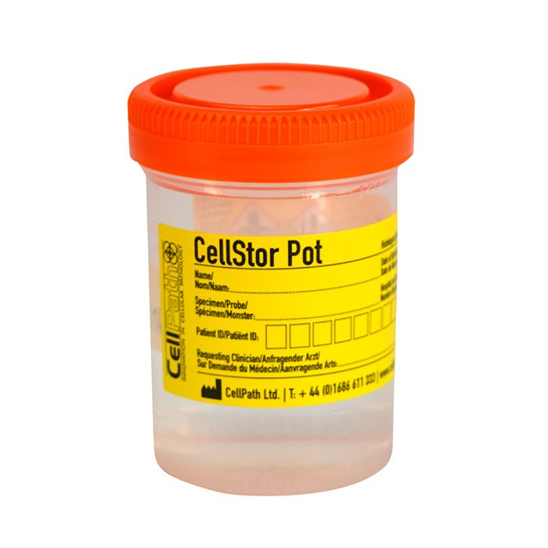
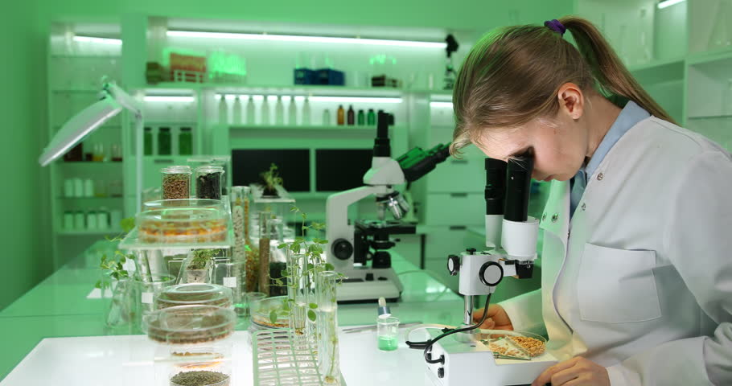
3. Sample collection
Optimise your sample quality!
Tissue samples should be collected from all organs and fixed in 10% neutral buffered formalin.
Keep a log of the samples you take, label carefully!
Notes:
Optimise your sample quality, gentle tissue handling, correct sample size, prompt fixation and adequate amounts of formalin all make a huge difference.
Samples collected for further testing will vary from case to case!
Dependent to some extent on the clinical history and gross findings.
Submit minimal tissues for histopathology in the first instance, sample everything and retain these samples in formalin within the practice, in case they are required at a later date. Next, tissue samples should be collected from all organs and fixed in 10% neutral buffered formalin — those not submitted in the first instance for histopathology can always be stored in case they are required later.
Biochemistry Micro and PCR storage conditions differ based on species and specimen.
Samples for microbial culture can be stored (fresh not fixed) at 4°C. Consider also taking impression smears of lesions for cytology, urine samples and wet preparations of faeces for microscopy — such tests can be valuable for rapid diagnosis. T

Slide 12
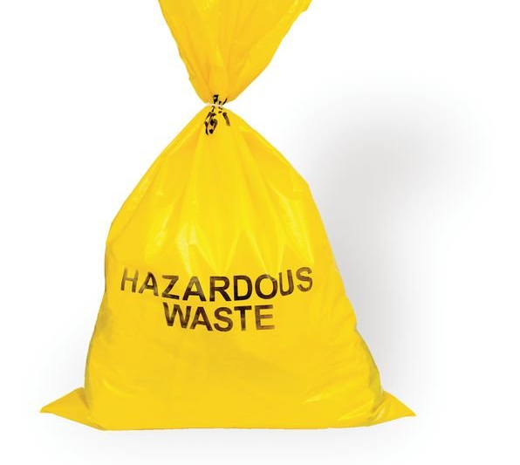
4. Carcass disposal
Notes:
Generally, a veterinary surgeon should seek informed consent from the owner to disposal options for the cadaver!

Slide 13
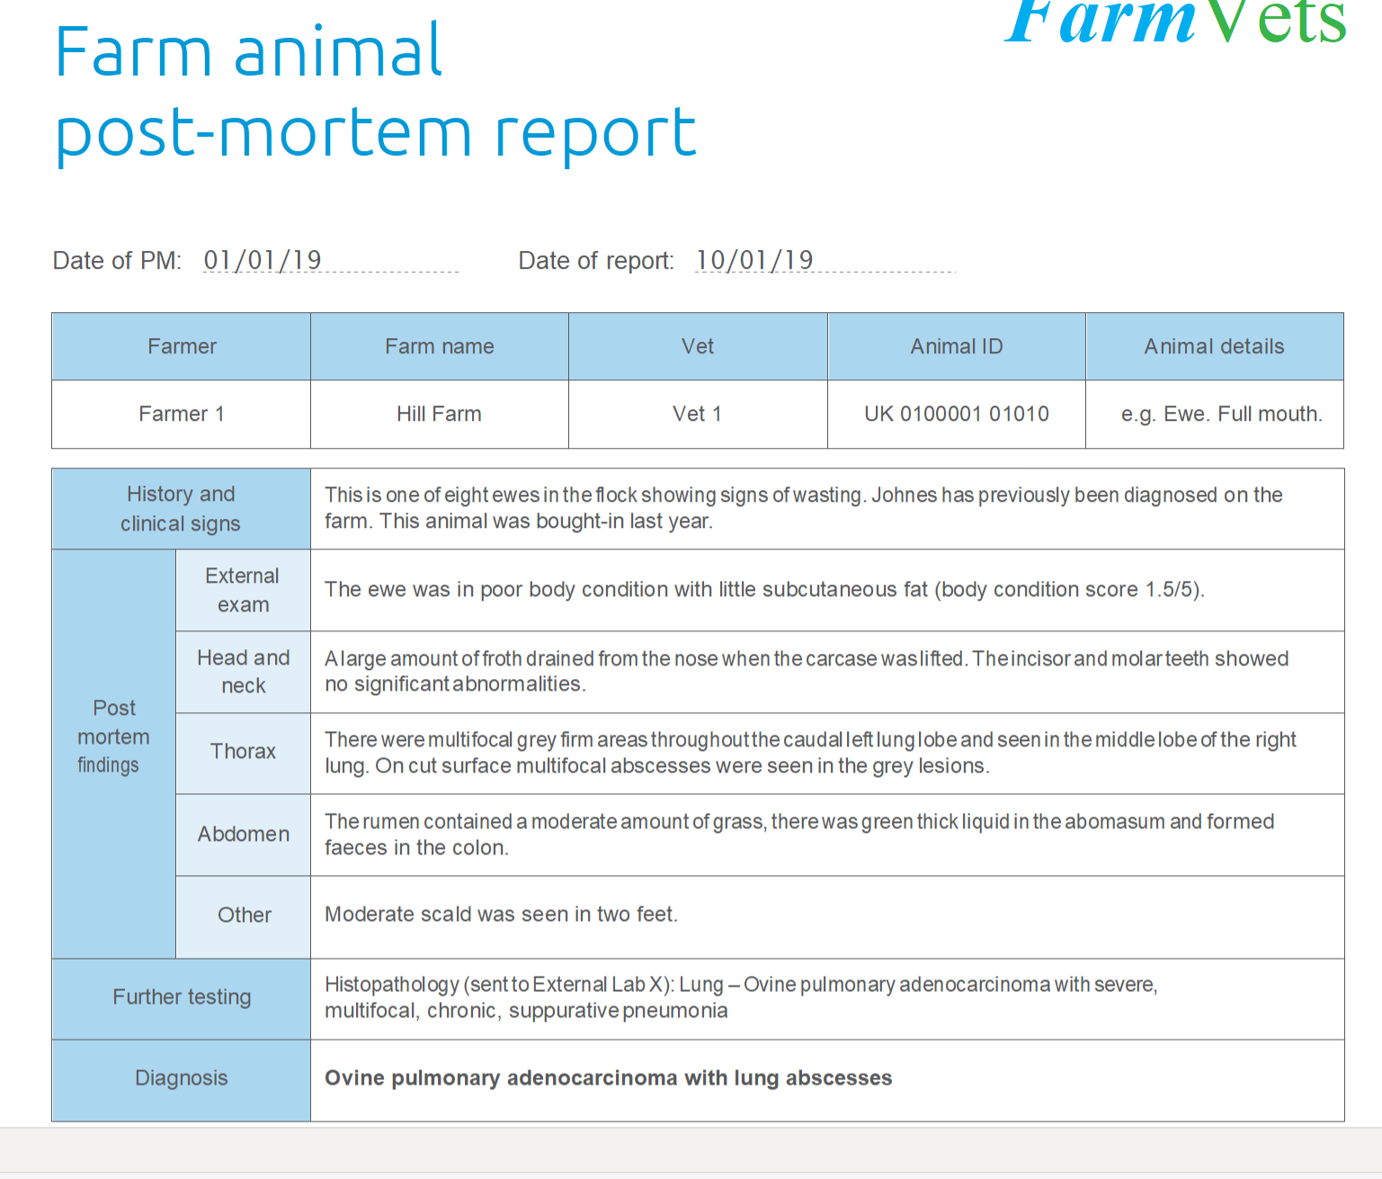
5. PME Report

Slide 14
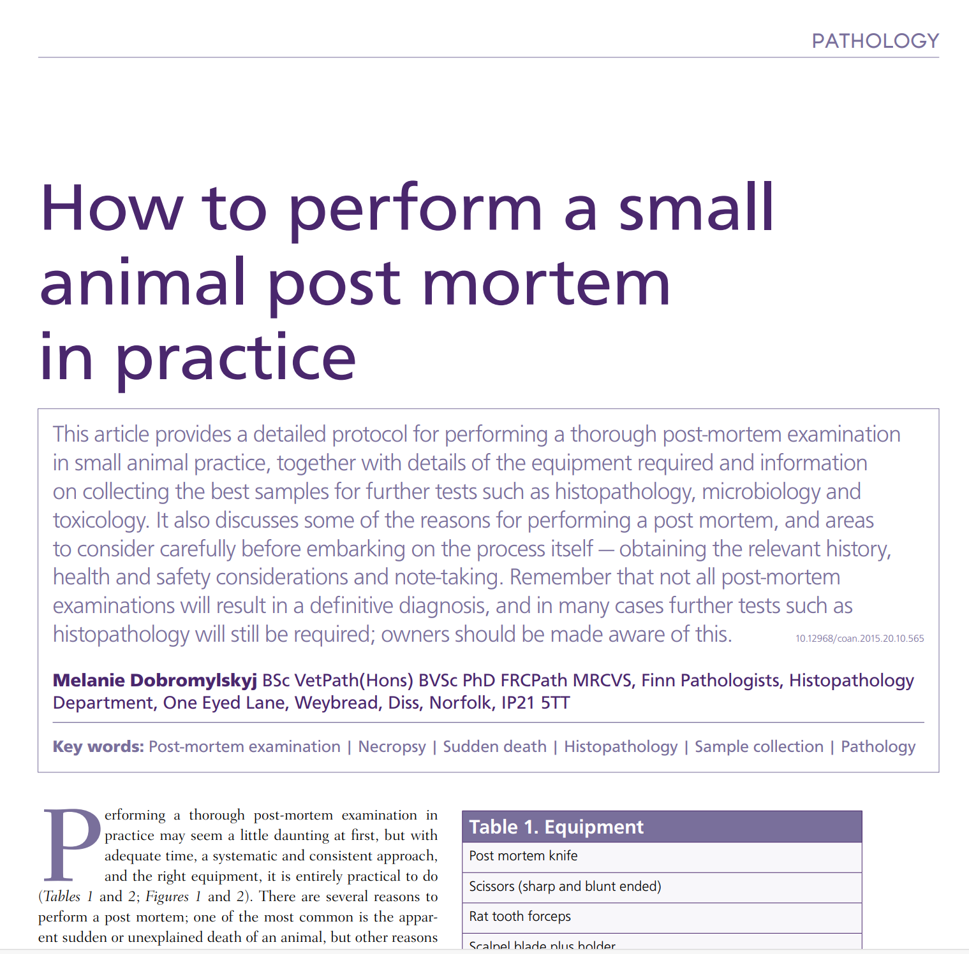
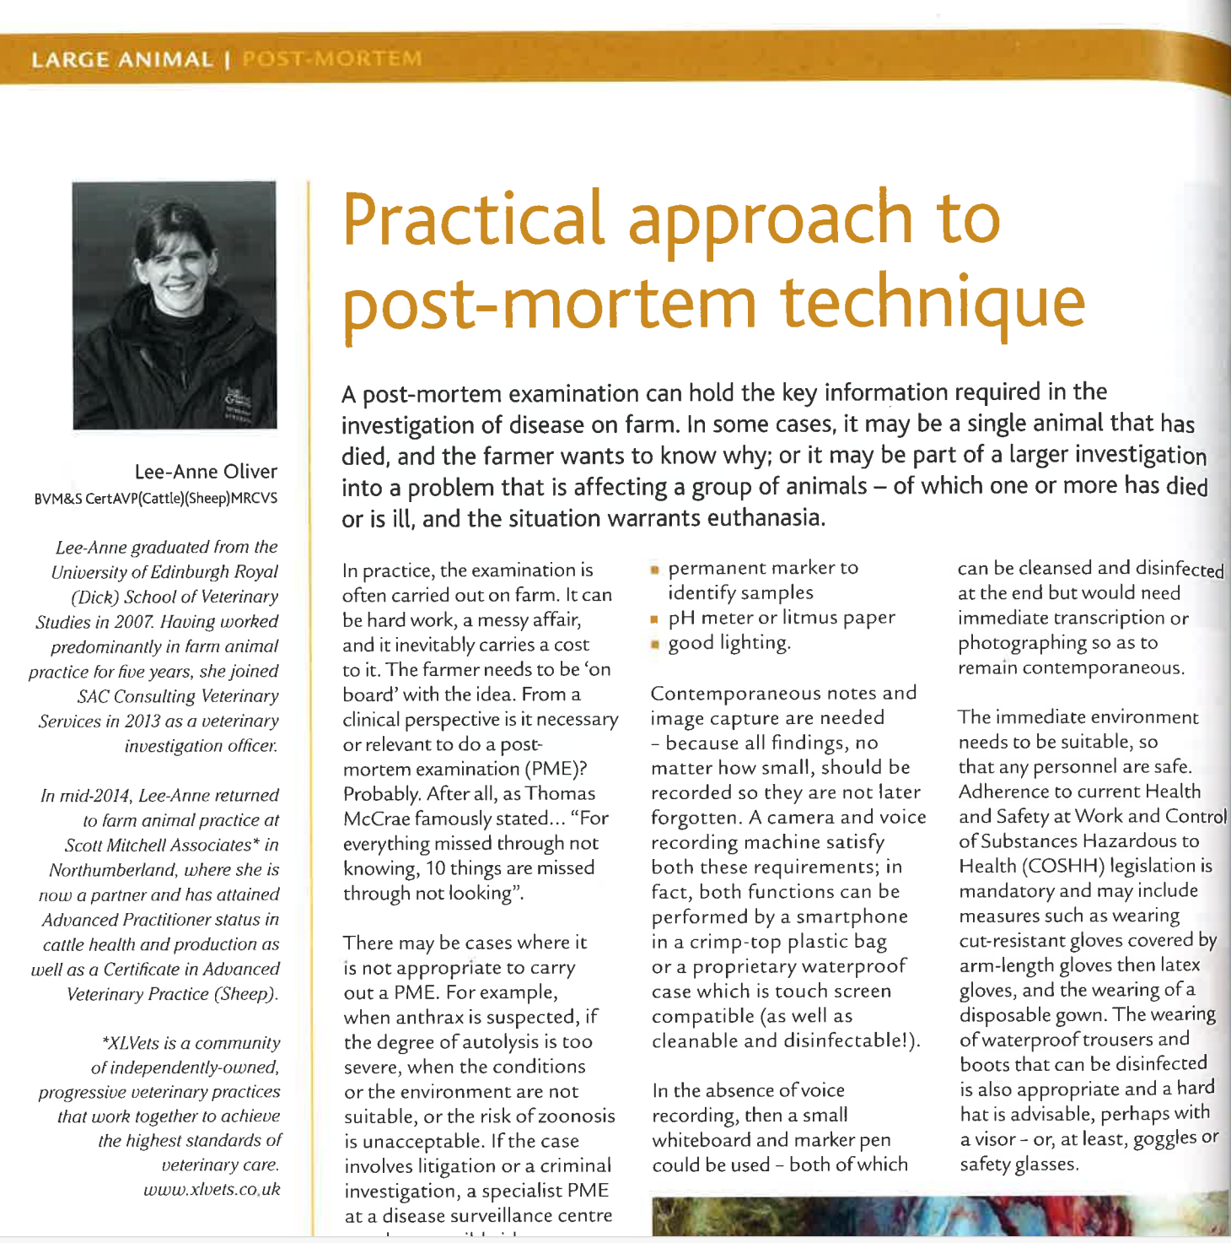
PME procedures in industry
Take 15 minutes to read the papers uploaded on Ledge
How do PME protocols and techniques align and differ?
(Dobromylskyj, 2005)
(Oliver, 2019)

Slide 15
PME rules of thumb
‘the fresher, the better’
I.E. APHA state ‘Animals dead for more than 24 hours will only be accepted.’
In fact, if there is a sick animal still alive, but near death, then it might be worth sacrificing it to maximise the chances of getting a useful outcome from the post-mortem.
Use appropriate PME terminology.
Write notes!
Try your best to describe any changes using as many descriptors as possible, i.e., colour, smell, measurements and size of organs.
Notes:
APHA state: Animals dead for more than 24 hours will only be accepted after careful consideration of the facts as autolysis will often reduce the likelihood of diagnosis.
Animals dead for more than 48 hours will not be accepted
Carcases which have been frozen may not be accepted

Slide 16
Full post mortem of a hedgehog
As we watch this video make notes on the following;
Method of post mortem
External concerns or considerations with a post mortem

Slide 17
PME of a Hedgehog
Make notes on the following;
Method of post-mortem
External concerns or considerations with a post-mortem

Slide 18
Full post mortem of a whale
National Geographic - Animal Autopsy - Whale – YouTube
As we watch this video make notes on the following;
Method of post mortem
External concerns or considerations with a post mortem

Slide 19
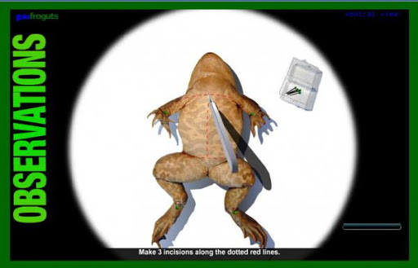
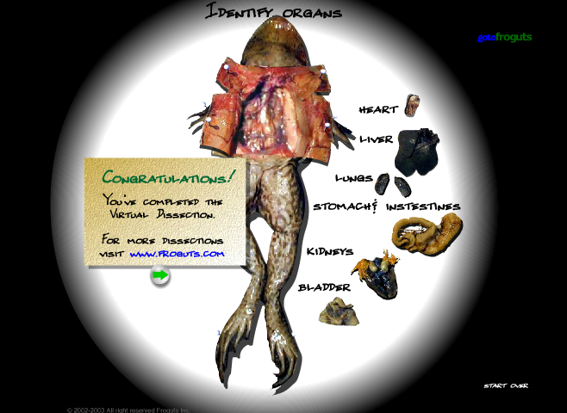
Froguts
Online virtual resource which allows users to dissect specimens, from a bullfrog, a cow eye, a starfish, a fetal pig, an owl pellet
What initially points would you observe at this stage?
What would you look at next?
Notes:
will allow users to virtually dissect a bullfrog, a cow eye, a starfish, a fetal pig, an owl pellet

