Slide 1
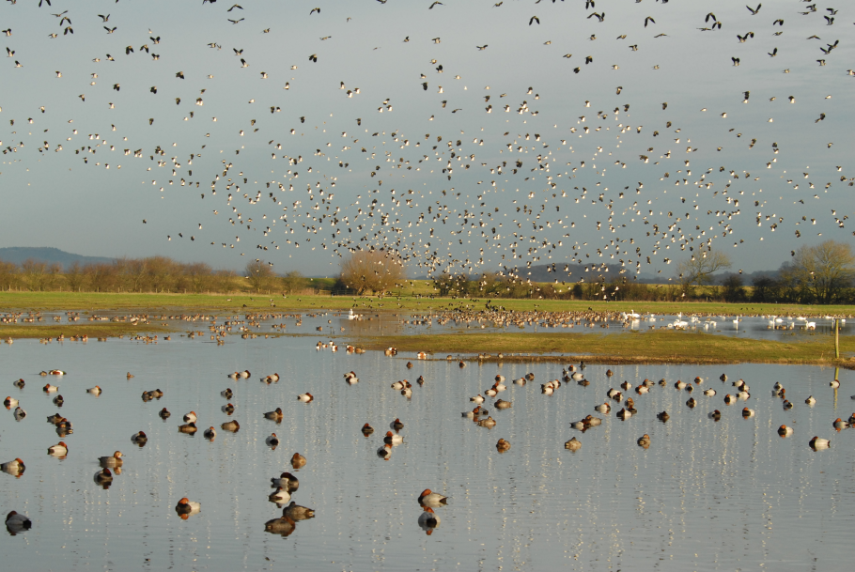
Assessing animal health in the field: WWT Slimbridge Wetland Centre
WAVS

Slide 2
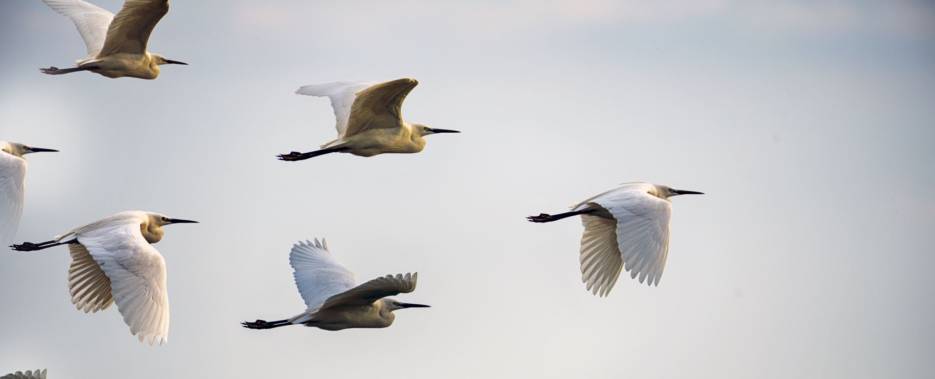
Stuff to do on the trip.
Three activities:
Enclosure evaluation (Bird health and welfare).
Wild bird survey.

Slide 3
About WWT
The Wildfowl & Wetlands Trust, is solely dedicated to promoting the protection of wetland birds and their habitats.
WWT started at Slimbridge, however now manages nine other reserves in Britain and advocates for wetlands and conservation issues world-wide. Of these reserves, seven are recognised as SSSIs (Site of Special Scientific Interest), five are SPAs (Special Protection Areas) and five are Ramsar sites.
10 WWT reserves include:
WWT Arundel, West Sussex
WWT Caerlaverock, Dumfries and Galloway, Scotland
WWT Castle Espie, County Down, Northern Ireland
WWT London Wetland Centre
WWT Llanelli Wetlands Centre, Carmarthenshire, Wales
WWT Martin Mere, Lancashire
WWT Slimbridge, Gloucestershire
WWT Steart, Somerset
WWT Washington, Tyne and Wear
WWT Welney, Norfolk

Slide 4
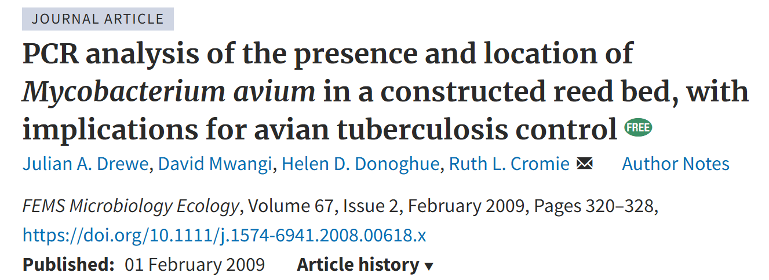

Slide 5
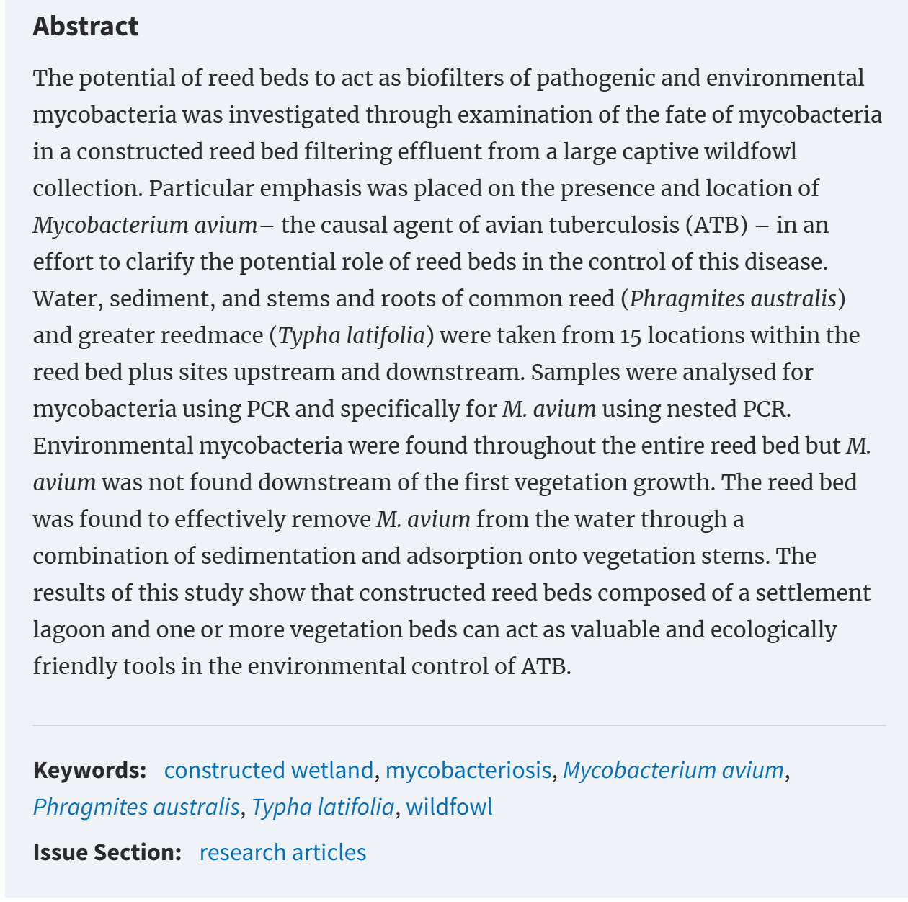

Slide 6
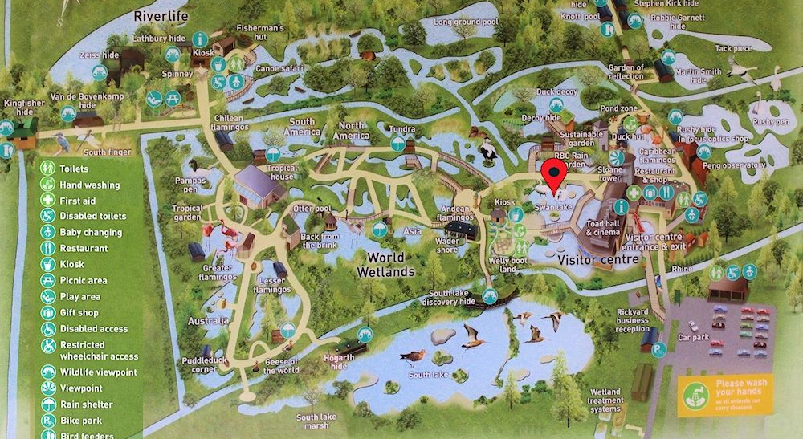
WWT Slimbridge map
It is important that the bird’s enclosures provide for all their needs! By observing where the birds are, what they are doing, their enclosure preferences, we can determine how well they are being cared for!
Notes:
The trust was founded in 1946 by the ornithologist and artist Sir Peter Scott. Slimbridge is the headquarters for the trust.
WWT Slimbridge is a wetland and wildlife reserve in Slimbridge, near Gloucestershire. Approximately 800 hectares. Various species of water bird will live all year round at WWT Slimbridge and others migrant, stopping at the reserve on their way to their summer breeding grounds. Some birds will ‘overwinter’ at Slimbridge, such as the Bewick swan.

Slide 7
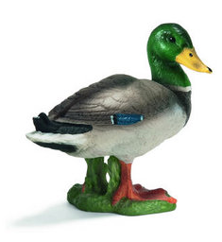
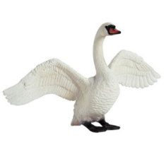
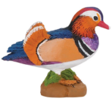
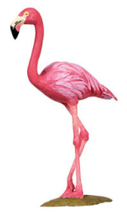
Something to think about…
Population fluctuation.
Season
Dependent on season, Slimbridge can be home to various species in number.
Notes:
Dependent on season, Slimbridge can be home to various species in number. In the winter up to 30,000 wild wintering duck spp., geese spp., and of course SWANS! In the spring, expect to see swallows, house martins and summer warblers. In Summer, you could find kingfishers, wading birds such as scarce chaser and green sandpiper.

Slide 8
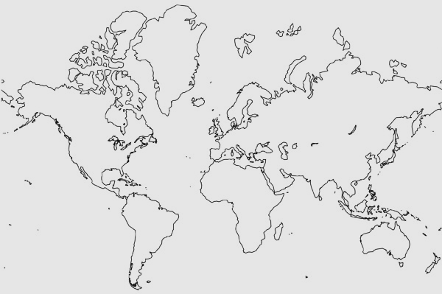
The geographical area covered by a migratory bird over the course of its annual cycle, encompassing both breeding and non-breeding grounds as well as the connecting migration route, is known as a flyway (Kirby et al. 2008).
Notes:
Migration bird flyways:
When birds travel between their breeding and wintering grounds, they follow set routes that provide suitable habitats along the way so they can stop, rest and feed.
8 main Flyways- Figure indicates four examples.

Slide 9
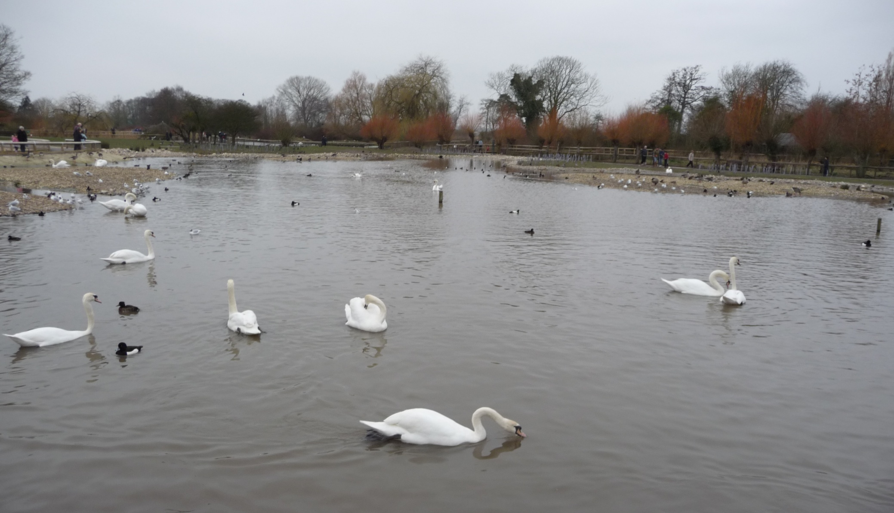
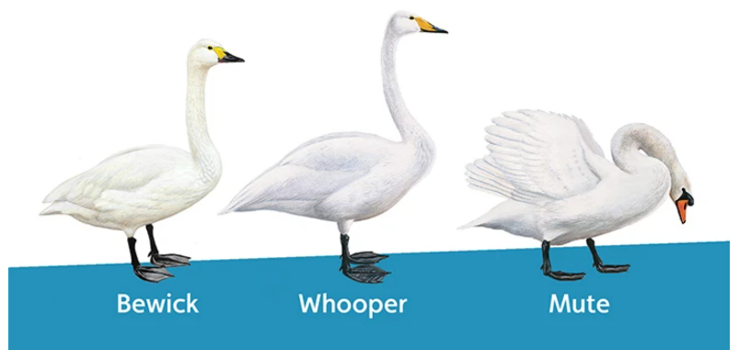
Swan Lake
Notes:
Group 1: Lizzie and Lily

Slide 10
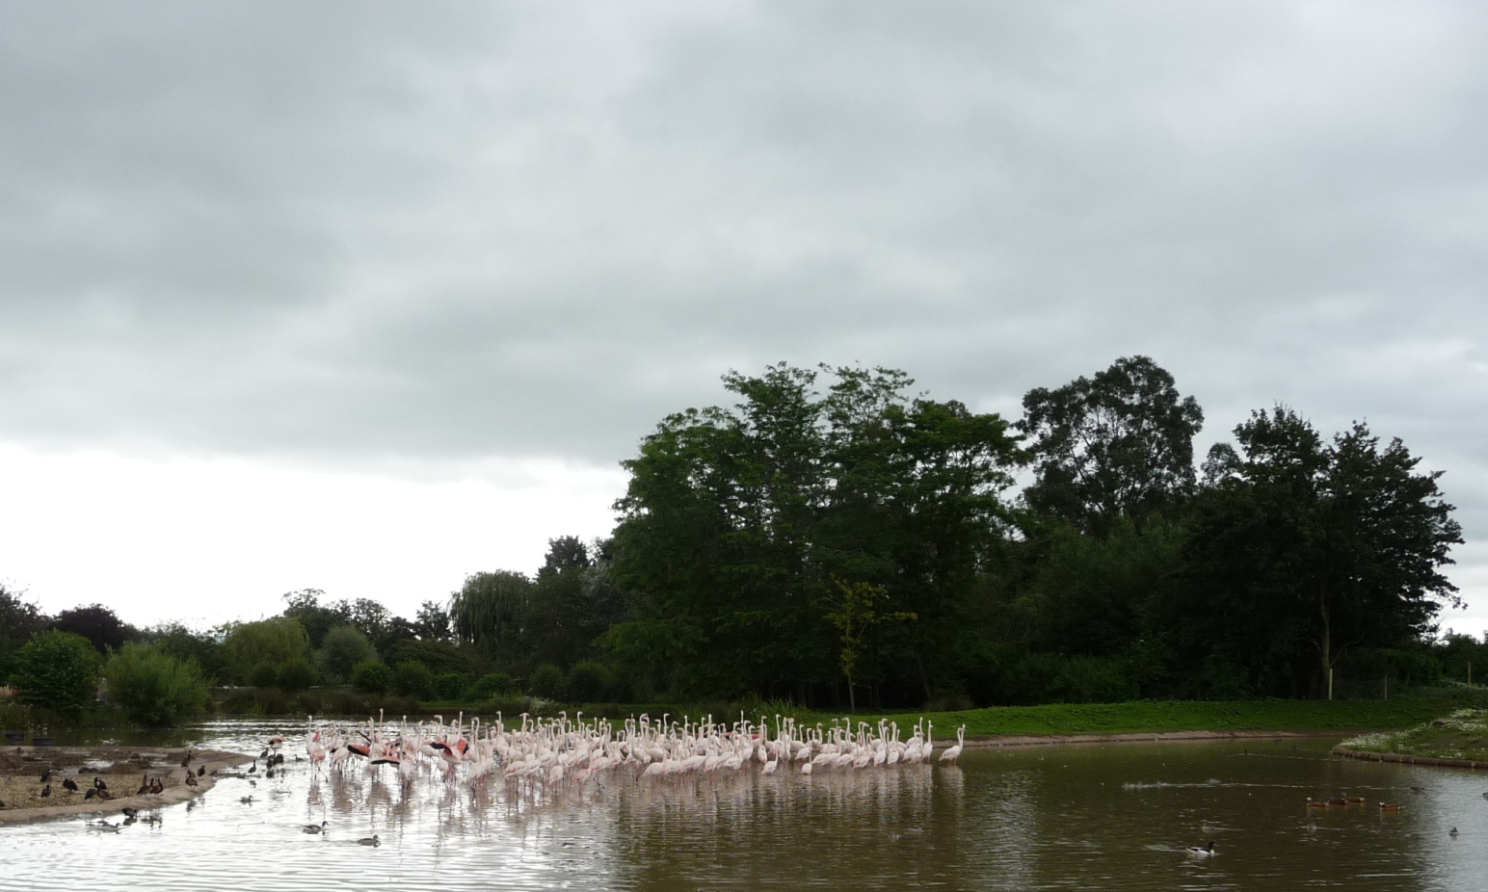
Flamingo Lagoon
Notes:
WWT Slimbridge is home to all six flamingo species. As of December 2023, the decision was made to move the vast majority of the greater flamingos to other collections. Please read: Goodbye to our Greater Flamingos | WWT.
During the catch, a small number of greater flamingos that were deemed too old for travel or health conditions were identified were not part of the move. Find these individuals in the Andean house.
As of December 2023, remaining species at Flamingo lagoon are Andean, Lesser, Chilean, and Caribbean flamingos.

Slide 11
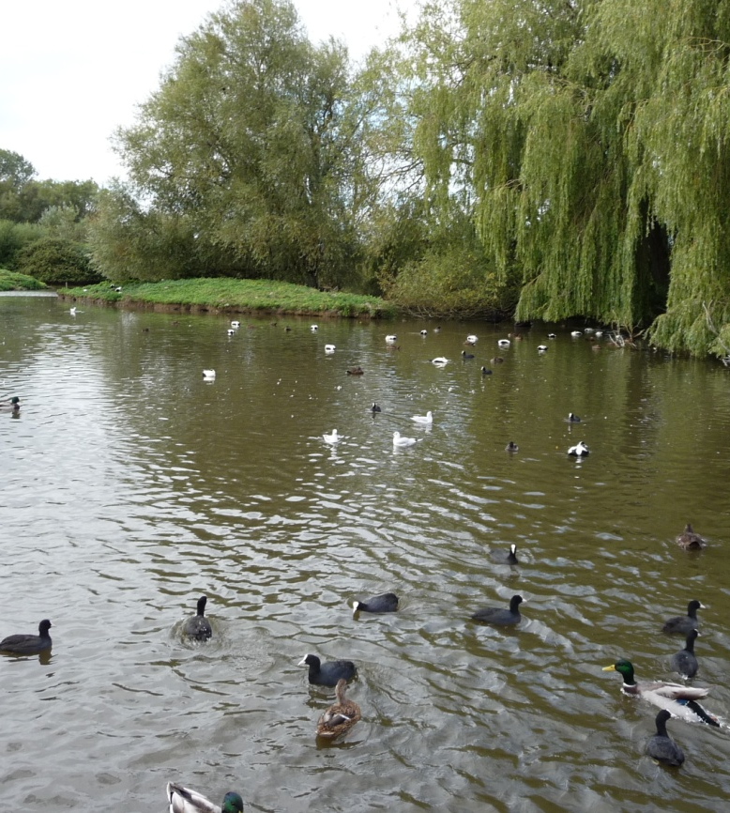
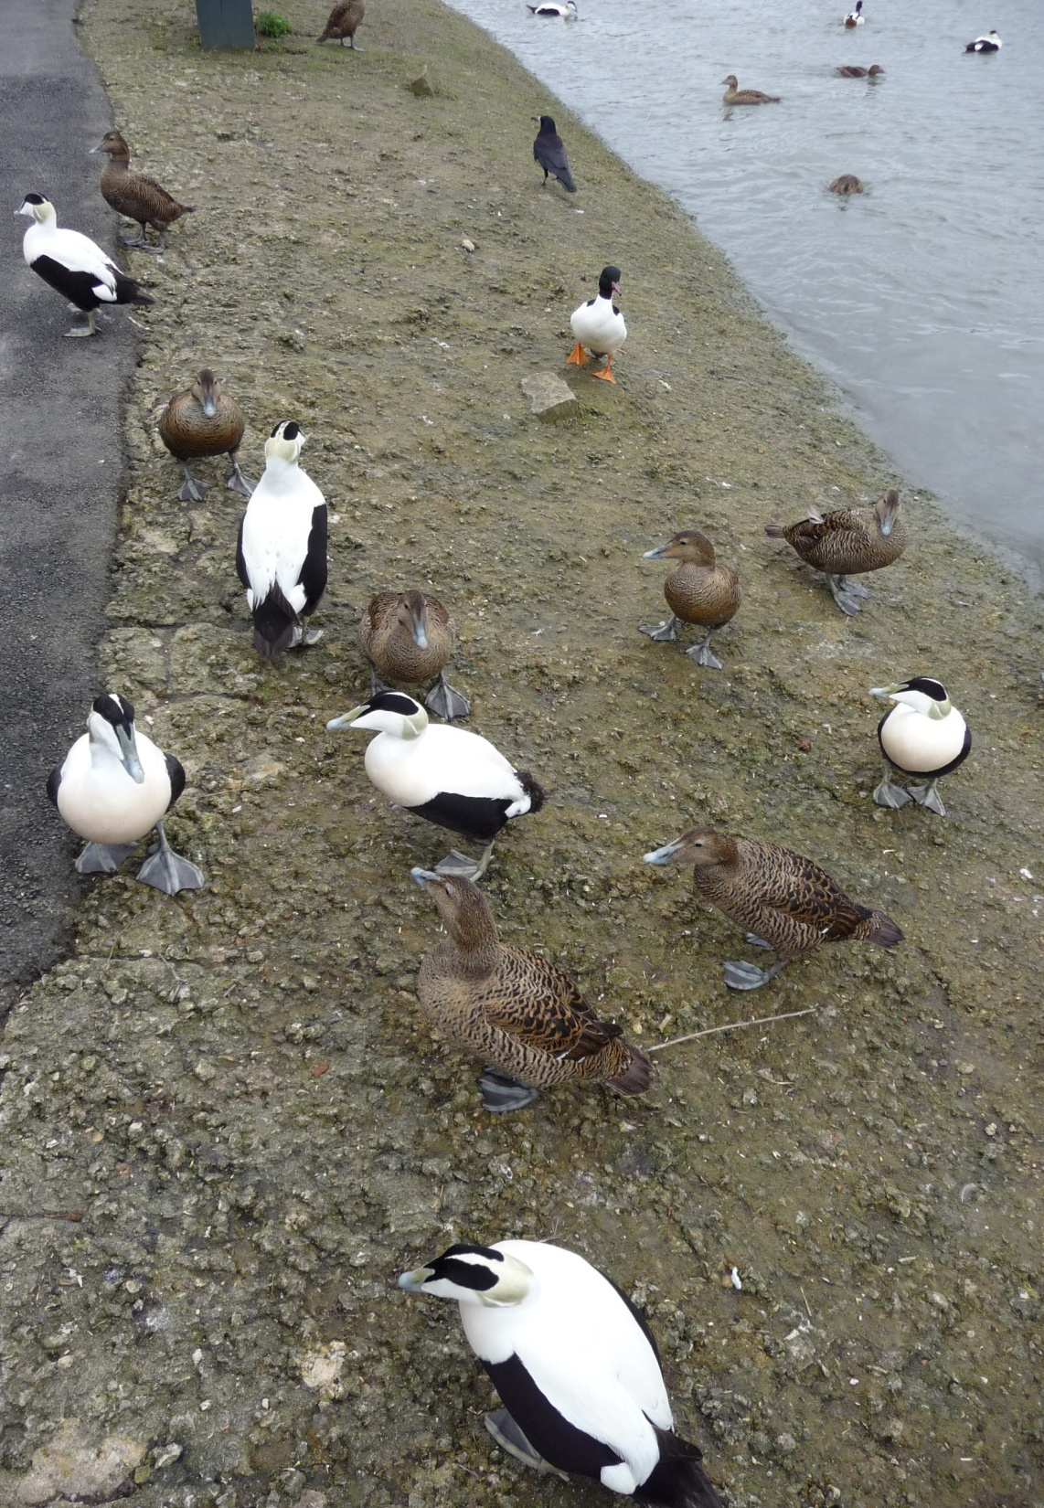
Eider Ducks
Notes:
Group 3: Alex and Martin

Slide 12
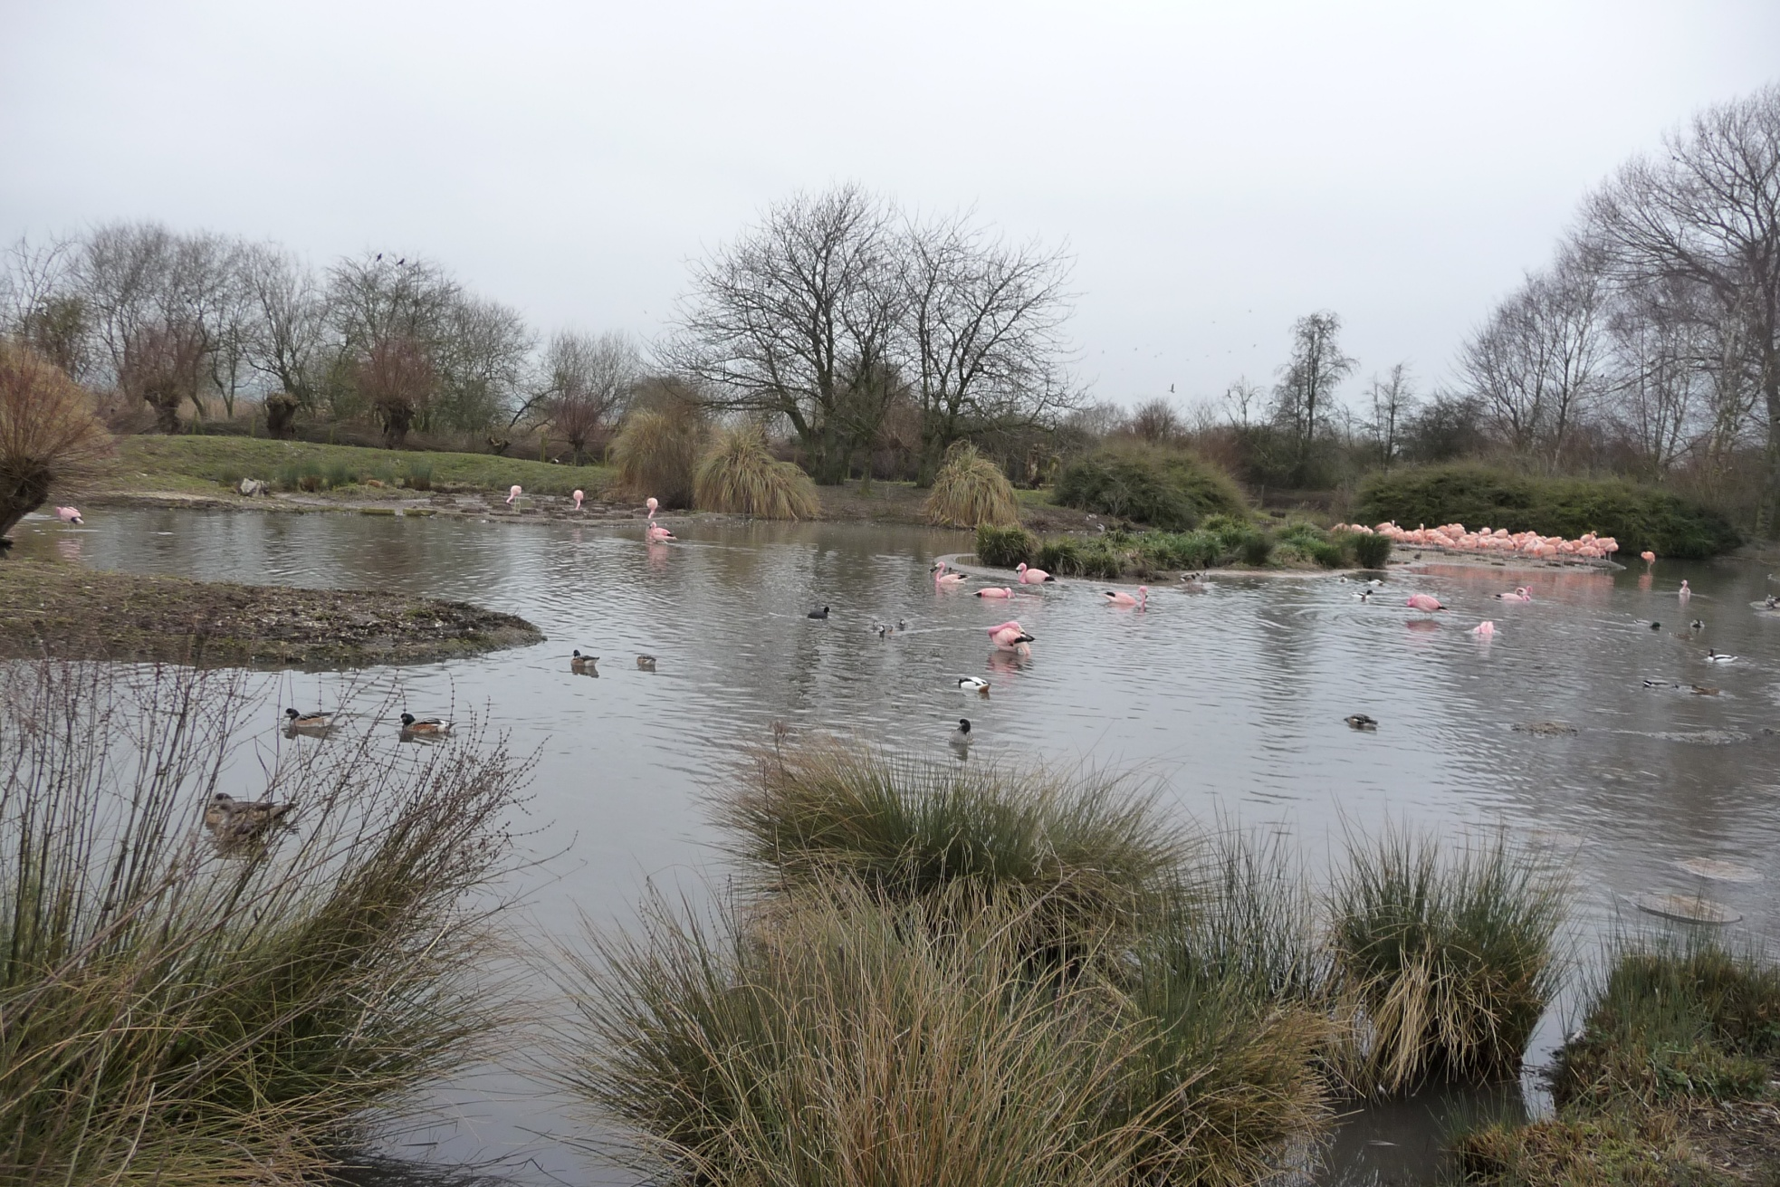
South American Pen
Notes:
As of December 2023, With the Greater Flamingos leaving, we have moved our Chilean flamingos into the flamingo lagoon house and, after some exhibit works, they will be out in the new year. This leaves the South American/Chilean flamingo lagoon with just the ducks in there for the Aswinter. This flamingo house needs a great deal of repairs; we do have a number of exciting plans for the area which could include a new species for Slimbridge, but none of this has been confirmed yet, so watch this species for an update next year. Group 4: Rachael, Imogen and Gabriela

Slide 13
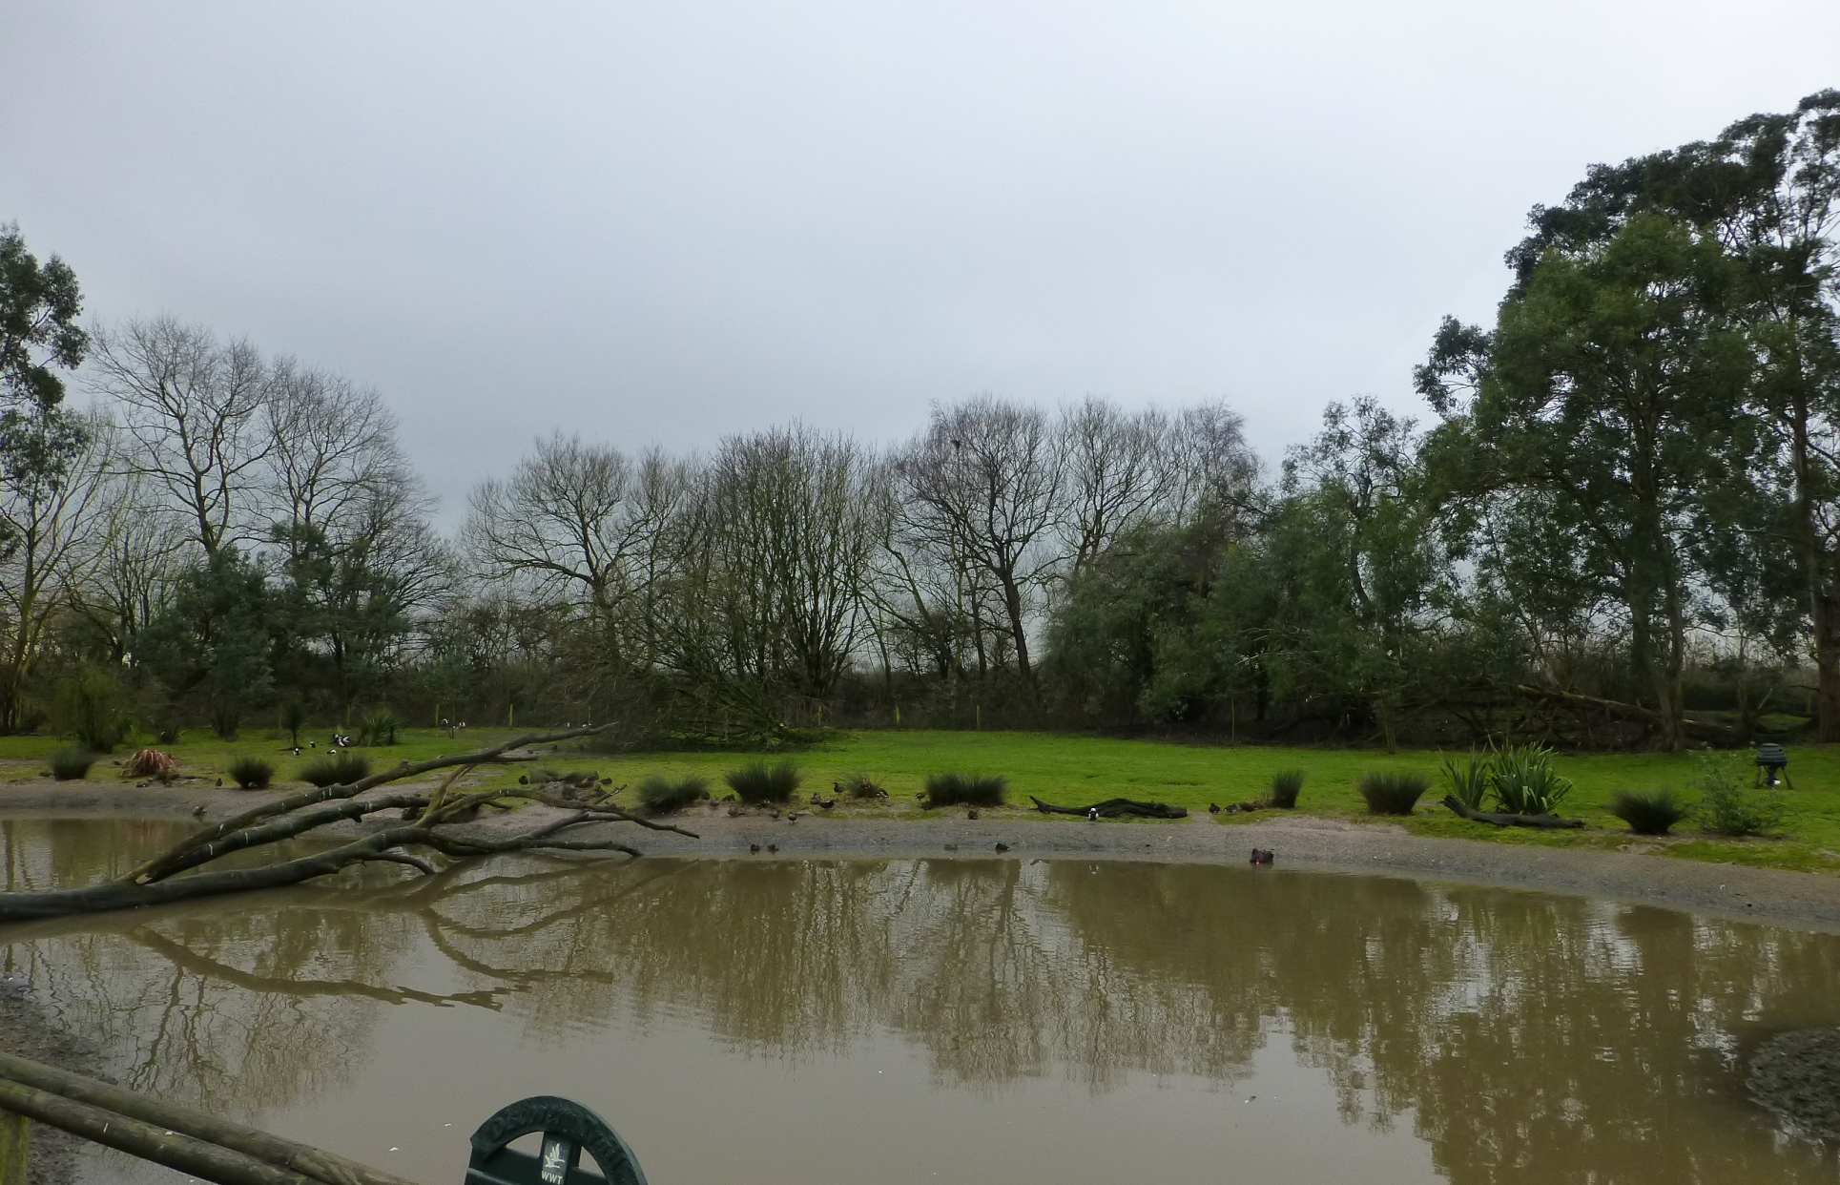
Australian Pen
Notes:
Group 5: Lauren and Josh

Slide 14
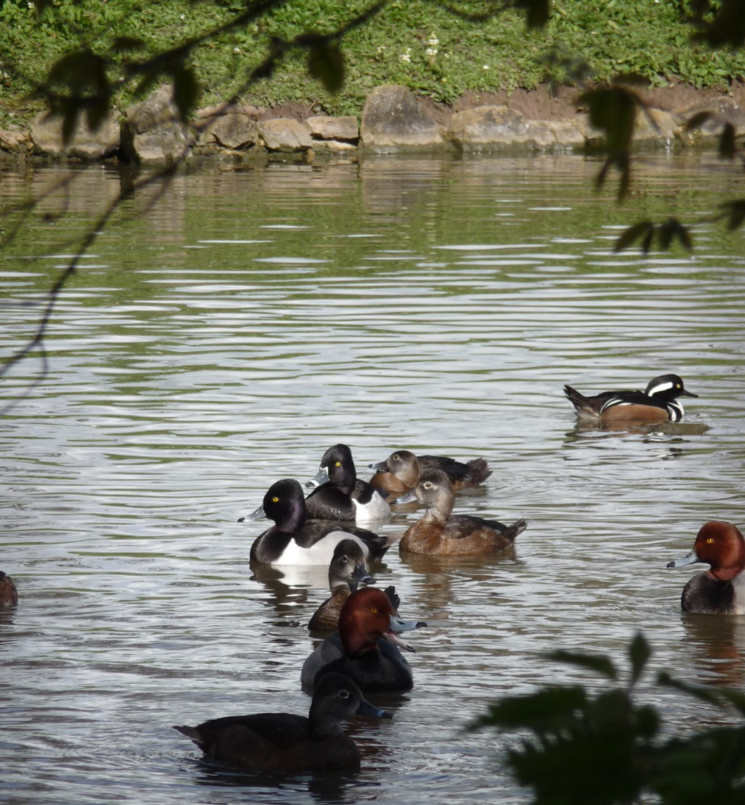
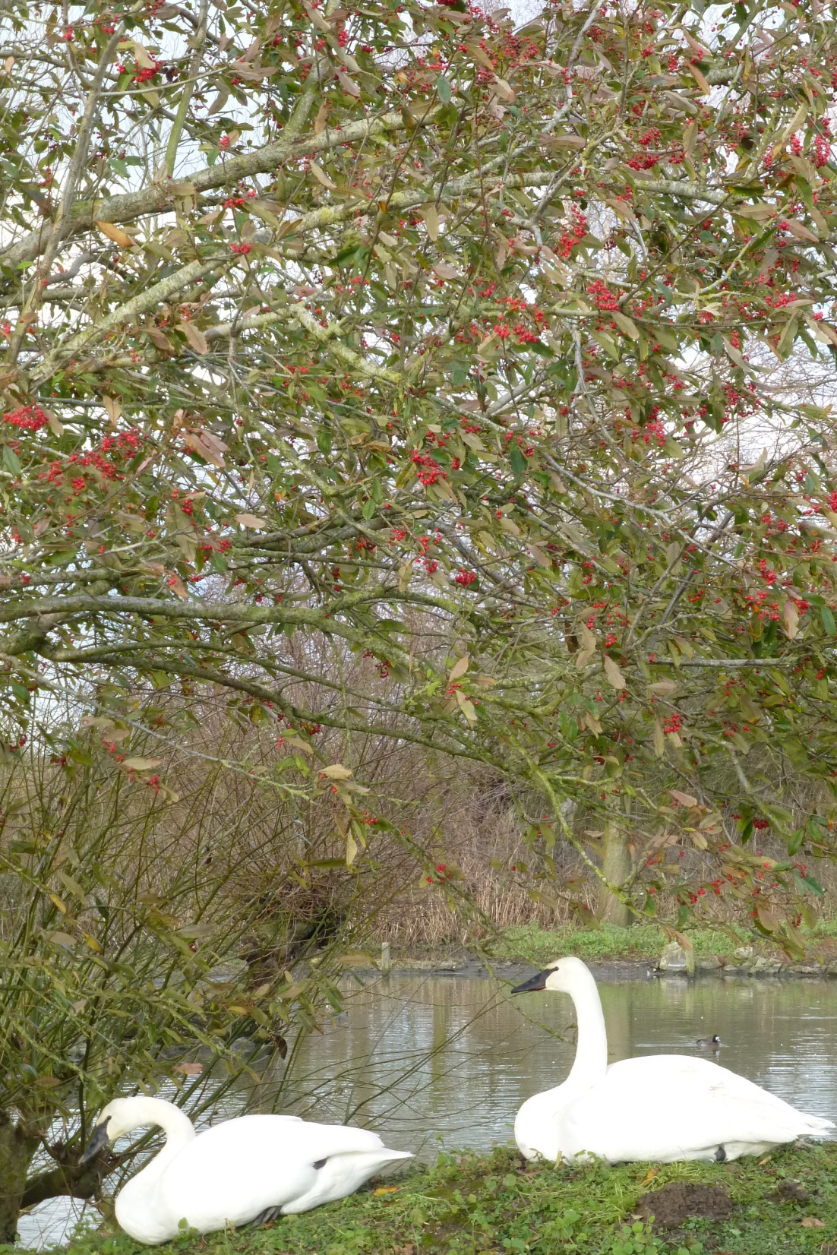
North American Pen
Notes:
Group 6: Leah and Lucas

Slide 15
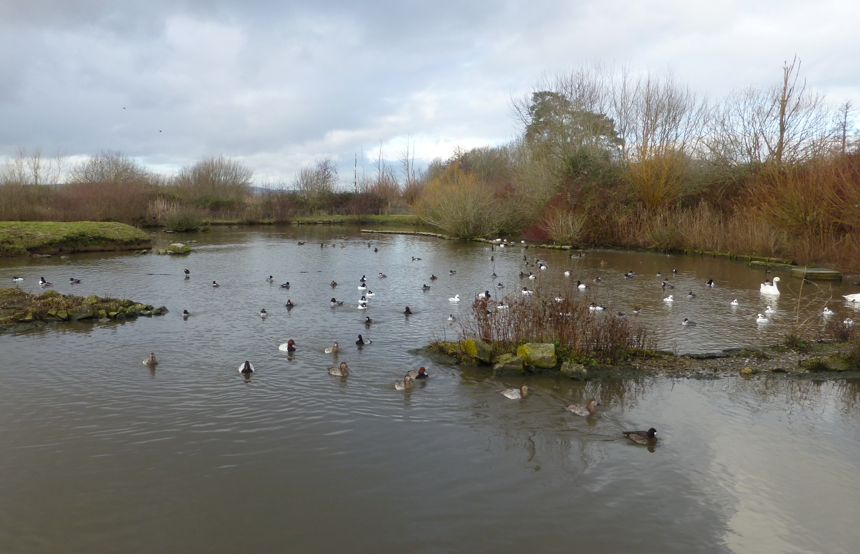
Tundra Pen
Notes:
Group 7: Ollie, Toby and Natalia

Slide 16
To maintain positive welfare and good health, captive animals need to be maintained in species-appropriate, biologically-relevant enclosures!
Record the species list that your exhibit is designed to hold!

Slide 17
Write this down!
We have discussed in previous lessons the potential for pathogen [“disease”] transmission, facilitation and spread.
Next task, know your bird ID!
Spend five minutes writing down a list of all wild species that you see entering (or already in) your exhibit.

Slide 18
Write this down!
Enclosures need to be designed to facilitate day-to-day access for regular husbandry and management protocols. You’ll have some knowledge of this from your undergraduate modules and on your PID work experience…
Without trespassing or entering ‘no public zones’, note down features of the exhibit that facilitate excellent animal care.

Slide 19
Write this down!
Now, get out your camera… (but don’t take photos of people /children).
Take some photos whilst you’re in the exhibit of:
Things that demonstrate evidence-based management.
Things that could be improved as they may cause future problems for bird health/welfare.
We will discuss your findings in our next lecture.

Slide 20
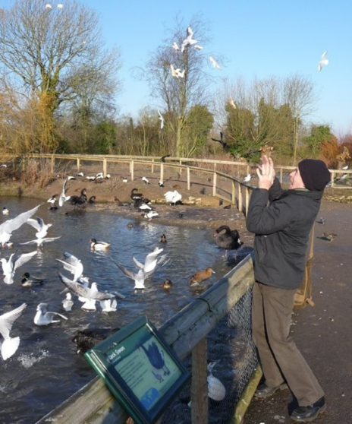
What about people?
Generally speaking, visitors enjoy close contact with animals.
Living collections are forever modifying and changing the way they display animals to encourage interaction between visitors and the animals on display.
Is this a good or a bad thing?
Can you evidence any areas of close contact between people and animals?
Does WWT actively encourage visitors to get ‘closer to nature’ and enhance their experience of the natural world? If so, how?
We’ll collate thoughts in the session after the trip…

Slide 21
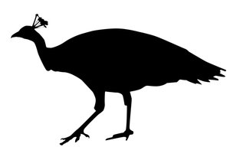
What will happen next?
Bring your information to the lecture as you’ll be going over what you found and putting it into context.
Application? Later in the term, we’ll do a practical at the AMC to body condition score, health check and review the bird collection as a zoo inspector would do during a routin inspection.

Slide 22
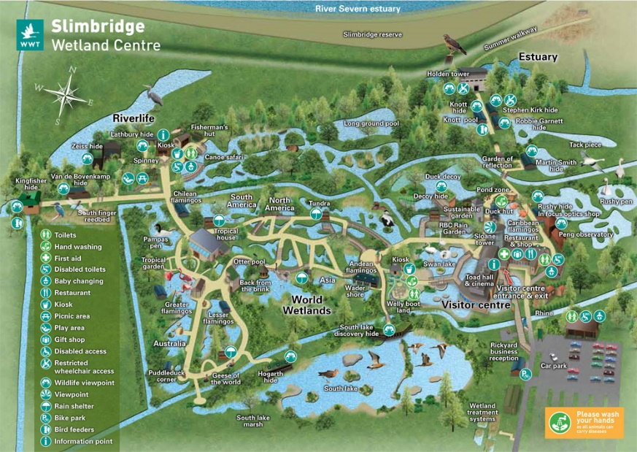
Next activity… bird survey.
It is a WWT speciality to attract specific migratory birds to managed reserves…
Group 1: Holden Tower
Group 2: Willow Hide
Group 3: Kingfisher Hide
Group 4: South Lake Observatory
Group 5: Zeiss Hide
Group 6: Martin Smith Hide
Group 7: Robbie Garnet Hide
Notes:
Group 1: Lizzie and Lily Group 2: Jenna and Megan Group 3: Alex and Martin Group 4: Rachael, Imogen and Gabriela Group 5: Lauren and Josh Group 6: Leah and Lucas Group 7: Ollie, Toby and Natalia

Slide 23
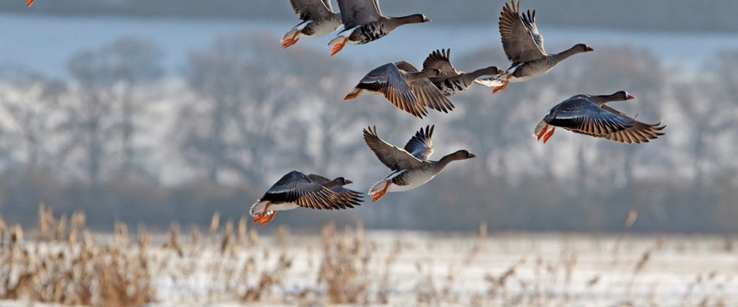
Write this down!
Spend 20 minutes at your specified hide… record what species of bird you see and the number of each as a tally.
Record what habitat your hide covers.
Record for every individual that flies in and lands, as well as flies over your hide.

Slide 24
For each group!
Put your photos of enclosure information on a memory stick or email. We will be reviewing these photographs in future content.
Bring your bird survey information too, we’ll try and draw a graph!
Give your individual enclosure review sheets to me for distribution.

Slide 25
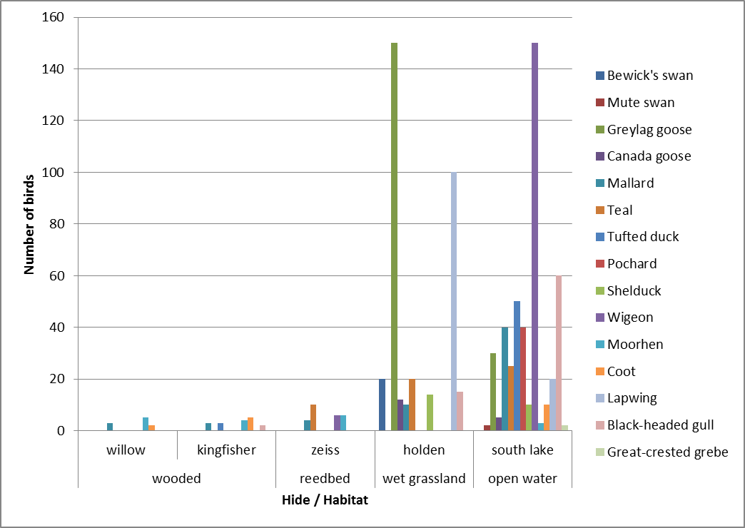
Data from previous trip…

Slide 26
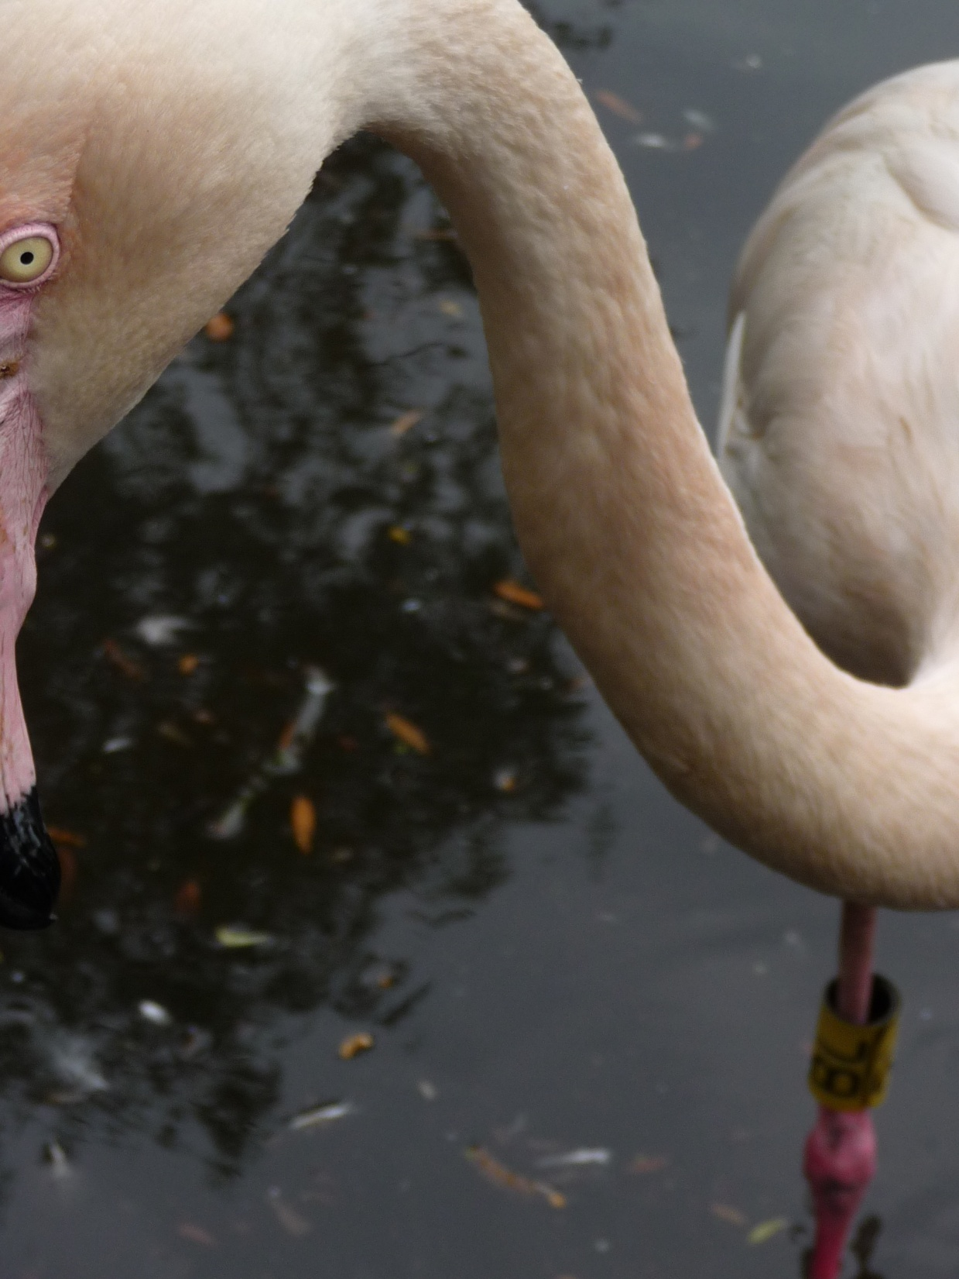
Please take this session to read the papers in preparation for Thursday’s trip!
Cromie et al., 2000: Avian immune responses to Mycobacterium avium: the wildfowl example.
Simpson (2002): Wild Animals as Reservoirs of Infectious Diseases in the UK – ScienceDirect
Painter (1997): Avian tuberculosis caused by Mycobacterium avium serotype 3 in captive wildfowl - ProQuest

Slide 27
Any questions?

