Slide 1
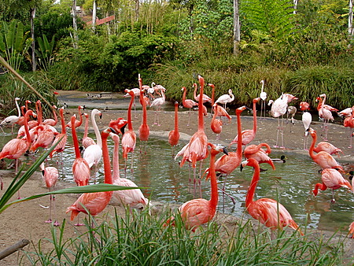
Disease control in managed animal collections

Slide 2
Aims & objectives
What challenges are faced in the health management of static wild animal populations?
How does the veterinary surgeon reconcile the conflicting needs of animals, the collection managers and the public in regards to health management?

Slide 3
What do we mean by ‘disease control in managed animal collections’?

Slide 4
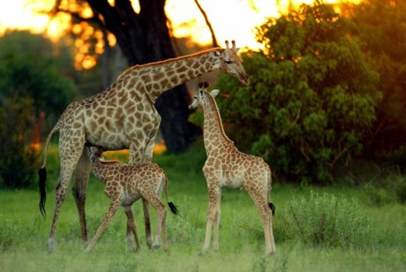
What challenges are faced in the health management of static wild animal populations?

Slide 5
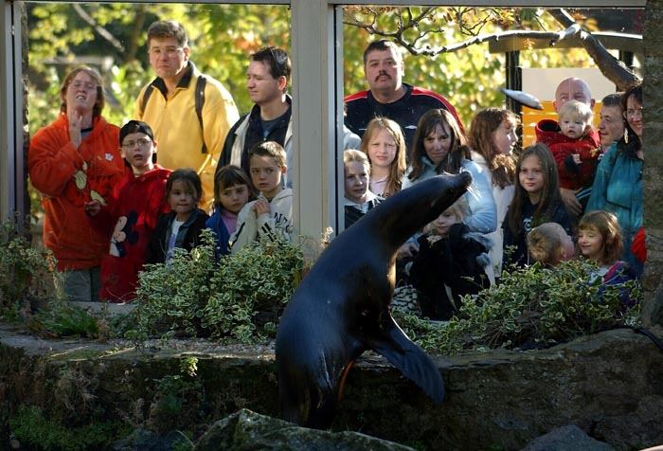
How does the veterinary surgeon reconcile the conflicting needs of animals, the collection managers and the public in regards to health management?
Edinburgh zoo, 2008

Slide 6
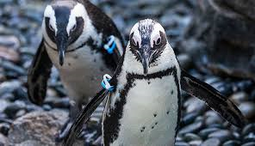
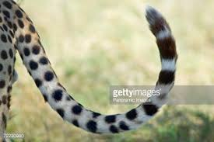
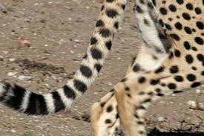
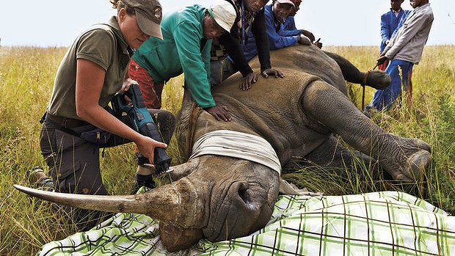
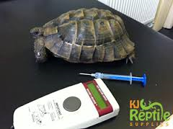
Identifying individuals
Markings
Tagging/IDs
Microchips

Slide 7
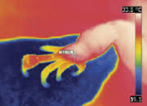
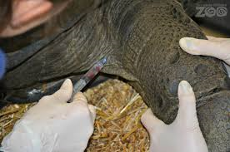
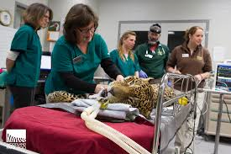
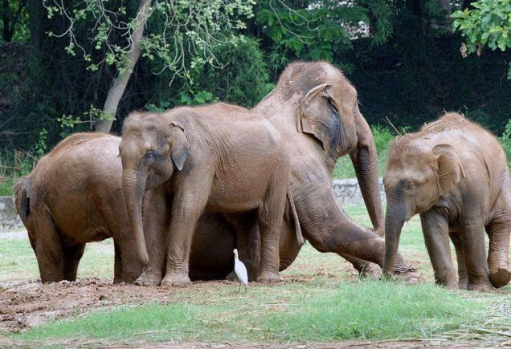
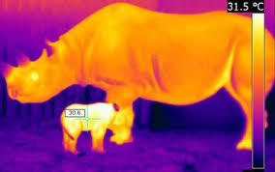
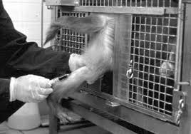
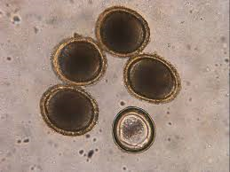
How can we assess health?
Visual assessment (how often?)
Faecal analysis
Who’s?
What info?
Blood analysis
How?
Thermal imaging
Notes:
Faecal analysis: nutrition, genetic analysis, parasitology, cortisol
Thermal imaging: inflammation or restricted blood flow

Slide 8
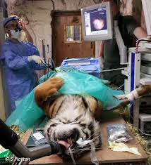
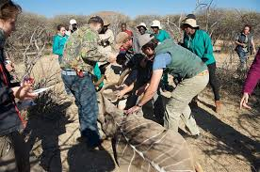
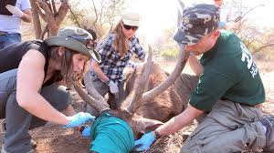
How do we administer treatments?
At what point do we intervene?
Anaesthesia?
Where?
Time?
How?
Temperature?
Asepsis?
Priorities?

Slide 9
Treatment, prevention or control… what is best?
Define these terms
In pairs, pick one species commonly kept in zoological collections.
Research common disorders seen and any methods of treatment, prevention or control used.
Find a case study/journal article on your species which demonstrates either treatment, prevention or control techniques (or all three).

