Slide 1
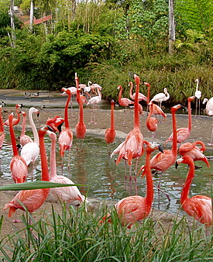
Disease control in captive collections

Slide 2
Learning outcomes covered today!
Detail, describe and discuss the key features of pathogenesis of infectious and non-infectious disease in captive wild animals and wildlife.
Analyse current treatment, prevention and control protocols used for named diseases of captive wild animals and wildlife.

Slide 3
Disease control in managed animal collections

Slide 4
Today’s lesson…
What challenges are faced in the health management of static wild animal populations?
How does the veterinary surgeon reconcile the conflicting needs of animals, the collection managers and the public in regards to health management?

Slide 5
What do we mean by ‘disease control in managed animal collections/or wildlife?
Infectious or non infectious diseases?
Notes:
Disease control in managed animal collections.
Nearpod

Slide 6
To control infectious diseases, it is necessary to take preventive measures against the occurrence and spread of diseases.
What do we mean by disease control in managed animal collections?
Notes:
Disease control in managed animal collections: To control diseases, it is necessary to take preventive measures against the occurrence and spread of diseases in systematic and well-planned ways.

Slide 7
What do we mean by disease control in managed animal collections?
To prevent the occurrence of infectious diseases;
Improve immunity through daily health checks, maintenance and vaccination
Break routes of infection through good hygiene and biosecurity, i.e. cleaning of captive environment and setting up the physical barriers against pathogens.
To prevent the spread of diseases, early detection through quarantine, regular physical examination and necropsy.
Containment of pathogens by placing movement restrictions, isolation, treatment.
Culling of captive animals can be appropriate measures.
Notes:
Disease control in managed animal collections: To control diseases, it is necessary to take preventive measures against the occurrence and spread of diseases in systematic and well-planned ways.

Slide 8
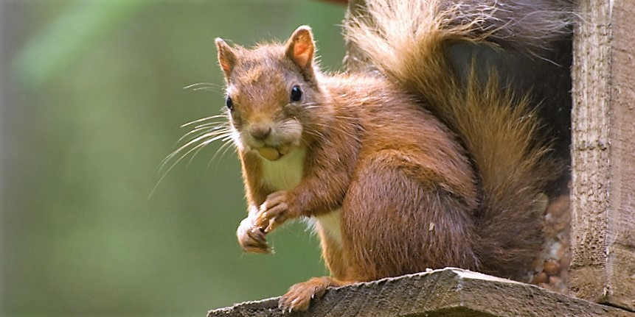
The key requisite for any disease control in wildlife is establishing a proper surveillance and monitoring scheme.
What do we mean by disease control in wildlife?
Notes:
Disease control in wildlife: Surveillance and monitoring build on the steady collection, collation, and analysis of data related to animal health but differs at the aim and target population.

Slide 9
What do we mean by disease control in wildlife?
Surveillance targets wildlife populations classified as healthy to demonstrate the absence of infection.
Monitoring focuses on known infected wildlife populations aiming to detect spatial and temporal trends. Disease control measures are only undertaken when disease is present!
Notes:
Disease control in wildlife: Surveillance and monitoring build on the steady collection, collation, and analysis of data related to animal health but differs at the aim and target population.

Slide 10
The primary means to control diseases shared by wildlife include preventive actions, arthropod vector control (if vector-borne disease), host population control through random or selective culling, habitat management or reproductive control and vaccination.
Notes:
Preventation controls such as translocation, fencing, feed, and water management, farm biosecurity and hygienic hunting-offal disposal.
Barrier concept includes the use of large or small-scale fencing and any other barrier: physical, dogs, deterrents, barriers to vectors, etc. to prevent the transmission of diseases between animal populations

Slide 11
What challenges are faced in the health management of static wild animal populations?
Notes:
Three basic forms of management strategies exist for wildlife disease, as follows: prevention of introduction of disease, control of existing disease or eradication.
Management may be directed at the disease agent, host population, habitat or be focused on human activities.
Disease agents may be dealt with in the environment through disinfection or in the host through treatment. Disinfection and pesticides used to destroy agents or vectors are limited to local situations, may have serious environmental effects and may result in acquired resistance. Difficulty in delivering treatment limits chemotherapy to local situations.
Host populations may be managed by immunisation, by altering their distribution or density, or by extirpation. Immunisation is best suited for microparasitic exogenous infections with a low reproductive rate and in populations which have a low turnover. Mass immunisation with oral baits has been effective, but this strategy is limited to a few serious diseases. It is difficult to move wild animals and techniques to discourage animals from entering an area become ineffective rapidly. The setting up of fences is feasible only in local situations.
Selective culling is limited to situations in which affected individuals are readily identifiable. General population reduction has had little success in disease control but reducing populations surrounding a focus or creating a barrier to disease movement have been successful. Population reduction is a temporary measure. Eradication of a wildlife population has not been attempted for disease management. Habitat modification may be used to reduce exposure to disease agents, or to alter host distribution or density. Management of diseases of wild animals usually requires a change in human activities. The most important method is by restricting translocation of wild animals to prevent movement of disease.

Slide 12
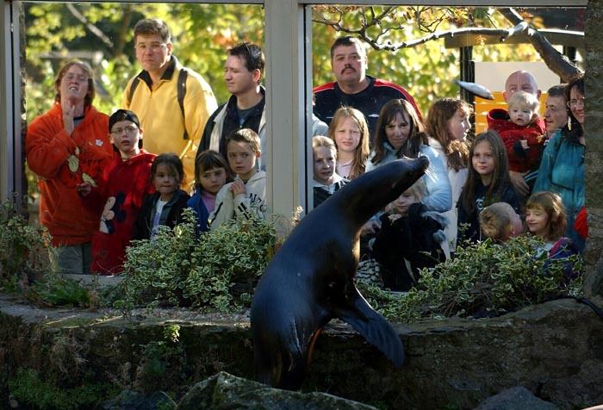
Edinburgh Zoo, 2008
How does the veterinary surgeon reconcile the conflicting needs of animals, the collection managers and the public in regards to health management?

Slide 13
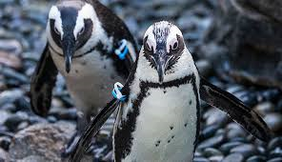
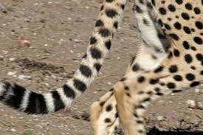
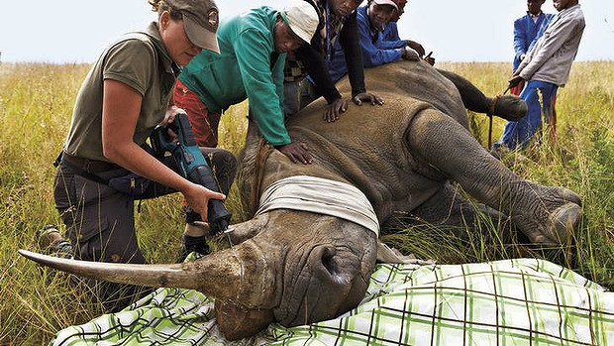
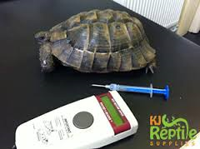
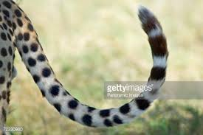
Identifying individuals
Disease control in managed animal collections?
Markings
Tagging/IDs
Microchips

Slide 14
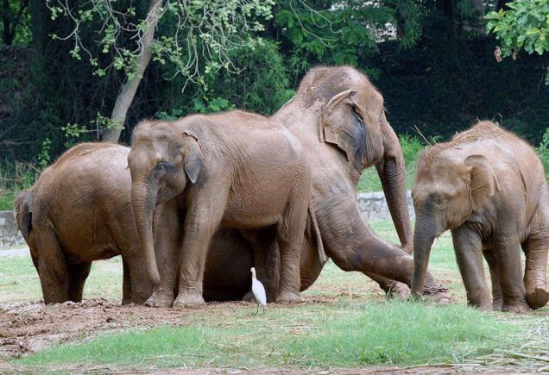
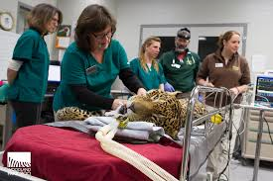
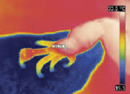
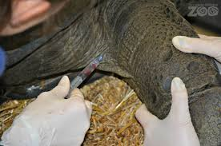
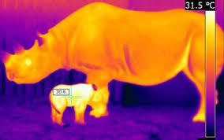
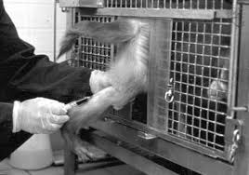
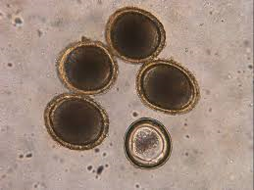
How can we assess health?
Disease control in managed animal collections
Visual assessment (how often?)
Faecal analysis
Who’s?
What info?
Blood analysis
How? Why?
Associated challenges?
Thermal imaging
In Birds (Jerem et al., 2015)
Notes:
Visual assessment: Perform frequent daily observations of animals they are working with, typically twice a day. AM and PM. Identify visual signs of poor health (can be physical: e.g. feather loss, visible wounds or behavioural: e.g. lethargy, reduced feeding)
Faecal analysis. Monitor waste output and report any unusual changes (e.g. loose faeces)
Faecal analysis: nutrition, genetic analysis, parasitology, cortisol.
Blood analysis: Blood tests are part of a normal health checks to combine with an animal’s external physical examination to make an assessment of internal health.
Infrared thermography is a non-invasive technique for assessing thermal states that measure the radiation emitted from the skin in distinct anatomical areas, known as thermal windows.
Thermal imaging: inflammation or restricted blood flow

Slide 15
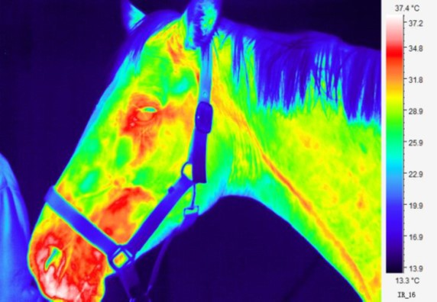
How can we assess health?
Disease control in managed animal collections
Blood analysis
DNA sexing
Especially important for some bird species which are sexually monomorphic.
Biochemistry panels
Insight to metabolic functions; i.e. blood sugar levels, liver and kidney function, liver inflammation, pancreatic and gut inflammation, blood fats, and calcium levels.
Haematology
Haematology or complete blood count (CBC) study red blood cell count, protein level and white blood cell count.
Anaemia (Low red blood cells)
What about changes in WBC and appearance, what does this indicate?
Blood cancer and parasites
Thermal imaging/ Infrared thermography (IRT)
How? Infrared thermography works by analysing the heat energy emitted or reflected from a body or surface.
Species specific?
In Birds (Jerem et al., 2015)
In Horses (Redaelli et al., 2019)
Notes:
Faecal analysis: nutrition, genetic analysis, parasitology, cortisol
Infrared thermography is a non-invasive technique for assessing thermal states that measure the radiation emitted from the skin in distinct anatomical areas, known as thermal windows.
Thermal imaging: inflammation or restricted blood flow
IRT allows the visualization of temperature distribution, and it can detect changes in peripheral blood flow from the resulting changes in heat loss and; therefore, have been a useful tool for assessing the presence of disease and stress in animals. . In this process, each colour expresses a specific temperature range; usually, the coldest colour areas are in blue, and the hottest areas are in white, with reds/yellows being "middle temperatures".
However, the wide diversity of species under human care has distinct anatomical, morphological, and physiological traits. For example, feathers are thermal insulators that maintain temperatures within normal ranges, but their presence limits the use of IRT, which requires zones with bare skin. Therefore, the eye region and legs are the preferred thermal windows in birds for evaluating superficial temperature changes. In the case of animals with sparse hair, such as elephants, rhinoceroses, and hippopotami, or those that do not have long hair, like giraffes, or equids like zebras, IRT can be used in the abdomen, thorax, or ears. In contrast, for carnivores or species with winter coats, the recommendation is to evaluate windows located in the joints, feet (on the caudal side), or facial region.
In horses: IRT can pick up Arthritis, hoof abscesses, soft tissue damage, tendon damage, laminitis.

Slide 16
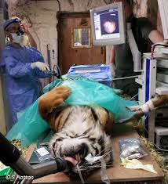
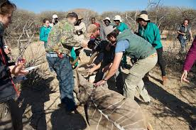
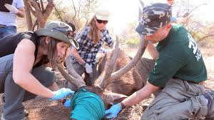
How do we administer treatments?
Disease control in managed animal collections
At what point do we intervene?
Anaesthesia?
Where?
Time?
How?
Temperature?
Asepsis?
Priorities?

Slide 17
Treatment, prevention or control… what is best?
First, define these terms.
In pairs, pick one species commonly kept in zoological collections.
Research common disorders seen and any methods of treatment, prevention or control used.
Find a case study or journal article on your species which demonstrates either treatment, prevention or control techniques (or all three).

